Slide 1
Android Internals System Startup
2 / 22/ 2012
Marakana
John Lombardo
John@Lombardos.org

Slide 2

System Startup
Chapter 7 of PDF

Slide 3
The hardware is powered off
No battery or
Powered off
Hardware

Slide 4
Power is applied
Once CPU has stable power, it begins executing instructions in the boot ROM, which it’s hard wired into.
Locates the first-stage boot loader
Load the first-stage boot loader into internal RAM
Jump to first-stage boot loader’s memory location to execute it
Hardware
Boot Rom

Slide 5
1st stage boot loader
Detect and initialize external RAM
Locate the second-stage boot loader
Load the second-stage boot loader into external RAM
Jump to the second-stage boot loader’s memory location to execute it
Hardware
Boot Rom
1st stage

Slide 6
2nd stage boot loader
Setup file systems (typically on Flash media)
Optionally setup display, network, additional memory, and other devices
Enable additional CPU features
Enable low-level memory protection
Optionally load security protections (e.g. ROM validation code)
Locate Linux Kernel
Load Linux Kernel into RAM
Place Linux Kernel boot parameters into memory so that kernel knows what to run upon startup
Jump to Linux Kernel memory address to run it
Hardware
Boot Rom
1st stage
2nd stage

Slide 7
Linux Kernel
Does a bunch of stuff
Create process 1 (/init) and runs it
Hardware
Linux Kernel
Boot Rom
1st stage
2nd stage

Slide 8
/init + init.rc
Kernel looks for /init executable and runs it as root user.
/init reads from init.rc to know what to do.
Sets up system clock, environment, logger,…
Let’s digress…
Hardware
Linux Kernel
/init (process 1)
Boot Rom
1st stage
2nd stage

Slide 9
Init
init is the grandaddy of all Android processes.
PID = 1
never exits
Android init …
Differs from Linux – no inittab, no /etc/rcX.d. No runlevels.
Prints “A N D R O I D”
Starts up a variety of daemons
init configuration files
/init.rc - generic initialization
/init.<board-name>.rc – board specific initialization
/init.goldfish.rc for the emulator
/init.trout.rc for HTC’s ADP1
/init.herring.rc for Samsung’s Nexus S
init’s language (no inittab)
four broad classes of statements:
Actions – named sequences of commands based on trigger occurance
Commands – start programs, export env vars, etc
Services – start (and optionally restart) programs
Options – modify how and when init runs services

Slide 10
daemons
/init is configured by init.rc to start about 20 deamons
/init starts a few more through init.<BOARD>.rc
Not all daemons are always started:
# adbd is controlled by the
# persist.service.adb.enable system
# property
service adbd /sbin/adbd
disabled
# adbd on at boot in emulator
on property:ro.kernel.qemu=1
start adbd
on property:persist.service.adb.enable=1
start adbd
on property:persist.service.adb.enable=0
stop adbd
There’s one more daemon we didn’t mention yet…
Hardware
Linux Kernel
Service
Manager
ueventd
console
adbd
vold
netd
debuggerd
ril-daemon
media
ueventd
bootanim
dbus
bluetooth (5)
installd
flash-memory
racoon
keystore
dumpstate
/init (process 1)
Boot Rom
1st stage
2nd stage

Slide 11
zygote
In biology, a zygote is a fertilized cell, before it splits into two cells.
In Android, the zygote is the ‘fertilized’ daemon process – it’s been fertilized with the dalvik engine along with 1800+ java classes.
Another digression…
Hardware
Linux Kernel
Service
Manager
zygote
dalvik
1800+ classes
preloaded
drawables
ueventd
console
adbd
vold
netd
debuggerd
ril-daemon
media
ueventd
bootanim
dbus
bluetooth (5)
installd
flash-memory
racoon
keystore
dumpstate
/init (process 1)
Boot Rom
1st stage
2nd stage

Slide 12
zygote
zygote
dalvik
1800+ classes
preloaded
drawables
Zygote starts from init.rc:
service zygote /system/bin/app_process -Xzygote /system/bin --zygote
socket zygote stream 666
onrestart write /sys/android_power/request_state wake
onrestart write /sys/power/state on
onrestart restart media
onrestart restart netd
base/cmds/app_process/app_main.cpp:main()
app_process then launches a dalvik VM running ZygoteInit.java:main()
ZygoteInit.main() then
Registers for zygote socket
Pre-loads classes defined in frameworks/base/preloaded-classes (1800+)
Pre-loads resources preloaded_drawables and preloaded_color_state_lists from frameworks/base/core/res/res/values/arrays.xml
Runs garbage collector (to clean the memory as much as possible)
Forks itself to start systemserver
Starts listening for requests to fork itself for other apps
Key to why zygote is important:
Because all Android apps are started by forking zygote instead of fork/exec, the memory containing the dalvik VM, the 1800+ classes, along with the preloaded drawables is shared among all of the Android apps in the system because of Linux’s “copy-on-write” of code and data in a forked process. This is a huge amount of memory savings.

Slide 13
systemServer
Most Android services run as threads within systemServer. For example, an Android Service (PowerService) talks to its manager (PowerManager) through Binder using AIDL.
PowerManager runs within the app’s process space (one of the 1800+ classes) with the apps’s permissions. PowerService runs in the systemServer process with “system” (higher) permissions.
All of the services register with the service manager, which acts as the telephone operator for apps looking for a particular service.
Hardware
Linux Kernel
systemServer
PowerService
ActivityService
VibratorService
. . .
Register with
Service
Manager
zygote
dalvik
1800+ classes
preloaded
drawables
ueventd
console
adbd
vold
netd
debuggerd
ril-daemon
media
ueventd
bootanim
dbus
bluetooth (5)
installd
flash-memory
racoon
keystore
dumpstate
/init (process 1)
Boot Rom
1st stage
2nd stage

Slide 14
And the system is up
Within ActivityManagerService.java:
finishBooting()
sets sys.boot_completed=1
Sends out intent android.intent.XXX
broadcast with action: XXX.action.PRE_BOOT_COMPLETED
gives apps a chance to do boot upgrades
activity with category: XXX.category.HOME
to launch the Home (or Launcher) application
broadcast with action: XXX.action.BOOT_COMPLETED
launches applications subscribed to this intent – needs permission RECEIVE_BOOT_COMPLETED
The system is up and running
Hardware
Linux Kernel
systemServer
. . . appN
Intent start
ActivityService
Intent start
PowerService
app1
Intent start
VibratorService
. . .
home
Register with
Service
Manager
zygote
dalvik
1800+ classes
preloaded
drawables
ueventd
console
adbd
vold
netd
debuggerd
ril-daemon
media
ueventd
bootanim
dbus
bluetooth (5)
installd
flash-memory
racoon
keystore
dumpstate
/init (process 1)
Boot Rom
1st stage
2nd stage

Slide 15
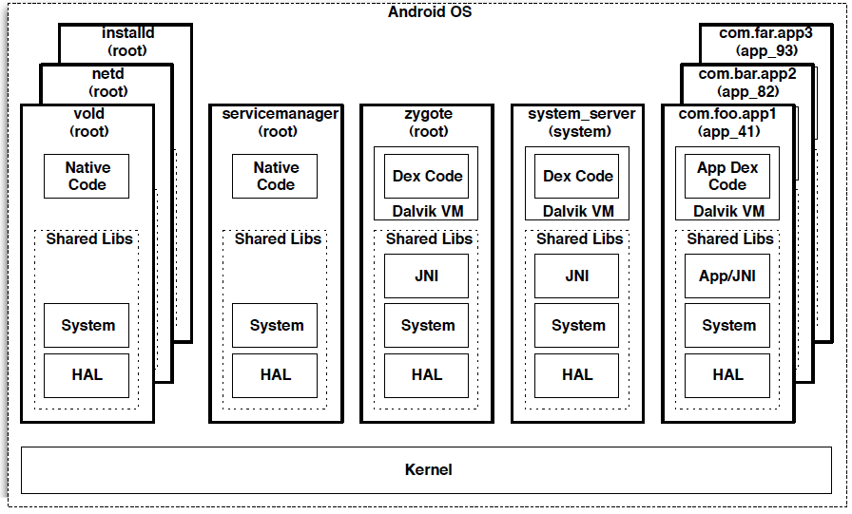
Process Diagram – Running System

Slide 16
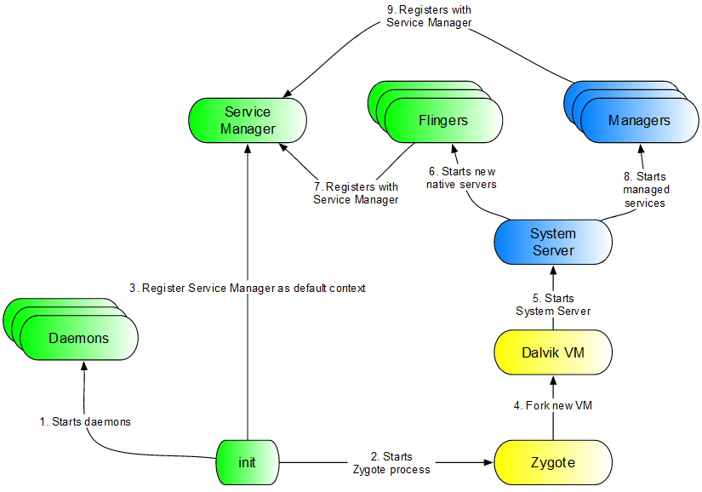
Android’s init

