Slide 1
Differential Drive Mobile Robot

Slide 2
Hello!
Sajad Ghadiri
Maral Mordad
Mahya Haghgoo
Mohammad Barabadi

Slide 3
What is mobile robot ?
Applications
Why we chose kinematic instead of dynamic?
We assumed 4 wheeled mobile robot which side wheels move with each other

Slide 4
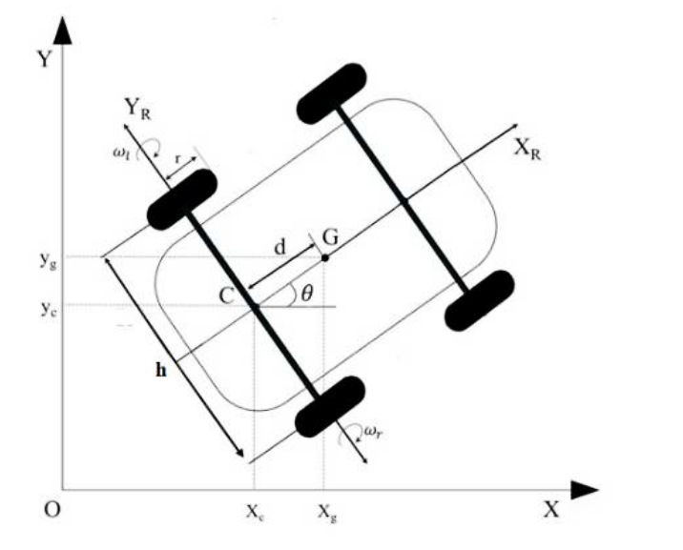
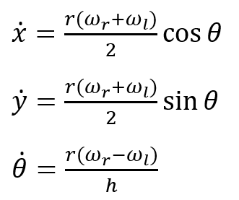

Slide 5
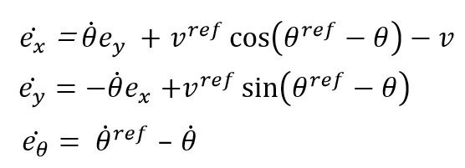
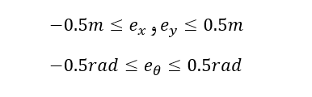

Slide 6
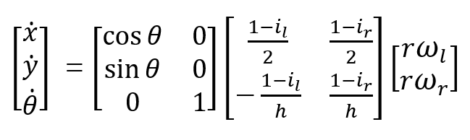
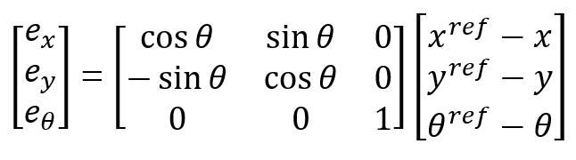

Slide 7
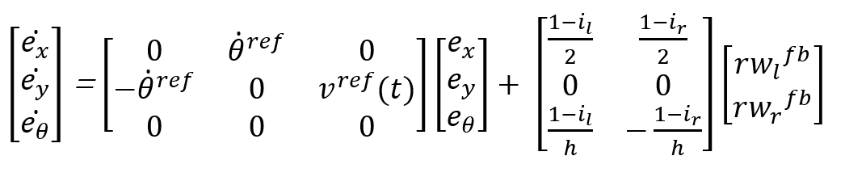
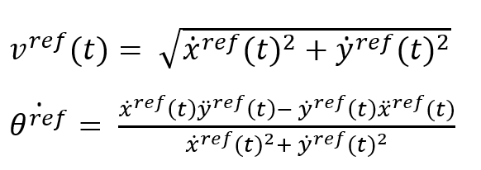


State space

Slide 8
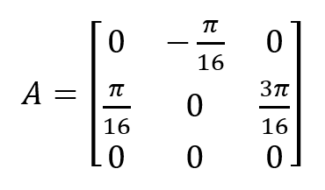
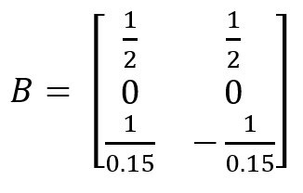
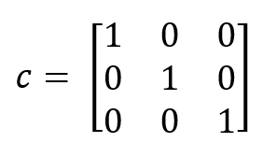

Slide 9

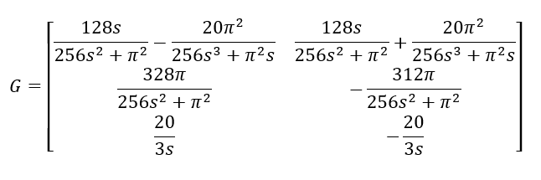


Stability?!

Slide 10
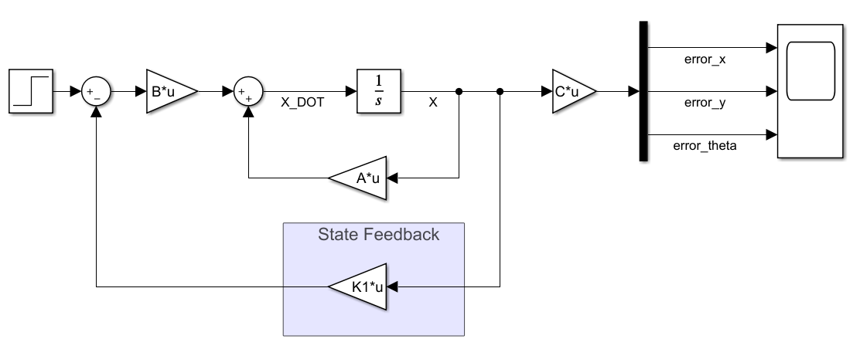
Error system
We can’t use this form because our trajectory is a circle with 3 meter radius
Also we need to follow the trajectory, not error

Slide 11
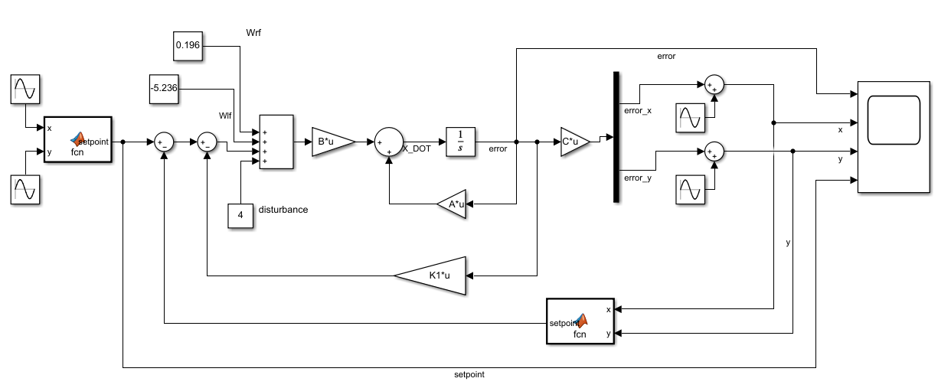
Modified system

Slide 12
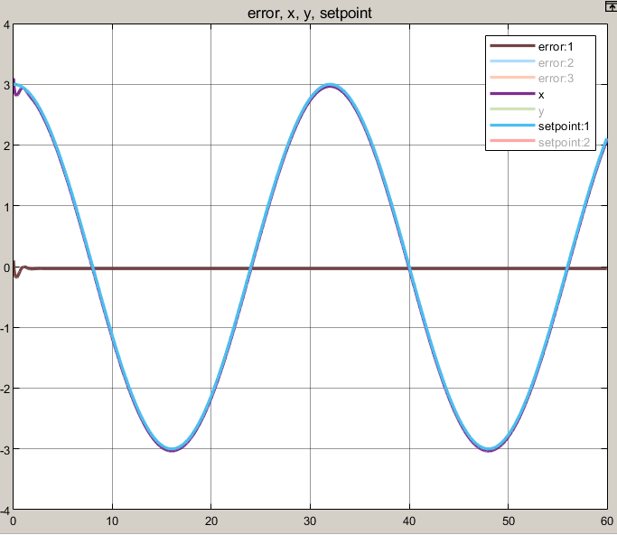
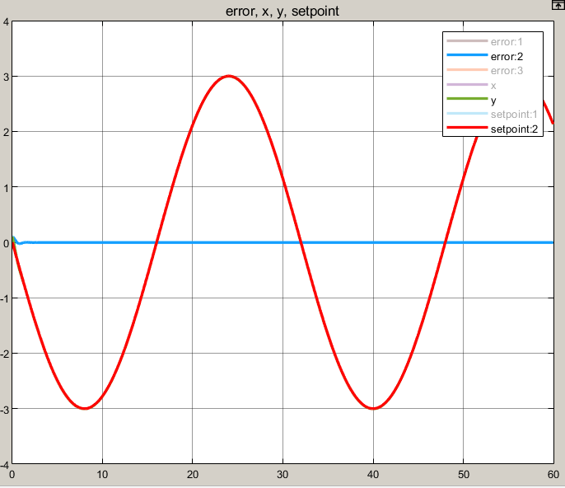
Modified system response

Slide 13
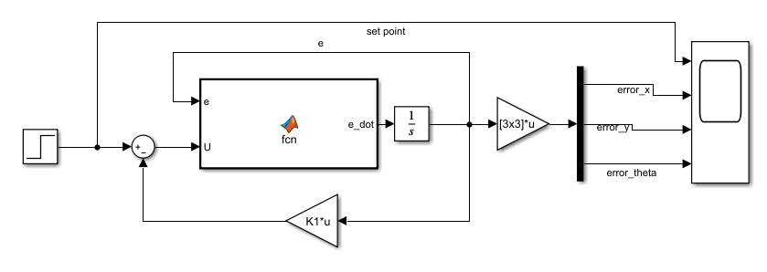
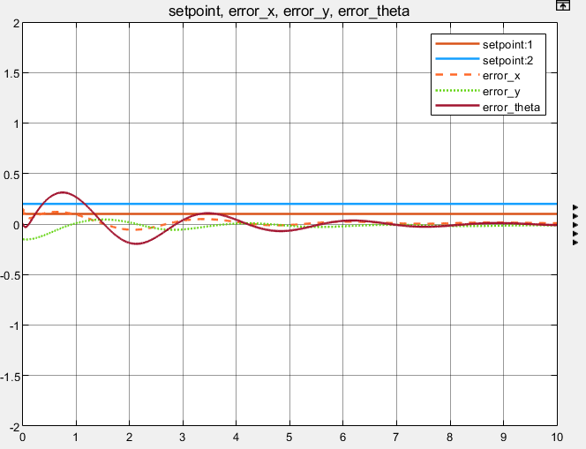
Apply state feedback controller on nonlinear system

Slide 14
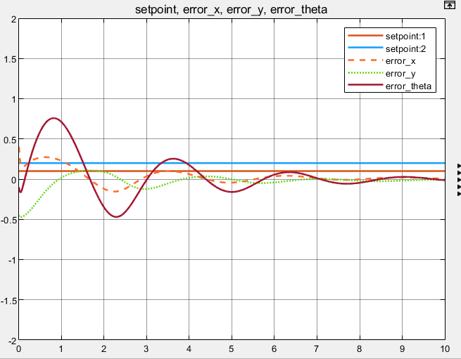
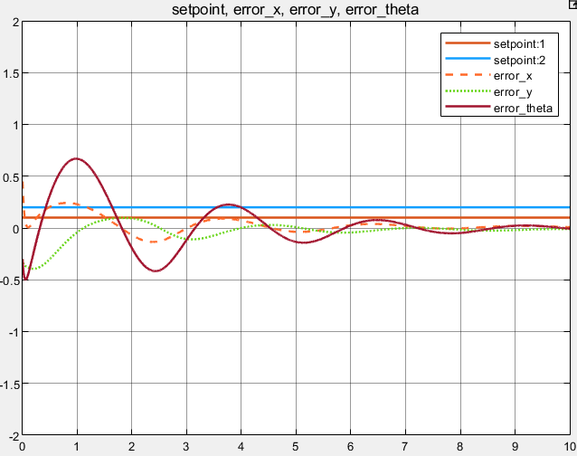
[ 0.45 ; -0.3 ; 0.3 ]
[ 0.4 ; -0.45 ; -0.1 ]

Slide 15
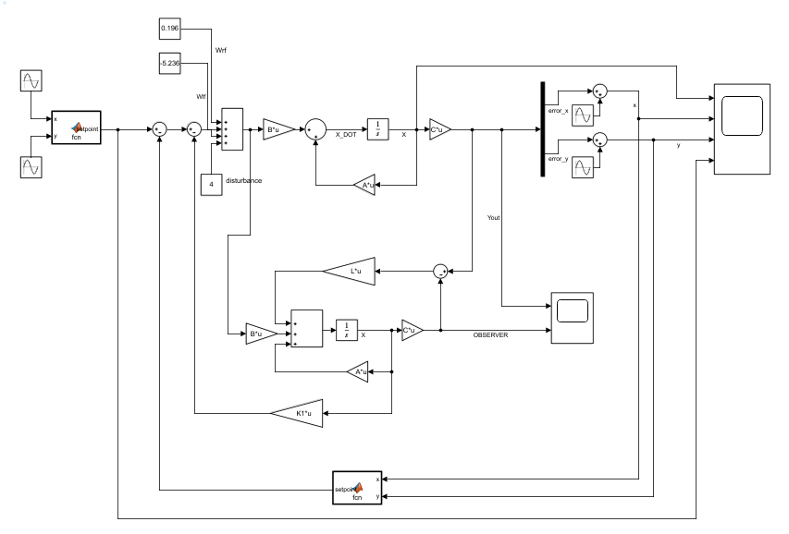
Full-order observer

Slide 16
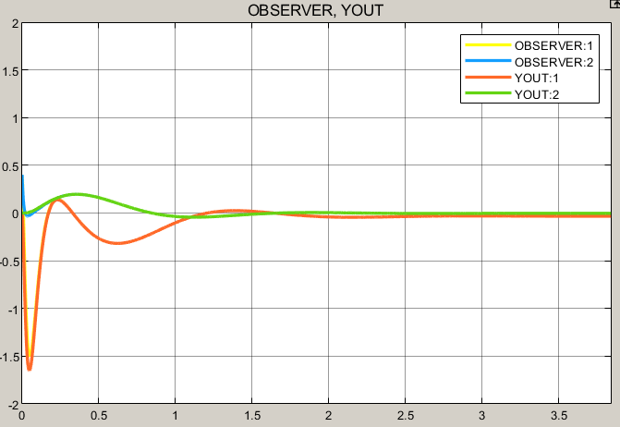
Full-order observer response
Observer initial
condition = [0.4; 0.4; 0.5]
System initial
condition = [0.1; 0.1; 0]
As we expected the states which are errors converged to zero
We chose our observer’s poles farther than our state feedback controller’s pole
State feedback poles are at [-30,
-1+4.899j, -1-4.899j]
Observer’s poles are at [-20, -20, -100]

Slide 17
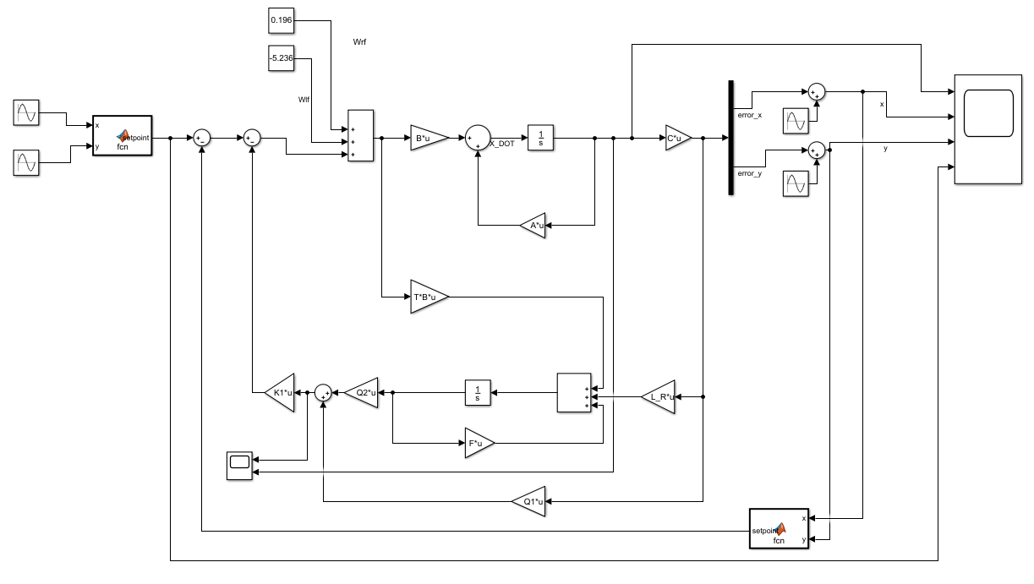
Reduced-order observer

Slide 18
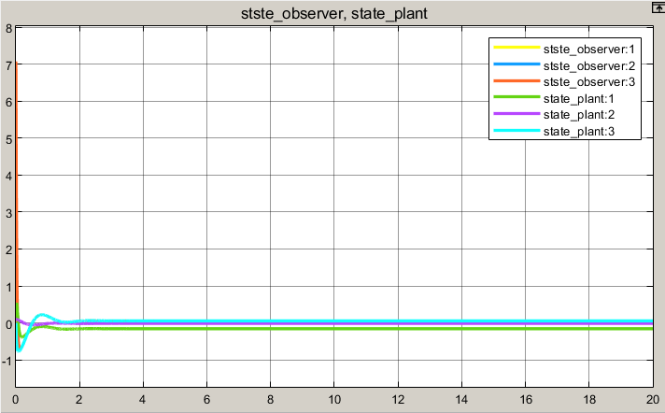
Reduced-order observer response

Slide 19
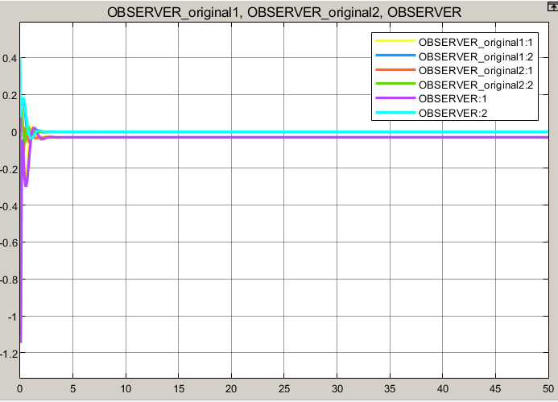
Robustness of system

Slide 20
Thanks!
Any questions?

