Slide 1
Control Of Wind Turbine System
Mohammad Barabadi
Maral Mordad
Sajad Ghadiri
Mahya Haghgoo

Slide 2
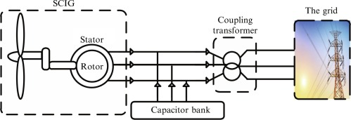
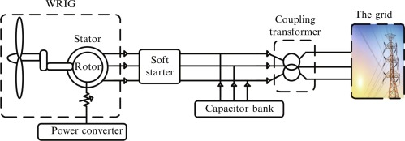
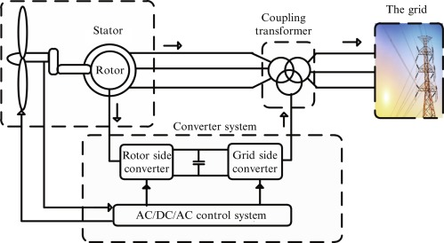
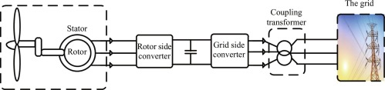
Introduction
Fixed speed wind turbines Variable speed wind turbines
SCIG
WRIG
Full Power Converter
DFIG

Slide 3
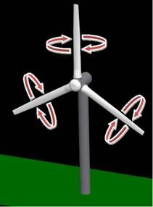
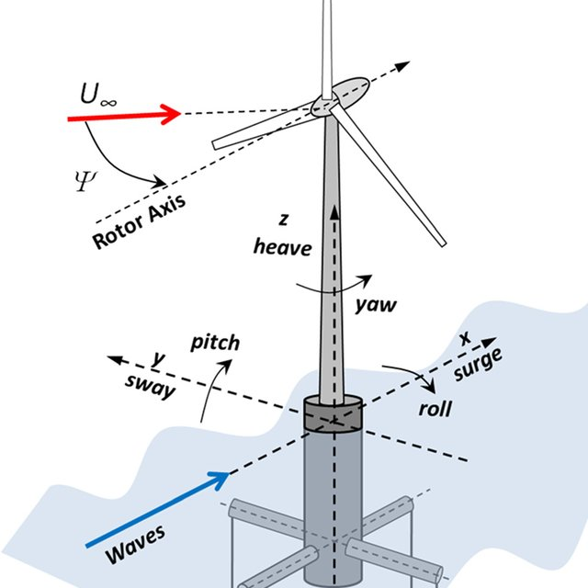
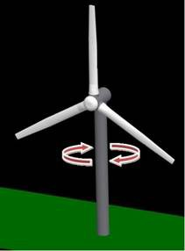
Introduction
Pitch
Yaw

Slide 4

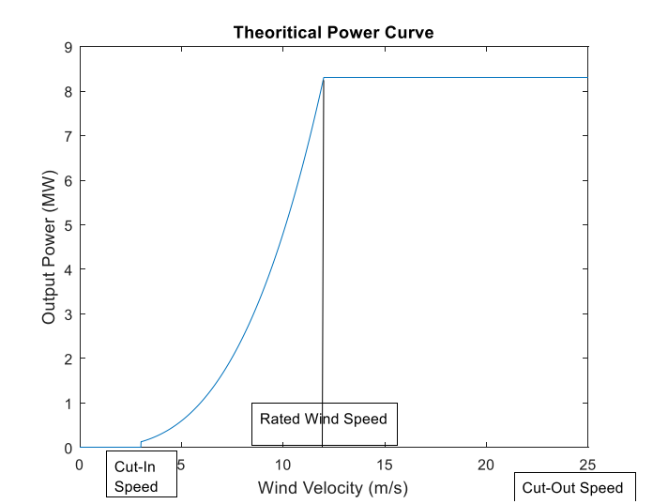
Mathematical Model of Wind Turbine

Slide 5





Mathematical Model of Wind Turbine

Slide 6
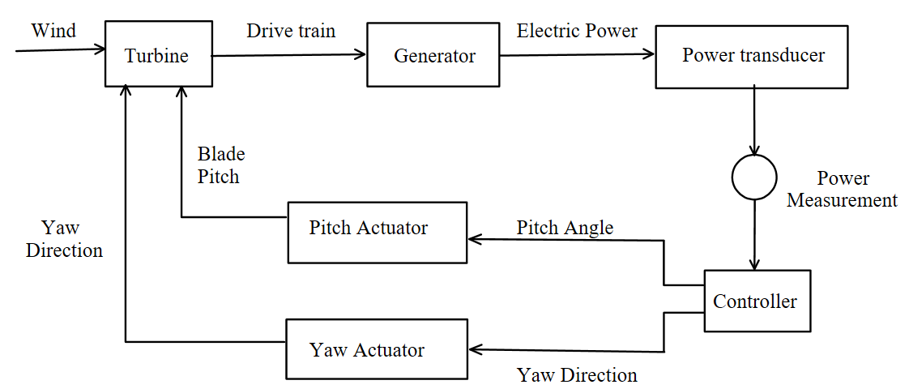
Modelling of the Wind Turbine System

Slide 7
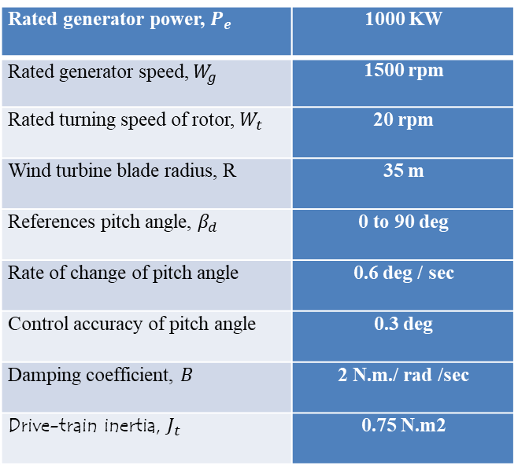







Modelling of the Wind Turbine System
$\frac{dβ}{dt}= \frac{(β_{d}−β)}{T_{β}}$
1000 KW | Rated generator power, $P_{e}$
1500 rpm | Rated generator speed, $W_{g}$
20 rpm | Rated turning speed of rotor, $W_{t}$
35 m | Wind turbine blade radius, R
0 to 90 deg | References pitch angle, $β_{d}$
0.6 deg / sec | Rate of change of pitch angle
0.3 deg | Control accuracy of pitch angle
2 N.m./ rad /sec | Damping coefficient, $B$
0.75 N.m2 | Drive-train inertia, $J_{t}$
$T_{β} .\frac{dβ}{dt}= ( β_{d}−β)$
$T_{β} .\frac{dβ}{dt}+β= β_{d}$
$T_{β} .β.s+β= β_{d}$
$β(T_{β}.s+1)= β_{d}$
$\frac{β}{β_{d}}= \frac{1}{T_{β}.s+1}$
$T_{β}=\frac{β_{d}−β}{\frac{dβ}{dt}}= \frac{0.3}{0.6}=0.5$

Slide 8
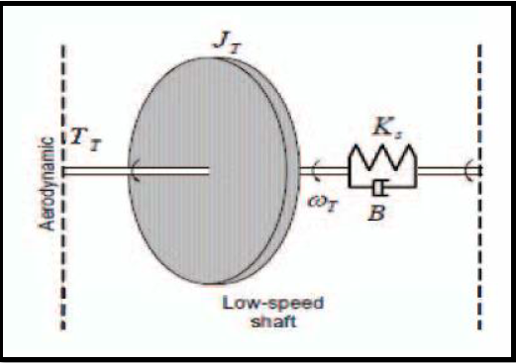



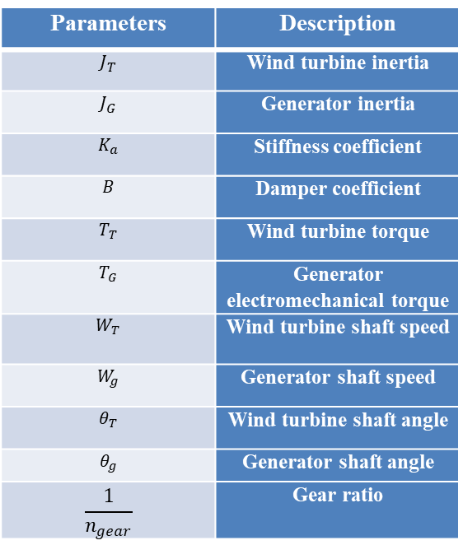






Drive Terrain Model
$J_{T}.\frac{d}{dt}\left(W_{T}\right)=T_{T}−(K_{s} .δ θ_{T}+B δW)$
Description | Parameters
Wind turbine inertia | $$J_{T}$$
Generator inertia | $$J_{G}$$
Stiffness coefficient | $$K_{a}$$
Damper coefficient | $$B$$
Wind turbine torque | $$T_{T}$$
Generator electromechanical torque | $$T_{G}$$
Wind turbine shaft speed | $$W_{T}$$
Generator shaft speed | $$W_{g}$$
Wind turbine shaft angle | $$θ_{T}$$
Generator shaft angle | $$θ_{g}$$
Gear ratio | $$\frac{1}{n_{gear}}$$
$\frac{d}{dt}\left(δ.θ\right)=δ.W$
$J.\frac{dw}{dt}=T−Bw$
$J.Ws=T−BW$
$J.Ws+BW=T$
$J.Ws+BW=T$
$W(Js+B)=T$
$\frac{W}{T}=\frac{1}{\left(Js+B\right)}$
$\frac{W}{T}=\frac{\frac{1}{B}}{\left( \frac{J}{B}s+1 \right)}=\frac{\frac{1}{2}}{\left( \frac{0.75}{2}s+1 \right)}= \frac{0.5}{\left(0.375s+1\right)}$

Slide 9
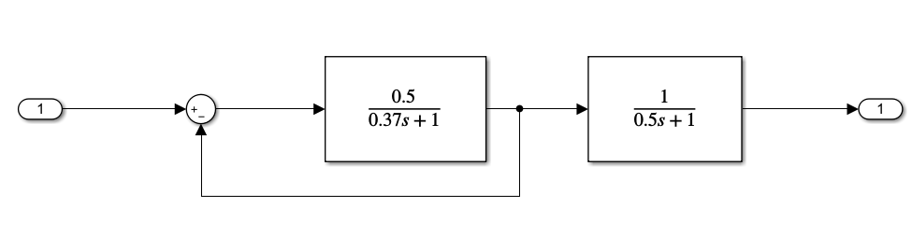
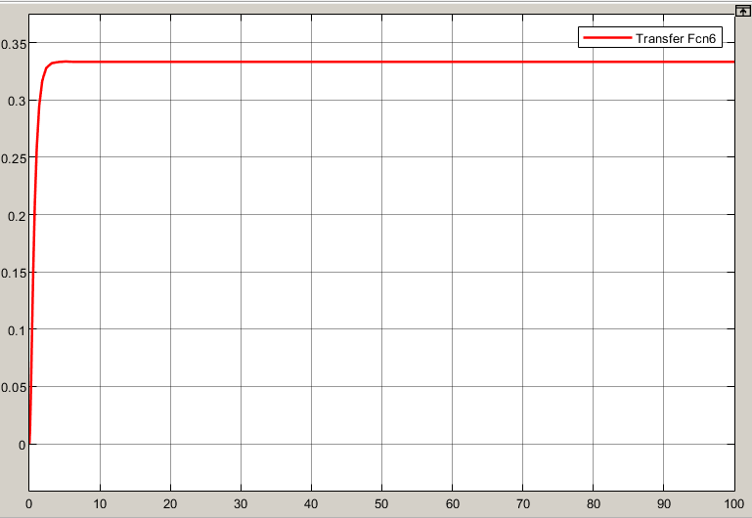



System Stability
$$G_{driveTerrain}=\frac{\frac{0.5}{0.37s+1}}{1+\frac{0.5}{0.37s+1}}= \frac{0.5}{0.37s+1.5}$$
$$G_{pitchActuator}=\frac{1}{0.5s+1}$$
$$G_{plant}=G_{driveTerrain}×G_{pitchActuator}$$

Slide 10
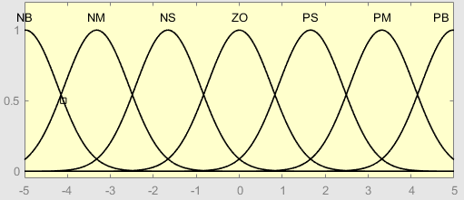
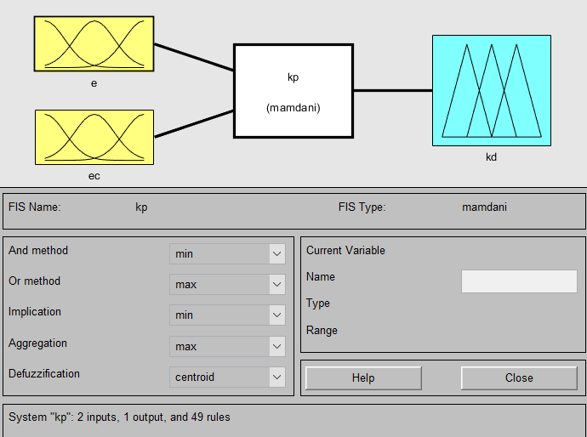
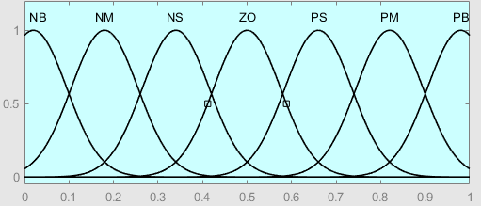
Fuzzy Controller Design
Membership Function Plots for Inputs 'e' and 'ec'
Membership Function Plots for Outputs

Slide 11
Fuzzy Controller Design
Kp
ec |  |  |  |  |  |  | e
PB | PM | PS | ZO | NS | NM | NB
ZO | ZO | PS | PM | PM | PB | PB | NB
NS | ZO | PS | PS | PM | PB | PB | NM
NS | NS | ZO | PS | PM | PM | PM | NS
NM | NM | NS | ZO | PS | PM | PM | ZO
NM | NM | NS | NS | ZO | PS | PS | PS
NB | NM | NM | NM | NS | ZO | PS | PM
NB | NB | NM | NM | NM | ZO | ZO | PB

Slide 12
Fuzzy Controller Design
Ki
ec |  |  |  |  |  |  | e
PB | PM | PS | ZO | NS | NM | NB
ZO | ZO | NS | NM | NM | NB | NB | NB
ZO | ZO | NS | NS | NM | NB | NB | NM
PS | PS | ZO | NS | NS | NM | NB | NS
PM | PM | PS | ZO | NS | NM | NM | ZO
PB | PM | PS | PS | ZO | NS | NM | PS
PB | PB | PM | PS | PS | ZO | ZO | PM
PB | PB | PM | PM | PS | ZO | ZO | PB

Slide 13
Fuzzy Controller Design
Kd
ec |  |  |  |  |  |  | e
PB | PM | PS | ZO | NS | NM | NB
PS | NM | NB | NB | NB | NS | PS | NB
ZO | NS | NM | NM | NB | NS | PS | NM
ZO | NS | NS | NM | NM | NS | ZO | NS
ZO | NS | NS | NS | NS | NS | ZO | ZO
ZO | ZO | ZO | ZO | ZO | ZO | ZO | PS
PB | PS | PS | PS | PS | NS | PB | PM
PB | PS | PS | PS | PM | PM | PB | PB

Slide 14
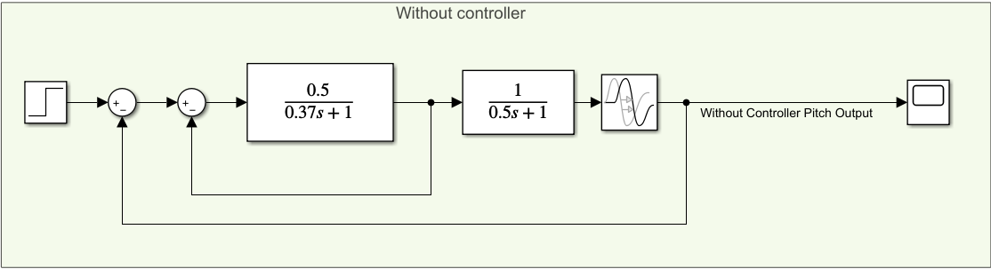
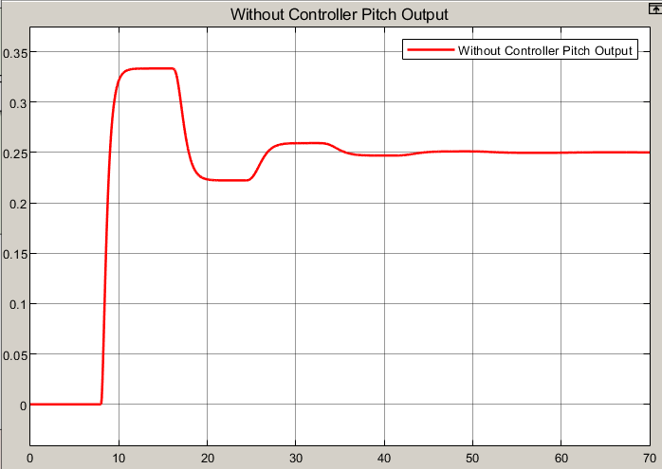
Simulation of the Controllers and Results
Without Controller
Time Domain | Result without controller
Delay Time | 8
Rise Time | 0.813
Settling Time | 38
Peak overshoot(%) | 32.157
Steady state error | 0.75

Slide 15
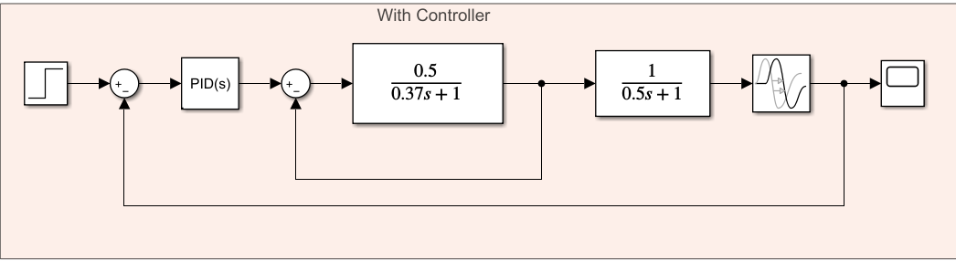
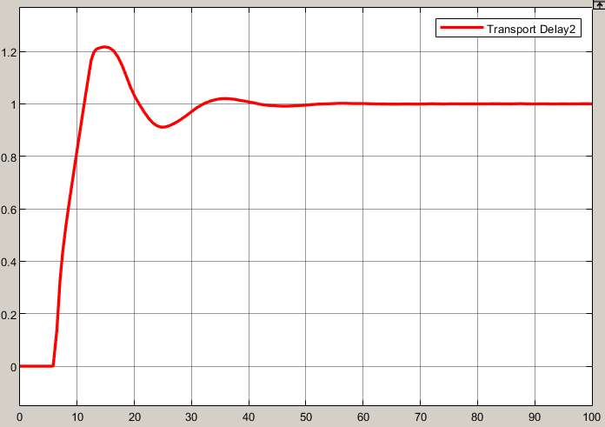

Simulation of the Controllers and Results
PID Controller
$$K_{p}=1.3 ,K_{i}=0.41, K_{d}=−2.18$$
PID | Time Domain
6 sec | Delay Time
4.19 sec | Rise Time
37 sec | Settling Time
21.34 sec | Peak overshoot(%)
0 | Steady state error

Slide 16
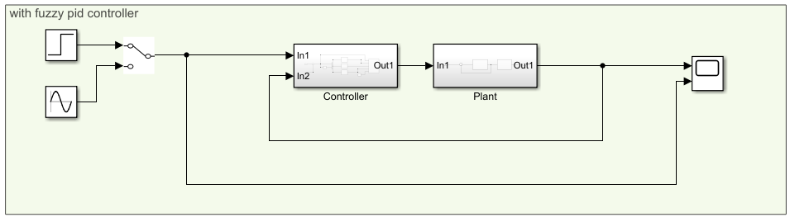
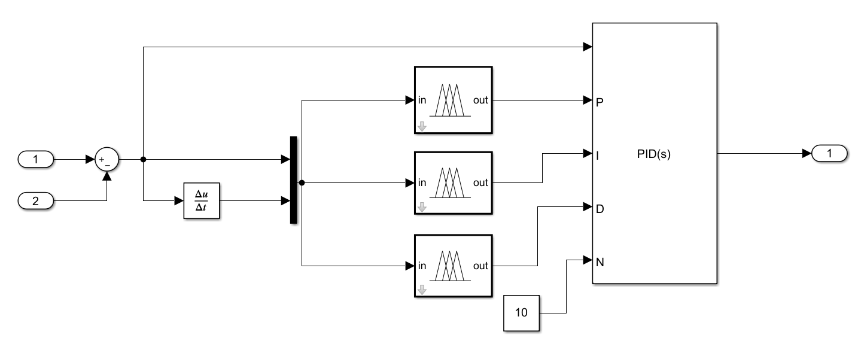
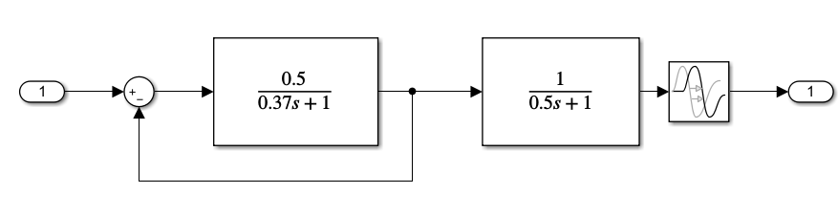
Simulation of the Controllers and Results
Fuzzy Controller

Slide 17
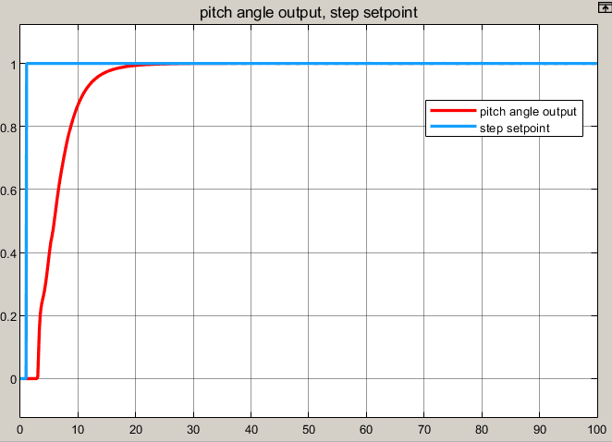
Simulation of the Controllers and Results
Fuzzy Controller
Result with fuzzy pid controller | Time Domain
2s | Delay Time
7.49s | Rise Time
20.5s | Settling Time
0 | Peak overshoot(%)
0 | Steady state error

Slide 18
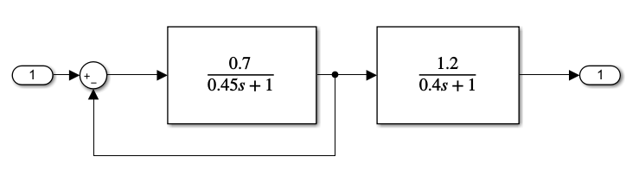
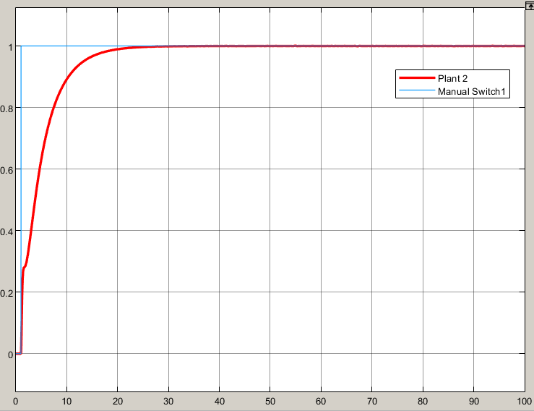
uncertainty

Slide 19
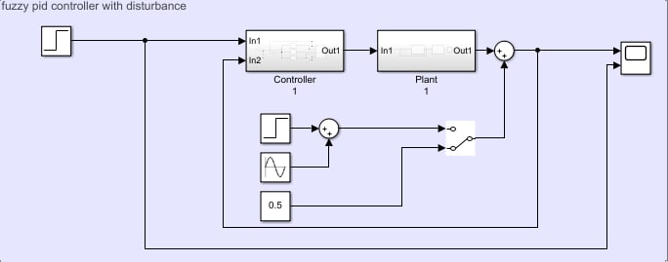
Disturbance

Slide 20
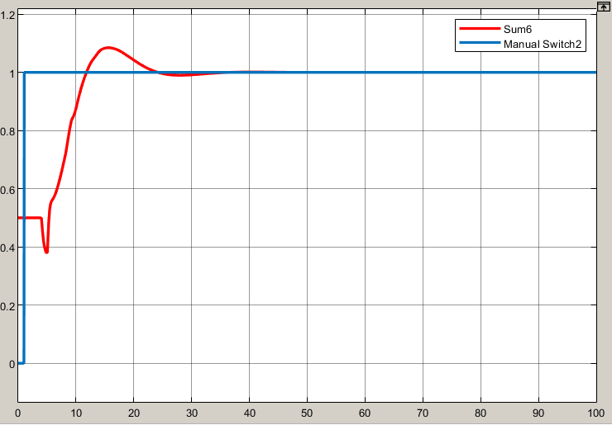
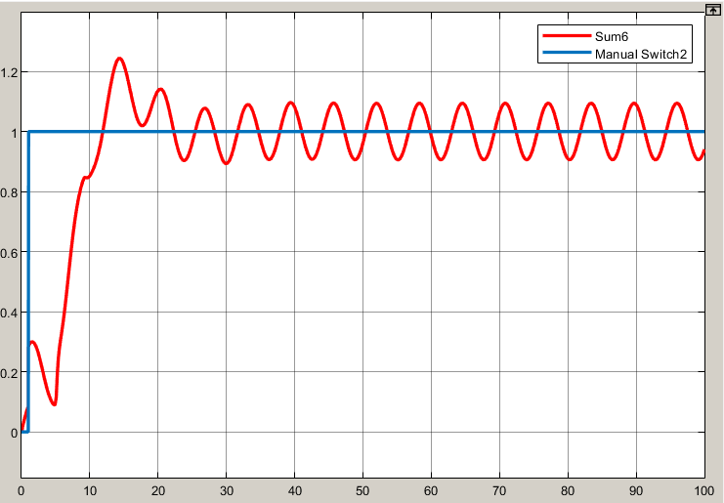
Disturbance

Slide 21
Thank For Your Attention

