Slide 1
Verilog to def
Soft Macro Floor-planner
Maram Abbas 900153570

Slide 2
Main file to be run is named mini_project.py

Slide 3
Inputs
Aspect ratio (core height/core width)
Core utilization
Library LEF file
Verilog netlist file
Pins file (file that contains information about the pins - Bonus)

Slide 4
LEF Parser
Class ﻿LefParser
Ready-made from online source
Referenced in slide 15

Slide 5
Verilog Netlist Parser
Class VNetParser
Parses file line by line
Stores all declared pins in list named pins
Stores all declared wires in list named declared_wires
Stored their values in list named values_of_undeclared_wires
Stores all other wires in list named undeclared_wires
Stores all cells in file in a list named cell_name
It is in same order as their occurrences in file
Stores all names of each called cell in file in a list named called_cell_name
It is in same order as their occurrences in file
Stores each cell’s pins/wires used in a 2D list named called_pins
It is in same order as their occurrences in file
Stores all nets in file in a list named ﻿pins_wires_all_nets

Slide 6
Pins File Parser
Class PinsParser
Parses file line by line
Stores all pin names in list named pins
Stores each pin’s side it is in, list named side
Stores each pin’s metal layer it is put on in list named metal_layer
All these lists are in same order, so each index has information for the same pin in all over the lists

Slide 7
Main (Generating DEF File)
The main is divided into SIX main parts
First part: header
Second part: DIEAREA
Third part: TRACKS
Fourth part: COMPONENTS
Fifth part: PINS
Sixth part: NETS
Each part is explained in the following slides

Slide 8
Header
The header is known to be somehow static so most of it is common between all DEF files
The only different thing would be:
DESIGN name
UNITS DISTANCE MICRONS number
The rest were as follows:
VERSION 5.6
NAMESCASESENSITIVE ON
DIVIDERCHAR "/"
BUSBITCHARS "<>"

Slide 9
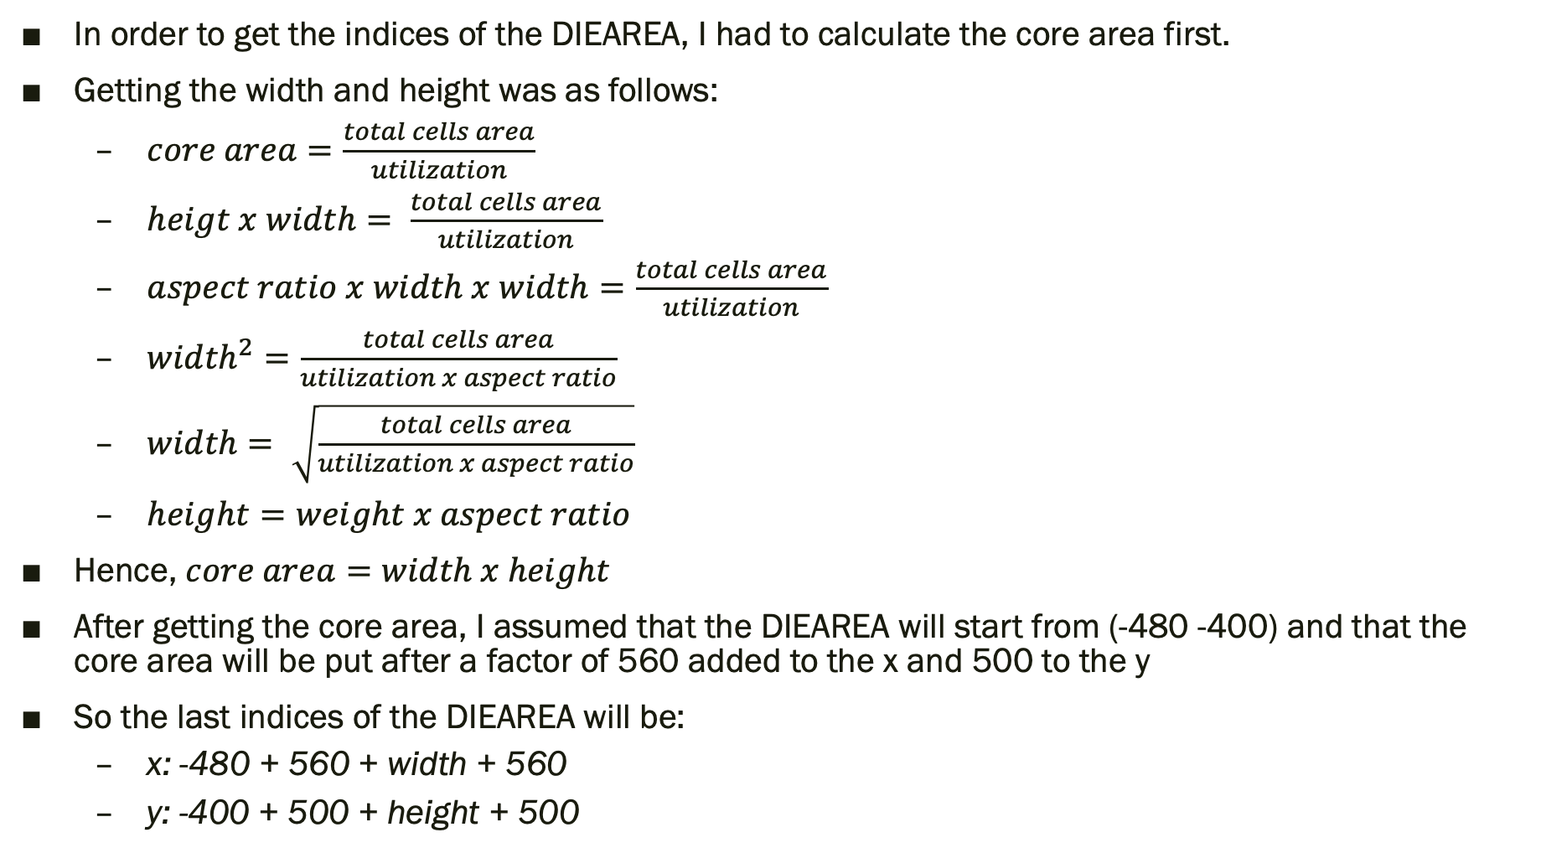
DIEAREA
In order to get the indices of the DIEAREA, I had to calculate the core area first.
Getting the width and height was as follows:
$core area=\frac{total cells area}{utilization}$
$heigt x width= \frac{total cells area}{utilization}$
$aspect ratio x width x width=\frac{total cells area}{utilization}$
${width}^{2}=\frac{total cells area}{utilization x aspect ratio}$
$width= \sqrt{\frac{total cells area}{utilization x aspect ratio}}$
$height=weight x aspect ratio$
Hence, $core area=width x height$
After getting the core area, I assumed that the DIEAREA will start from (-480 -400) and that the core area will be put after a factor of 560 added to the x and 500 to the y
So the last indices of the DIEAREA will be:
x: -480 + 560 + width + 560
y: -400 + 500 + height + 500

Slide 10
TRACKS
A loop is done on all 4 metals
Metals are alternatively changed in order from being horizontal to being vertical
Hence, metal1 takes Y
metal2 takes X
metal3 takes Y
metal4 takes X
STEP number:
This number is the pitch from LEF file
DO number:
This number is determined by the dimensions of the core area

Slide 11
COMPONENTS
Components are put with the same order of cells in the Verilog netlist file
The total number of components is the same as the size of the list ﻿called_cell_name
I looped on ﻿called_cell_name and since cell_name has the same order, so it was easy to just write the call name and how it was being called in one loop.

Slide 12
PINS
The number of the total pins is gotten from the list named pins from the Verilog netlist file
While looping on them, the layer each pin is in is gotten from the parsed pins file (metal_layer list)
How each pin is placed:
Side of which pin is put in is found in list named side
based on that side, I look in which metal layer it is put on
Side note:
L and R sides can only have metals 1 and 3 since they are vertical
U and D sides can only have metals 2 and 4 since they are horizontal
Based on the metal it is put on, I start placing them on the boundaries and make sure that they are not placed on the corners
Between each pin and the other is the pitch of that metal
A figure in the following slide explains how the pins are placed

Slide 13
PINS contd.
Components are color coded:
Die area
Core area
Pin on L side
Pin on R side
Pin on U side
Pin on D side

Slide 14
NETS
Total number of nets is gotten from the list named ﻿pins_wires_all_nets in the Verilog netlist parser
This list is looped on and all other information is put as well from other lists gotten from the parser
the pins are distinguished from the others by searching for it in the pins list
If it is a pin, the DEF file has the line ( PIN pin_name ) under the pin’s name

Slide 15
Test Cases
8 Test cases were used (as required)
2 test cases were already given in Slack
mux4x1
rca4
The other 6 test cases were randomly created by me
test_1
test_2
test_3
test_4
test_5
test_6
All the test cases’ Verilog netlist files are stored in a folder named Vnet
All the test cases’ pins files are stored in a folder named Pins
The LEF file used is in a folder named LEF
All the test cases’ generated DEF files are stored in a folder named DEF

Slide 16
References
LEF Parser: https://github.com/trimcao/lef-parser

