Slide 1

Flight Arrival Delay Prediction
Maram Elsayed and Madhu Selvaraj

Slide 2

Project Scope and Objectives
What are the consequences of flight delays?
Increased operating costs for airlines
Decreased passenger welfare
Greater fuel consumption
Increased emissions
The Objectives of our Project:
Studying and understanding two research papers
Extracting methods proposed
Making modifications to the process
Compare Results overall

Slide 3



Dataset
“Airline On-Time Performance Data” extracted from the Bureau of Transportation Statistics.
Scheduled and actual departure and arrival times reported by certified U.S. air carriers.
Extracted only for the years 2015 and 2016.
The following table lists all the attributes utilised.

Slide 4
Feature
YEAR | TAXI_IN
QUARTER | CRS_ARR_TIME
MONTH | ARR_TIME
DAY_OF_MONTH | ARR_DELAY
DAY_OF_WEEK | ARR_DELAY_NEW
OP_UNIQUE_CARRIER | ARR_DEL15
OP_CARRIER_AIRLINE_ID | CANCELLED
TAIL_NUM | CANCELLATION_CODE
OP_CARRIER_FL_NUM | DIVERTED
ORIGIN | CRS_ELAPSED_TIME
ORIGIN_WAC | ACTUAL_ELAPSED_TIME
DEST | AIR_TIME
DEST_WAC | DISTANCE
CRS_DEP_TIME | CARRIER_DELAY
DEP_TIME | WEATHER_DELAY
DEP_DELAY | NAS_DELAY
DEP_DELAY_NEW | SECURITY_DELAY
DEP_DEL15 | LATE_AIRCRAFT_DELAY
TAXI_OUT

Slide 5

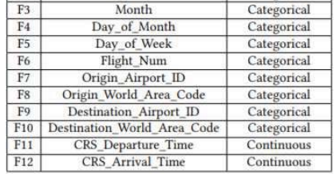
Paper 1:
January 2015 to December 2016
Focused on American Airlines flights between 5 airports
Used Gradient Boosting Classifier that was tuned with Grid Search
Label: Arr_Del_15 (1 = arrival delay, 0 = no delay)

Slide 6

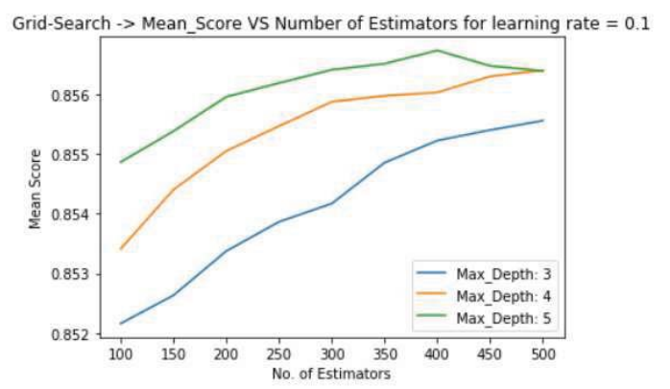
Paper 1: Modification
Paper used Grid Search to obtain optimal hyperparameters
Result: n_estimators= 400, max_depth = 5
Modified to use Random Search instead
Much faster
Allows for larger range of parameters to be tested
Result: n_estimators = 650, max_depth = 7

Slide 7
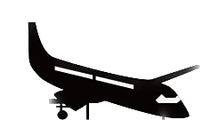
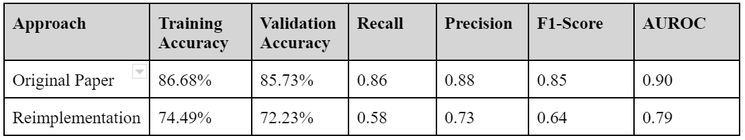
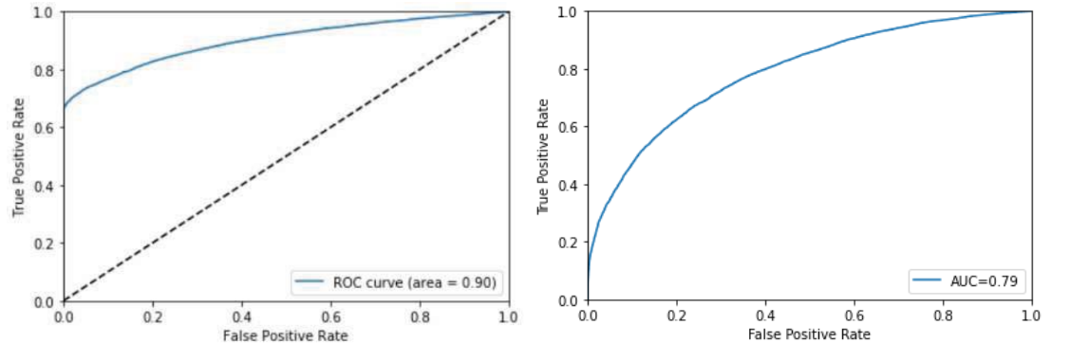
Paper 1: Reimplementation Results

Slide 8

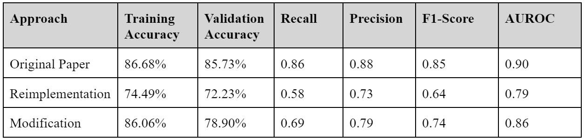
Paper 1: Modification Results

Slide 9

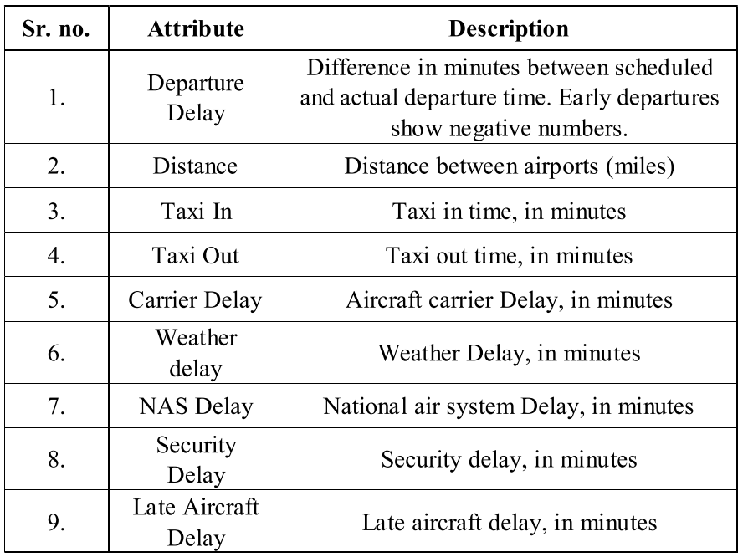
Paper 2
January 2016 to December 2016
Three mainly proposed methods:
Multiple (Linear) Regression
Decision Tree
Random Forest

Slide 10
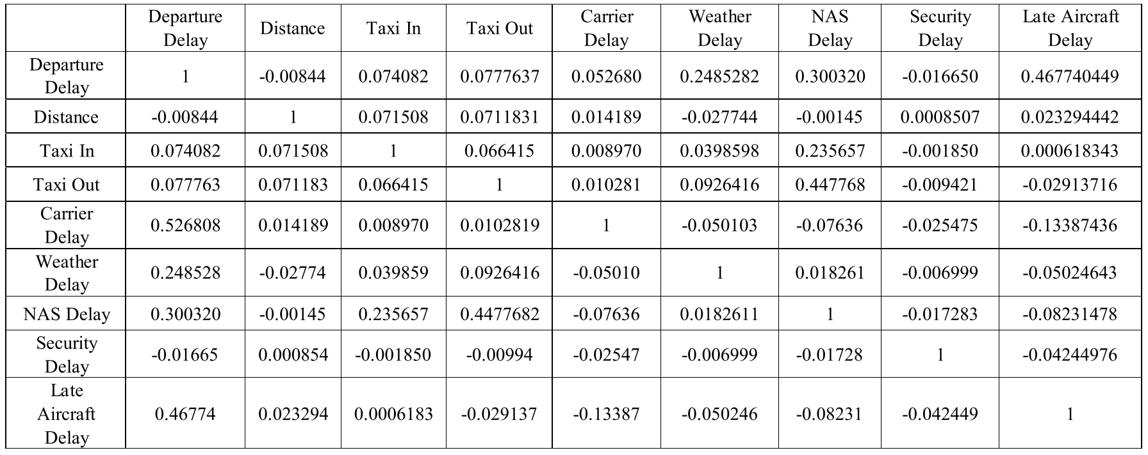

Slide 11
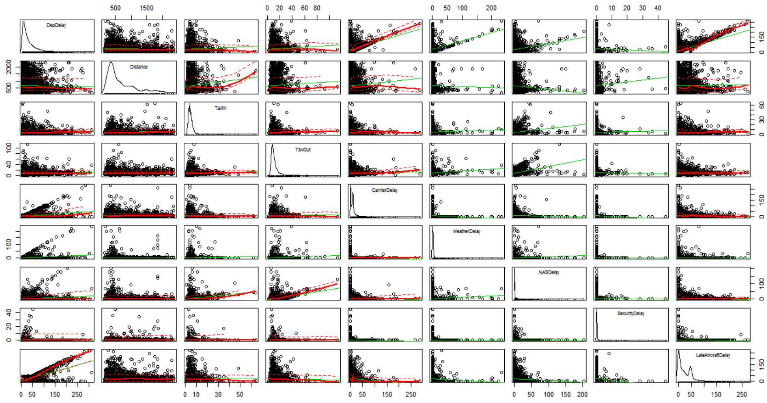

Slide 12

Paper 2: Modifications
Features (variables)
DAY_OF_WEEK | SCHEDULED_ELAPSED_TIME
AIRLINE | ELAPSED_TIME
ORIGIN | AIR_TIME
DEST | DISTANCE
DEP_DELAY | CARRIER_DELAY
TAXI_OUT | WEATHER_DELAY
TAXI_IN | NAS_DELAY
ARR_DELAY | SECURITY_DELAY
DIVERTED | LATE_AIRCRAFT_DELAY
Implementing my own preprocessing procedure due to lack of it in paper.
Instead of 9 features, they’re 18 ( 9 attributes mentioned in the paper and an extra 9).
Instead of using proposed 500 trees for RF, only 10 were used.

Slide 13



Paper2: Results and Comparison
R-squared Score: Subtracting the Sum of Squared Regression over the Total Sum of Squares from one. (Ideal is 1)
Mean Absolute Error: Subtracting the actual response value from the predicted value for all the observations and calculating the mean for all absolute values of them, (Ideal is 0)
Approach | R-squared Score | Mean Absolute Error (or RMSE in paper) (minutes)
MLR (Paper) | 0.84 | 21.2
DT (Paper) | ~0.80 ( for 12 splits) | 26.5
RF(Paper) | 0.94 | 12.5
MLR (Modification) | 0.9999999995788214 | 2.2018607992789854e-06
DT (Modification) | 0.9979946574458742 | 0.48023635338022747
RF (Modification) | 0.9989853044854837 | 0.3347003366468358

Slide 14
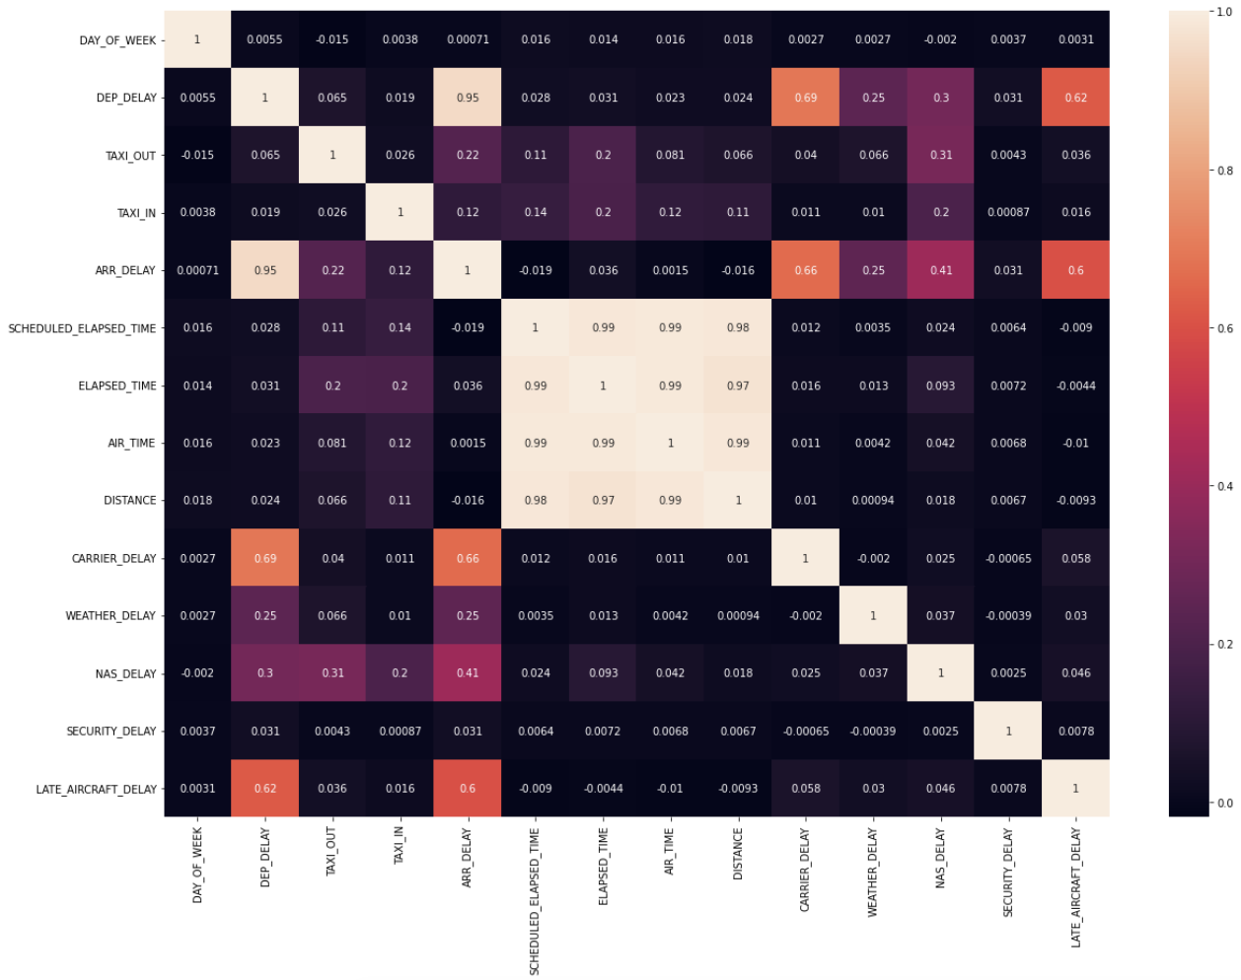

Slide 15
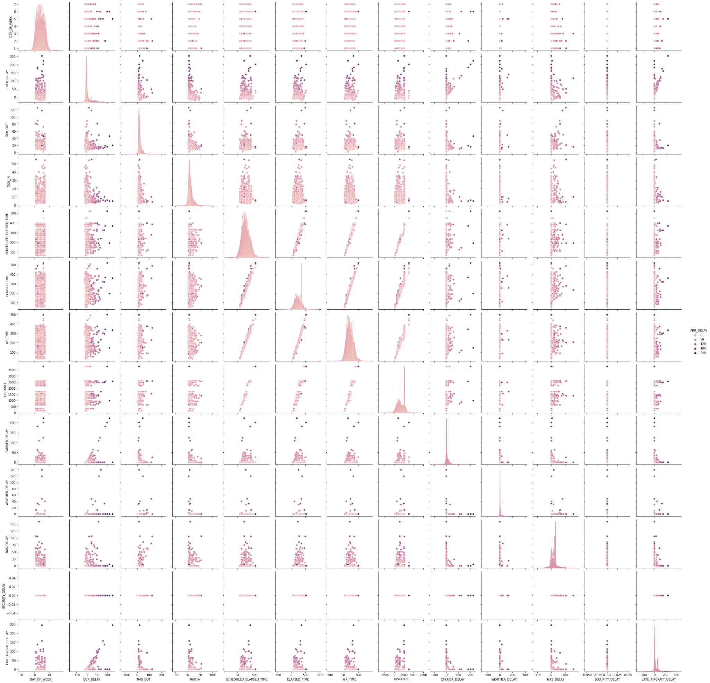

Slide 16
