Slide 1
+
DIABETES CARE RAG ASSISTANT
From Colab Notebook to Production App
A retrieval-augmented question-answering system over ADA, NIDDK and WHO
diabetes guidelines — powered by hybrid search and a local LLM.
FastAPI Backend · Streamlit UI · Qdrant Hybrid Search · Ollama LLM

Slide 2
What This Project Does
A question-answering assistant that only speaks from trusted source documents.
①
②
③
④
Grounded answers
Hybrid retrieval
Cited sources
Simple chat UI
Every response is generated strictly from retrieved passages — never outside knowledge.
Combines dense semantic search with BM25 keyword search, fused for stronger recall.
Each answer references the exact source document, organization and page it came from.
Users just type a question in Streamlit and get an answer with expandable citations.
Diabetes Care RAG Assistant
2

Slide 3
End-to-End Architecture
Offline ingestion builds the index; the app serves questions in real time.
OFFLINE INGESTION (run once, or whenever source PDFs change)
PDFs
→
Extract
→
Clean
→
Chunk
→
Embed
→
Qdrant
Index
RUNTIME (on every user question)
Streamlit UI
(chat)
→
FastAPI
/query
→
Hybrid Search
(dense + BM25)
→
Ollama
LLM
The two rows share one Qdrant collection: ingestion writes it offline, and every user question reads from it at query time.
Diabetes Care RAG Assistant
3

Slide 4
The Ingestion Pipeline
Three focused phases turn messy PDF layouts into clean, searchable chunks.
1
Extract
2
Clean
3
Chunk
src/ingestion/extract.py
src/ingestion/clean.py
src/ingestion/chunk.py
Layout-aware text extraction with PyMuPDF
Detects multi-column pages automatically
Rebuilds correct top-to-bottom, left-to-right reading order
Strips standalone page numbers
Fixes line-break hyphenation (hypo-\nglycemia → hypoglycemia)
Removes repeated headers/footers across pages
Attaches organization, title & page metadata
Paragraph-aware splitting, ~1,200 characters
Falls back to sentence-level splits for long paragraphs
200-character overlap between chunks
Stable chunk_id for traceability
Diabetes Care RAG Assistant
4

Slide 5
Embedding & Hybrid Retrieval
Two complementary search signals, fused into one ranked result.
D
Dense semantic search
S
Sparse keyword search (BM25)
Model: BAAI/bge-base-en-v1.5
Captures meaning, not just exact words
Normalized cosine-similarity vectors
Great at paraphrased or conceptual questions
Model: Qdrant/bm25 (FastEmbed)
Rewards exact term matches
Strong for clinical terms & acronyms
Complements dense search's blind spots
Fused with RRF in Qdrant
Diabetes Care RAG Assistant
5

Slide 6
FastAPI Backend
A thin, typed HTTP layer over the RAG pipeline — backend/main.py
GET
/health
POST
/query
Reports readiness — whether the Qdrant index has been built yet, so the UI can show a clear status.
Accepts a question (+ optional top_k), runs hybrid search and the LLM, and returns a grounded answer with its sources.
// request
{ "question": "What are the glycemic goals for adults?", "top_k": 3 }
// response
{ "answer": "…grounded answer citing [1], [2]…",
"sources": [ { "document_title": "...", "organization": "ADA", "page": 12, "score": 0.83 } ] }
Diabetes Care RAG Assistant
6

Slide 7
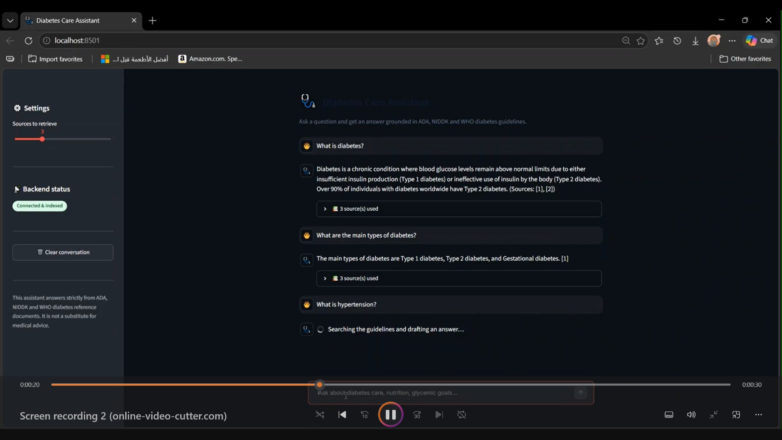
The Streamlit Chat Experience
frontend/app.py — a clean, focused chat UI in front of the API
💬
Simple chat input
Just type a question — no forms, no jargon
📚
Expandable sources
Each answer shows the exact passages it used
📷
🎚️
Adjustable top_k
Insert Streamlit UI screenshot here
Sidebar slider controls how many sources to retrieve
Recommended: 16:9 screenshot of the chat view with an answer and sources expanded
📡
Live status pill
Sidebar shows whether the API and index are ready
Diabetes Care RAG Assistant
7

Slide 8
Tech Stack
Every layer of the app, top to bottom.
UI
API
EXTRACTION
DENSE EMBED.
Streamlit
FastAPI
PyMuPDF
bge-base-en-v1.5
Chat interface & source display
Typed HTTP endpoints, CORS-ready
Layout-aware PDF parsing
Semantic vector search
SPARSE EMBED.
VECTOR STORE
LLM
LANGUAGE
FastEmbed BM25
Qdrant (embedded)
Ollama · phi3
Python 3
Keyword-precise search
Hybrid RRF fusion
Local, grounded generation
End to end
Diabetes Care RAG Assistant
8

Slide 9
Getting Started
Four commands from a fresh clone to a working chat assistant.
1
pip install -r requirements.txt
and pull an Ollama model (e.g. phi3)
2
python scripts/run_ingestion.py
extract → clean → chunk the PDFs
3
python scripts/build_index.py
embed chunks & build the Qdrant index
4
uvicorn backend.main:app + streamlit run frontend/app.py
start the API, then the chat UI
Full setup, configuration and API reference are in README.md

