Slide 1
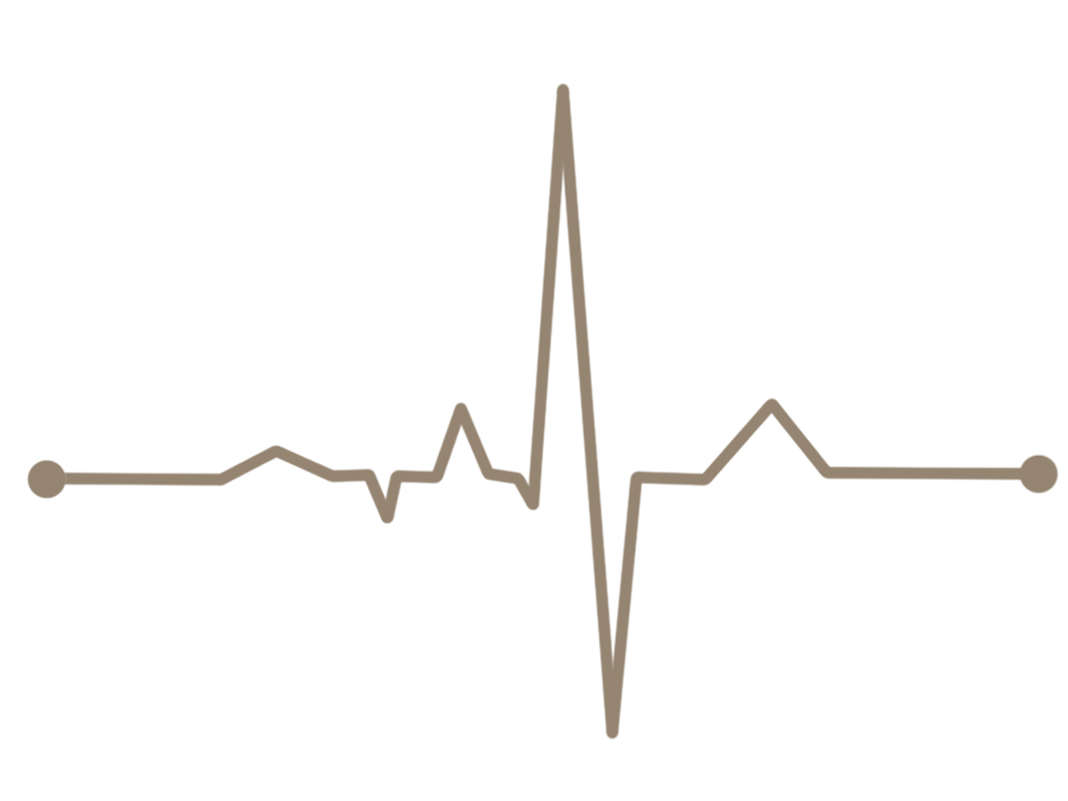

Heart Attack Analysis & Prediction

Slide 2
Introduction
I choose to work on the heart attack prediction dataset from Kaggle.This dataset and the relative problem is of health and the likelihood of patients to suffer heart attack.The context of the data is that given certain variables, is one able to build a model that will correctly predict if a patient will suffer a heart attack.The motivation of this project is to save human resources in medical centers and improve accuracy of diagnosis.

Slide 3
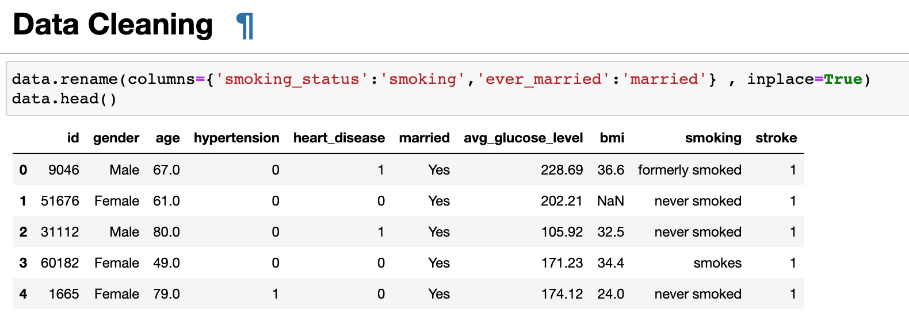
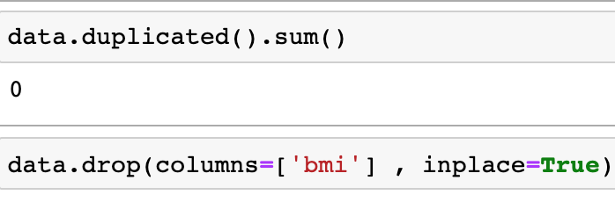
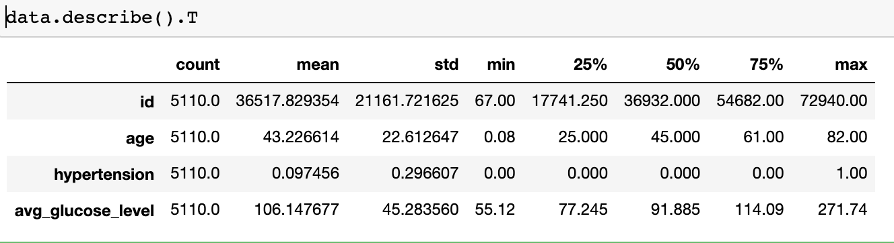
I used a data clean, and I changed the names of some columns, Then I used duplicate to show the sum of the repeated rows, Then I used drop to delete the columns that were not needed, Then I divided the ata into two halves that are infected and unaffected.

Slide 4
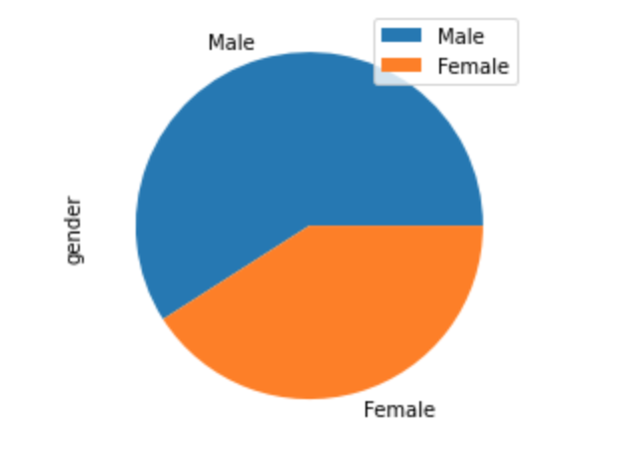
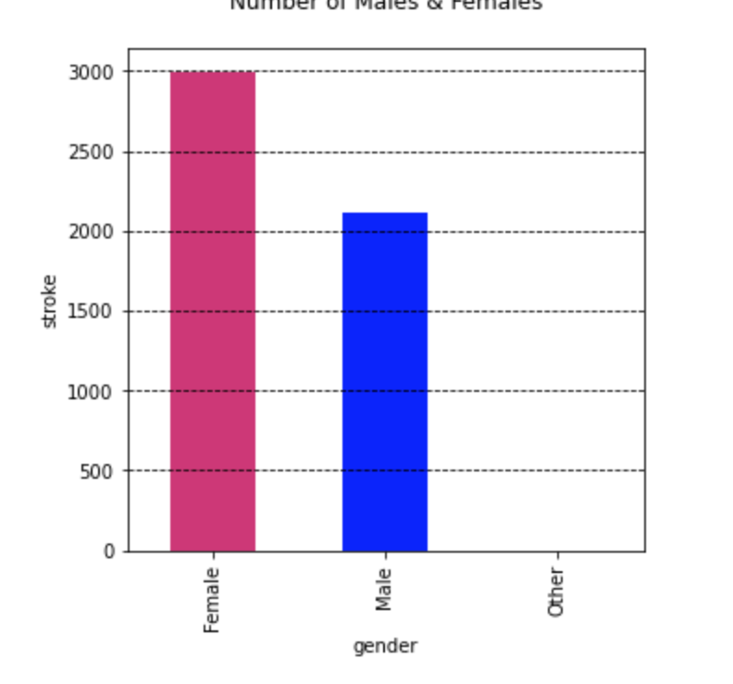
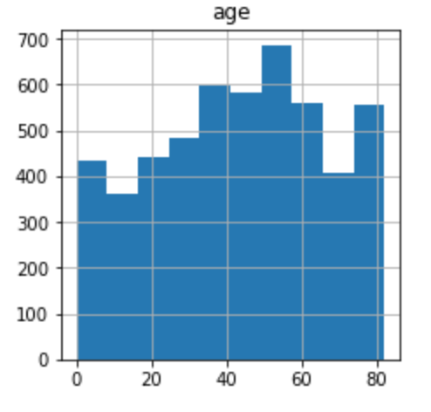
Pie chart
Bar chart
Histograms
Result :Almost 59% of patients are males
Result : Most of patients almost 94.5% are over 50 years old

Slide 5
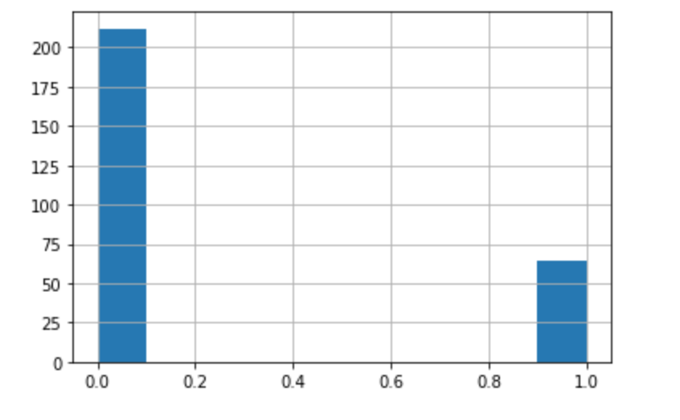
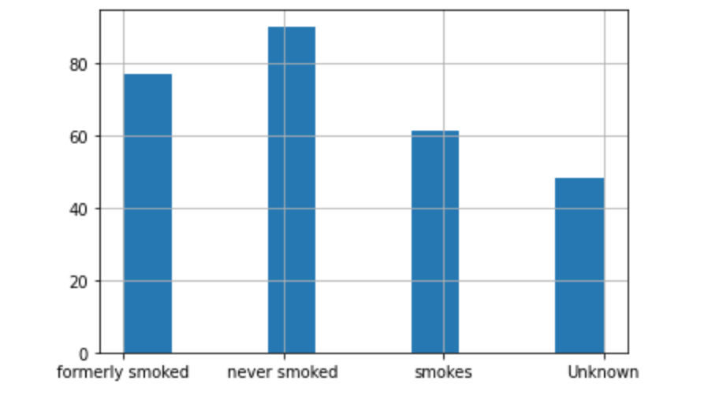
Ruslt: Almost hypertension 64
Ruslt :Almost 50% of the patients were either smoking or formerly smoked

