Slide 1
Finding the best location for a bar in the city of Toronto

Slide 2
Introduction
A new bar should be opened based on
a high number of potential customers
a low number of competing bars

Slide 3
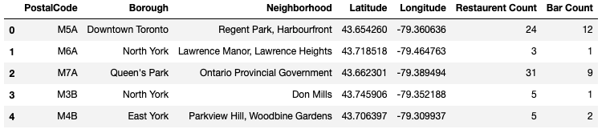
Data Understanding
For each neighborhood in Toronto, get
number of restaurant in the neighborhood
number of bars in the neighborhood

Slide 4
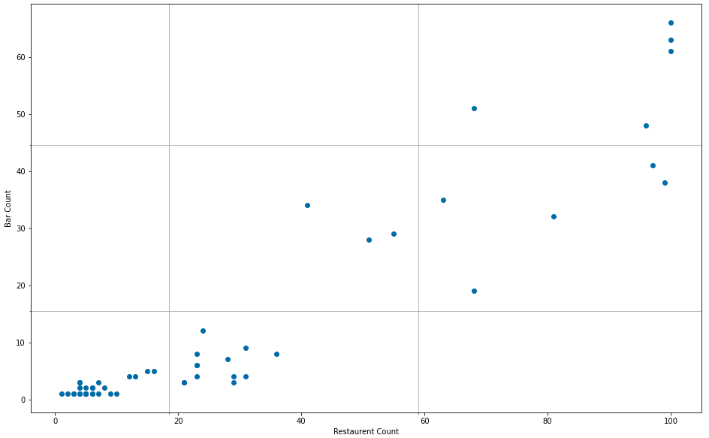
Methodology
Use k-means clustering to identify neighborhoods with ’high’, ‘medium’ and ‘low’ number of restaurants
Do the same for the number of bars

Slide 5
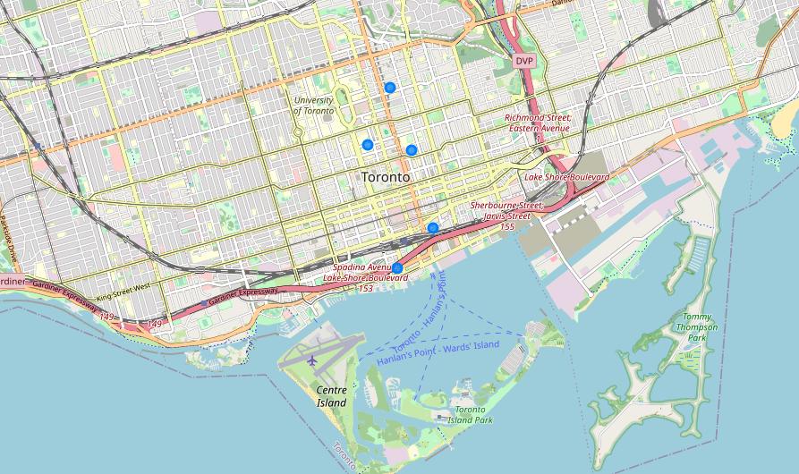
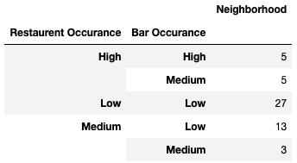
Results and Discussion
There are 5 neighborhoods with a ‘high’ number of restaurants but only a ‘medium’ number of bars
These are ideal locations for the new bar

