Slide 1

Very Brief Background on RDBMSs, Big Data/NoSQL Systems, Machine Learning
AnHai Doan
Notes:
Let me start this talk by telling you how I got to social media. For that, I need to go back to the year 2001.

Slide 2
Database Management Systems
At the start, people mixed data and code
Soon recognized that many apps must deal with the same amount of data, and it can be huge
So better to factor that amount of data into a separate place, to be managed separately => a DBMS
Apps then connect to that DBMS
A DBMS has several advantages
keep data in a persistent place, does not risk losing data
can be optimized for query answering
can handle multiple concurrent transactions, they do not interfere with one another
security, access control

Slide 3
Database Management Systems
The first DBMSs assumes the user know how the data is laid out on disk
When writing a query the user must figure out how to get data efficiently from disk
Example:
note: this example assumes data is in table format so keep things simple
early DBMSs do not assume data is in table format
Problems: changing data layout on disk is very hard

Slide 4
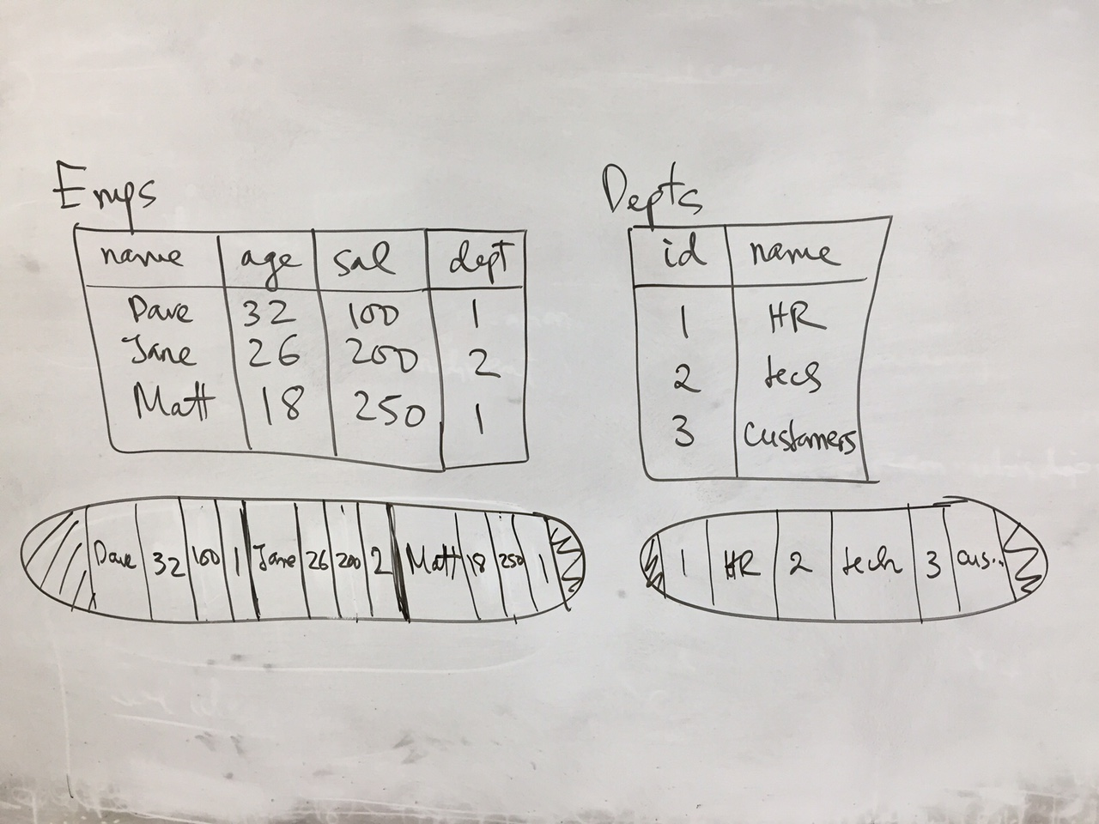
Example

Slide 5
Enter RDBMSs
data will be stored in relational tables
declarative query language
specify what the user wants
an example SQL query here
data is stored in any way the system likes
system will take the query and figure out how to answer it efficiently
cost-based query optimization
estimate the cost of each plan, then pick the one with the lowest estimated cost
well-defined notions of transactions
methods to efficiently handle concurrent transactions

Slide 6
Examples of Transactions
Matt is making too much money
Transaction one: take 50K of Matt’s salary and add that to Jane’s salary
Transaction two: compute the average salary
If not careful, these two will interfere with each other
ACID properties
atomic
consistent
isolation
durable
These properties are typically ensured using locks on the data

Slide 7
Transactional Data Management
What you have seen so far is transactional data management
A lot of transactions, many concurrent ones
Each touching just a small piece of data (read/write)
Transaction management, aka concurrency control, is vital
Focus on high throughput
Also a lot of queries, many concurrent ones
Each touching a small piece of data (just read)
How to answer a lot of them efficiently
(Each query is a transaction)
Examples: buying airline tickets, checkout at grocery stores, …
This is the typical data management paradigm up until early 90s

Slide 8
Web / Social Data Change All These
Way more data
Need to process them, not transaction centric, rather insight centric
First question: where to store them? How to query them quickly?
Problems with RDBMSs => NoSQL stores
Distributed, no longer enforce ACID properties
Second question: how to process them? This can take a very long time
Either super computer, or parallel processing on a lot of commodity PCs
=> Big Data systems
Web companies pioneer these, but soon virtually everyone has a lot of data, so everyone needs these

Slide 9
Machine Learning
Supervised learning: classification
Unsupervised learning: clustering

Slide 10
Classification
Training
Predicting
Each object is modeled using a set of feature-value pairs
Feature engineering is a serious problem
Object
(X₁,C₁)
(X₂,C₂)
...
(X_{m},C_{m})
Observed label
Classification model
(hypothesis)
Training
examples
X
labels (weighted by confidence score)
Notes:
Lets start with the base learners. As a learning program, a base learner operates in two phases. In the training phase, the base learner examines a set of training examples, where each example is a pair of object and its observed label, then constructs an internal classification model on how to assign label to objects. These models are the hypotheses that I mentioned earlier. Then in the matching phase, when given an object, the base learner will apply the classification model to make prediction for the object. The prediction will be labels weighted by confidence score.
For example, consider the Name Learner and the Naive Bayes Learner. The Name Learner matches schema elements based on their names. Thus, its training examples look like this. This example says that if a schema element has the name “location”, then it matches address, and so on. Once the Name Learner has been trained on these examples, in the matching phase, given the name “agent name”, the Name Learner may predict that the schema element with this name matches name with confidence 0.7, and matches phone with conf. 0.3.
The Naive Bayes Learner matches schema elements based on the frequencies of words and symbols in their data values. Thus, it training examples look like this. This example says that the data value “Seattle, WA” is an address, and so on. Once the NB learner has been trained on these examples, in the matching phase, given the data value “Kent, WA”, the learner may predict that it is an address with confidence 0.8, and an name with confidence 0.2.

