Slide 1
Data Understanding, Cleaning, Transforming

Slide 2
Recall the Data Science Process
Data acquisition
Data extraction (wrapper, IE)
Understand/clean/transform
Integration (resolving schema/instance conflicts)
Understand/clean/transform (again if necessary)
Further pre-processing
Modeling/understand the problem
Debug, iterate
Report, visualization

Slide 3
Other Names for This Step
exploration
visualization
summarize
profiling
pre-processing
understand
cleanse
scrub
tranform
validation
verification
data quality management, …

Slide 4
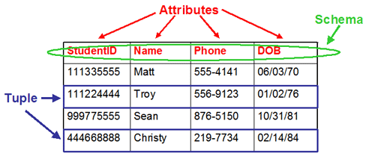
Data
Typically taken to mean schema + data instances
Ideally we should use “schema” and “data instances”
But often we will say “schema” and “data”

Slide 5
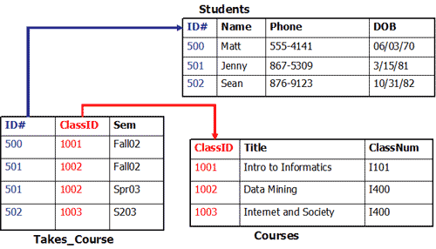
Schema Often Has Many Constraints
Key, uniqueness, functional dependencies, foreign keys

Slide 6
Data Often Has Many Constraints Too
value range, format, etc.

Slide 7
Understanding, Cleaning, & Transformation
understand what
schema/data
look like right now
understand what
schema/data should
ideally look like
identify
problems
solve
prolems
Additional transformation

Slide 8
Understand the Current Schema/Data
To understand one attribute:
  min, max, avg, histogram, amount of missing values, value range
  data type, length of values, etc.
  synonyms, formats
To understand the relationship between two attributes
  various plots
To understand 3+ attributes
Data profiling tools can help with inferring constraints
  eg keys, functional dependencies, foreign key dependencies
Other issues
  cryptic values, abbreviations, cryptic attributes

Slide 9
Understand the Ideal Schema/Data
While trying to understand the current schema/data, will gain a measure of understanding the ideal ones
May need more information
  read documents
  talk with domain experts, owners of schema/data

Slide 10
Identify the Problems
Basically clashes between the current and the ideal ones
  i.e., violations of constraints for the ideal schema/data
Schema problems
  mispelt names
  violating constraints (key, uniqueness, foreign key, etc)
Data problems
  missing values
  incorrect values, illegal values, outliers
  synonyms
  mispellings
  conflicting data (eg, age and birth year)
  wrong value formats
  variations of values
  duplicate tuples

Slide 11

Solving the Problems
Basically clashes between the current and the ideal ones
  i.e., violations of constraints for the ideal schema/data
Schema problems
  mispelt names
  violating constraints (key, uniqueness, foreign key, etc)
Data problems
  missing values
  incorrect values, illegal values, outliers
  synonyms
  mispellings
  conflicting data (eg, age and birth year)
  wrong value formats

Slide 12
Solving the Problems
Good tools exist for certain types of attributes
  names, addresses
But in general no real good generic tools out there
Much research has been done
People mostly roll their own set of tools

Slide 13
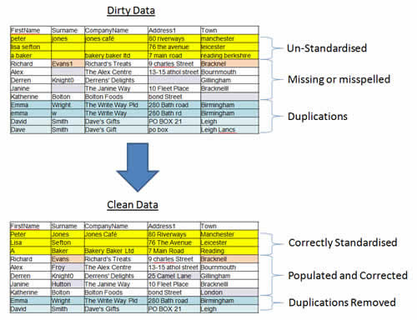
Examples

Slide 14
Examples (see Google Doc)

Slide 15
Additional Transformations
These are not to correct something wrong in schema/data per se
Not data cleaning
But rather transformations of schema/data into something better suited for our purposes
Examples
  split a field (eg full name)
  concat of multiple values/fields
  schema transformation

Slide 16
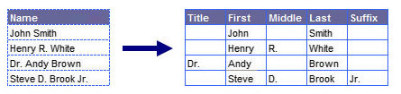
Examples

Slide 17
Do These for Each Source, then Integrate
understand what
schema/data
look like right now
understand what
schema/data should
ideally look like
identify
problems
solve
prolems
Additional transformation

Slide 18
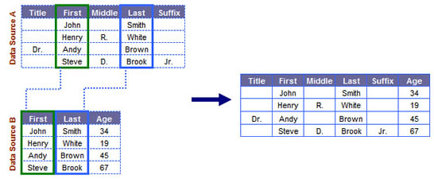
Examples

Slide 19
After Data Integration, May Have to Do Understand/Clean/Transform Again
Conflicting values (eg age)
Inconsistent formats (eg UPC)

Slide 20
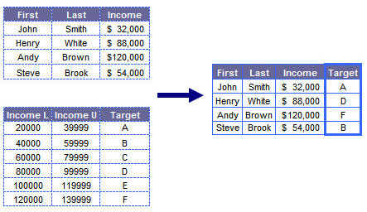
Some Other Possible Steps
Data enrichment

Slide 21
What Have We Covered So Far?
For data from each source
  understand current vs ideal schema/data
  compare the two and identify possible problems
  clean and transform
  perform additional transformations if necessary
  possibly enrich/enhance
Integrate data from the multiple sources
  schema matching, data matching
May need to do another round of understand/clean/transform (+ enrich/enhance)

Slide 22
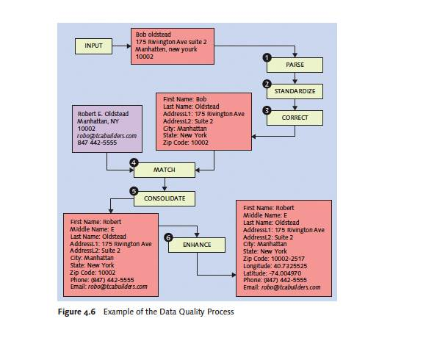

Slide 23
Further Generic Pre-Processing
Sampling
Re-scaling
Dimensionality reduction
Discretization

Slide 24
Task-Specific Pre-processing
E.g., incorrect labels

