Slide 1
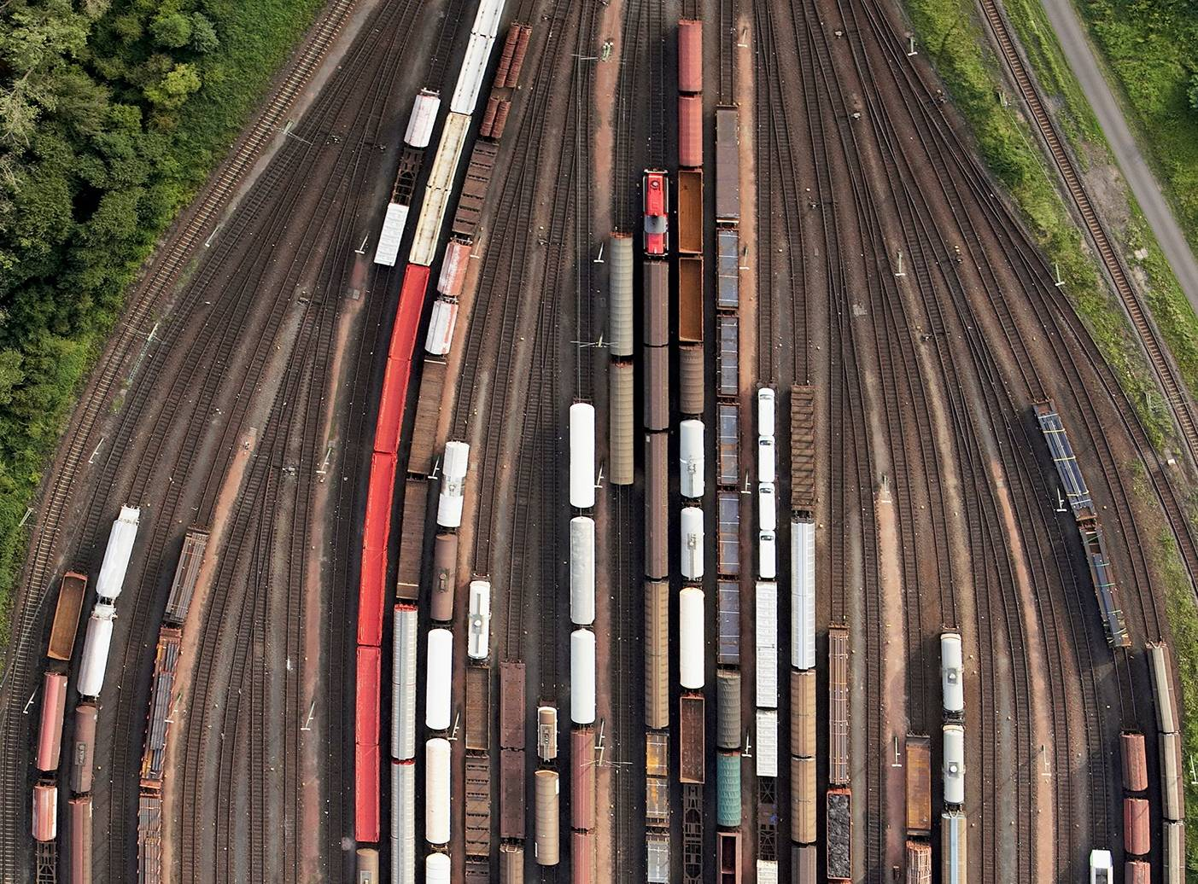



Chapter 9: Wrappers
PRINCIPLES OF
DATA INTEGRATION
ANHAI DOAN ALON HALEVY ZACHARY IVES

Slide 2
Introduction
Wrappers are components of DI systems that communicate with the data sources
  sending queries from higher levels in the system to the sources
  converting replies to a format that can be manipulated by query processor
Complexity of wrapper depends on nature of data source
  e.g., source is RDBMS, wrapper’s task is to interact with JDBC driver
  in many cases, wrapper must parse semi-structured data such as HTML pages and tranform it into a set of tuples
  we focus on this latter case

Slide 3
Outline
Problem definition
Manual wrapper construction
Learning-based wrapper construction
Wrapper learning without schema
  a.k.a., automatic approaches
Interactive wrapper construction

Slide 4
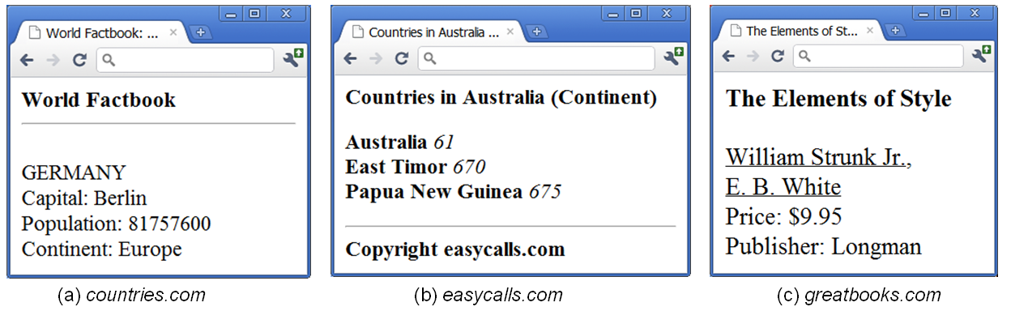
Data Sources
Consider data sources that consist of a set of Web pages
For each source S, assume each Web page displays structured data using a schema T_{S} and a format F_{S}
  these are common across all pages of the source

Slide 5
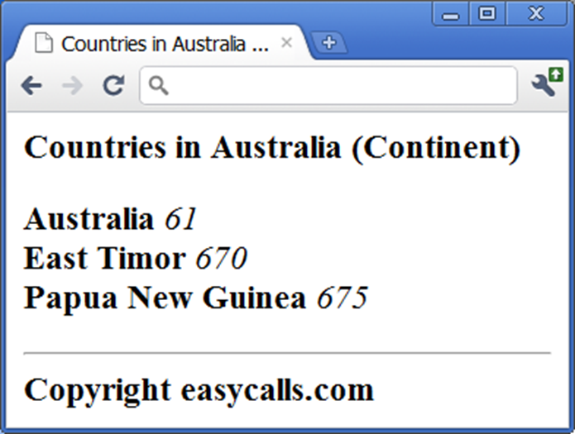
Data Sources
These kinds of pages are very common on the Web
  often created in sites that are powered by database systems
  user sends a query to the
  database system
    e.g., list all countries and calling codes
    in the continent Australia
  system produces a set of tuples
  a scripting program creates an
  HTML page that embeds the tuples ,
  using a schema T_{s} and a format F_{s}
  the HTML is sent to the user

Slide 6
Wrapper
A wrapper W extracts structured data from pages of S
Formally, W is a tuple (T_{W}, E_{W})
  T_{W} is a target schema
    this needs not be the same as the schema T_{S} used on the page, because we may want to extract only a subset of attributes of T_{S}
  E_{W} is an extraction program that uses format F_{S} to extract from each page a data instance conforming to T_{W}
    T_{W} is typically written in a script language (e.g., Perl) or in some higher-level declarative language that an execution engine can interpret

Slide 7
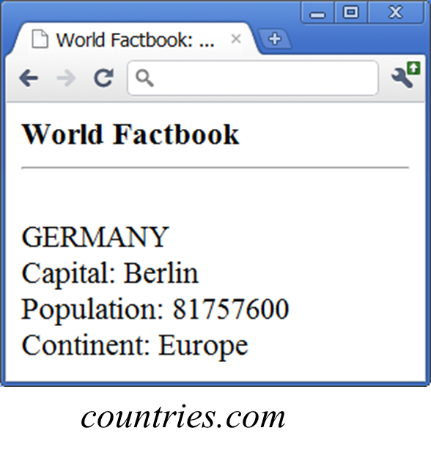
Example 1
Consider a wrapper that extracts
all attributes from pages of
countries.com
  target schema T_{W} is the source
  schema T_{S} = (country, capital,
  population, continent)
  extraction program E_{W} may be a
  Perl script that specifies that given a page P from this source
    return the first fully capitalized string as country
    return the string immediately following “Capital:” as capital
    etc.

Slide 8
Example 2
Consider a wrapper that extracts
only the first two attributes from
pages of countries.com
  target schema T_{W} is (country, capital)
  extraction program E_{W} may be a
  Perl script that specifies that given
  a page P from this source
    return the first fully capitalized string as country
    return the string immediately following “Capital:” as capital

Slide 9
The Wrapper Construction Problem
Construct (T_{W}, E_{W}) by inspecting the pages of S
  also called wrapper learning
Two main variants
  given schema T_{W}, construct extraction program E_{W}
    e.g., given T_{W} = (country, capital), construct E_{W} that extracts these two attributes from source countries.com
    manual/learning/interactive approaches address this problem
    (see later)
  no T_{W} is given, instead, construct the source schema T_{S} and take it to be the target schema T_{W}, then construct E_{W}
    e.g., given pages from source countries.com, learn their schema T_{S}, then learn E_{W} program that extracts the attributes of T_{S}
    the automatic approach addresses this problem (see later)

Slide 10
Challenges of Wrapper Construction
1. Learning source schema T_{S} is very difficult
  typically view each page of S as a string generated by a grammar G
  learn G from a set of pages of S, then use G to infer T_{S}
  e.g., pages of countries.com may be generated by
  R = <html>.+?<hr><br>(.+?)<br>Capital: (.+?)<br>Population: (.+?)<br>Continent: (.+?)</html>
  which encodes a regular grammar
  inferring a grammar from positive examples (i.e., pages of S) is well-known to be difficult
    regular grammars cannot be correctly identified from positive examples
    even with both positive and negative examples, there is no efficient algorithm to identify a reasonable grammar (i.e., one that is minimal)

Slide 11
Challenges of Wrapper Construction
1. Learning source schema T_{S} is very difficult (cont.)
  current solutions consider only relatively simple regular grammars that encode either flat or nested tuple schemas
  even learning these simple schemas has proven difficult
  typically use various heuristics to search a large space of candidate schemas
    incorrect heuristics often lead to incorrect schemas
    increasing the complexity of the schema even slightly can lead to an exponential increase in size of search space, resulting in an intractable searching process

Slide 12
Challenges of Wrapper Construction
2. Learning the extraction program E_{W} is difficult
  ideally, E_{W} should be Turing complete (e.g., as a Perl script) to have maximal expressive power, but impractical to learn such programs
  so assume E_{W} to be of a far more restricted computational model, then learn only the limited set of parameters of model
    e.g., learning to extract country and capital from pages of countries.com
    assume E_{W} is specified by a tuple (s₁, e₁, s₂, e₂): E_{W} always extract the first string between s₁ and e₁ as country, and the first string between s₂ and e₂ as capital
    so here learning E_{W} reduces to learning the above four parameters
  even just learning a limited set of parameters has proven quite difficult, for reasons similar to those of learning schema T_{S}

Slide 13
Challenges of Wrapper Construction
Coping with myriad exceptions
  there are often many exceptions in how data is laid out and formatted
    e.g., (title, author, price) in the normal cases, but
    attributes (e.g., price) may be missing,
    attribute order may be reversed (e.g., (author, title, price)), or
    attribute format may be changed (e.g., price in red font)
  when inspecting a small number of pages to create wrapper, such exceptions may not be apparent (yet)
  thus exceptions cause many problems
    invalidate assumptions on schema/data format, thus producing incorrect wrappers
    force us to revise source schema T_{S} and extraction program E_{W}, such revisions blow up the search space

Slide 14
Main Solution Approaches
Manual
  developer manually creates T_{W} and E_{W}
Learning
  developer highlights the attributes of T_{W} in a set of Web pages, then applies a learning algorithm to learn E_{W}
Automatic
  automatically learn both T_{S} and E_{W} from a set of Web pages
Interactive
  combines aspects of learning and automatic approaches
  developer provides feedback to a program until convergence

Slide 15
Outline
Problem definition
Manual wrapper construction
Learning-based wrapper construction
Wrapper learning without schema
  a.k.a., automatic approaches
Interactive wrapper construction

Slide 16

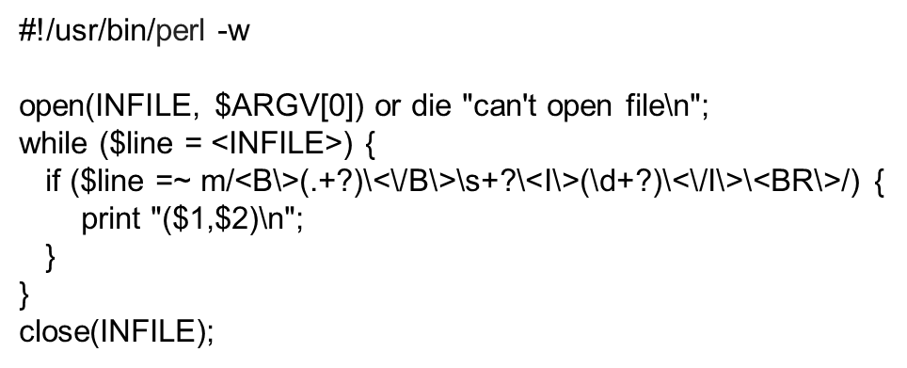
Manual Wraper Construction
Developer examines a set of Web pages
  manually creates target schema T_{W} and extraction program E_{W}
  often writes E_{W} using a procedural language such as Perl

Slide 17
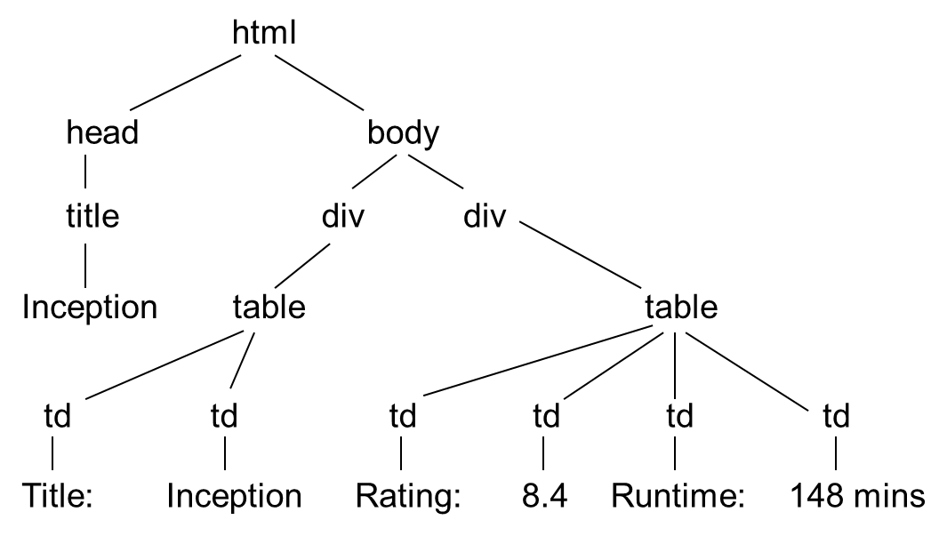
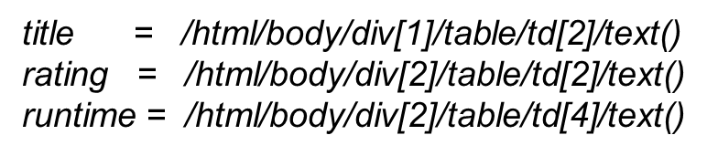
Manual Wrapper Construction
There are multiple ways to view a page
  as a string ➔ can write wrapper as Perl program
  as a DOM tree ➔ can write wrapper using XPath language
  as a visual page, consisting of blocks

Slide 18
Manual Wrapper Construction
Regardless of page model (string, DOM tree, visual, etc.), using a low-level procedural language to write E_{W} can be very laborious
High-level wrapper languages have been proposed
E.g., HLRT language
  see the next part on learning
Using high-level language often result in loss of expressiveness
But they are often easier to understand, debug, and maintain

Slide 19
Outline
Problem definition
Manual wrapper construction
Learning-based wrapper construction
Wrapper learning without schema
  a.k.a., automatic approaches
Interactive wrapper construction

Slide 20
Learning-Based Wrapper Construction
Consider more limited wrapper types (compared to the manual approach)
But can automatically learn these using training examples
Providing such examples typically involve marking up Web pages
  can be done by technically naïve users
  often requires far less work than manually writing wrappers
We explain learning approaches using two wrapper types
  HLRT
  Stalker

Slide 21

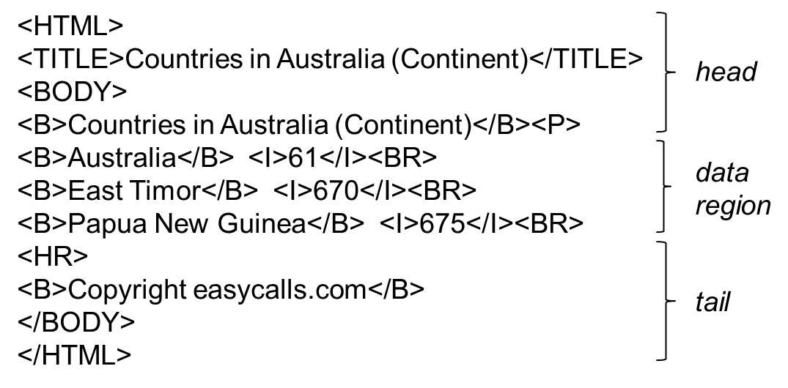
HLRT Wrappers
Use string delimiters to specify how to extract tuples
To extract (country, code), an HLRT wrapper can
  chop off the head using <P>, chop off the tail using <HR>
  extract strings between <B> and </B> in the data region as countries, and between <I> and </I> as codes

Slide 22
HLRT Wrappers
Thus, HLRT = Head-Left-Right-Tail
Above wrapper can be represented as tuple
(<P>, <HR>, <B>, </B>, <I>, </I>)
Formally, an HLRT wrapper that extracts n attributes is a tuple of (2n + 2) strings (h, t, l₁, r₁, …, l_{n}, r_{n})

Slide 23
Learning HLRT Wrappers
Suppose
  D wants to extract n attributes a₁, …, a_{n} from source S
  after examining pages of S, D has established that an HLRT wrapper W = (h, t, l₁, r₁, …, l_{n}, r_{n}) will do the job
Our goal: learn h, t, l₁, r₁, …, l_{n}, r_{n}
  to do this, label a set of pages T = {p₁, …, p_{m}}
    i.e., identifying in p_i the start and end positions of all values of attributes a₁, …, a_{n}, typically done using a GUI
  feed the labeled pages p₁, …, p_{m} into a learning module
  learning module produces h, t, l₁, r₁, …, l_{n}, r_{n}

Slide 24
Example of a Learning Module for HLRT
A simple module systematically searches the space of all possible HLRT wrappers
1. Find all possible values for h
  let x_{i} be the string from the beginning of page p_{i} (a labeled page) until the first occurrence of the very first attribute a₁
  then x₁, …, x_{m} contains the correct h
  thus, take the set of all common substrings of x₁, …, x_{m} to be candidate values for h
2. Find all possible values for t:
  similar to the case of finding all possible values for h

Slide 25
Example of a Learning Module for HLRT
3. Find all possible values for each l_{i}
  e.g., consider l₁, the left delimiter of a₁
  l₁ must be a common suffix of all strings (in labeled pages) that end right before a marked value of a₁
  can take the set of all such suffixes to be cand values for l₁
4. Find all possible values for each r_{i}
  similar to case of l_{i}, but consider prefixes instead of suffixes
5. Search in the combined space of the above values
  combine above cand values to form cand wrappers
  if a cand wrapper W correctly extracts all values of a₁, …, a_{n} from all labeled pages p₁, …, p_{m}, then return W
The notes discuss optimizing the above learning module

Slide 26
Limitations of HLRT Wrappers
HLRT wrappers are easy to understand and implement
But have limited applicability
  assume a flat tuple schema
  assume all attributes can be extracted using delimiters
In practice
  many sources use more complex schemas, e.g., nested tuples
    book is modeled as a tuple (title, authors, price), where authors is a list of tuples (first-name, last-name)
  may not be able to extract using delimiters
    extracting zip codes from “40 Colfax, Phoenix, AZ 85258”
Stalker wrappers address these issues

Slide 27
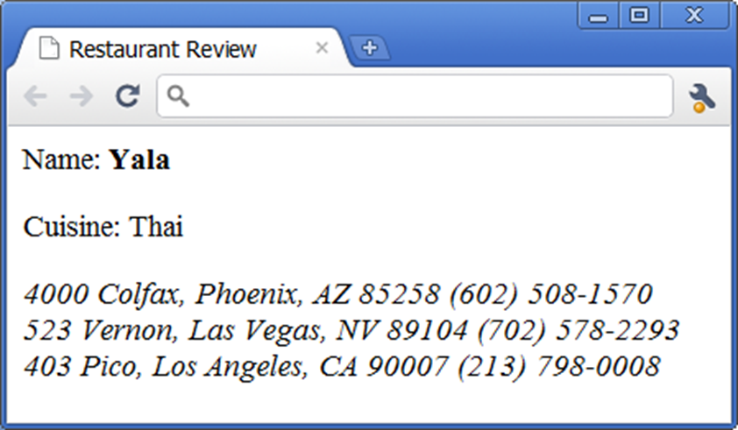
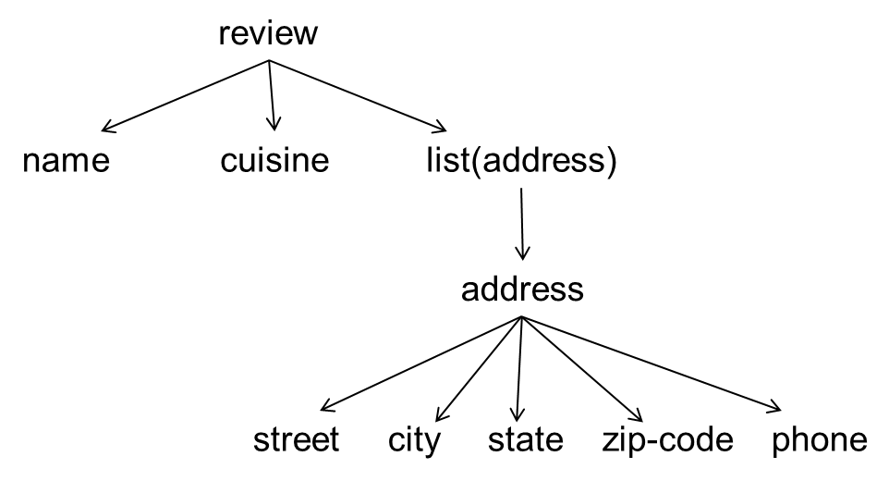
Nested Tuple Schemas
Stalker wrappers use nested tuple schemas
  here each page is a tuple (name, cuisine, addresses), where addresses is a list of tuples (street, city, state, zipcode, phone)
Nested tuple schemas are very commonly used in Web pages
  capture how many people think about the data
  convenient for visual representation

Slide 28
Nested Tuple Schemas
Definition: let N be the set of all nested tuple schemas
  the schema displaying data as a single string belongs to N
  if T₁, …, T_{n} belong to N, then the tuple schema (T₁, …, T_{n}) belongs to N
  if T belongs to N, then the list schema <T> also belongs to N
A nested tuple schema can be visualized as a tree
  leaves are strings; internal nodes are tuple or list nodes

Slide 29
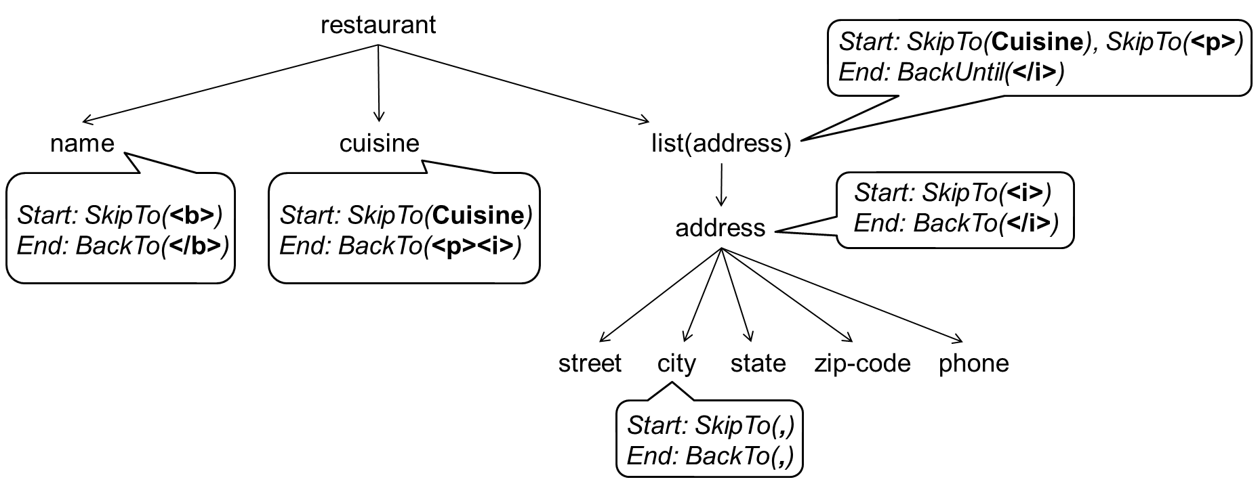
The Stalker Wrapper Model
A Stalker wrapper
  specifies a nested-tuple schema in form of a tree
  assigns to each tree node a set of rules that show how to extract values for that node

Slide 30
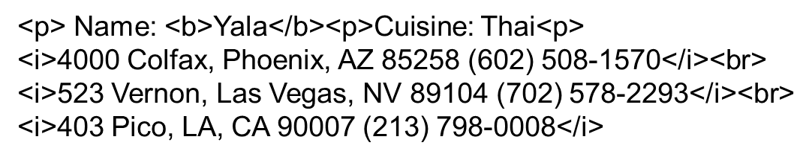
An Example of Executing the Wrapper

Slide 31
Stalker Extraction Rules
Each rule = context: sequence of commands
Context: Start, End, etc.
Sequences of commands: SkipTo(<b>)
SkipTo(Cuisine:), SkipTo(<p>)
Each command inputs a landmark
  e.g., <b>, Cuisine:, <p>, or triple (Name Punctuation HTMLTag)
A landmark = sequence of tokens and wildcards
  each wildcard refers to a class of tokens
    e.g., Punctuation, HTMLTag
  a landmark = a restricted kind of regex

Slide 32
Stalker Extraction Rules
Each rule = context:sequence of commands
Executing rule = executing commands sequentially
Executing command = consuming text until reaching a string that matches the input landmark
Stalker also considers rules that contain disjunction of sequences of commands
  Start: either SkipTo(<b>) or SkipTo(<i>)

Slide 33
Learning Stalker Wrappers
Input (of the learner):
  a nested tuple schema in form of a tree
  a set of pages where the instances of the tree nodes have been marked up
Output:
  use the marked-up pages to learn the rules for the tree nodes
  for each leaf node: learn a start rule and an end rule
  for each internal node, e.g., list(address), learn a start rule and an end rule to extract the entire list
We now illustrate the learning process by considering learning a start rule for a leaf node

Slide 34
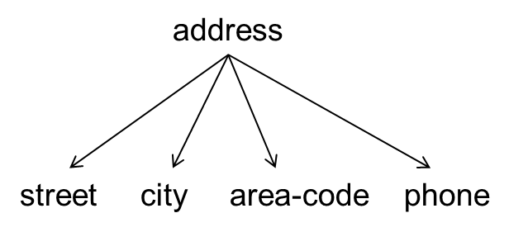
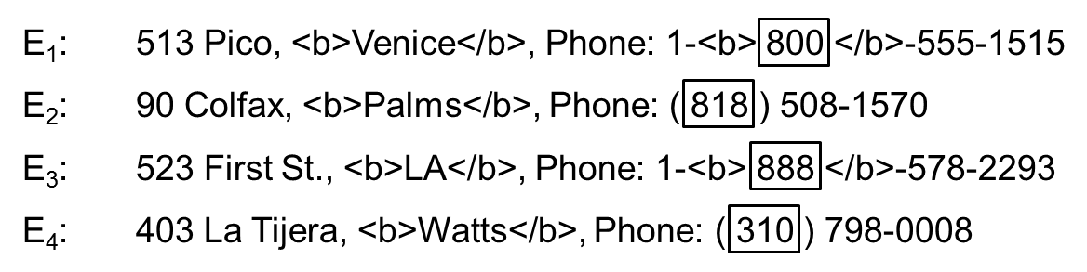
Learning a Start Rule for Area Code
Use a learning technique called sequential covering
  1st iteration: find a rule that covers a subset of training examples
    e.g., R₁ = SkipTo( ( ), which covers E₂ and E₄
  2nd iteration: find a rule that covers a subset of remaining exams
    e.g., R₇ = SkipTo(-<b>), which covers all remaining examples
  and so on, the final rule is a disjunction of all rules found so far
    e.g., Start: either SkipTo( ( ) or SkipTo(-<b>)

Slide 35
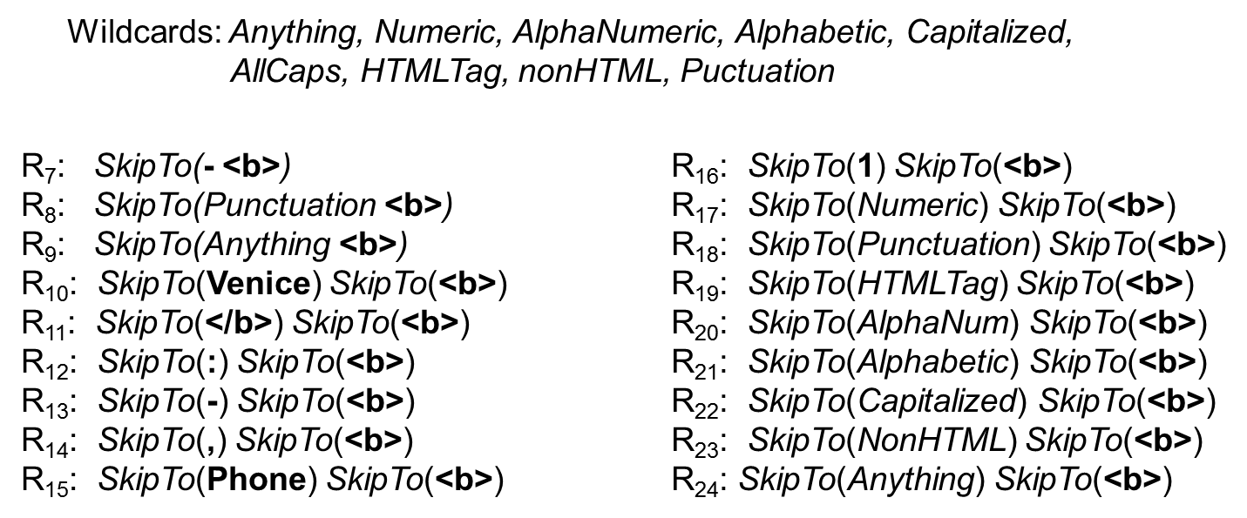
Learning a Start Rule for Area Code
Sequential covering can consider a huge number of rules
Example: consider these rules during the 2nd iteration before selecting the best rule (rule R₇):

Slide 36
Discussion
The wrapper model of Stalker subsumes that of HLRT
  nested tuple schemas are more general than flat tuple schemas
Both can be viewed as modeling finite state automata
Both illustrate how imposing structure on the target schema language makes learning practical
  structure can be simple as flat tuple schema, or more complex, as nested tuple schemas
  significantly restrict target language, and transform general learning into a far easier problem of learning a relatively small set of parameters: delimiting strings or extraction rules
Even with such restricted problem settings, learning is still very difficult: large search space, use of heuristics

Slide 37
Outline
Problem definition
Manual wrapper construction
Learning-based wrapper construction
Wrapper learning without schema
  a.k.a., automatic approaches
Interactive wrapper construction

Slide 38
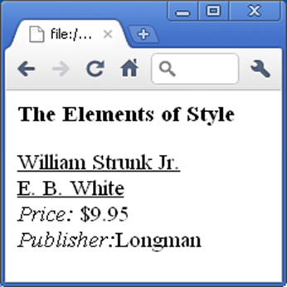
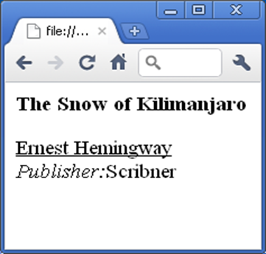

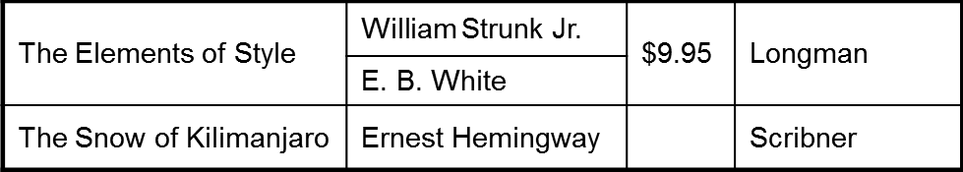
Wrapper Learning without Schema
Also called automatic approaches to wrapper learning
  input a set of Web pages of source S
  examine similarities and dissimilarities
  across pages
  automatically infer schema T_{S} of pages
  and extraction program E_{W} that extracts
  data conforming to T_{S}

Slide 39
RoadRunner:
A Representative Approach
Web pages of source S use schema T_{S} to display data
RoadRunner models T_{S} as a nested tuple schema
  allows optionals (e.g., C in AB+C?D)
  but does not allow disjunctions (would blow up run time)
  so T_{S} here is union-free regular expressions
Roadrunner models extraction program E_{W} as a regex that when evaluated on a Web page will extract attributes of T_{S}
  e.g.,
  #PCDATA are slots for values, which can’t contain HTML tags

Slide 40
Inferring Schema T_{S} and Program E_{W}
Given set of Web pages P = {p₁, …, p_{n}}, examine P to infer E_{W}, then infer T_{S} from E_{W}
To infer E_{W}, iterate
  initializing E_{W} to page p₁ (which can be viewed as a regex)
  generalize E_{W} to also match p₂, and so on
  return an E_{W} that has been generalized (minimally) to match all pages in P
Generalization step is the key, which we discuss next

Slide 41
The Generalization Step
Assume E_W has been initialized to page p_1
Now generalize to match page p_2
Tokenize pages into tokens (string or HTML tag)
Compare two pages, starting from the first token
Eventually, will likely to run into a mismatch (of tokens)
  string mismatch: “Database” vs. “Data Integration”
  tag mismatch: 2 tags, or 1 tag and 1 string
    e.g., <UL> vs. <IMG …>
  resolving a string mismatch is not too hard, resolving a tag mismatch is far more difficult

Slide 42
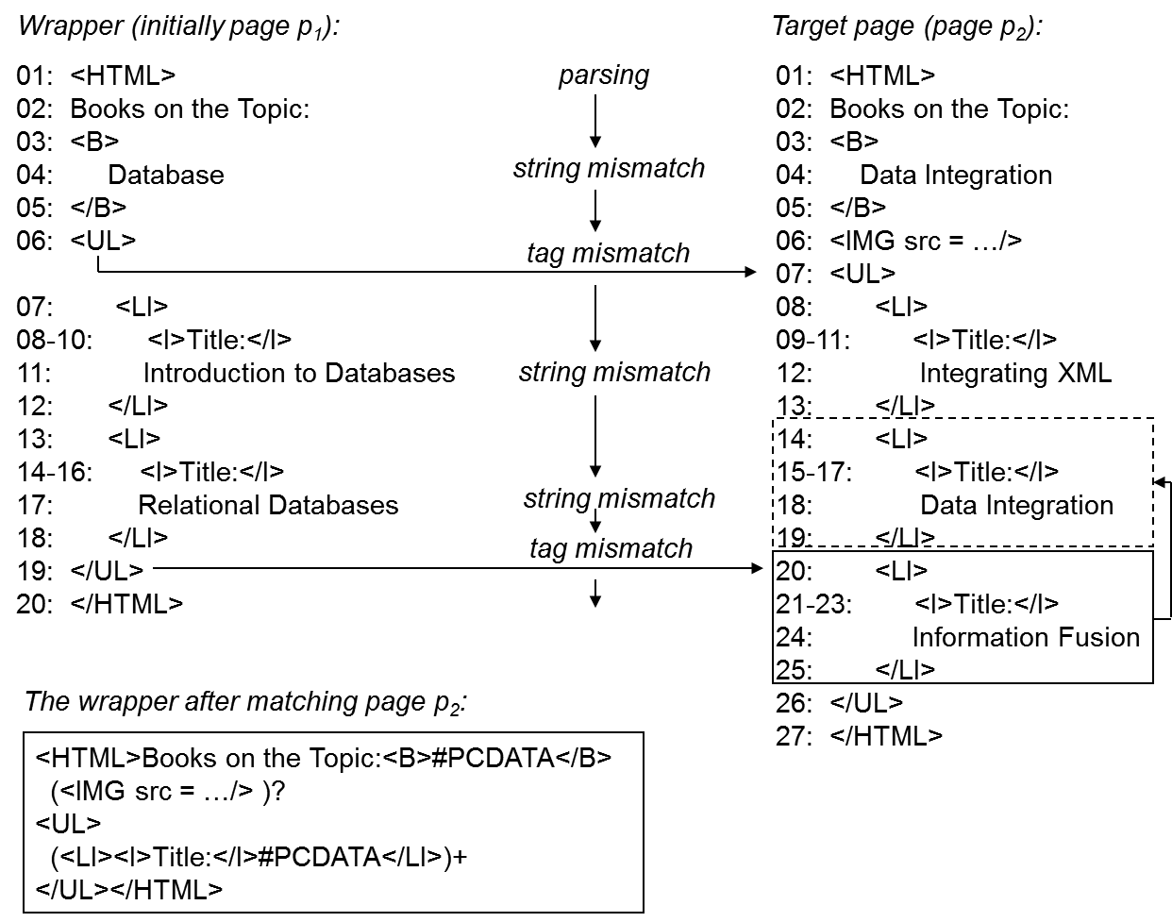

Slide 43
Handling Tag Mismatch
Due to either an iterator or an optional
  <UL> vs. <IMG src=…/> is due to an optional image on p₂
  </UL> on line 19 of p₁ vs. <LI> on line 20 of p₂ is due to an iterator (2 books in p₁ vs. 3 books in p₂)
When tag mismatch happens
  try to find if it’s due to an iterator
  if yes, generalize E_W to incorporate iterator
  otherwise generalize E_W to incorporate optional
  there is a reason why we look for iterator before looking for optional
    if we don’t do so, everything will be thought of as optional, and be generalized accordingly

Slide 44
Handling Tag Mismatch
Generalize E_{W} to incorporate an optional
  detect which page includes the optional
    in the running example, <IMG src=…/> is the optional string
  generalize E_{W} accordingly
    e.g., introducing the pattern (<IMG src=…/>)?
Generalize E_{W} to incorporate an iterator
  an iterator repeats a pattern, which we call a square
    e.g., each book description is a square
  find the squares, use them to find the lists, then generalize E_{W}

Slide 45
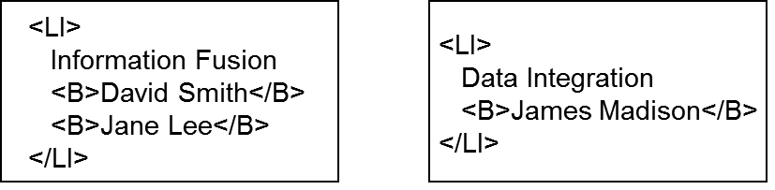
Handling Tag Mismatch
Resolving an iterator mismatch often involves recursion
  while resolving an outer mismatch, may run into an inner mismatch
  mismatches must be resolved from inside out, recursively

Slide 46
Summary
To generalize E_{W} to match a page p
  must detect and resolve all mismatches
  for each mismatch, must decide if it is a string mismatch, iterator mismatch, or optional mismatch
  for an iterator or optional mismatch, can search on either the side of E_{W} (e.g., page p₁) or the side of the target page p
    e.g., for optional mismatch, the optional can be on either E_{W} or p
  for an iterator or optional mismatch, even when we limit the search to just one side, there are often many square candidates and optional candidates to consider
  to resolve an iterator mismatch, it may be necessary to recursively resolve many inner mismatches first

Slide 47
Reducing Runtime Complexity
From summary, it is clear that the search space is vast
  multiple options at each decision point
  when dead end, must backtrack to the closest decision point and try another option
  the generalization algorithm incurs exponential time in the length of the inputs
RoadRunner uses three heuristics to reduce runtime
  limits # of options at each decision point, consider only top k
  does not allow backtracking at certain decision points
  ignores certain iterator/optional patterns judged to be highly unlikely

Slide 48
Outline
Problem definition
Manual wrapper construction
Learning-based wrapper construction
Wrapper learning without schema
  a.k.a., automatic approaches
Interactive wrapper construction

Slide 49
Motivation
Limitations of learning and automatic approaches
  use heuristics to reduce search time in huge space of cands
  such heuristics are not perfect, so approaches are brittle
    we have no idea when they produce correct wrappers
  even with heuristics, still takes way too long to search
Interactive approaches address these problems
  start with little or no use input, search until uncertainty arises
  ask user for feedback, then resume searching
  repeat until converging to a wrapper that user likes

Slide 50
Motivation
User feedback can take many forms
  label new pages, identify correct extraction result, visually create extraction rules, answer questions posed by system, identify page patterns, etc.
Key challenges
  decide when to solicit feedback
  what feedback to solicit
Will describe three representative systems
  interactive labeling of pages with Stalker
  Identifying correct extraction results with Poly
  Creating extraction rules with Lixto

Slide 51
Interactive Labeling of Pages with Stalker
Modify Stalker so that it ask user to label pages during the search process (not “before”, as discussed so far)
  asks user to label a page (or a few)
  uses this page to build an initial wrapper
  interleaves search with soliciting user feedback until finding a satisfactory wrapper
How to find which page to ask user to label next?
  maintain two candidate wrappers
  find pages on which they disagree
  ask user to label one of these problematic pages
  this is a form of active learning called co-testing

Slide 52
Detailed Algorithm
1. User labels one or several Web pages
2. Learn two wrappers
  e.g., learning to mark the start of a phone number: we can learn a forward rule as well as a backward rule
    forward rule R₁: SkipTo(Phone:<i>)
    backward rule R₂: BackTo(Fax), BackTo(()
3. Apply learned wrappers to find a problematic page
  apply them to a large set of unlabeled pages
  if they disagree in extraction results on a page ➔ problematic
4. Ask user to label a problematic page
5. Repeat Steps 2-4 until no more problematic pages

Slide 53
Identifying Correct Extraction Results with Poly
Also uses co-testing, but differs from Stalker
  maintains multiple cand wrappers instead of just two
  asks user to identify correct extraction results
  instead of using string model, uses DOM tree and visual model
1. Initialization
  assumes multiple tuples per page, assume user wants to extract a subset of these tuples
  thus, asks user to label a target tuple on a page by highlighting the attributes of the tuple
    e.g., extracting all tuples (title, price, rating) with rating 4 in Table Books
    user highlights the first tuple (a, 7, 4) in Table Books

Slide 54
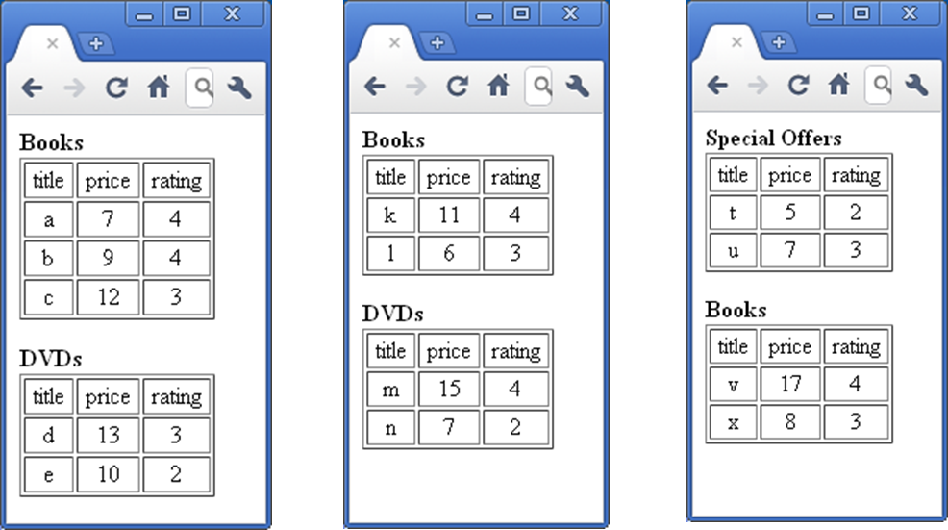
Example

Slide 55
Identifying Correct Extraction Results with Poly
2. Using the labeled tuple to generate multiple wrappers
  generate multiple wrappers, each extracts from current page a set of tuples that contain the highlighted tuple
  example wrappers
    extracts all book and DVD tuples, just book tuples, book and DVD tuples with rating 4, just book tuples with rating 4, the first tuple of all tables, just the first tuple of the first table
    all of these wrappers extract the highlighted tuple (a, 7, 4)
3. Soliciting the correct extraction result
  shows user extraction result produced by cand wrappers on the page, and asks user to identify the correct result
  remove all cand wrappers that do not produce that result

Slide 56
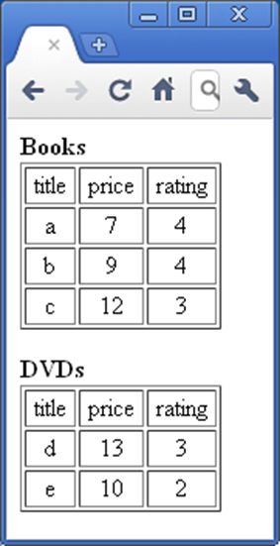
Identifying Correct Extraction Results with Poly
3. Soliciting the correct extraction result (cont.)
  example
    user wants all books with rating 4,
    so identifies the set
    {(a, 7, 4), (b, 9, 4)} as correct
    this removes several wrappers,
    still leaves those that extract all book and
    DVD tuples with rating 4, book tuples with
    rating 4, and all tuples with rating 4 from
    the first table
    all of the remaining wrappers still produce
    correct results on the highlighted page;
    this page is no longer useful

Slide 57
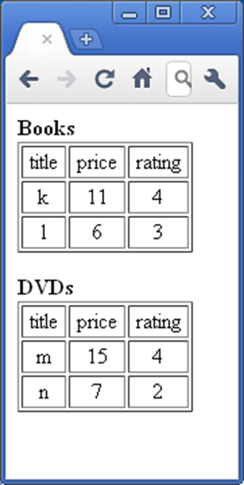
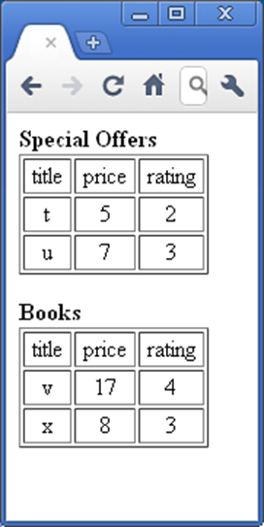
Identifying Correct Extraction Results with Poly
4. Evaluating the remaining wrappers on verification pages
  applies all remaining wrappers to a large set of unlabeled pages to see if wrappers disagree
    e.g., “extract all book and DVD tuples with
    rating 4” and “extract all book tuples with
    rating 4” disagree on the first page here
    “extract book tuples with rating 4” and
    “extract all tuples with rating 4 in
    the first table” disagree on the second page
  if finds a disagreement on a page q, repeat
  Steps 3-4: asks user to select the correct
  result on q, etc.
5. Return all cand wrappers when they no longer disagree on unlabeled pages

Slide 58
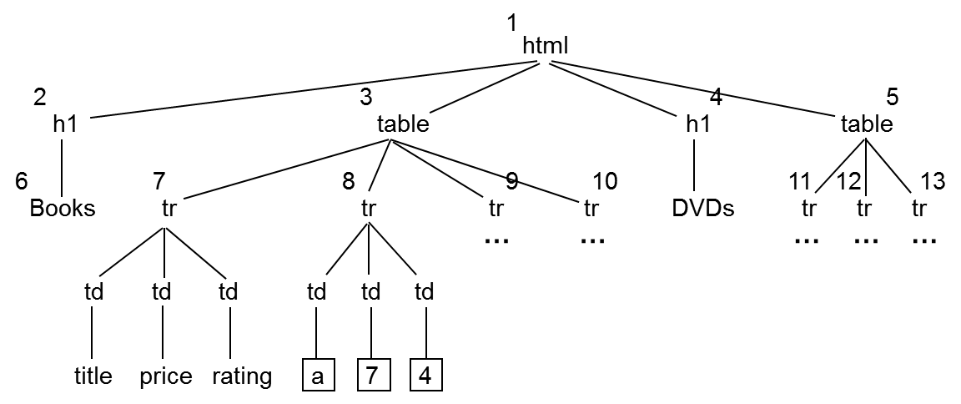
Generating the Wrappers in Poly
Convert page into a DOM tree
Identifies nodes that map to highlighted attributes
Create XPath-like expressions from root to these nodes
See notes for details

Slide 59
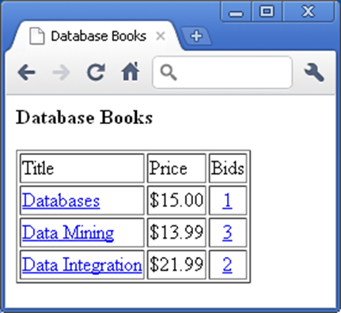
Creating Extraction Rules with Lixto
Lixto vs. Poly and Stalker
  user visually create extraction rules using highlighting and dialog boxes
    instead of labeling pages or identifying extraction results
  encodes extraction rules internally using a Datalog-like language, defined over DOM tree and string models of pages
Creating the extraction rules visually
  Web page lists books being auctioned
  user can create 4 rules
    Rule 1 extracts books themselves
    Rules 2-4 extract title/price/# of bids
    of each book, respectively

Slide 60
Creating the Extraction Rules with Lixto
To create Rule 1, which extracts books
  user highlights a book tuple
    e.g., the first one “Databases”
  Lixto maps this tuple to corresponding
  subtree of the DOM tree of page,
  extrapolates to create Rule 1, shows
  result of Rule 1 on the page
  user accepts Rule 1
    can also refine the rule

Slide 61
Creating the Extraction Rules with Lixto
To create Rule 2, which extracts titles
  user specifies that this rule will
  extract from the book instances
  identified by Rule 1
  user highlights a title
  Lixto uses this to create a rule and
  shows user all extraction results
  of this rule
  user realizes this rule is too general
  (e.g., extracting both titles and bids), so user refines the rule using dialog boxes

Slide 62
Creating the Extraction Rules with Lixto
What can user do?
  highlighting a tuple or a value
  using dialog boxes to restrict or
  relax a rule
  write regular expressions
  refers to real-world concepts defined
  by Lixto

Slide 63
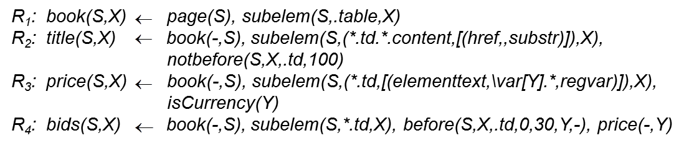
Representing the Extraction Rules
Using a Datalog-like internal language
User is not aware of this language
Example of the four rules discussed
so far

Slide 64
Summary
Critical problem in data integration
  where many sources produce HTML data
Huge amount of literature
Remains very difficult
Common approaches
  Manual wrapper construction
  Learning-based wrapper construction
  Wrapper learning without schema
    a.k.a., automatic approaches
  Interactive wrapper construction

