Slide 1
CS 121: Introduction to AI
Jean-Claude Latombe
ai.stanford.edu/~latombe
cs121.stanford.edu
Required textbook:
S. Russell and P. Norvig.
Artificial Intelligence: A Modern Approach.
3rd edition, Prentice Hall, 2010

Slide 2
Course Assistants
Jacob Quain
Nikil Viswanathan

Slide 3
Office Hours and Sections
JCL Mon at 11am-12pm in Gates 135
Jacob Quain
Nikil Viswanathan
CA section:

Slide 4
Today’s Agenda
Introduction to AI
(Russell and Norvig: Chap. 1 and 2)
Overview of CS121

Slide 5
What is AI?
an attempt of
AI is the reproduction of human reasoning and intelligent behavior by computational methods
Intelligent
behavior
Computer
Humans

Slide 6
What is AI?
(R&N)
Discipline that systematizes and automates reasoning processes to create machines that:
Act like humans | Act rationally
Think like humans | Think rationally

Slide 7
Act like humans | Act rationally
Think like humans | Think rationally
The goal of AI is to create computer systems that perform tasks regarded as requiring intelligence when done by humans
→ AI Methodology: Take a task at which people are better, e.g.:
  Prove a theorem
  Play chess
  Plan a surgical operation
  Diagnose a disease
  Navigate in a building
and build a computer system that does it automatically
But do we want to duplicate human imperfections?

Slide 8
Act like humans | Act rationally
Think like humans | Think rationally
Here, how the computer performs tasks does matter
The reasoning steps are important
→ Ability to create and manipulate symbolic knowledge (definitions, concepts, theorems, …)
What is the impact of hardware on low-level reasoning, e.g., to go from signals to symbols?

Slide 9
Act like humans | Act rationally
Think like humans | Think rationally
Now, the goal is to build agents that always make the “best” decision given what is available (knowledge, time, resources)
“Best” means maximizing the expected value of a utility function
→ Connections to economics and control theory
What is the impact of self-consciousness, emotions, desires, love for music, fear of dying, etc ... on human intelligence?

Slide 10
Can Machines Act/Think Intelligently?
“If there were machines which bore a resemblance to our bodies and imitated our actions as closely as possible for all practical purposes, we should still have two very certain means of recognizing that they were not real men. The first is that they could never use words, or put together signs, as we do in order to declare our thoughts to others… Secondly, even though some machines might do some things as well as we do them, or perhaps even better, they would inevitably fail in others, which would reveal that they are acting not from understanding, …”
Discourse on the Method, by Descartes (1598-1650)

Slide 11
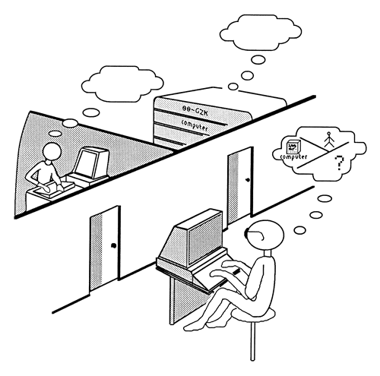
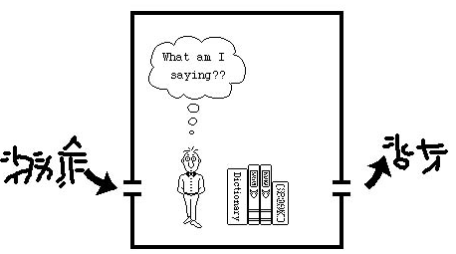
Can Machines Act/Think Intelligently?
Turing Test:
http://plato.stanford.edu/entries/turing-test/
Test proposed by Alan Turing in 1950
The computer is asked questions by a human interrogator. It passes the test if the interrogator cannot tell whether the responses come from a person
Required capabilities: natural language processing, knowledge representation, automated reasoning, learning,...
No physical interaction
Chinese Room (J. Searle)

Slide 12
An Application of the Turing Test
CAPTCHA: Completely Automatic Public Turing tests to tell Computers and Humans Apart
E.g.:
  Display visually distorted words
  Ask user to recognize these words
Example of application: have only humans open email accounts

Slide 13
Can Machines Act/Think Intelligently?
Yes, if intelligence is narrowly defined as information processing
AI has made impressive achievements showing that tasks initially assumed to require intelligence can be automated
But each success of AI seems to push further the limits of what we consider “intelligence”

Slide 14
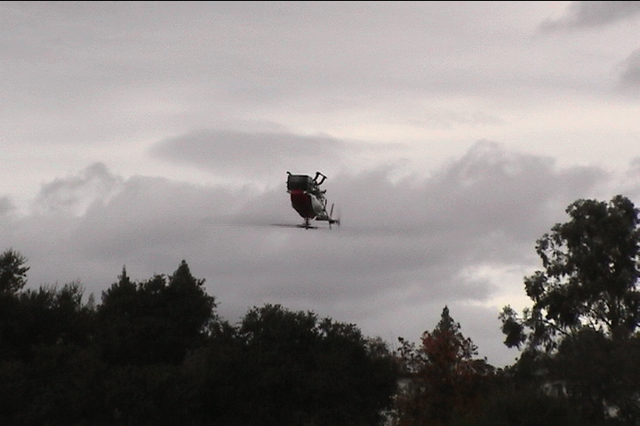
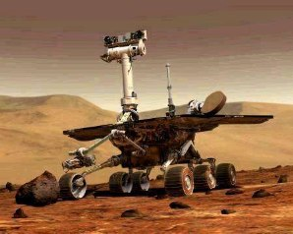
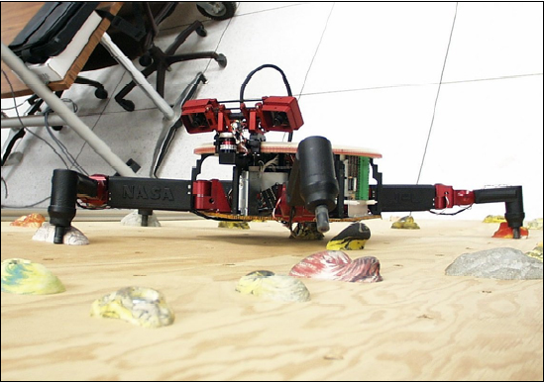
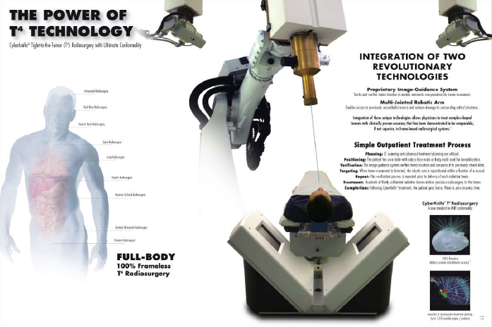
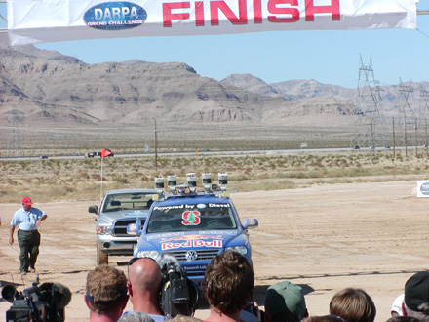
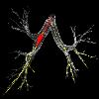
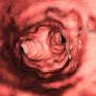
Some Achievements
Computers have won over world champions in several games, including Checkers, Othello, and Chess, but still do not do well in Go
AI techniques are used in many systems: formal calculus, video games, route planning, logistics planning, pharmaceutical drug design, medical diagnosis, hardware and software trouble-shooting, speech
recognition, traffic monitoring,
facial recognition,
medical image analysis, part
inspection, etc...
Stanford’s robotic car, Stanley, autonomously traversed 132 miles
of desert
Some industries (automobile, electronics) are highly robotized,
while other robots perform brain
and heart surgery, are rolling
on Mars, fly autonomously, …,
but home robots still remain
a thing of the future

Slide 15
Can Machines Act/Think Intelligently?
Yes, if intelligence is narrowly defined as information processing
AI has made impressive achievements showing that tasks initially assumed to require intelligence can be automated
Maybe yes, maybe not, if intelligence is not separated from the rest of “being human”

Slide 16
Some Big Open Questions
AI (especially, the “rational agent” approach) assumes that intelligent behaviors are only based on information processing? Is this a valid assumption?
If yes, can the human brain machinery solve problems that are inherently intractable for computers?
In a human being, where is the interface between “intelligence” and the rest of “human nature”, e.g.:
  How does intelligence relate to emotions felt?
  What does it mean for a human to “feel” that he/she understands something?
Is this interface critical to intelligence? Can there exist a general theory of intelligence independent of human beings? What is the role of the human body?

Slide 17
Some Big Open Questions
AI (especially, the “rational agent” approach) assumes that intelligent behaviors are based on information processing? Is this a valid assumption?
If yes, can the human brain machinery solve problems that are inherently intractable for computers?
In a human being, where is the interface between “intelligence” and the rest of “human nature”, e.g.:
  How does intelligence relate to emotions felt?
  What does it mean for a human to “feel” that he/she understands something?
Is this interface critical to intelligence? Can there exist a general theory of intelligence independent of human beings? What is the role of the human body?
In the movie I, Robot, the most impressive feature of the robots is not their ability to solve complex problems, but how they blend human-like reasoning with other key aspects of human beings (especially, self-consciousness, fear of dying, distinction between right and wrong)

Slide 18
AI contributes to building an information processing model of human beings, just as Biochemistry contributes to building a model of human beings based on bio-molecular interactions
Both try to explain how a human being operates
Both also explore ways to avoid human imperfections (in Biochemistry, by engineering new proteins and drug molecules; in AI, by designing rational reasoning methods)
Both try to produce new useful technologies
Neither explains (yet?) the true meaning of being human

Slide 19
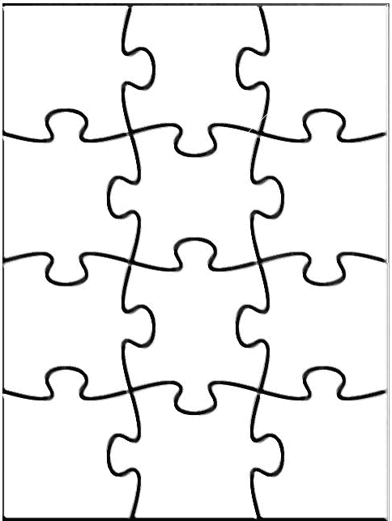
Main Areas of AI
Knowledge representation (including formal logic)
Search, especially heuristic search (puzzles, games)
Planning
Reasoning under uncertainty, including probabilistic reasoning
Learning
Agent architectures
Robotics and perception
Natural language processing
Agent
Perception
Robotics
Reasoning
Search
Learning
Knowledge
rep.
Constraint
satisfaction
Planning
Natural
language
...
Expert
Systems

Slide 20
Bits of History
1956: The name “Artificial Intelligence” is coined
60’s: Search and games, formal logic and theorem proving
70’s: Robotics, perception, knowledge representation, expert systems
80’s: More expert systems, AI becomes an industry
90’s: Rational agents, probabilistic reasoning, machine learning
00’s: Systems integrating many AI methods, machine learning, reasoning under uncertainty, robotics again

Slide 21
Schedule
Date | Topic | HW: Out | Due (Tue,) | Russell & Norvig textbook | Slides (ppt) | Slides (pdf)
1/3 | Introduction |  |  | Chap. 1 and 2 | 1 | 1
1/5 | Search problems |  |  | Chap. 3, Sections 3.1-2 | 2 | 2
1/10 | Blind Search | HW1(doc, pdf) |  | Chap. 3, Sections 3.3-4 | 3 | 3
1/12 | Heuristic search (1/3) |  |  | Chap. 3, Sections 3.5-7 | 4-5 | 4-5
1/17 | MLK Day (no class) | HW2(doc, pdf) | HW1
1/19 | Heuristic search (2/3) |  |  | Chap. 3, Sections 3.5-7 | 4-5 | 4-5
1/24 | Heuristic search (3/3) + Motion planning (1/2) | HW3(doc, pdf) | HW2 | Chap. 4, Section 4.1 | 6-7 | 6-7
1/26 | Motion planning (2/2) |  |  | Chap. 25, Section 25.4 | 6-7 | 6-7
1/31 | Action planning | HW4(doc, pdf) | HW3 | Chap. 10 | 8 | 8
2/2 | Constraint satisfaction |  |  | Chap. 6, Section 6.1 | 9 | 9
2/7 | Constraint propagation |  | HW4 | Chap. 6, Sections 6.2-5 | 10 | 10
2/9 | Introduction to uncertainty |  |  | Chap. 13, Sections 13.1-2 | 11 | 11
2/14 | Non-deterministic uncertainty | HW5(doc, pdf) |  |  | 12 | 12
2/16 | Adversarial Search |  |  | Chap. 5 | 13 | 13
2/21 | Presidents’ Day (no class) | HW6(doc, pdf) | HW5
2/23 | Deciding under probabilistic uncertainty |  |  | Chap. 16 and 17 | 14 | 14
2/28 | Bayesian nets | HW7(doc, pdf) | HW6 | Chap. 14 | 15 | 15
3/2 | Inductive learning (1/2) |  |  | Chap. 18 | 16 | 16
3/7 | Inductive learning (2/2) |  | HW7 | Chap. 18 | 17 | 17
3/9 | Course review by CAs
- Note that HWs are due on Tuesdays at noon (not on Mondays)
- Final: Wednesday March 16th at 8:30-11:30am

Slide 22
CS121 Web Site
cs121.stanford.edu
ai.stanford.edu/~latombe/cs121/2011/home.htm
(homeworks, exam, grading)
Required textbook:
S. Russell and P. Norvig. Artificial Intelligence: A Modern Approach.

Slide 23
157
222
Logic & Automated
Reasoning
224N
224S
224U
224M
Rational Agency
and Intelligent Interaction
Natural Language Processing
+ Speech Recognition and Synthesis
227B
227
Multi-Agent
Systems
General
Game Playing
Reasoning
Methods in AI
221
121
228
226
223A
225A
225B
Structured
Probabilistic Models
Statistical Techniques
in Robotics
Intro. to Robotics + Experimental Robotics
223B
229
Intro. to
Computer Vision
Machine Learning

Slide 24
Immediate actions:
1. Browse cs121.stanford.edu
2. Register on AXESS as soon as possible

