Slide 1
Basic search techniques
Points
State spaces
• Examples
Issues in search
Depth-first and breadth-first search
Cost analysis of blind search
• The cost of breadth-first search
• The cost of depth-first search
Iterative deepening
• The cost of iterative deepening
Beam search
Iterative broadening

Slide 2
Search spaces
A problem can be represented as
• a set of states of the problem
that we are solving,
• moves between states
(operations, actions).
We distinguish
• initial states,
• final states.
A problem representation contains some initial states and some final states.
A solution is represented by a sequence of moves.

Slide 3
Search spaces (2)
A state space is usually implemented as a graph:
nodes correspond to states, edges correspond to moves (start from an initial state; perform sequences of legal moves).
A state space often is -- more simply -- a tree, but if it is not, we must be careful to avoid infinite loops during graph traversal.
A solution is found by searching the graph, that is, finding a path (such as a route between cities) or reaching a final state (such as a win in a game).

Slide 4
Search spaces (3)
Examples of problems that can be solved by search
Board games:
  Go
  Chess
  Chequers
  Othello
  ...
  Tic-Tac-Toe
Solitaires and puzzles:
  Towers of Hanoi
  15-puzzle, 8-puzzle, 3-puzzle

Slide 5
Search spaces (4)
The water-jug problem
0
0
0
3
3
0
3
3
4
2
4
3
4
3
4
3
4
3
4
3
http://lazytoad.com/lti/ai/hw1-1.html

Slide 6
Search spaces (5)
Missionaries and cannibals;
farmer, wolf, goat, cabbage.
Planning a trip (the travelling salesman problem).
Vision (scene analysis).
Proving theorems.
A representation for a game:
a tree (we never return to a previous state).
A representation for the water jug problem:
a graph with cycles (unless we impose restrictions on moves).

Slide 7
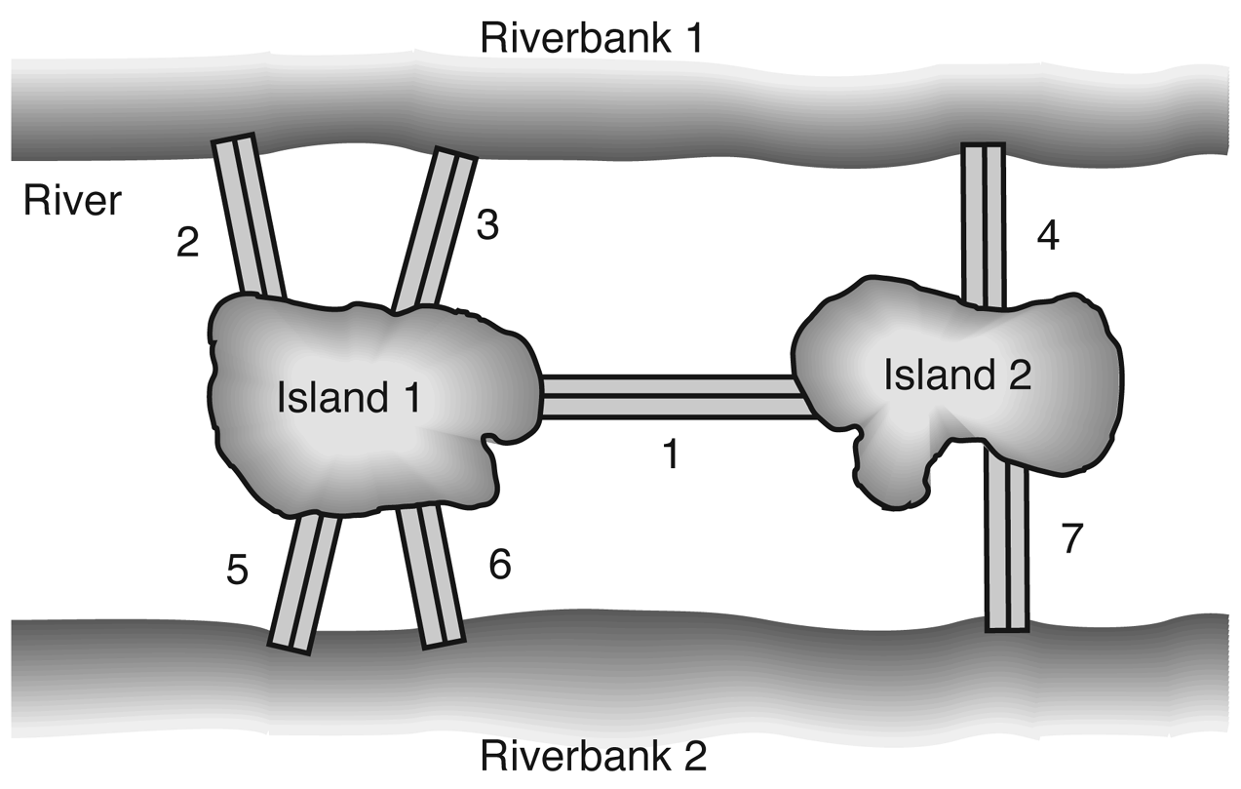
Search spaces (6)
The bridges of Königsberg

Slide 8
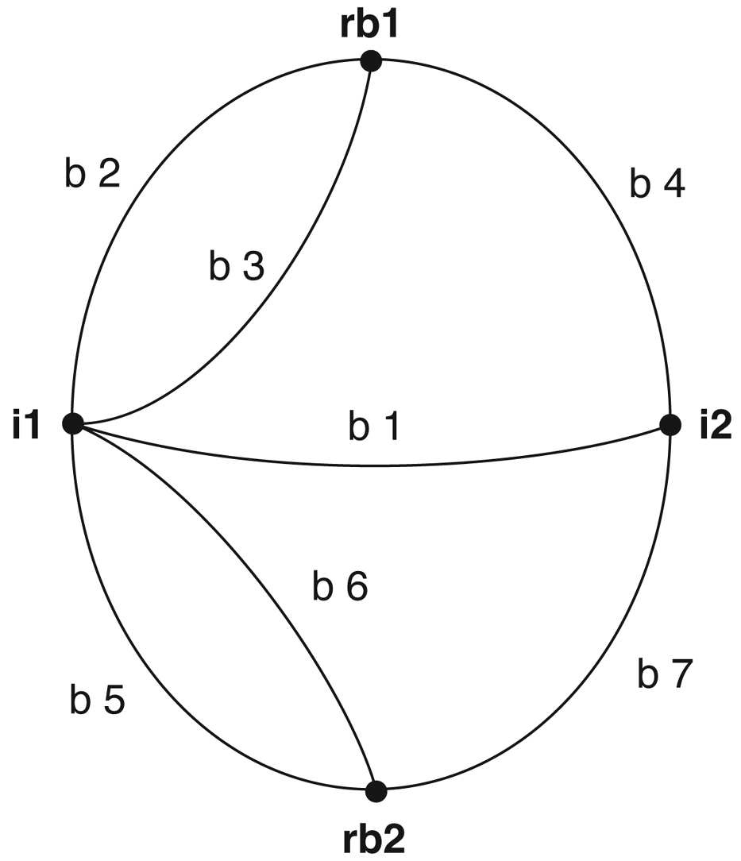
Search spaces (7)
The city of Königsberg as a graph

Slide 9
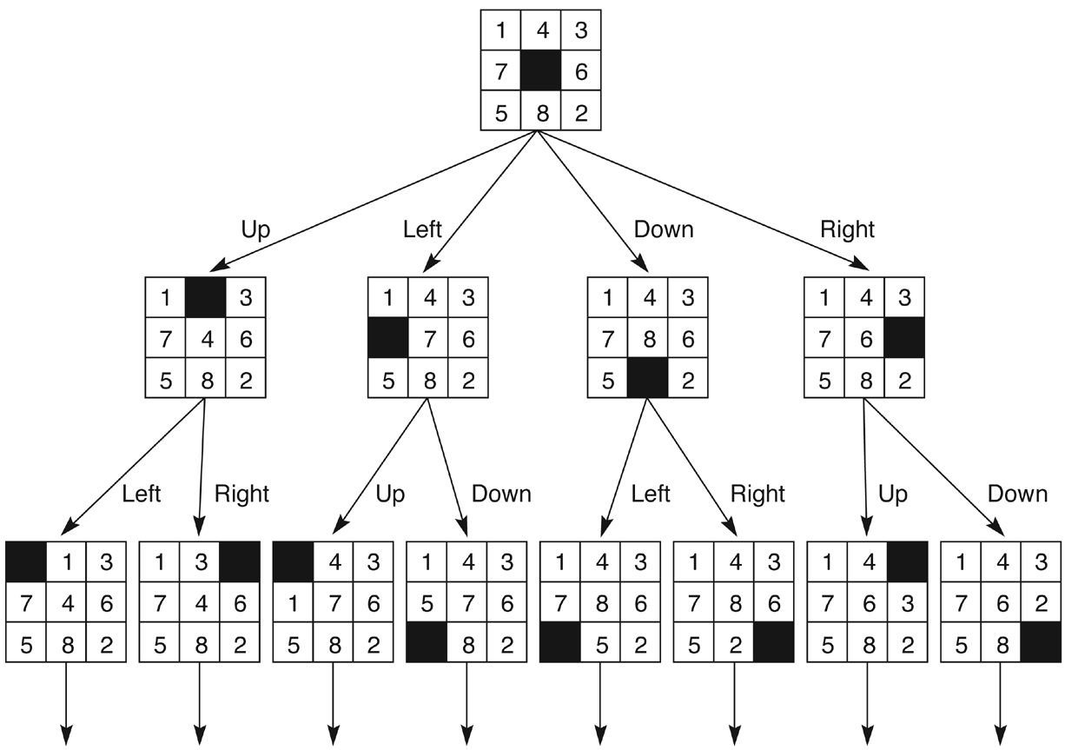
Search spaces (8)
A fragment of the 8-puzzle state space

Slide 10
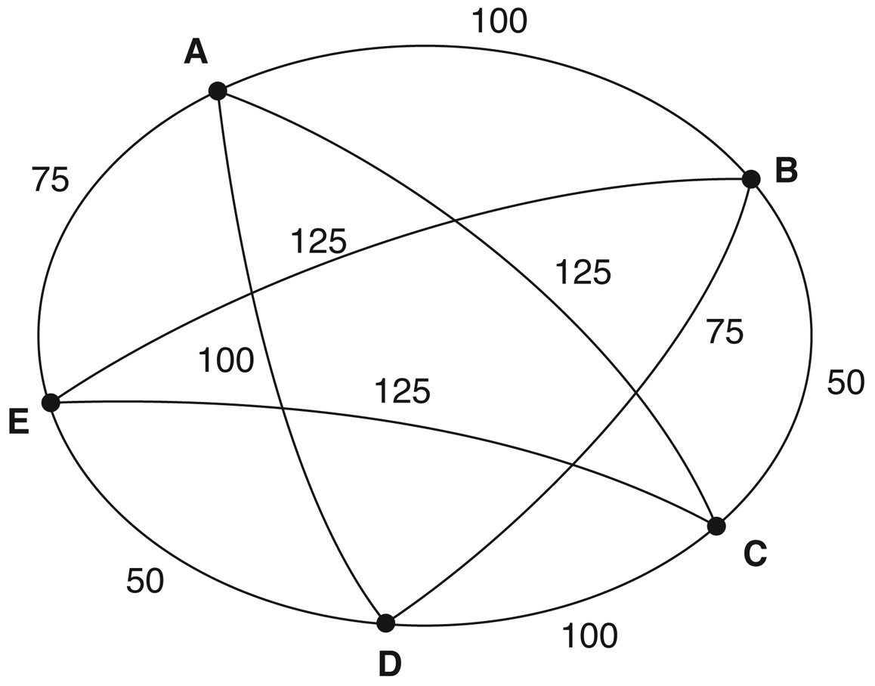
Search spaces (9)
The travelling salesman problem, an example

Slide 11
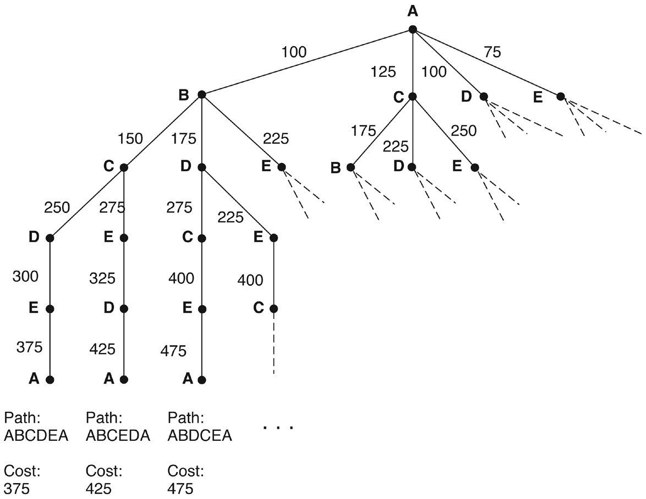
Search spaces (10)
The travelling salesman problem, a search space

Slide 12
Issues in search
The existence of a solution (no infinite loops); completeness of the search procedure.
The quality (optimality?) of a solution, quality criteria.
The cost of search in time.
The cost of search in memory.
Controlling search -- heuristics.
Some spaces are too large to be effectively searched by brute force: chequers has 10⁴⁰ game paths, chess 10¹²⁰, go 10???.

Slide 13
Issues in search (2)
We can sacrifice optimality for tractability if finding a sub-optimal solution is much less expensive, but such a solution must be practically acceptable. Examples:
the perfect response in chess versus a strong (not the strongest) move;
a water-jug problem solution with more steps than really needed;
an approximate recognition of an aerial picture.
The idea behind any heuristic search is to prune large (maybe very large!) portions of the state space, that is, never to touch most of the theoretically possible paths.

Slide 14
Issues in search (3)
Strategies for search:
data-driven, also known as "forward chaining" (e.g., diagnosis, fault detection);
goal-driven, also known as "backward chaining" (e.g., theorem proving -- from theorems to axioms; planning -- from the final state backwards).
If an oracle is available, we can have perfect search: the oracle tells us how to choose the one and only correct move.
Normally, we choose a move, remember what has been chosen, and later backtrack if the choice has turned out to be wrong.

Slide 15
Depth-first and breadth-first search
Given:
a list of open nodes (those to be examined, compared with the goal state -- a solution may be among the open nodes);
a list of closed nodes (examined and rejected).
A node is labelled by its whole path from the initial node.
Depth-first: open nodes stored on a stack.
Breadth-first: open nodes stored in a queue.

Slide 16
Depth-first and breadth-first search (2)
The algorithm
put the initial node(s) on the open list [stack or queue];
repeat
  select N, the first open node [top node on a stack, front node in a queue];
  succeed if N is a goal node; otherwise put N on the closed list and add N's children [at the top of a stack, the back of a queue];
until
  we succeed or the open list becomes empty (that is, we fail);

Slide 17
Depth-first and breadth-first search (3)
A
B
C
D
E
F
G
H
I
J
K
L
M
N
O
P
Q
R
S
T
U
V
W
X
Y
Z

Slide 18
The rough cost of blind search
The branching factor of a search space is the number of children of any node. If the branching factor is not constant -- as it is in binary or ternary trees, for example -- we need an average.
The depth of a search space is the number of moves in the longest path. It may be infinite.

Slide 19
The cost of blind search (2)
Breadth-first search
Memory: at least b^{d-1} nodes must be stored.
Time (measured in the number of nodes visited):
the pessimistic cost is (b^{d+1} - 1) / (b - 1);
the average is around b^{d}(b + 1) / 2(b - 1) for sufficiently large values of d;
for binary trees (b = 2) the cost is around 2^{d} + 2^{d-1}.

Slide 20
The cost of blind search (3)
Depth-first search
Memory: exactly d(b - 1) + 1 nodes must be stored.
Time: the pessimistic cost is the same, (b^{d+1} - 1) / (b - 1);
the average is around b^{d+1} / 2(b - 1) for large values of d;
for binary trees the cost is around 2^{d}.

Slide 21
The cost of blind search (4)
Breadth-first search is slightly more expensive. The ratio of the average costs for large d is about (b + 1) / b.
On the other hand, depth-first search does not guarantee success: there may be an infinite loop if the search space has infinite depth.

Slide 22
Iterative deepening
This is depth-first search with a mechanism to prevent looping. We allow paths of at most c moves.
The algorithm
set c, the current depth limit, to 0;
repeat
  put the initial node(s) on the open stack;
  c = c + 1;
  repeat
    select N, the top open node on the stack;
    succeed if N is a goal node; otherwise put N on the closed list and add N's children at the top of the stack;
  until
  we succeed or the open stack becomes empty;
until
  we succeed or a maximal c has been reached (we fail);

Slide 23
The cost of iterative deepening
Memory: as in depth-first, d(b - 1) + 1 nodes must be stored.
Time: we have to count d-1 failed depth-first searches plus one complete (and successful) search.
The average cost is approximately
b^{d+1}(b + 1) / 2(b - 1)² for large values of d.
The overhead of repeated failed searches is surprisingly low: the ratio of the average costs for large d is around (b + 1) / (b - 1).

Slide 24
Beam search
A variant of breadth-first search, with a limit on the number of children visited.
The algorithm
put the initial node(s) on the open queue;
select the search width w < b;
repeat
  select N, the front open node in the queue;
  succeed if N is a goal node; otherwise put N on the closed list and add the first w of N's children at the back of the queue;
until
  we succeed or the open queue becomes empty (we fail).

Slide 25
Iterative broadening
This method is to beam search what iterative deepening is to depth-first search: a "wrapper".
The algorithm
set w, the current width limit, to 0;
repeat
  put the initial node(s) on the open queue;
  w = w + 1;
  repeat
    select N, the front open node in the queue;
    succeed if N is a goal node; otherwise put N on the closed list and add the first w of N's children at the back of the queue;
  until
    we succeed or the open queue becomes empty;
until
  we succeed or some maximal w has been reached (we fail);

Slide 26
Discussion
What are the pros and what are the cons of blind search?
What are the practical limits of its applicability?
Is there any intelligence in it?
...

