Slide 1
Introduction to Artificial Intelligence
CS 271, Fall 2007
Instructor: Professor Padhraic Smyth

Slide 2
Goals of this Course
This class is a broad introduction to artificial intelligence (AI)
  AI is a very broad field with many subareas
    We will cover many of the primary concepts/ideas
    But in 10 weeks we can’t cover everything
    Other classes in AI you may want to consider:
      Belief Networks, 276
      Winter: Probabilistic Learning, 274A
      Spring: Machine Learning, 273A
  If you have taken another class (e.g., undergrad) in AI, you may want to consider waiving this class and taking a more specialized AI class (feel free to ask me about this).

Slide 3
Class Overview
Class Web page
  http://www.ics.uci.edu/~smyth/courses/cs271/
Review
  Organizational details
  Textbook
  Schedule and syllabus
  Homeworks, exams, grading
  Academic honesty

Slide 4
Academic Honesty
It is each student’s responsibility to be familiar with UCI’s current policies on academic honesty
Violations can result in getting an F in the class (or worse)
Please take the time to read the UCI academic honesty policy
  See also the class Web page
Academic dishonesty is defined as:
  Cheating
  Dishonest conduct
  Plagiarism
  Collusion
You can discuss problems verbally – otherwise, the work you hand in should be entirely your own

Slide 5
Assigned Reading
Chapter 1 in the text
Papers on Web page
  http://www.ics.uci.edu/~smyth/courses/cs271/schedule.html
  Paper by Sebastian Thrun et al on robot driving
  Slides or video by Peter Stone on autonomous agents

Slide 6
Why taking 271 could change your life…..
As we begin the new millenium
  science and technology are changing rapidly
  “old” sciences such as physics are relatively well-understood
  computers are ubiquitous
Grand Challenges in Science and Technology
  understanding the brain
    reasoning, cognition, creativity
  creating intelligent machines
    is this possible?
    what are the technical and philosophical challenges?
  arguably AI poses the most interesting challenges and questions in computer science today

Slide 7
Today’s Lecture
What is intelligence? What is artificial intelligence?
A very brief history of AI
  Modern successes: Stanley the driving robot
An AI scorecard
  How much progress has been made in different aspects of AI
AI in practice
  Successful applications
The rational agent view of AI

Slide 8
What is Intelligence?
Intelligence:
  “the capacity to learn and solve problems” (Websters dictionary)
  in particular,
    the ability to solve novel problems
    the ability to act rationally
    the ability to act like humans
Artificial Intelligence
  build and understand intelligent entities or agents
  2 main approaches: “engineering” versus “cognitive modeling”

Slide 9
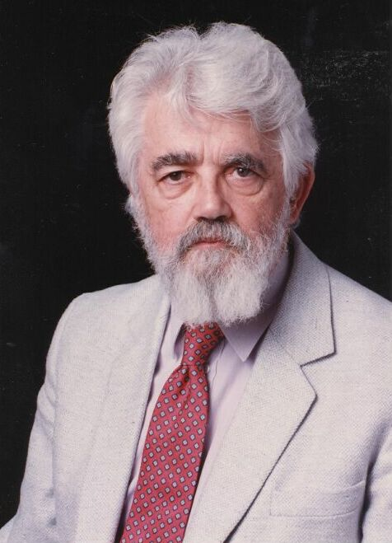
What is Artificial Intelligence?
(John McCarthy, Stanford University)
What is artificial intelligence?
It is the science and engineering of making intelligent machines, especially intelligent computer programs. It is related to the similar task of using computers to understand human intelligence, but AI does not have to confine itself to methods that are biologically observable.
Yes, but what is intelligence?
Intelligence is the computational part of the ability to achieve goals in the world. Varying kinds and degrees of intelligence occur in people, many animals and some machines.
Isn't there a solid definition of intelligence that doesn't depend on relating it to human intelligence?
Not yet. The problem is that we cannot yet characterize in general what kinds of computational procedures we want to call intelligent. We understand some of the mechanisms of intelligence and not others.
More in: http://www-formal.stanford.edu/jmc/whatisai/node1.html

Slide 10
What’s involved in Intelligence?
Ability to interact with the real world
  to perceive, understand, and act
  e.g., speech recognition and understanding and synthesis
  e.g., image understanding
  e.g., ability to take actions, have an effect
Reasoning and Planning
  modeling the external world, given input
  solving new problems, planning, and making decisions
  ability to deal with unexpected problems, uncertainties
Learning and Adaptation
  we are continuously learning and adapting
  our internal models are always being “updated”
    e.g., a baby learning to categorize and recognize animals

Slide 11
Academic Disciplines relevant to AI
Philosophy Logic, methods of reasoning, mind as physical
system, foundations of learning, language,
rationality.
Mathematics Formal representation and proof, algorithms,
computation, (un)decidability, (in)tractability
Probability/Statistics modeling uncertainty, learning from data
Economics utility, decision theory, rational economic agents
Neuroscience neurons as information processing units.
Psychology/ how do people behave, perceive, process cognitive
Cognitive Science information, represent knowledge.
Computer building fast computers
engineering
Control theory design systems that maximize an objective
function over time
Linguistics knowledge representation, grammars

Slide 12
History of AI
1943: early beginnings
  McCulloch & Pitts: Boolean circuit model of brain
1950: Turing
  Turing's "Computing Machinery and Intelligence“
1956: birth of AI
  Dartmouth meeting: "Artificial Intelligence“ name adopted
1950s: initial promise
  Early AI programs, including
  Samuel's checkers program
  Newell & Simon's Logic Theorist
1955-65: “great enthusiasm”
  Newell and Simon: GPS, general problem solver
  Gelertner: Geometry Theorem Prover
  McCarthy: invention of LISP

Slide 13
History of AI
1966—73: Reality dawns
  Realization that many AI problems are intractable
  Limitations of existing neural network methods identified
    Neural network research almost disappears
1969—85: Adding domain knowledge
  Development of knowledge-based systems
  Success of rule-based expert systems,
    E.g., DENDRAL, MYCIN
    But were brittle and did not scale well in practice
1986-- Rise of machine learning
  Neural networks return to popularity
  Major advances in machine learning algorithms and applications
1990-- Role of uncertainty
  Bayesian networks as a knowledge representation framework
1995-- AI as Science
  Integration of learning, reasoning, knowledge representation
  AI methods used in vision, language, data mining, etc

Slide 14
Success Stories
Deep Blue defeated the reigning world chess champion Garry Kasparov in 1997
AI program proved a mathematical conjecture (Robbins conjecture) unsolved for decades
During the 1991 Gulf War, US forces deployed an AI logistics planning and scheduling program that involved up to 50,000 vehicles, cargo, and people
NASA's on-board autonomous planning program controlled the scheduling of operations for a spacecraft
Proverb solves crossword puzzles better than most humans
Robot driving: DARPA grand challenge 2003-2007
2006: face recognition software available in consumer cameras

Slide 15
Example: DARPA Grand Challenge
Grand Challenge
  Cash prizes ($1 to $2 million) offered to first robots to complete a long course completely unassisted
  Stimulates research in vision, robotics, planning, machine learning, reasoning, etc
2004 Grand Challenge:
  150 mile route in Nevada desert
  Furthest any robot went was about 7 miles
  … but hardest terrain was at the beginning of the course
2005 Grand Challenge:
  132 mile race
  Narrow tunnels, winding mountain passes, etc
  Stanford 1st, CMU 2nd, both finished in about 6 hours
2007 Urban Grand Challenge
  This November in Victorville, California

Slide 16
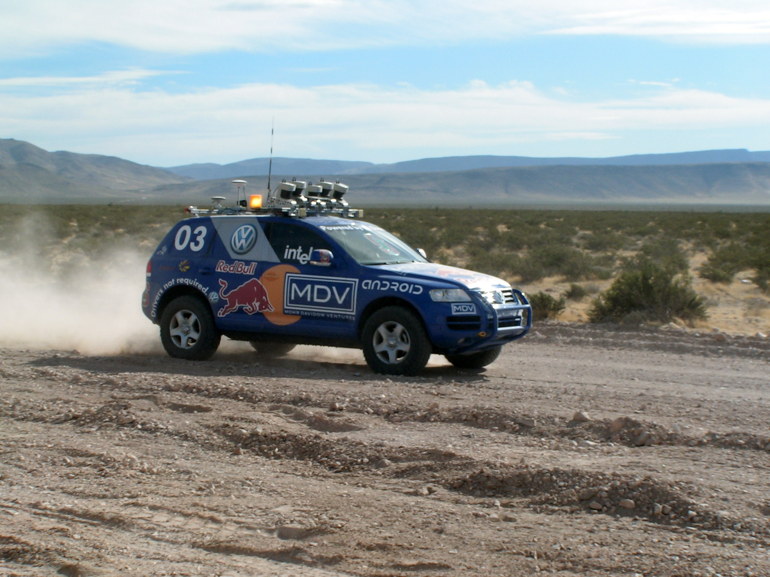
Stanley Robot
Stanford Racing Team www.stanfordracing.org
Next few slides courtesy of Prof.
Sebastian Thrun, Stanford University

Slide 17
SENSOR INTERFACE PERCEPTION PLANNING&CONTROL USER INTERFACE
RDDF database
corridor
Top level control
Touch screen UI
Laser 1 interface
pause/disable command
Wireless E-Stop
Laser 2 interface
RDDF corridor (smoothed and original)
driving mode
Laser 3 interface
Road finder
road center
Path planner
Laser 4 interface
laser map
Laser 5 interface
Laser mapper
map
trajectory
VEHICLE
INTERFACE
Camera interface
Vision mapper
vision map
Radar interface
Radar mapper
obstacle list
Steering control
vehicle state (pose, velocity)
Touareg interface
GPS position
UKF Pose estimation
vehicle
state
Throttle/brake control
Power server interface
GPS compass
vehicle state (pose, velocity)
IMU interface
Surface assessment
velocity limit
Wheel velocity
Brake/steering
heart beats
Linux processes start/stop
emergency stop
Process controller
health status
Health monitor
data
power on/off
GLOBAL
SERVICES
Data logger
File system
Communication requests
Communication channels
clocks
Inter-process communication (IPC) server
Time server

Slide 18
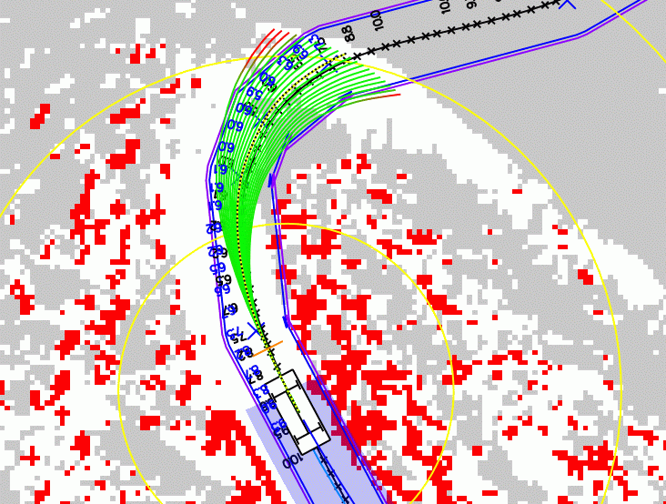
Planning = Rolling out Trajectories

Slide 19
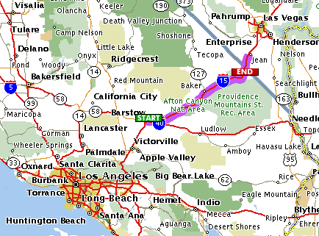





2004: Barstow, CA, to Primm, NV
150 mile off-road robot race across the Mojave desert
Natural and manmade hazards
No driver, no remote control
No dynamic passing
Fastest vehicle wins the race (and 2 million dollar prize)

Slide 20
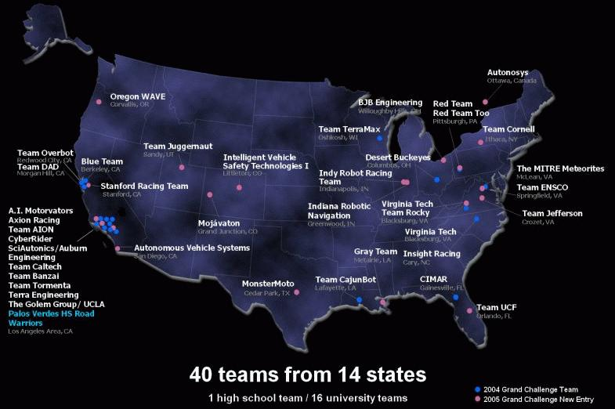
2005 Semi-Finalists: 43 Teams

Slide 21

The Grand Challenge Race

Slide 22
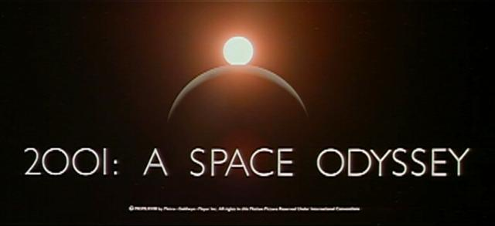
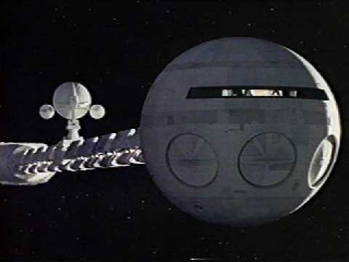
HAL: from the movie 2001
2001: A Space Odyssey
  classic science fiction movie from 1969
HAL
  part of the story centers around an intelligent computer called HAL
  HAL is the “brains” of an intelligent spaceship
  in the movie, HAL can
    speak easily with the crew
    see and understand the emotions of the crew
    navigate the ship automatically
    diagnose on-board problems
    make life-and-death decisions
    display emotions
In 1969 this was science fiction: is it still science fiction?

Slide 23
Hal and AI
HAL’s Legacy: 2001’s Computer as Dream and Reality
  MIT Press, 1997, David Stork (ed.)
  discusses
    HAL as an intelligent computer
    are the predictions for HAL realizable with AI today?
Materials online at
  http://mitpress.mit.edu/e-books/Hal/contents.html
The website contains
  full text and abstracts of chapters from the book
  links to related material and AI information
  sound and images from the film

Slide 24
Consider what might be involved in building a computer like Hal….
What are the components that might be useful?
  Fast hardware?
  Chess-playing at grandmaster level?
  Speech interaction?
    speech synthesis
    speech recognition
    speech understanding
  Image recognition and understanding ?
  Learning?
  Planning and decision-making?

Slide 25
Can we build hardware as complex as the brain?
How complicated is our brain?
  a neuron, or nerve cell, is the basic information processing unit
  estimated to be on the order of 10 ¹² neurons in a human brain
  many more synapses (10 ¹⁴) connecting these neurons
  cycle time: 10 ⁻³ seconds (1 millisecond)
How complex can we make computers?
  10⁸ or more transistors per CPU
  supercomputer: hundreds of CPUs, 10¹² bits of RAM
  cycle times: order of 10 ⁻ ⁹ seconds
Conclusion
  YES: in the near future we can have computers with as many basic processing elements as our brain, but with
    far fewer interconnections (wires or synapses) than the brain
    much faster updates than the brain
  but building hardware is very different from making a computer behave like a brain!

Slide 26
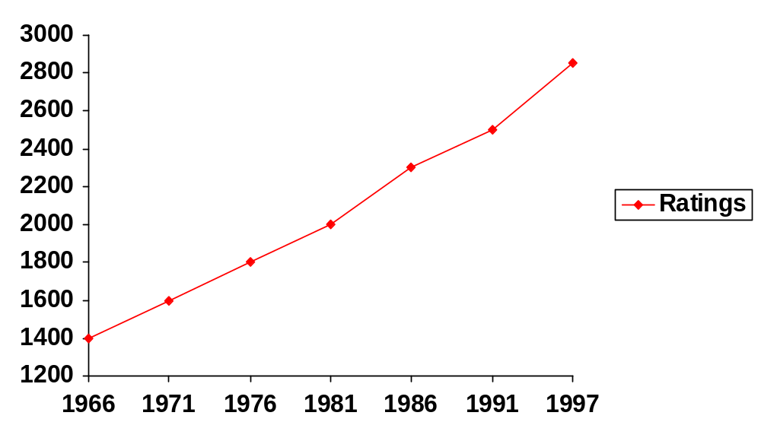
Can Computers beat Humans at Chess?
Chess Playing is a classic AI problem
  well-defined problem
  very complex: difficult for humans to play well
Conclusion:
  YES: today’s computers can beat even the best human
Deep Blue
Human World Champion
Deep Thought
Points Ratings

Slide 27
Can Computers Talk?
This is known as “speech synthesis”
  translate text to phonetic form
    e.g., “fictitious” -> fik-tish-es
  use pronunciation rules to map phonemes to actual sound
    e.g., “tish” -> sequence of basic audio sounds
Difficulties
  sounds made by this “lookup” approach sound unnatural
  sounds are not independent
    e.g., “act” and “action”
    modern systems (e.g., at AT&T) can handle this pretty well
  a harder problem is emphasis, emotion, etc
    humans understand what they are saying
    machines don’t: so they sound unnatural
Conclusion:
  NO, for complete sentences
  YES, for individual words

Slide 28
Can Computers Recognize Speech?
Speech Recognition:
  mapping sounds from a microphone into a list of words
  classic problem in AI, very difficult
    “Lets talk about how to wreck a nice beach”
    (I really said “________________________”)
Recognizing single words from a small vocabulary
    systems can do this with high accuracy (order of 99%)
    e.g., directory inquiries
      limited vocabulary (area codes, city names)
      computer tries to recognize you first, if unsuccessful hands you over to a human operator
      saves millions of dollars a year for the phone companies

Slide 29
Recognizing human speech (ctd.)
Recognizing normal speech is much more difficult
  speech is continuous: where are the boundaries between words?
    e.g., “John’s car has a flat tire”
  large vocabularies
    can be many thousands of possible words
    we can use context to help figure out what someone said
      e.g., hypothesize and test
      try telling a waiter in a restaurant:
      “I would like some dream and sugar in my coffee”
  background noise, other speakers, accents, colds, etc
  on normal speech, modern systems are only about 60-70% accurate
Conclusion:
  NO, normal speech is too complex to accurately recognize
  YES, for restricted problems (small vocabulary, single speaker)

Slide 30
Can Computers Understand speech?
Understanding is different to recognition:
  “Time flies like an arrow”
    assume the computer can recognize all the words
    how many different interpretations are there?

Slide 31
Can Computers Understand speech?
Understanding is different to recognition:
  “Time flies like an arrow”
    assume the computer can recognize all the words
    how many different interpretations are there?
      1. time passes quickly like an arrow?
      2. command: time the flies the way an arrow times the flies
      3. command: only time those flies which are like an arrow
      4. “time-flies” are fond of arrows

Slide 32
Can Computers Understand speech?
Understanding is different to recognition:
  “Time flies like an arrow”
    assume the computer can recognize all the words
    how many different interpretations are there?
      1. time passes quickly like an arrow?
      2. command: time the flies the way an arrow times the flies
      3. command: only time those flies which are like an arrow
      4. “time-flies” are fond of arrows
    only 1. makes any sense,
      but how could a computer figure this out?
      clearly humans use a lot of implicit commonsense knowledge in communication
Conclusion: NO, much of what we say is beyond the capabilities of a computer to understand at present

Slide 33
Can Computers Learn and Adapt ?
Learning and Adaptation
  consider a computer learning to drive on the freeway
  we could teach it lots of rules about what to do
  or we could let it drive and steer it back on course when it heads for the embankment
    systems like this are under development (e.g., Daimler Benz)
    e.g., RALPH at CMU
      in mid 90’s it drove 98% of the way from Pittsburgh to San Diego without any human assistance
  machine learning allows computers to learn to do things without explicit programming
  many successful applications:
    requires some “set-up”: does not mean your PC can learn to forecast the stock market or become a brain surgeon
Conclusion: YES, computers can learn and adapt, when presented with information in the appropriate way

Slide 34
Can Computers “see”?
Recognition v. Understanding (like Speech)
  Recognition and Understanding of Objects in a scene
    look around this room
    you can effortlessly recognize objects
    human brain can map 2d visual image to 3d “map”
Why is visual recognition a hard problem?
Conclusion:
  mostly NO: computers can only “see” certain types of objects under limited circumstances
  YES for certain constrained problems (e.g., face recognition)

Slide 35
Can computers plan and make optimal decisions?
Intelligence
  involves solving problems and making decisions and plans
  e.g., you want to take a holiday in Brazil
    you need to decide on dates, flights
    you need to get to the airport, etc
    involves a sequence of decisions, plans, and actions
What makes planning hard?
  the world is not predictable:
    your flight is canceled or there’s a backup on the 405
  there are a potentially huge number of details
    do you consider all flights? all dates?
      no: commonsense constrains your solutions
  AI systems are only successful in constrained planning problems
Conclusion: NO, real-world planning and decision-making is still beyond the capabilities of modern computers
  exception: very well-defined, constrained problems

Slide 36
Summary of State of AI Systems in Practice
Speech synthesis, recognition and understanding
  very useful for limited vocabulary applications
  unconstrained speech understanding is still too hard
Computer vision
  works for constrained problems (hand-written zip-codes)
  understanding real-world, natural scenes is still too hard
Learning
  adaptive systems are used in many applications: have their limits
Planning and Reasoning
  only works for constrained problems: e.g., chess
  real-world is too complex for general systems
Overall:
  many components of intelligent systems are “doable”
  there are many interesting research problems remaining

Slide 37
Intelligent Systems in Your Everyday Life
Post Office
  automatic address recognition and sorting of mail
Banks
  automatic check readers, signature verification systems
  automated loan application classification
Customer Service
  automatic voice recognition
The Web
  Identifying your age, gender, location, from your Web surfing
  Automated fraud detection
Digital Cameras
  Automated face detection and focusing
Computer Games
  Intelligent characters/agents

Slide 38
AI Applications: Machine Translation
Language problems in international business
  e.g., at a meeting of Japanese, Korean, Vietnamese and Swedish investors, no common language
  or: you are shipping your software manuals to 127 countries
  solution; hire translators to translate
  would be much cheaper if a machine could do this
How hard is automated translation
  very difficult! e.g., English to Russian
      “The spirit is willing but the flesh is weak” (English)
      “the vodka is good but the meat is rotten” (Russian)
  not only must the words be translated, but their meaning also!
  is this problem “AI-complete”?
Nonetheless....
  commercial systems can do a lot of the work very well (e.g.,restricted vocabularies in software documentation)
  algorithms which combine dictionaries, grammar models, etc.
  Recent progress using “black-box” machine learning techniques

Slide 39
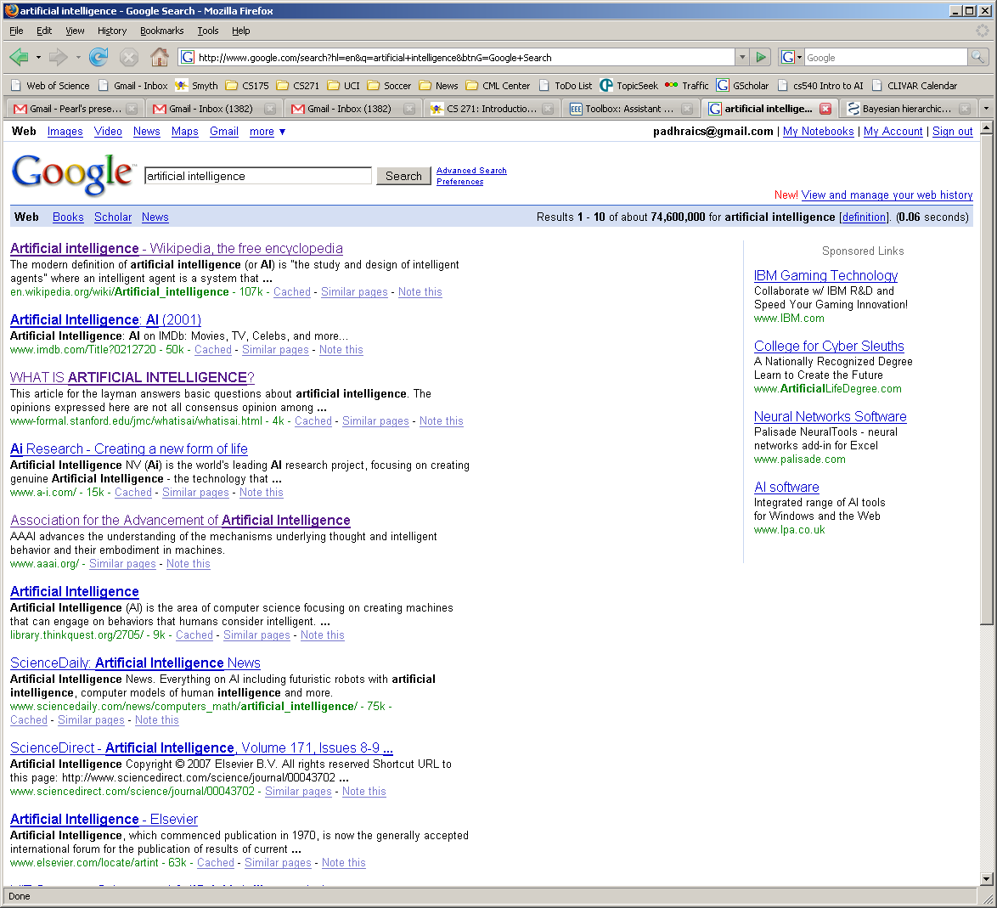
AI and Web Search

Slide 40
What’s involved in Intelligence? (again)
Perceiving, recognizing, understanding the real world
Reasoning and planning about the external world
Learning and adaptation
So what general principles should we use to achieve these goals?

Slide 41
Different Types of Artificial Intelligence
Modeling exactly how humans actually think
Modeling exactly how humans actually act
Modeling how ideal agents “should think”
Modeling how ideal agents “should act”
Modern AI focuses on the last definition
  we will also focus on this “engineering” approach
  success is judged by how well the agent performs

Slide 42

Acting humanly: Turing test
Turing (1950) "Computing machinery and intelligence“
"Can machines think?" → "Can machines behave intelligently?“
Operational test for intelligent behavior: the Imitation Game
Suggests major components required for AI:
- knowledge representation
- reasoning,
- language/image understanding,
- learning
* Question: is it important that an intelligent system act like a human?

Slide 43
Thinking humanly
Cognitive Science approach
  Try to get “inside” our minds
  E.g., conduct experiments with people to try to “reverse-engineer” how we reason, learning, remember, predict
Problems
  Humans don’t behave rationally
    e.g., insurance
  The reverse engineering is very hard to do
  The brain’s hardware is very different to a computer program

Slide 44
Thinking rationally
Represent facts about the world via logic
Use logical inference as a basis for reasoning about these facts
Can be a very useful approach to AI
  E.g., theorem-provers
Limitations
  Does not account for an agent’s uncertainty about the world
    E.g., difficult to couple to vision or speech systems
  Has no way to represent goals, costs, etc (important aspects of real-world environments)

Slide 45
Acting rationally
Decision theory/Economics
  Set of future states of the world
  Set of possible actions an agent can take
  Utility = gain to an agent for each action/state pair
  An agent acts rationally if it selects the action that maximizes its “utility”
    Or expected utility if there is uncertainty
Emphasis is on autonomous agents that behave rationally (make the best predictions, take the best actions)
  on average over time
  within computational limitations (“bounded rationality”)

Slide 46
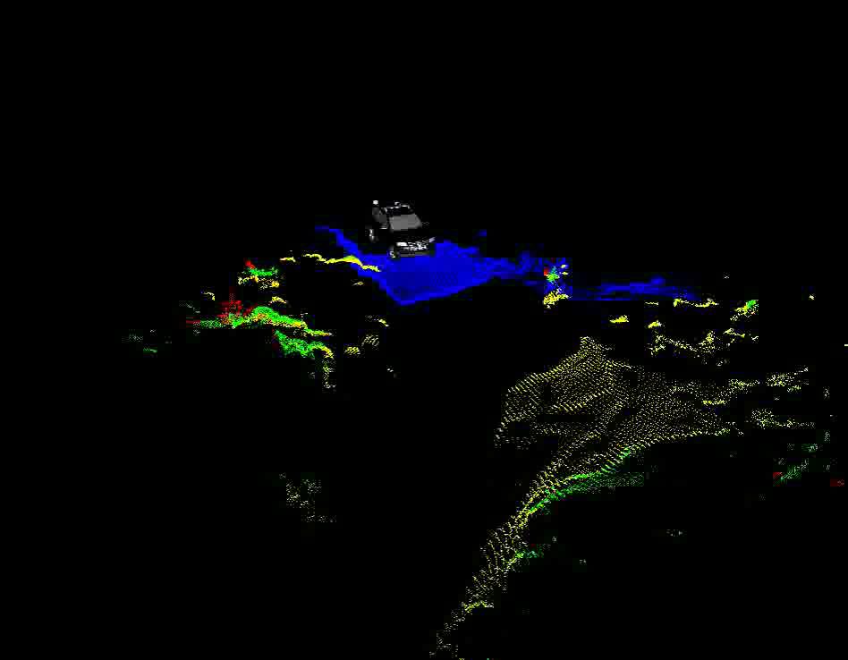

Slide 47
Summary of Today’s Lecture
Artificial Intelligence involves the study of:
  automated recognition and understanding of signals
  reasoning, planning, and decision-making
  learning and adaptation
AI has made substantial progress in
  recognition and learning
  some planning and reasoning problems
  …but many open research problems
AI Applications
  improvements in hardware and algorithms => AI applications in industry, finance, medicine, and science.
Rational agent view of AI
Reading: chapter 1 in text, Thrun paper, Stone lecture

