Slide 1

CS642: Computer Security
X86 Review
Process Layout, ISA, etc.
Drew Davidson
davidson@cs.wisc.edu

Slide 2

From Last Time
ACL-based permissions (UNIX style)
Read, Write, eXecute can be restricted on users and groups
Processes (usually) run with the permissions of the invoking user
passwd
input
write
/etc/shadow
RUID:
ace
EUID:
root

Slide 3

Processes are the front line of system security
Control a process and you get the privileges of its UID
So how do you control a process?
Send specially formed input to process
passwd
input
write
/etc/shadow
RUID:
ace
EUID:
root

Slide 4
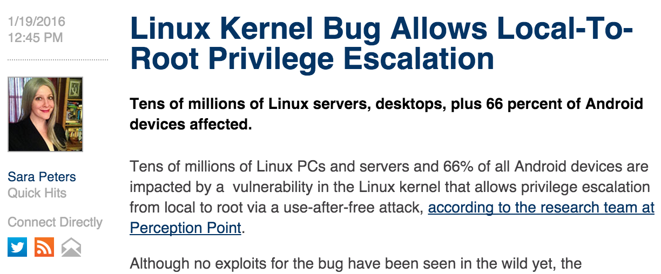
Privilege Escalation
article published
last Thursday!

Slide 5

Lecture Roadmap
Today
Enough x86 to understand (some) process vulnerabilities
Memory Layout
Some x86 instruction semantics
Tools for inspecting assembly
Next Time
How such attacks occur

Slide 6
Why do we need to look at assembly?
“WYSINWYX: What you see is not what you eXecute”
[Balakrishnan and Reps TOPLAS 2010]
Vulnerabilities exploited in this form
We understand code in this form
pushl %ebp
movl %esp, %ebp
subl $16, %esp
movl $0, -4(%ebp)
movl -4(%ebp), %eax
addl $7, %eax
leave
ret
int foo(){ int a = 0;
return a + 7;
}
Compiler

Slide 7
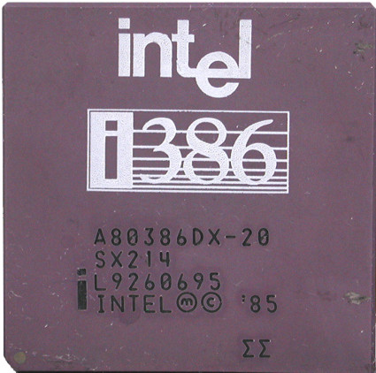
X86: The De Facto Standard
Extremely popular for desktop computers
Alternatives
ARM: popular on mobile
MIPS: very simple
Itanium: ahead of its time

Slide 8
x86: Popular but Crazy
CISC (complex instruction set computing)
Over 100 distinct opcodes in the set
Register poor
Only 8 registers of 32-bits, only 6 are general-purpose
Variable-length instructions
Built of many backwards-compatible revisions
Many security problems preventable… in hindsight

Slide 9
A Little History
Intel attempts to trademark
the number 486, gets denied
1978
1982
1985
1989
1993
1995
2003
…
Pentium
Pentium Pro
AMD makes
x86-64 (64 bit)
Intel introduces
8086 (16 bit)
80386 (32-bit)
i486 (32-bit)
80186 and 80286
“five”
Science-y?
This is not a joke.
It’s the real reason

Slide 10

Let’s Dive in To X86!
X86

Slide 11
Registers
32 bits
EAX
AX
AH
AL
EBX
BX
BH
BL
ECX
CX
CH
CL
EDX
DX
DH
DL
ESI
EDI
ESP
(stack pointer)
EBP
(base pointer)

Slide 12
Process memory layout
.text
.data
.bss
heap
Free
memory
stack
Env
Low memory
addresses
Grows downward
High memory
addresses
Grows upward
.text
Machine code of executable
.data
Global initialized variables
.bss
Below Stack Section
global uninitialized vars
heap
Dynamic variables
stack
Local variables
Function call data
Env
Environment variables
Program arguments

Slide 13
Heap and Stack Design
heap
heap
stack
Grows
upward
Free
memory
Grows
downward
stack
Low memory
addresses
High memory
addresses
Allow for more efficient use of finite free memory
Growing in opposite directions allows extra flexibility at runtime
Stack
Local variables, function bookkeeping
Heap
Dynamic memory

Slide 14
Heap and Stack use: Example
0x100 bytes
bar
7
bar
Free
memory
7
foo
main
Low memory
addresses
High memory
addresses
main():
call foo()
call bar()
foo():
f_glob = malloc(0x100)
call bar()
bar()
b_loc = 7;

Slide 15
Reminder: These are conventions
Dictated by compiler
Only instruction support by processor
Almost no structural notion of memory safety
Use of uninitialized memory
Use of freed memory
Memory leaks
So how are they actually implemented?

Slide 16
Instruction Syntax
Instruction ends with data length
opcode, src, dst
Constants preceded by $
Registers preceded by %
Indirection uses ( )
Examples:
subl $16, %ebx
movl (%eax), %ebx

Slide 17
Register Instructions: sub
registers
%eax
%ebx
Subtract from a register value
7
9
2
memory
subl %eax, %ebx

Slide 18
Frame Instructions: push
registers
%eax
%ebp
%esp
Put a value on the stack
Pull from register
Value goes to %esp
Subtract from %esp
Example:
7
M
N
memory
pushl %eax
Frame
registers
%eax
%ebp
%esp
7
M
N-4
pushl %eax
memory
7
Frame

Slide 19
Frame Instructions: pop
registers
%eax
%ebp
%esp
Take a value from the stack
Pull from stack pointer
Value goes from %esp
Add to %esp
9
M
K
memory
popl %eax
7
Frame
registers
%eax
%ebp
%esp
7
M
K+4
memory
7
Frame

Slide 20
Control flow instructions: jmp
%eip points to the currently executing instruction (in the text section)
Has unconditional and conditional forms
Uses relative addressing
%eip
%ebp
%esp
registers
K
M
N
memory
jmp -20
Frame
%eip
%ebp
%esp
registers
K-20
M
N
memory
Frame

Slide 21
Control flow instructions: call
registers
%eip
%ebp
%esp
K
M
N
Saves the current instruction pointer to the stack
Jumps to the argument value
memory
A: call FOO
Frame
registers
%eip
%ebp
%esp
FOO
M
N-4
memory
FOO: (1st of foo)
A+2
Frame

Slide 22
Control flow instructions: ret
registers
%eip
%ebp
%esp
K
M
N
Pops the stack into the instruction pointer
memory
K: ret
A
Frame
registers
%eip
%ebp
%esp
A
M
N+4
memory
A: (caller instr)
Frame

Slide 23
Stack instructions: leave
registers
%ebp
%esp
M
N
Equivalent to
movl %ebp, %esp
popl %ebp
memory
leave
A
Stack
registers
%ebp
%esp
A
M
memory
Stack

Slide 24
Implementing a function call
10
%eax
1
esp
esp
esp
esp
esp
3
main
ebp
main eip+2
1
2
Stack
data
(main)
(foo)
ebp
ebp
main:
…
subl $8, %esp
movl $2, 4(%esp)
movl $l, (%esp)
call foo
addl $8, %esp
…
foo:
pushl %ebp
movl %esp, %ebp
subl $16, %esp
movl $3, -4(%ebp)
movl 8(%ebp), %eax
addl $9, %eax
leave
ret
eip
eip
eip
eip
eip
eip
eip
eip
eip
eip
eip
eip
eip

Slide 25
Function Calls: High level points
Locals are organized into stack frames
Callees exist at lower address than the caller
On call:
Save %eip so you can restore control
Save %ebp so you can restore data
Implementation details are largely by convention
Somewhat codified by hardware

Slide 26
Data types / Endianness
x86 is a little-endian architecture
pushl %eax
esp
esp
%eax
0xdeadbeef
0xef
0xbe
0xad
0xde
4 bytes
1
1
1
1

Slide 27
Arrays
esp
HEAP
‘D’
0x44
‘r’
0x72
‘e’
0x65
‘w’
0x77
‘\0’
0x00
caller
ebp
caller
eip+2
&in
(bar)
.text
.data
ebp
bar:
pushl %ebp
movl %esp, %ebp
subl $5, %esp
movl 8(%ebp), %eax
movl %eax, 4(%esp)
leal -5(%ebp), %eax
movl %eax, (%esp)
call strcpy
leave
ret
void bar(char * in){ char name[5];
strcpy(name, in);
}

Slide 28

Assembly Code Tools
Let’s look at some programs for observing these phenomena

Slide 29
Tools: GCC
gcc –O0 –S program.c –o program.S –m32
gcc –O0 –g program.c –o program –m32

Slide 30
Tools: GDB
gdb program
(gdb) run
(gdb) decompile foo
(gdb) quit

Slide 31
Tools: objdump
objdump –Dwrt program

Slide 32
Tools: od
od –x program

Slide 33

Memory Safety: Why and Why Not
The freedom from these shenanigans
X86 has little inbuilt notion of memory safety
Compiler or analysis can

Slide 34
Summary
Basics of x86
Process layout
ISA details
Most of the instructions that you’ll need
Introduced the concept of a buffer overflow
Some tools to play around with x86 assembly
Next time: exploiting these vulnerabilities

