Slide 1
Act Agile in web automation by using Selenium2
Act Agile
Use Selenium2

Slide 2
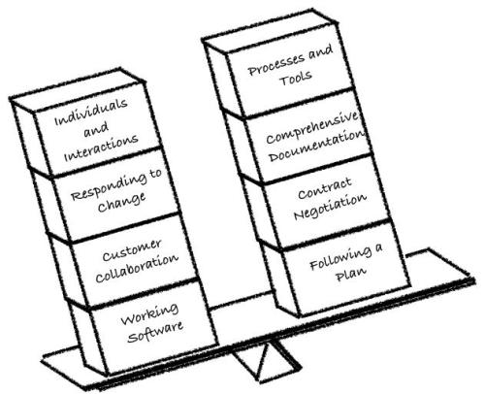
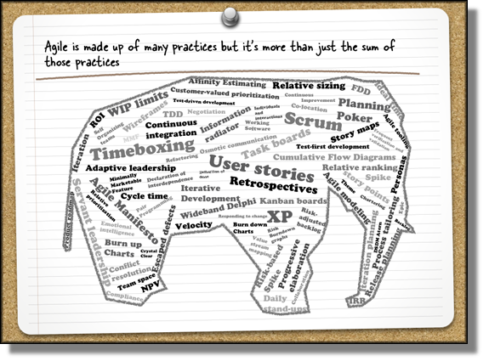
Part One: Act Agile
Hypothesis
  Automation Effort Scale
    Starting Point
      What to automate?
        Don’t automate
          Implementation Guidelines
            How to do it?
              Automated Tests Symptoms
                Benefits of using Automation

Slide 3

Hypothesis
The fact: Today, many testers are involved in agile projects. Some of them follow few or all agile principles and they are conducting a successful process.
The question: But can be an agile project successful without any automation testing?
The most appropriate answer will be: it is not impossible to succeed with no automation , but there are better chances and valuable ROI if you do.
Why is that?
Here are few reasons:
Because we don’t have enough time to manually perform all regression testing;
Because we just might get bored executing same tests over and over again and we might loose the details (less productive).
So what do we want:
to increase the quality work by doing automation (more motivated);
Free up time for most important work;
Provide quick feedback;
Tests provide documentation;

Slide 4
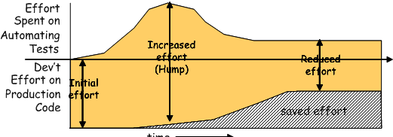
The Automation Effort Scale

