Slide 1
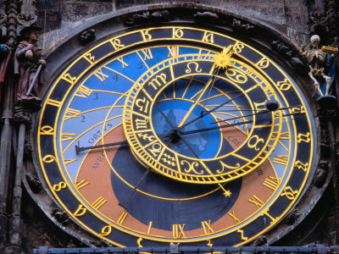
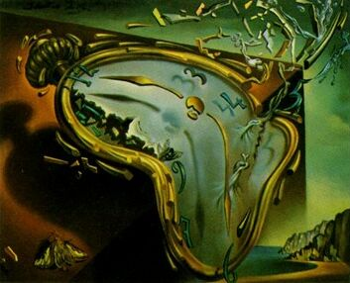
We all desire perfection but, the road to success is often misleading with self confessed Oracles.
Fantasy
Reality
Notes:
There is of course plenty of material out there in all off its various guises, unfortunately how do you filter out the good from the bad and the downright barmy ideas from the snippets of wisdom?
We all have a fantasy of how the ideal working environment should be, but how do we even try to achieve that goal. In the mean time we have to deal with all the current broken processes as best as we can. Unfortunately there is one way, ever organisation is different therefore the solutions will be different.

