Slide 1

TypeScript
Steve Michelotti
http://geekswithblogs.net/michelotti

Slide 2
Agenda
What is TypeScript?
Why TypeScript?
Demos – Intro
Demos – Real World

Slide 3
What is TypeScript?
Language for application-scale JavaScript
Superset of JavaScript (ECMAScript 5)
Includes proposed features of ECMAScript 6
Any browser, any host, any OS
Compiles to JavaScript

Slide 4


Is this CoffeeScript?
Notes:
CoffeeScript has own language syntax rules
TS is staticly typed

Slide 5

Why TypeScript?
Maintainable Code
Enables static checking
Symbol-based navigation
Statement completion
Code re-factoring

Slide 6
TypeScript Features
Tool Support
Standard JS code
Classes/Modules
Interfaces
Static Typing
Constructors
Properties
Functions
Arrow Functions =>
Intellisense
Debugging
AMD Support

Slide 7
Demo
Introduction

Slide 8
TypeScript Keywords
Keyword | Description
class | Contains members: constructor, fields, properties, methods
constructor | Initializer for a class
exports | Export a member from a module (public)
extends | Used for inheritance
implements | Implements an interface
imports | Import a module (namespace)
interface | Define code contract
module | Container for classes or any code
public/private | Member visibility

Slide 9
TypeScript Operators
Keyword | Description
=> | Function expression with lexical scoping of this (ES6 feature)
: | Separator for type specifications
… | Rest parameter syntax (similar to C# “params” keyword)
<type name> | Cast/convert between types

Slide 10
TypeScript Types
Keyword | Description
any | Any JS value (think System.Object for C# devs)
number | Corresponds to JS type. Double-precision 64-bit
boolean | Corresponds to JS type. Boolean primitive.
string | Corresponds to JS type. Sequences of characters (UTF-16)
null | Corresponds to JS null literal.
undefined | Corresponds to JS undefined literal.
object types | All class, module, interface, and literal types.
void | Return type for functions that do not return a value.

Slide 11
Demo
Real World Examples

Slide 12
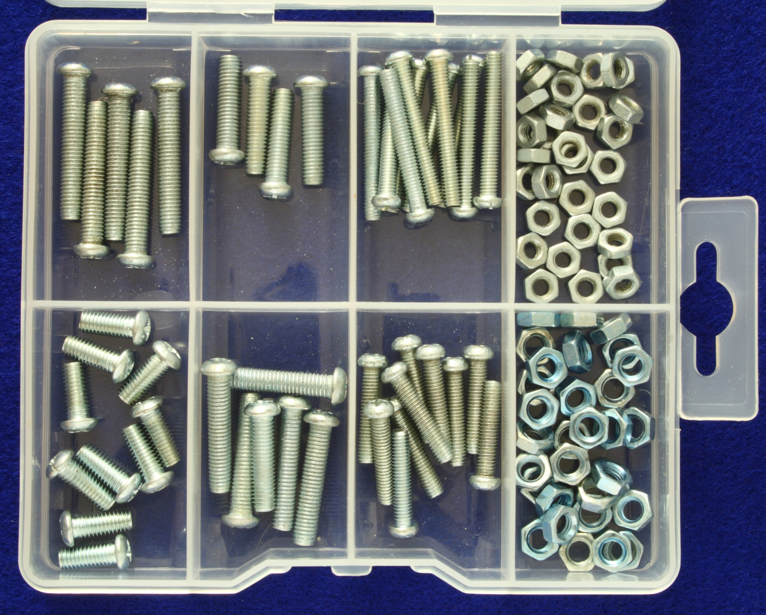
Modules
Avoid polluting the global scope!
Encapsulation
Better/easier re-use
Dependency Management
AMD Support

Slide 13
Demo
Modules

Slide 14
What we covered
Tool Support
Standard JS code
Classes/Modules
Interfaces
Static Typing
Constructors
Properties
Functions
Arrow Functions =>
Intellisense
Debugging
AMD Support

Slide 15
Additional Resources
TypeScript
http://www.typescriptlang.org
http://stackoverflow.com/questions/tagged/typescript/
Stack
Overflow

