Slide 1




WSP KBTU
Marat Boldachyov
Faculty of informational technologies

Slide 2
Digital product overview
Mobile application for KBTU students and teachers. It contains all the necessary information and simplifies the process of finding it.
The application is linked to the web version wp.kbtu.kz , having a common database and sending the SQL queries those are necessary for users. The main functionality of the application is mobility and comfort when using
The WSP KBTU application is suitable for students and the working team of the Kazakh-British Technical University. The application will also help applicants wishing to enroll in our university
The application allows you to access the necessary information that does not require downloading regardless of the Internet. All services that require dynamic network updates are disabled at this moment.

Slide 3
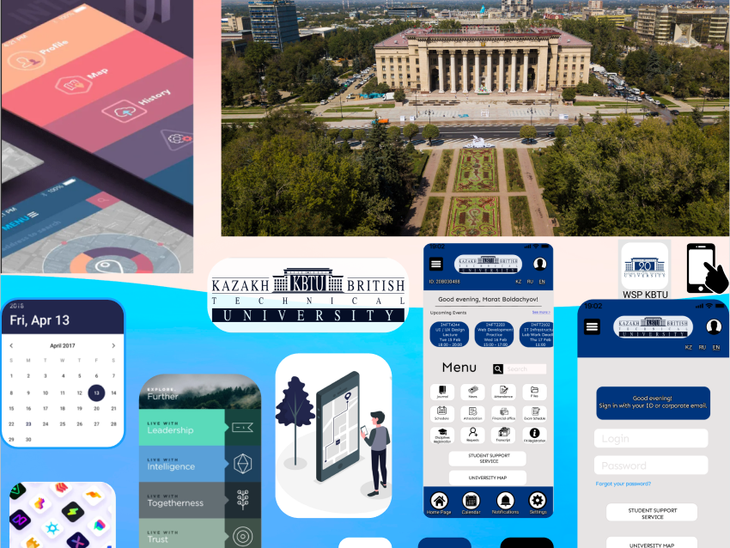
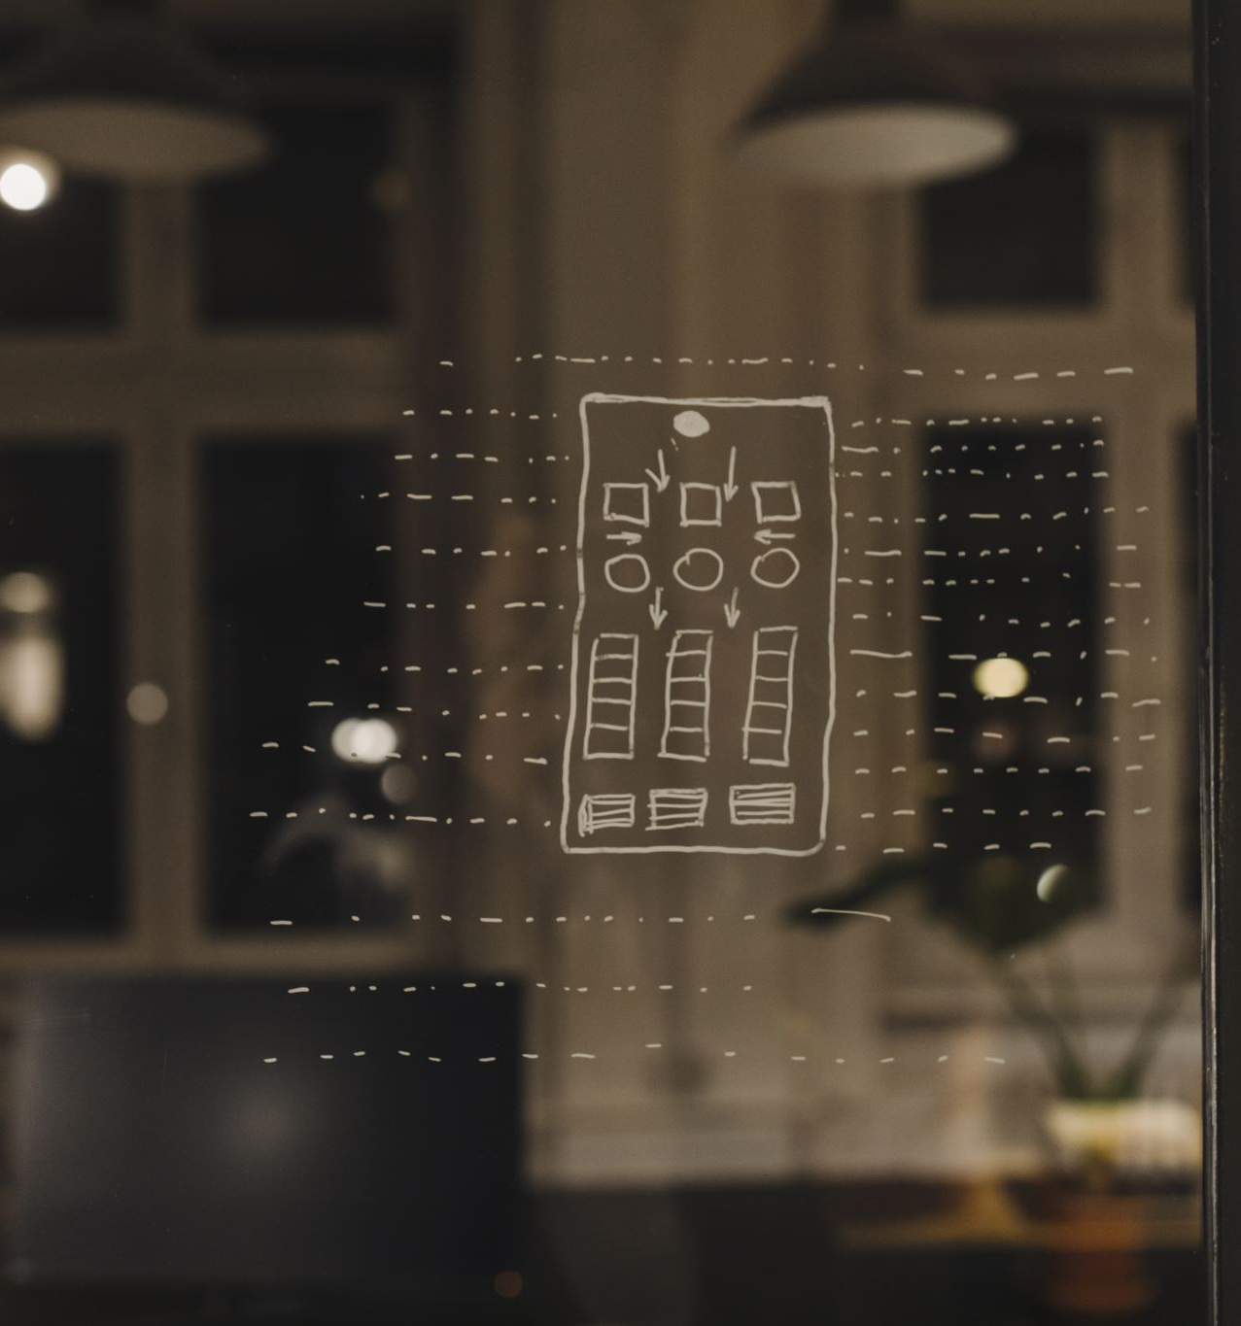
Mood board

Slide 4








Pattern library
All buttons are made for the purpose of intuitive navigation. The home button takes us to the home page, the button with the image of a person gives us the opportunity to view your profile, the calendar button gives us the opportunity to open the schedule, and so on.

Slide 5

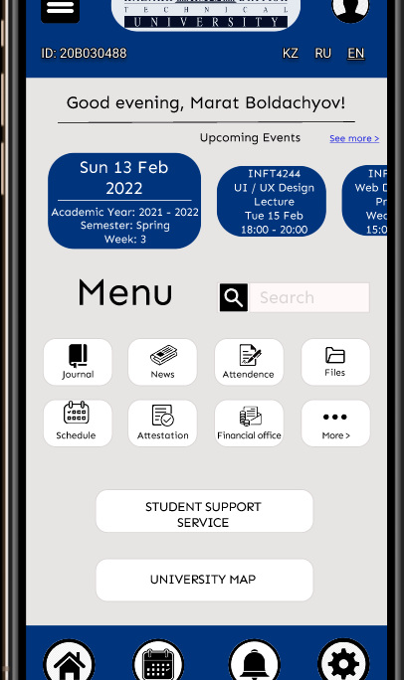
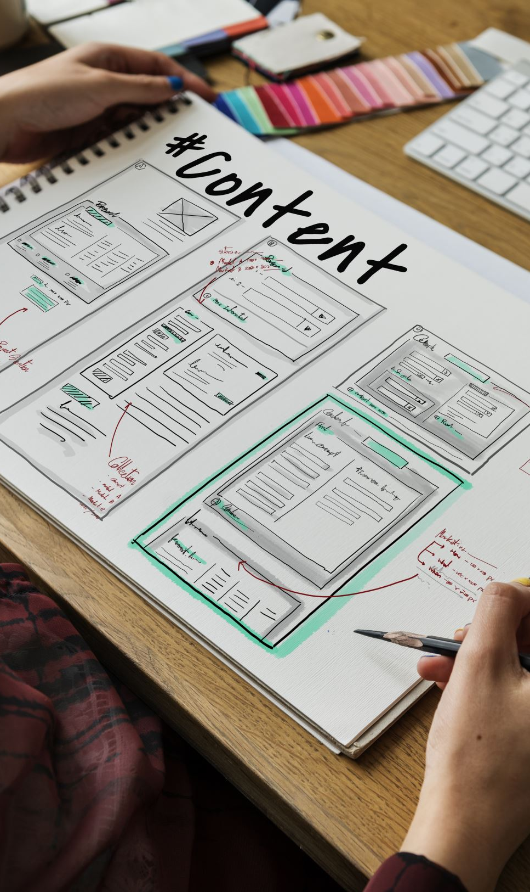
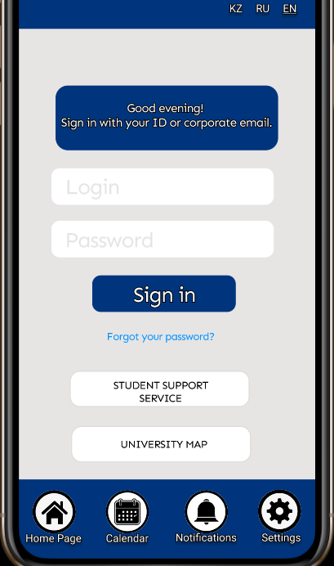
Interface sketches
Link to all interfaces of the app: https://sites.google.com/view/marat-boldachyov/главная-страница

