Slide 1
H | T | M | L
T | A | B | L | E | S

Slide 2
What is a TABLE?
The HTML table allows web designers to arrange & organize data -- text, images, hyperlinks, forms, form fields, other tables, etc.
Tables are made up of rows and columns. -Rows are horizontally arranged cells -Columns are vertically arranged cells
1 COLUMN
1 ROW

Slide 3
TABLE: Components
Basic HTML table tags: <table></table> required Defines the beginning and end of the table <tr></tr> required Table Row - Defines the beginning and end of a horizontal row. <td></td> required Table Cell - Defines an individual cell. Cells are always placed inside a row. “td” stands for table data.

Slide 4
TABLE: Components
Code <table> <tr><td>1</td><td>2</td></tr> <tr><td>3</td><td>4</td></tr> </table>
Browser View
1 | 2
3 | 4

Slide 5
TABLE: Components Cont.
Additional HTML table tags: <th></th> optional Defines a table header row. Used instead of “td.” Text is bold & centered within the cell <caption></caption> optional Sets a caption for the table. Goes after the table tag but not inside “tr” or “td.” There should be only one caption per table. Appears centered above the table.

Slide 6
TABLE: Components Cont.
Code <table> <caption>My Schedule</caption> <tr><th>Period</th><th>Class</th></tr> <tr><td>1st</td><td>PE</td></tr> <tr><td>2nd</td><td>Math</td></tr> </table>
Browser View
My Schedule
Period | Class
1st | WT
2nd | TOC

Slide 7
TABLE: Tag attributes
Attributes that can be added to table tags: Table Border optional Table border attribute dictates border thickness Example: <table border=“1”> 0 = no border & larger numbers = thicker borders No border defined = no border viewable bordercolor can be added to change the color of the table border. Border must be >0 to see the color Example: <table border=“1” bordercolor=“red”>
Table Width & Height optional Width & Height can be defined in the open table tag Example: <table width=“100” height=“100”>

Slide 8
TABLE: Tag attributes cont.
Attributes that can be added to th, tr, & td tags: Alignment optional Alignment can be added to the table, tr, th, & td tag. Code <table border=“1”><tr align=“right”> <td>Test1</td><td>Test2</td></tr><tr> <td>Test3</td><td>Test4</td></tr></table>
Browser View
Test1 | Test2
Test3 | Test4

Slide 9
TABLE: Tag attributes cont.
Column & Row span optional Column span (colspan) is added to a th or td tag Row span (rowspan) can added to the tr tag Code <table><tr><td colspan=2>Heading</td></tr> <tr><td>Entry1</td><td>Entry2</td></tr></table>
Browser View
Heading
Entry1 | Entry2

Slide 10
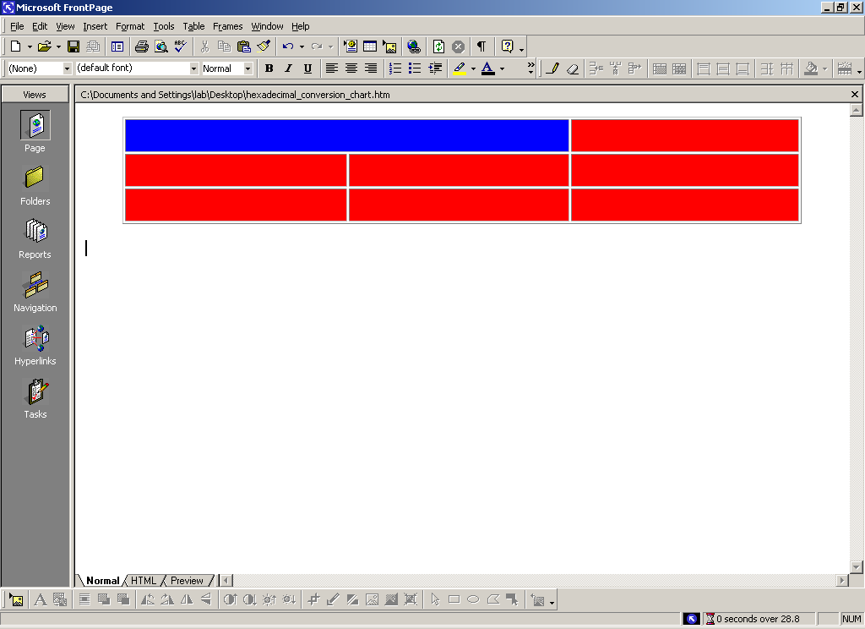
<td colspan …> Example
<tr>
<td colspan=“2”
bgcolor=“blue”>
</td>
<td>
…
</td>
</tr>

Slide 11
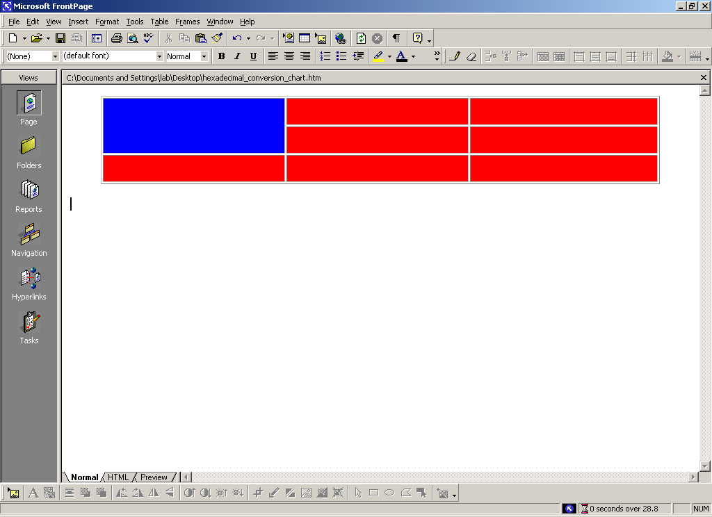
<td rowspan …> Example
<tr>
<td rowspan=“2”
bgcolor=“blue”>
</td>
<td>
…
</td>
</tr>

Slide 12

Cellspacing
CELLSPACING controls the space between table cells.
Defines the space between cells.
Although there is no official default, browsers usually use a default of 2.

Slide 13
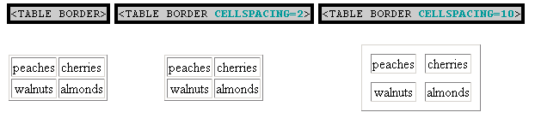
Cellspacing Tag
You can designate the spacing for the cells in your table by using the cellspacing tag. The tag for cellspacing is used within the table tag. Specify the number of pixels that you would like your cells to be spaced.
cellspacing=#

Slide 14

Cellpadding
CELLPADDING sets the amount of space between the contents of the cell and the cell wall. The default is 1.
CELLPADDING is usually more effective than CELLSPACING for spreading out the contents of the table.

Slide 15
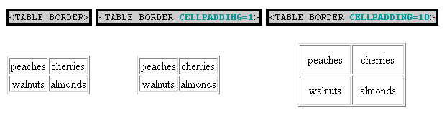
Cellpadding Tag
You can designate the padding for the cells in your table by using the cellpadding tag. The tag for cellpadding is used within the table tag. Specify the number of pixels that you would like your cells to be spaced.
cellpadding=#

Slide 16
Table Data and Table Header Attributes
Colspan: Specifies how many cell columns of the table this cell should span.
Rowspan: Specifies how many cell rows of the table this cell should span.
Align: cell data can have left, right, or center alignment.
Valign: cell data can have top, middle, or bottom alignment.
Width: you can specify the width as an absolute number of pixels or a percentage of the document width.
Height: You can specify the height as an absolute number of pixels or a percentage of the document height.

Slide 17
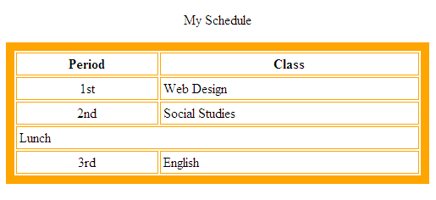
REVIEW: HTML tables
Code <table border=“10” bordercolor=“orange” cellspacing=“2” cellpadding=“3” width=“500”> <caption>My Schedule</caption> <tr><th>Period</th><th>Class</th></tr> <tr><td align=“center”>1st</td> <td>Web Design</td></tr> <tr><td align=“center”>2nd</td><td>Social Studies</td></tr> <tr><td colspan=“2”>Lunch</td></tr> <tr><td align=“center”>3rd</td><td>English</td></tr> </table>
table header
Browser View
align center
cell
spacing
table
border
column
span
cell padding

