Slide 1
HTML FORMS
Prepared By:
Mrs.K G.Walke

Slide 2
Intro to Forms
HTML forms are used to gather information from end-users.
A form can contain elements like radio-buttons, text fields, checkboxes, submit buttons and more.

Slide 3
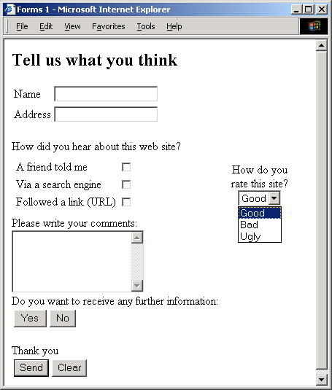
Input types
text
checkbox
radio (buttons)
select (options)
textarea
password
button
submit
reset
hidden
file
image
BSc CM0133 Internet Computing

Slide 4
Forms
A form is an area that can contain form elements.
<form></form>
Commonly used form elements includes:
  Text fields
  Radio buttons
  Checkboxes
  Submit buttons
Notes:
Many Web applications require that a user to provides some input. Typically a user fills out a form by filling in some fields with text and/or selecting from lists of options. HTML forms provide a mechanism for including many input boxes (and buttons) that the user can use to provide input to a web application.

Slide 5

Forms: Input Elements
Text Fields: allows the user to type in text into the text field box.
  <input type=“text" /> defines a one-line input field that a user can enter text into. Default width of a text field is 20 characters.
Code View:
Browser View:
<form>
Car Make: <input type="text“ name="carmake" />
<br />
Car Model: <input type="text" name="carmodel" />
</form>

Slide 6

Text Box
Text boxes: Used to provide input fields for text, phone numbers, dates, etc.
<INPUT TYPE= " TEXT " >
Browser will display
Textboxes use the following attributes:
TYPE: text.
SIZE: determines the size of the textbox in characters. Default=20 characters.
MAXLENGHT : determines the maximum number of characters that the field will accept.
NAME: is the name of the variable to be sent to the CGI application.
VALUE: will display its contents as the default value.

Slide 7

Forms: Input Elements
Password Field: like the text field, it allows the user to type in text into the text field box but the characters are masked.
  <input type=“password" /> defines a password field.
Code View:
Browser View:
<form>
Password:
<input type="password"
name="password" />
</form>
with user input

Slide 8
Password
Password: Used to allow entry of passwords.
<INPUT TYPE= " PASSWORD " >
Browser will display
Text typed in a password box is starred out in the browser
display.
Password boxes use the following attributes:
TYPE: password.
SIZE: determines the size of the textbox in characters.
MAXLENGHT: determines the maximum size of the password in characters.
NAME: is the name of the variable to be sent to the CGI application.
VALUE: is usually blank.

Slide 9

Forms: Input Elements
Radio Buttons: let a user select ONLY ONE of a limited number of choices.
  <input type="radio" /> defines a radio button.
Code View:
Browser View:
<form>
<input type="radio" name=“grade"
value=“9th" /> Freshmen
<br />
<input type="radio" name=“grade" value=“10th" /> Sophomore
<br />
<input type="radio" name=“grade" value="11th" /> Junior
</form>

Slide 10

Forms: Input Elements
Checkboxes: let a user select ONE or MORE options of a limited number of choices.
  <input type=“checkbox" /> defines a checkbox.
Code View:
Browser View:
<form>
<input type="checkbox"
name="language" value="spanish" />
I speak Spanish<br />
<input type="checkbox"
name="language" value="french" />
I speak French
</form>

Slide 11

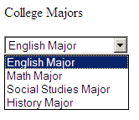
Forms: Input Elements
Drop-Down List: allows a user to select one option from a simple drop-down menu.
Code View:
Browser View:
default view
College Majors<br />
<form action=“”>
<select name=“collegemajors">
<option value=“eng">English Major</option>
<option value=“math">Math Major</option>
<option value=“SS">Social Studies Major</option>
<option value=“history“>History Major</option>
</select>
</form>
with drop-down menu engaged

Slide 12

Forms: Input Elements
Submit Button: used to send form data to a server. The data is sent to the page referenced in the form's “action” attribute. The file defined in the action attribute processes the received input.
  <input type=“submit" /> defines a submit button.
Code View:
Browser View:
<form name="input" action="html_form_action.asp"
method="get">
User Login: <input type="text"
name="user" />
<input type="submit" value="Submit" />
</form>

Slide 13
Forms: Review
HTML forms are used to gather information from end-users in the following ways:
Radio Buttons
Drop-down List
Submit Button
Password Field
Text Field
Checkbox

