Slide 1
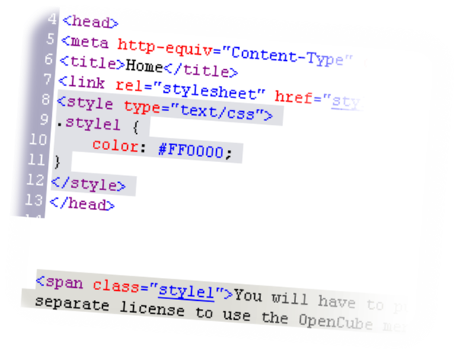

Using <DIV> and <SPAN> Block and Inline Elements
Notes:
*
07/16/96
(c) 2007 National Academy for Software Development - http://academy.devbg.org. All rights reserved. Unauthorized copying or re-distribution is strictly prohibited.*
<number>##

Slide 2
Block and Inline Elements
Block elements add a line break before and after them
  <div> is a block element
  Other block elements are <table>, <hr>, headings, lists, <p> and etc.
Inline elements don’t break the text before and after them
  <span> is an inline element
  Most HTML elements are inline, e.g. <a>

Slide 3
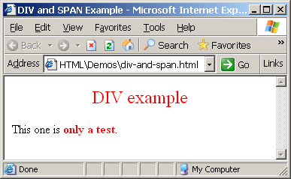
The <div> Tag
<div> creates logical divisions within a page
Block style element
Used with CSS
Example:
div-and-span.html
<div style="font-size:24px; color:red">DIV example</div>
<p>This one is <span style="color:red; font-weight:bold">only a test</span>.</p>
Notes:
*
07/16/96
(c) 2007 National Academy for Software Development - http://academy.devbg.org. All rights reserved. Unauthorized copying or re-distribution is strictly prohibited.*
<number>##

Slide 4

The <span> Tag
Inline style element
Useful for modifying a specific portion of text
  Don't create a separate area (paragraph) in the document
Very useful with CSS
span.html
<p>This one is <span style="color:red; font-weight:bold">only a test</span>.</p>
<p>This one is another <span style="font-size:32px; font-weight:bold">TEST</span>.</p>
Notes:
*
07/16/96
(c) 2007 National Academy for Software Development - http://academy.devbg.org. All rights reserved. Unauthorized copying or re-distribution is strictly prohibited.*
<number>##

Slide 5
Block and Inline Elements
Block elements add a line break before and after them
  <div> is a block element
  Other block elements are <table>, <hr>, headings, lists, <p> and etc.
Inline elements don’t break the text before and after them
  <span> is an inline element
  Most HTML elements are inline, e.g. <a>

Slide 6
The <div> Tag
<div> creates logical divisions within a page
Block style element
Used with CSS
Example:
div-and-span.html
<div style="font-size:24px; color:red">DIV example</div>
<p>This one is <span style="color:red; font-weight:bold">only a test</span>.</p>
Notes:
*
07/16/96
(c) 2007 National Academy for Software Development - http://academy.devbg.org. All rights reserved. Unauthorized copying or re-distribution is strictly prohibited.*
<number>##

Slide 7
The <span> Tag
Inline style element
Useful for modifying a specific portion of text
  Don't create a separate area (paragraph) in the document
Very useful with CSS
span.html
<p>This one is <span style="color:red; font-weight:bold">only a test</span>.</p>
<p>This one is another <span style="font-size:32px; font-weight:bold">TEST</span>.</p>
Notes:
*
07/16/96
(c) 2007 National Academy for Software Development - http://academy.devbg.org. All rights reserved. Unauthorized copying or re-distribution is strictly prohibited.*
<number>##

Slide 8
HTML Videos
Videos can be embedded in HTML pages with several methods.
<video width="320" height="240" controls>
<source src="movie.mp4" type="video/mp4">
<source src="movie.ogg" type="video/ogg">
<source src="movie.webm" type="video/webm">
<object data="movie.mp4" width="320" height="240">
<embed src="movie.swf" width="320" height="240">
</object>
</video>

Slide 9
Past, Present, & Future of HTML
HTML5 is the future of HTML
  HTML5 is the next generation of HTML.
  HTML5 is still a work in progress. However, not all browsers have HTML5 support.
  Some elements in HTML 4 are obsolete or not used the way they were supposed to. These elements are re-written in HTML5.
  HTML5 addresses today’s internet needs by including new elements for media content, better structure, drawing, & better form handling.

Slide 10
Past, Present, & Future of HTML
New features of HTML5
Better support for local offline storage
New form controls like: calendar, date, time, email, url, search, etc.
The canvas element for sketching
The video and audio elements for media playback
  Allows video and audio to be tagged easier (like images)… such as <video src=…> and <audio src=…>
New content specific elements such as article, footer, header, navigation, section, etc.

Slide 11
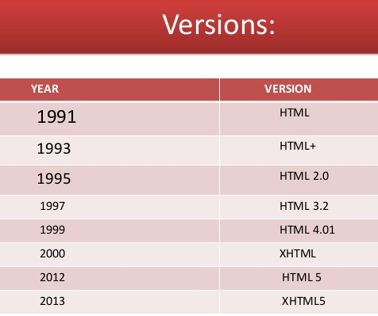

Slide 12
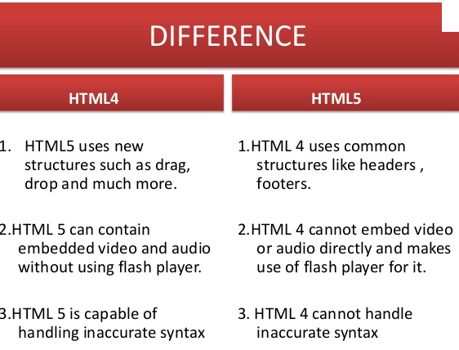

Slide 13
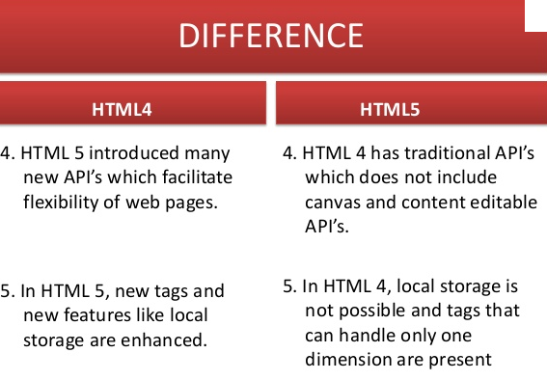

Slide 14
How to specify Relative pathnames
The current HTML document is my.html and the current directory is Iam
C:\- Iam -my.html
    -your.html
Type this ; <A href=your.html>Your link </A>
C:\- Iam -my.html
Child -your.html
Type this ; <A href=Child/your.html>Your link </A>
C:\-  Iam -my.html
 Sister -your.html
Type this ; <A href=../Sister/your.html>Your link </A>
C:\-  Mother -your.html
     Iam -my.html
Type this ; <A href=../your.html>Your link </A> ⬇Go to Back

Slide 15
How to specify Relative pathnames
The HTML document is my.html and the image file is dragonfly.gif
C:\-  Iam -my.html ☞ Type this ; <IMG SRC=dragonfly.gif>
-dragonfly.gif
C:\-  Iam -my.html ☞ Type this ; <IMG SRC=Image/dragonfly.gif>
 Image
-dragonfly.gif
C:\-  Iam -my.html ☞ Type this ; <IMG SRC=../Image/dragonfly.gif>
 Image
-dragonfly.gif
C:\-  Image -dragonfly.gif ☞ Type this ; <IMG SRC=../dragonfly.gif>
 Iam
-my.html
Go to Back

