Slide 1
Unit1
WEB ENGINEERING INTRODUCTION
Prepared By:
Mrs.P.Y.Pawar

Slide 2
Syllabus
Part1: Introduction - What is Web Engineering? Web Development History, Motivation, Categories of Web Applications, Web Applications Characteristics. Evolution and Need for Web Engineering,
Web Engineering Models, Software Engineering v/s Web Engineering
Part2: World Wide Web: Introduction to TCP/IP and WAP, DNS, Email, TelNet, HTTP and FTP.
Introduction to Browser and search engines, Search fundamentals, Search strategies,
Directories search engines and Meta search engines, Working of the search engines ,
Miscellaneous Web Browser details,
Introduction to Web Servers: Features of web servers, caching, case
study-IIS, Apache, Configuring web servers.

Slide 3
What is WEB?
WEB, which stands for “Where Everybody Belongs”.
The World Wide Web, or simply Web, is a way of accessing information over the medium of the Internet. It is an information-sharing model that is built on top of the Internet.
The Web uses the HTTP protocol, only one of the languages spoken over the Internet, to transmit data.
Web services, which use HTTP to allow applications to communicate in order to exchange business logic, use the Web to share information.

Slide 4
What is WEB?
The Web also utilizes browser, such as IE, Mozilaor Firefox, to access Web documents called Web Pages that are linked to each other via hyperlinks.
Web documents also contain graphics, sounds, text and video.
The Web is just one of the ways that information can be disseminated over the Internet.
The Internet, not the Web, is also used for email, which relies on SMTP, news groups, instant messaging and FTP. So the Web is just a portion of the Internet.

Slide 5
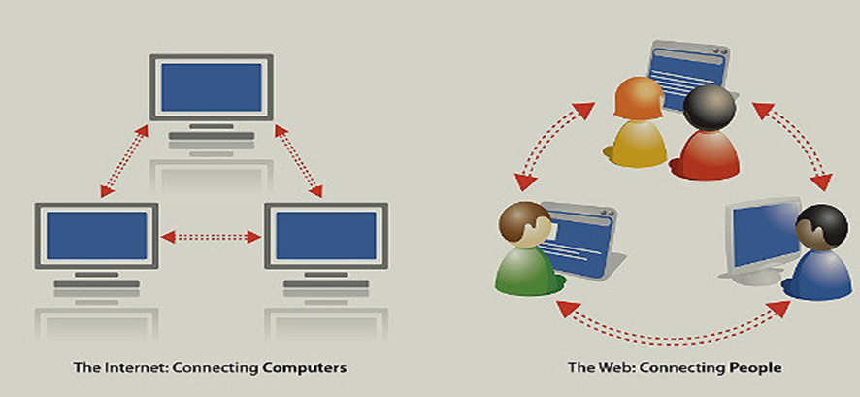
Difference between Internet and WEB
The Web is software that lets you use that content…or contribute your own. The Web, running on the mostly invisible Internet, is what you see and click on in your computer’s browser.

Slide 6
Web Engineering(WebE)
A web application or web app is any application software that runs in a web browser or is created in a browser-supported programming language (such as the combination of Java Script and CSS) and relies on a common web browser to render the application
Web Engineering is the process used to create high quality Web-based applications (WebApps)
WebE draws heavily on the principles and management activities found in software engineering processes.

Slide 7
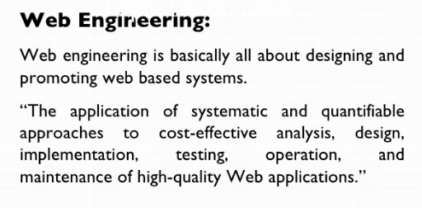

Slide 8
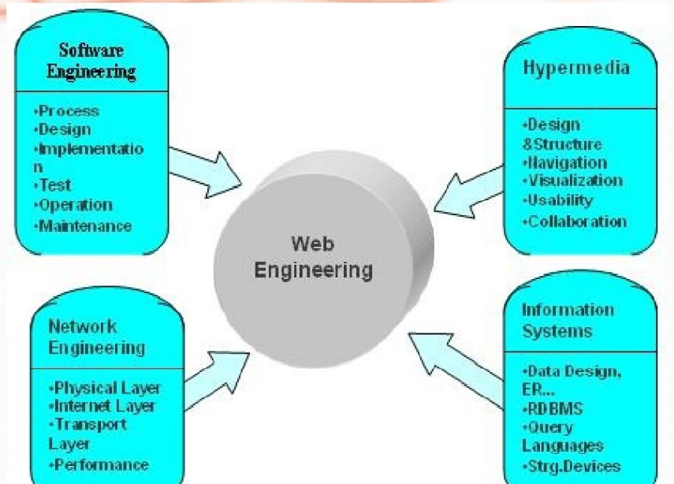

Slide 9
Basic Premises
Developing a Web-based system is no longer an event, it is a process
Web-based systems are growing systems
Web-based applications are adding a whole new dimension to software development

Slide 10
Terms
Web System – an infrastructure or system enabling the operation of a Web application
Web Application – a distributed application that accomplishes a certain business need based on the technologies of WWW and that consists of a set of Web-specific resources.

Slide 11
Web Development History
Web design encompasses many different skills and disciplines in the production and maintenance of websites.
The different areas of web design include web graphic design; interface design; authoring, including standardized code and proprietary software; user experience design; and search engine optimization.
The term web design is normally used to describe the design process relating to the front-end (client side) design of a website including writing mark up.

Slide 12
History
1988—2001(start)
In 1989, whilst working at CERN Tim Berners-Lee proposed to create a global hypertext project, which later became known as the World Wide Web.
During 1991 to 1993 the World Wide Web was born. Text-only pages could be viewed using a simple line-mode browser.
In 1993 Marc Andreessen and Eric Bina, created the Mosaic browser. At the time there were multiple browsers, however the majority of them were Unix-based and naturally text heavy.

Slide 13
History
The W3C(www Consortium ) was created in October 1994 to "lead the World Wide Web to its full potential by developing common protocols that promote its evolution and ensure its interoperability. the W3C continues to set standards, which can today be seen with JavaScript.
In 1994 Andreessen formed Communications Corp. that later became known as Netscape Communications, the Netscape 0.9 browser.
Netscape created its own HTML tags without regard to the traditional standards process. For example, Netscape 1.1 included tags for changing background colours and formatting text with tables on web pages.

Slide 14
History
Throughout 1996 to 1999 the browser war began, as Microsoft and Netscape fought for ultimate browser dominance. During this time there were many new technologies in the field, notably Cascading Style Sheets ,JavaScript, and Dynamic HTML. On the whole, the browser competition did lead to many positive creations and helped web design evolve at a rapid pace

Slide 15
History
Evolution of Web Designing
In 1996, Microsoft released its first competitive browser, which was complete with its own features and tags.
It was also the first browser to support style sheets, which at the time was seen as authoring technique.
To create complex designs, many web designers had to use complicated table structures or even use blank spacer .GIF images to stop empty table cells from collapsing.
CSS was introduced in December 1996 by the W3C(Consortium ) to support presentation and layout. This allowed HTML code to be semantic rather than both semantic and presentational, and improved web accessibility, see tableless web design . In 1996, Flash (originally known as FutureSplash) was developed.

Slide 16
History
End of the first browser wars
During 1998 Netscape released Netscape Communicator code under an open source licence , enabling thousands of developers to participate in improving the software.
2000 was a big year for Microsoft. Internet Explorer was released for Mac; this was significant as it was the first browser that fully supported HTML 4.01 and CSS 1, raising the bar in terms of standards compliance. It was also the first browser to fully support the PNG image format.
2001—2012
Since the start of the 21st century the web has become more and more integrated into peoples lives.
New Browsers: Internet Explorer with HTML5 and CSS

Slide 17
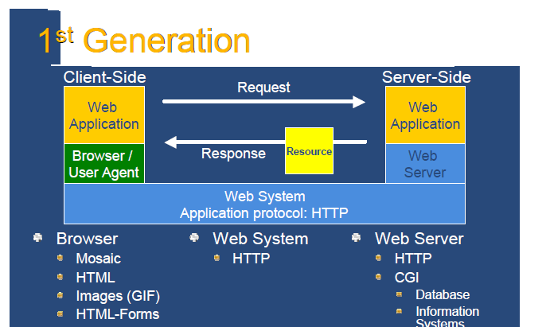

Slide 18
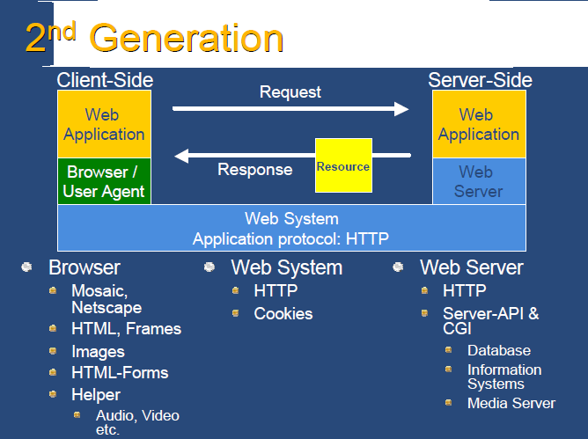

Slide 19
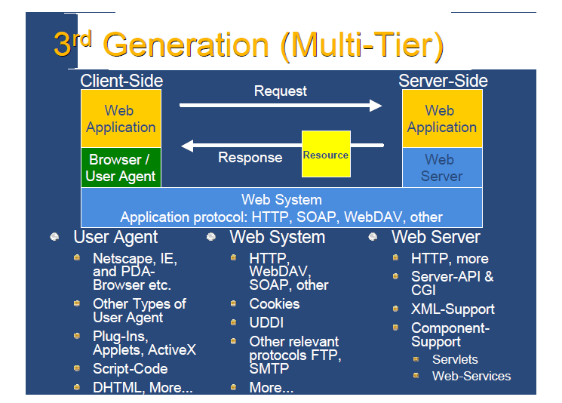

Slide 20
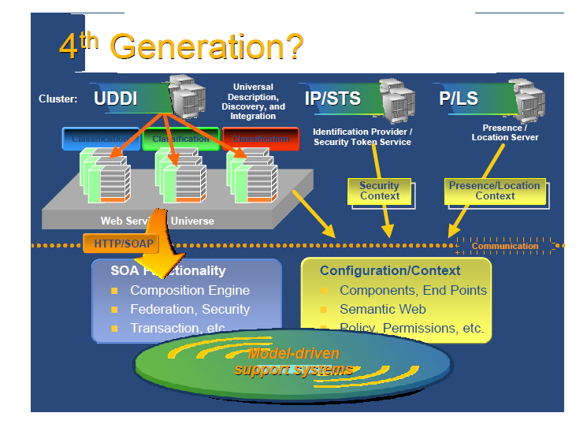

Slide 21
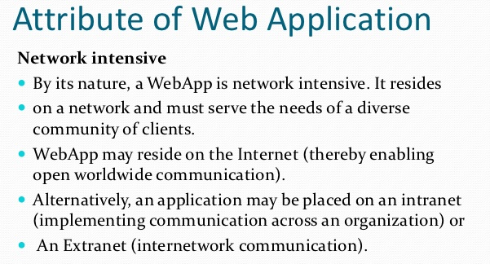

Slide 22
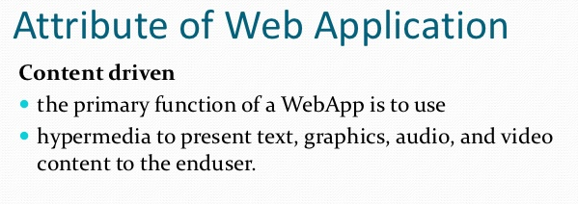

Slide 23
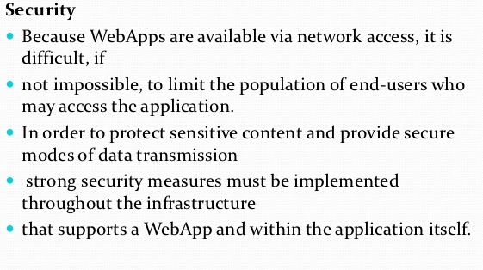

Slide 24
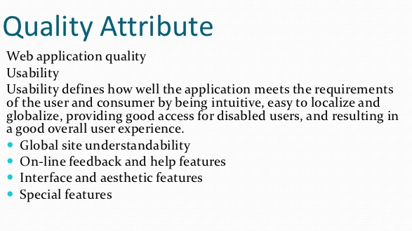

Slide 25
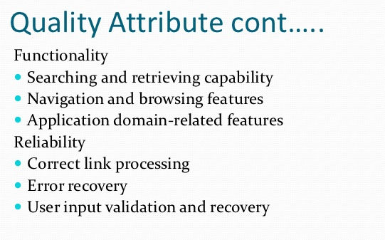

Slide 26
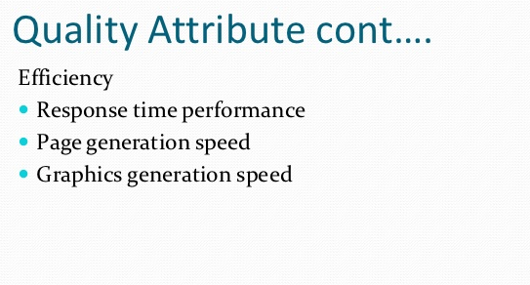

Slide 27
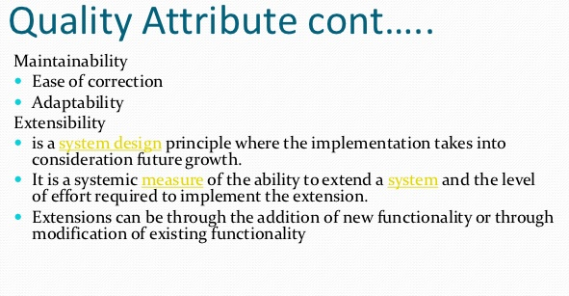

Slide 28
Categories of Web-Based Systems
Category | Examples
Informational/Document | Online newspapers, manuals
Interactive | Registration forms
Transactional | Electronic shopping
Workflow-oriented | Status monitoring
Collaborative work | Distributed authoring
Online communities | Discussion groups
Web portals | Shopping malls
Web services | Enterprise applications

Slide 29
1. Informational/Document centric Web sites
stored on a Web server as ready-made, i.e. static, HTML documents and sent to the Web client in response to a request
contents are frequently represented redundantly on several Web pages
simplicity and stability
short response time

Slide 30
2. Interactive Web applications
web pages and links to other pages are generated dynamically according to user input
uses CGI, ASP, PHP and HTML form
e.g., virtual exhibitions, news sites, or timetable information

Slide 31
3.Transactional Web applications
provide more interactivity
performing updates on the underlying content
efficient and consistent handling of the increasing amount of content
offer the possibility of structured queries
e.g., online banking, online shopping, and booking systems

Slide 32
4.Workflow-based Web applications
handling of workflows between different companies, public authorities, and private users
availability of appropriate Web services to guarantee interoperability
e.g., Business-to-Business solutions (B2B solutions) in e-commerce, e-government applications,

Slide 33
5. Collaborative Web applications
especially for cooperation purposes in unstructured operations (groupware)
communication between the cooperating users support shared information and workspaces
e.g, wiki, Weblogs, scheduling systems,
e-learning platforms

Slide 34
6. Portal-oriented Web applications
provide a single point of access to separate, potentially heterogeneous sources of information and services
e.g., online shopping malls, community portals

Slide 35
7. Ubiquitous Web applications
provides customized services anytime anywhere and for any device
facilitating ubiquitous access
either personalization or location-aware services or multi-platform delivery

Slide 36
8. Semantic Web
The Semantic Web is regarded as an integrator across different content, information applications and systems
present information on the Web
  not merely for humans,
  but also in a machine readable form
facilitate knowledge management on the Web
  linking and reuse of knowledge (content syndication)
  locating new relevant knowledge
interoperation on the semantic level and the possibility of automating tasks (via software agents)

Slide 37
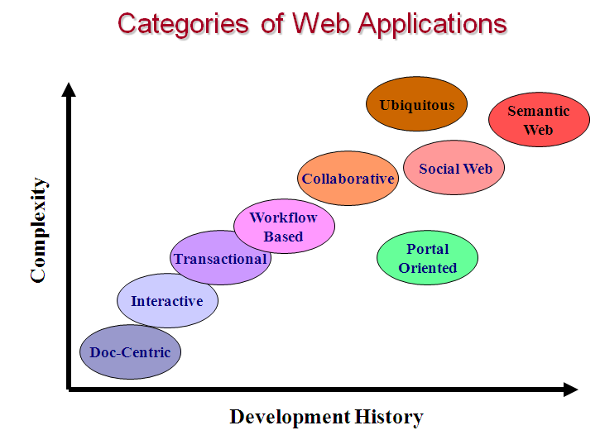

Slide 38
WebE Process Overview
Formulation of the problem
Planning
WebApp requirements analysis
Architectural, navigational, and interface design
System implementation using specialized languages and tools associated with the Web
Configuration management, quality control, and maintenance mechanisms are established early

Slide 39

elaboration
inception

Slide 40
WebE Process Model: Formulation
Goals and objectives, scope for first increment
  What is the motivation for the WebApp?
  Why is the WebApp needed?
  Who will use the WebApp?
Informational goals
  user's intention for using the content
Applicative goals
  ability to perform tasks within the WebApp

Slide 41
WebE Process Model: Planning
Estimate project cost
Evaluate risks
Define finely granulated schedule for first increment
Define schedule for subsequent increments

Slide 42
WebE Process Model : Analysis
Establishes requirements and identifies content items
Content analysis
  content provided by WebApp is identified
Interaction analysis
  use-cases developed to describe user interaction
Functional analysis
  usage scenarios used to define operations and functions applied to WebApp content
Configuration analysis
  WebApp environment described in detail

Slide 43
WebE Process Model: Engineering
Content design and production tasks are one thread
Architectural design, navigation design, interface are the other thread.

Slide 44
WebE Process Model:
Page Generation and Testing
Content and technical designs are merged to produce executable web pages
Testing exercises WebApp navigation, attempts to uncover errors in applets/scripts/forms, and checks for environment incompatibilities

Slide 45
WebE Process Model:
Customer Evaluation
Each increment of the WebApp is reviewed
Changes required by customer are applied to next increment

Slide 46
WebE Best Practices
Take time to understand the business needs and product objectives, even if WebApp details are vague.
Describe how users will interact with the WebApp using a scenario-based approach.
Develop a brief project plan.
Spend time modeling what you are going to build.

Slide 47
WebE Best Practices
Review models for consistency and quality.
Use tools and technology that enable you to construct the system with as many reusable components as possible.
Don’t rely on users to debug the WebApp, design comprehensive tests and execute them before releasing the system.

Slide 48
Web Development vs. Software Development
They are different due to the nature and distinct requirements of Web-based systems
Even though Web-based systems often require programming and specialty software, the development of that software is often unique

Slide 49
Web Development vs. Software Development
Web-based systems:
Are document-oriented containing static or dynamic content
More emphasis on “look and feel”
Are “content-driven” – process is driven by the availability of content
Need to provide to users with diverse skills and capabilities
Are typically constrained to a short development time, making it difficult to apply the same levels of formal planning and testing as used in software development

Slide 50
Web Development vs. Software Development
Web-based systems:
Differ by means of their access and delivery medium
Have different lifespan
Have differing development requirements
Developers are vastly varied in terms of their background, skills, knowledge, and system understanding
Developers differ in their perception of Web systems

Slide 51
Web Development vs. Software Development
Web-based systems:
Should be scalable
Have varying performance requirements –
must be able to cope with uncertain, random heavy demands on services
Must be secure
Are subject to various legal, social, and ethical security

Slide 52
Difference between web engineering and software engineering’
Although both of them follows the disciplined approach to develop, deploy and maintained the applications; the basic difference is that the requirements (Scope) of web projects is different from the software projects.
Software projects have the various models like Waterfall, Spiral, Incremental, etc., but there is no defined models for Web Applications project, as the requirements are dynamic (not fixed). For simplicity we can define model for web projects as PDCA model. (P)lan, (D)o, (C)heck and (A)ct.

Slide 53
Difference between web engineering and software engineering’
Secondly, WEBE is more complex than SWE, as former is dependent on the various types of browsers, OS, and servers like Web server, application servers..

