Slide 1
CARVION AI
Career Development Platform
Full-Stack AI-Powered Resume Analysis, Roadmaps & Mock Interview Preparation
Project Team Presentation | Comprehensive Report Summary

Slide 2
OVERVIEW
Presentation Outline
01. Executive Abstract & Summary
02. Project Context & Objectives
03. Proposed System Architecture
04. System Technology Stack
05. Module Detail: Resume Intelligence
06. Module Detail: Career Roadmaps
07. Module Detail: Mock Interviews
08. Module Detail: Recommendation Engine
09. Module Detail: Admin Dashboard
10. System Architecture & DFDs
11. Entity Relationship Design
12. System Interaction Workflows
13. Database Schema Layout
14. Verification & Testing QA
15. Future Scope & Enhancements

Slide 3
OVERVIEW
Project Abstract
Platform Mission & Core Value
Architectural Foundation
• Carvion AI is a full-stack, AI-powered career development platform designed to empower job seekers.
• Bridges the gap between raw candidate capability and industry readiness.
• Provides an integrated suite of intelligent tools acting as a 24/7 personal career mentor.
• Decoupled client-server architecture built with focus on responsiveness, user privacy, and accessibility.
• Frontend: React (Vite) single-page application providing clean interface with responsive layout.
• Backend: Python-based Django REST Framework securing operations and data exchanges.
• AI Engine: Server-side integration of Google Gemini 2.5 Flash API for prompt-driven intelligence.
• Databases: Dual setup using MongoDB for documents and SQLite for admin/session sessions.

Slide 4
OVERVIEW
Introduction & Problem Statement
The Resume 'Black Box'
Fragmented Tool Ecosystem
The Mentorship Access Gap
• Standard template creators lack validation and content feedback.
• Candidates submit resumes blindly without knowing if they pass Applicant Tracking Systems (ATS).
• No alignment check between resume details and target roles.
• Learning pathways, interview practice, resume tools, and job boards are isolated.
• No unified context profile; users must jump between different tools.
• Hard to coordinate continuous progress across platforms.
• Professional career coaching and recruitment reviews are highly expensive.
• Free career advice online is static, generic, and non-interactive.
• A clear demand exists for an accessible, scalable, intelligent mentor.

Slide 5
CONTEXT
Project Objectives
Functional Objectives
Architectural & Operational Objectives
• Resume Analytics: Build an AI tool to parse resumes, calculate ATS scores, and suggest enhancements.
• Career roadmapping: Construct customized milestone-based paths for learning target roles.
• Mock Interview simulator: Evaluate natural language answers for technical/behavioral roles.
• Intelligent search: Match courses and jobs to candidate capabilities and roadmaps.
• Conversational AI: Set up a chatbot to answer career queries and explain platform findings.
• Role-based security: Build robust JWT security to isolate candidate data from platform admins.
• Enterprise Admin Console: Give operations teams dashboard views into KPIs and logs.
• Client-Server framework: Establish decoupled React SPA and Python Django REST API.
• System Reliability: Implement API limits, rotating logging, and graceful AI fallbacks.
• Premium Design: Deliver modern responsive UX using custom CSS and glassmorphism styling.

Slide 6
PROPOSED SOLUTION
Proposed System & Key Features
AI-Driven Candidate Journey
Enterprise Controls & Reliability
• Unified Candidate Profile: One shared context links all resume, interview, and roadmap workflows.
• Active AI Mentorship: Direct interface to Gemini 2.5 Flash for high-quality, real-time guidance.
• Actionable Feedback: Outputs are concrete (e.g. key missing terms, text rewrites, sample answers).
• Progressive Journey: Users transition seamlessly from resume parsing to skill building to mock prep.
• Enterprise Console: Dedicated dashboard for platform operators powered by live DB queries.
• Role-Based Governance: Granular control over accounts, moderation tickets, and logs.
• Production Ready: Strict JWT authorization, rate limiters, and logs ensure security compliance.
• API Resilience: Handles external LLM downtime gracefully using default responses.

Slide 7
ARCHITECTURE
Platform Technology Stack
Frontend (Client)
Backend (API)
Data Storage
AI Engine & Tools
• React (v18) SPA
• Vite Build Tool
• TanStack Query
• Recharts (SVG Charts)
• Axios (JWT Interceptors)
• Vanilla CSS Themes
• Python (v3.11)
• Django Framework
• Django REST (DRF)
• Simple JWT (Auth)
• PyMuPDF & python-docx
• Python Logging Module
• MongoDB (Primary DB)
• MongoEngine (ODM)
• SQLite (Auth Blacklist)
• TTL Auto-Expiry Index
• Relational Sessions
• Document collections
• Gemini 2.5 Flash
• Google GenAI SDK
• JSearch External API
• Postman API Tests
• Git version control
• PowerShell Shell

Slide 8
FEATURES
Core Module: Resume Intelligence
Parsing and Text Extraction
AI Scoring & Feedback Report
• File Formats: Accepts PDF and DOCX file formats via multipart forms.
• Parsing Pipeline: Backend extracts text pages using PyMuPDF and paragraphs using python-docx.
• Section Classification: Scans text to identify standard blocks (contact, work, education, projects, skills).
• ATS Scorer: Evaluates structured data via Gemini, producing a standard score (0-100).
• AI Action Report: Generates details on missing keywords, formatting fixes, and structural adjustments.
• Resume Builder: Enables building resumes in a structured wizard and downloading clean PDFs.

Slide 9
FEATURES
Core Module: AI Career Roadmaps
Tailored Learning Paths
Interactive Tracking & Resources
• Dynamic Creation: Retreives user profile context (skills, level, target role) to prompt Gemini.
• Structured JSON: Returns a validated list of milestone objects containing descriptions and skills.
• Skill Alignment: Targets the exact gaps found between user skills and desired roles.
• Progress Milestones: Visual checklist tracking. Clicking item marks it done and recalculates path.
• Curated Study: Mentions specific textbooks, online courses, and projects to guide skill acquisition.
• Auto-regeneration: Updates paths automatically when target role or profile details change.

Slide 10
FEATURES
Core Module: Mock Interviews
Simulated Scenarios
Evaluation & Analytics
• Setup Configuration: Choose target role, question difficulty (Easy/Med/Hard), and category.
• Three Pillars: Supports Technical, Behavioural, or Situational scenarios.
• AI Question Generation: Gemini generates role-tailored questions dynamically.
• Speech & Text Responses: Accepts text replies representing verbal statements.
• Comprehensive Scorecard: Scored on relevance and clarity; returns strengths and weaknesses.
• Interview History: Saves all transcripts and performance metrics for progressive review.

Slide 11
FEATURES
Core Module: Recommendations & Chatbot
Job & Course Recommendations
Conversational AI Assistant
• Smart Job Match: Fetches local listings from JSearch API matched to target role and skills.
• Caching Layer: Stores results in MongoDB with TTL index to optimize performance.
• Targeted Learning: Suggests online tutorials and classes addressing resume skill gaps.
• Embedded Assistant: Conversational agent accessible throughout the user experience.
• Career Guardrails: System prompt limits chat responses specifically to professional development.
• Multi-Turn Context: Stores complete ChatSession history in MongoDB to maintain discussion context.

Slide 12
FEATURES
Enterprise Admin Console
KPI Dashboards & Users
Messages & Broadcasts
System Logs & Overrides
• Live KPI Analytics: Displays registered users, resume files, and AI hits using live DB lookups.
• Account Life Cycle: Enables operations teams to search, review, and toggle active user profiles.
• Support Resolution: Lists support contact items; tracks resolution state with email feedback.
• Global Broadcasting: Sends notifications instantly to individuals, custom user cohorts, or all users.
• Operational Log Trail: Automatically records administrative actions (identities, events, IP logs).
• Platform Controls: Offers buttons to clear caches and trigger system maintenance mode.

Slide 13
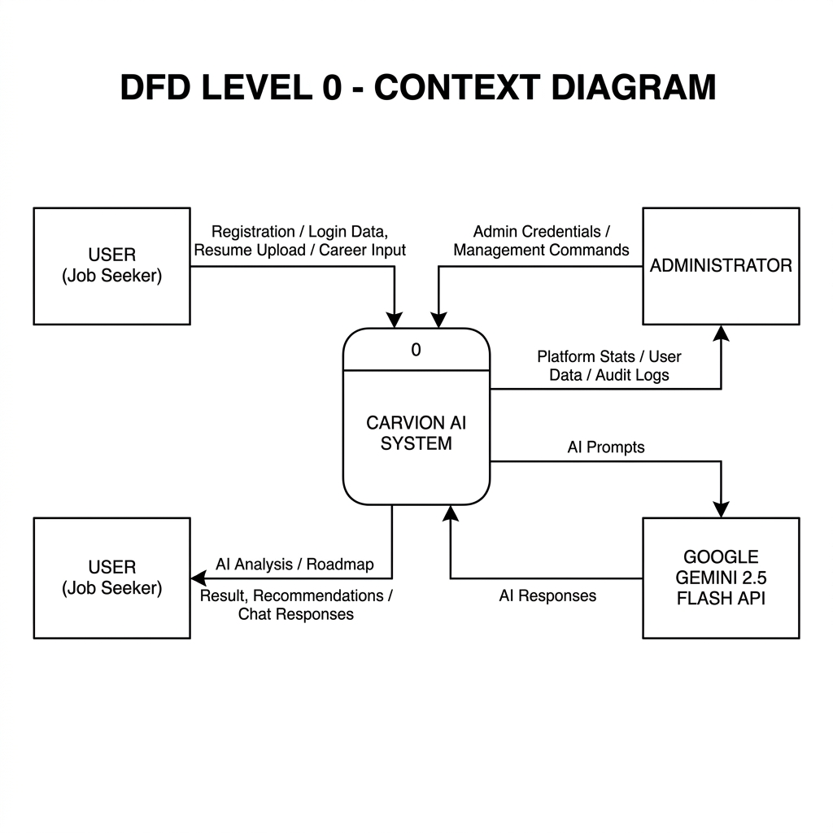
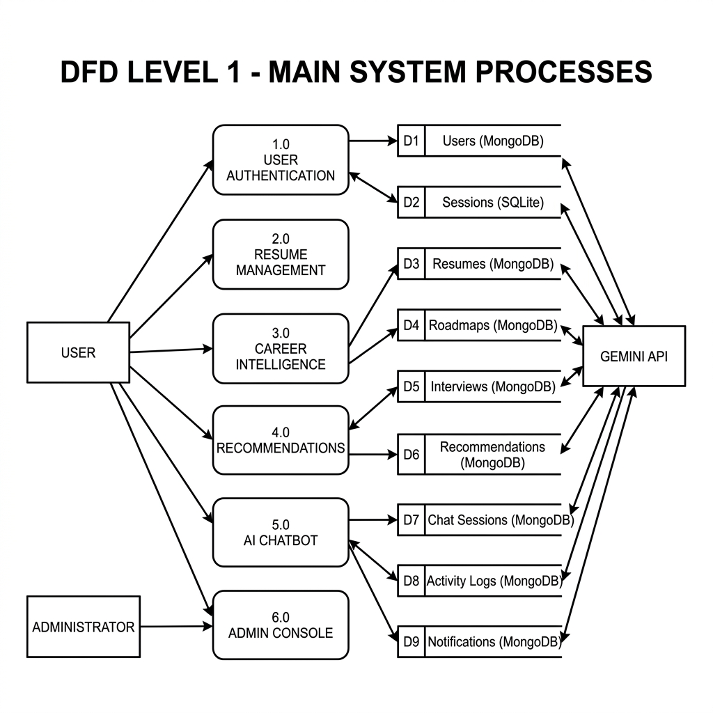
SYSTEM ARCHITECTURE
Data Flow: Context & Main Processes
DFD Structure Summary
Level 0: Context Diagram
Level 1: Main System Processes
• Context (Level 0): Illustrates the boundaries. Identifies high-level data flows between User, Admin, and Gemini API.
• System (Level 1): Decomposes the platform into the 6 major processes (Auth, Resume, Roadmaps, Interviews, Recommends, Admin).
• Data Stores: Showcases connections to primary DB storage (D1-D9) mapping credentials, files, and chat logs.

Slide 14
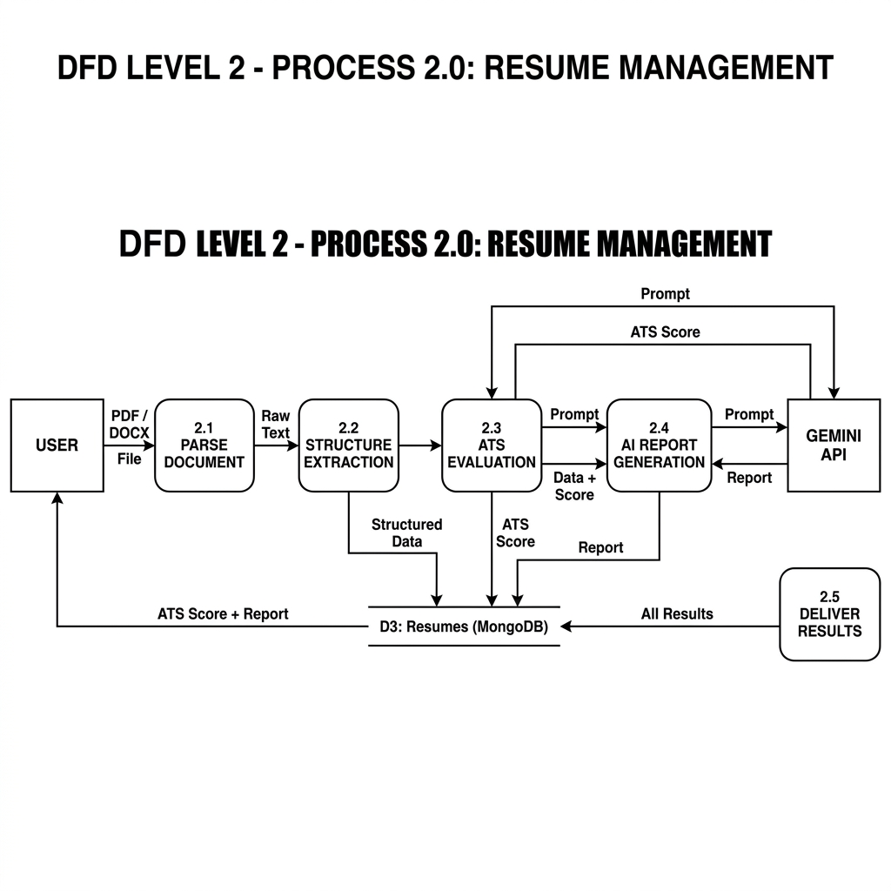
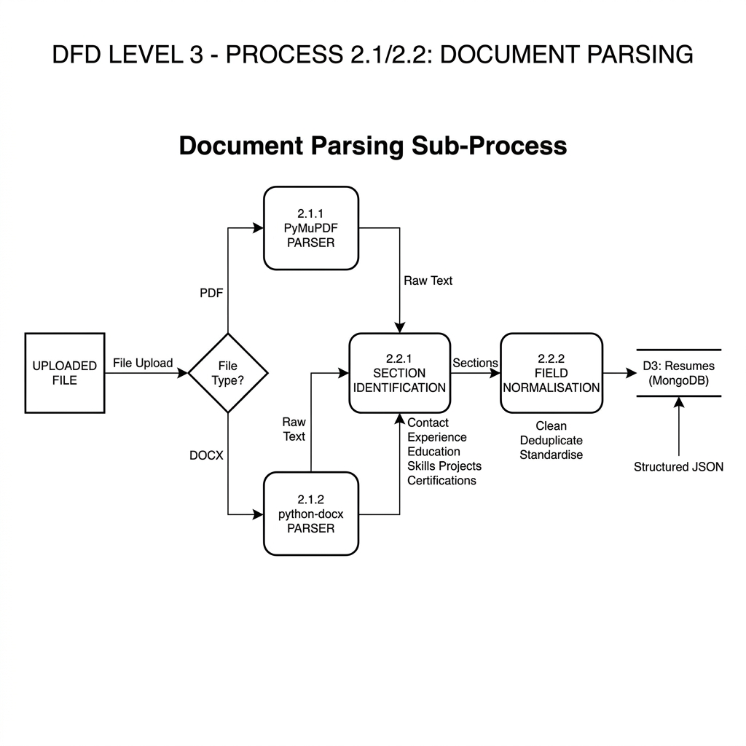
SYSTEM ARCHITECTURE
Data Flow: Resume & Parsing Detail
Decomposition Summary
Level 2: Resume Management
Level 3: Document Ingestion
• Process 2.0 (Level 2): Explains the Resume Management internals. Captures document ingestion, parsing, score, and reports.
• Detailed Parsing (Level 3): Drills down into raw byte extraction, segregating PyMuPDF (PDF) and python-docx (DOCX) pipelines.
• Structure Normalization: Captures text classification, whitespace cleanup, and database record assembly.

Slide 15
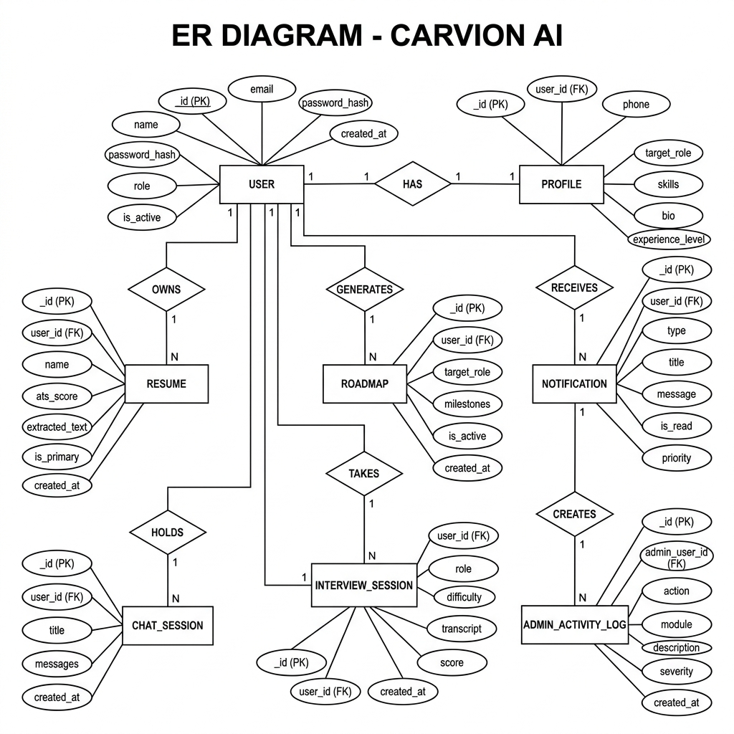
SYSTEM ARCHITECTURE
Data Model: Entity Relationships
Model Integrity
Carvion AI Entity Relationship Diagram (ERD)
• Central User: The core entity. Main user account links standard profiles, logs, and notification records.
• Profile (1:1 Relation): Standard users hold a single profile containing biographical details and desired role specifications.
• Work Products (1:N): Users can own multiple resumes, active learning roadmaps, mock interview iterations, and chats.

Slide 16
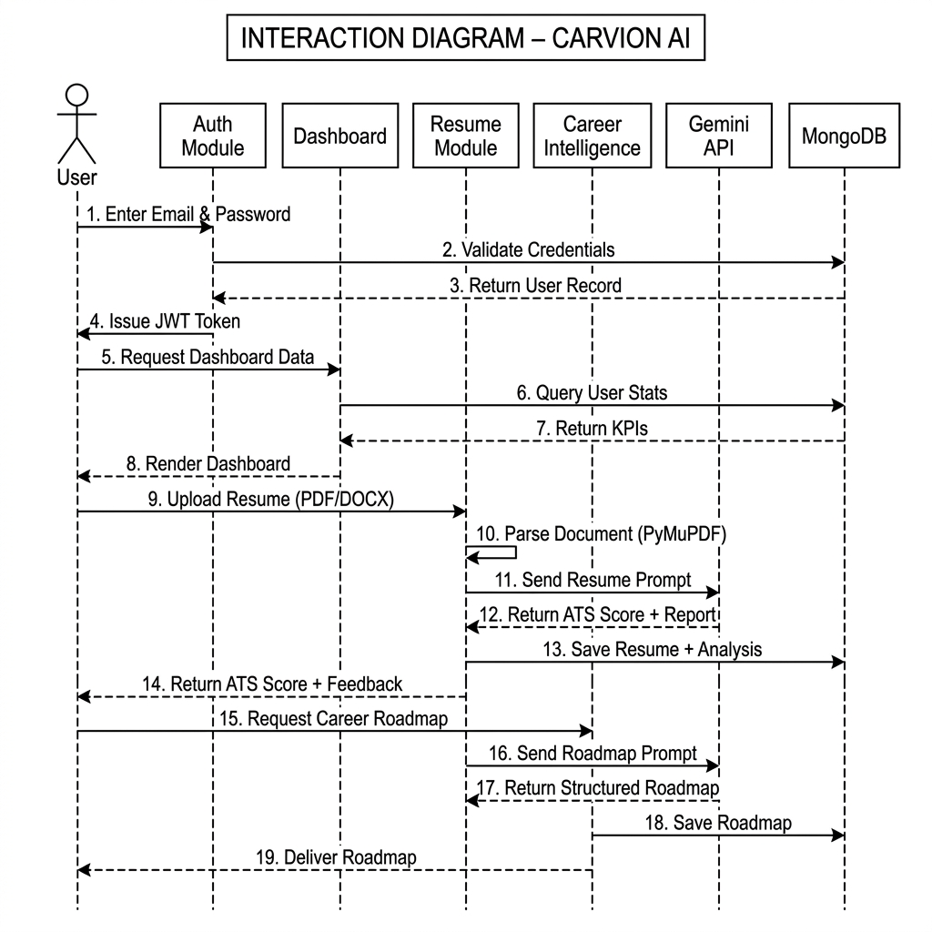
SYSTEM ARCHITECTURE
Dynamic Interaction Workflow
Sequence Highlights
Component Interaction Sequence
• Secure Exchange: Initial login yields a JWT token returned to client storage.
• Dashboard Query: Triggers parallel backend calls mapping live platform metrics and user trends.
• AI Parsing loop: Resume upload -> Python parser -> prompt sent to Gemini -> results returned -> MongoDB persist.

Slide 17
DATABASE DESIGN
Database Collections & Fields
User Accounts (MongoDB)
Resumes (MongoDB)
Roadmaps (MongoDB)
Session Store (SQLite)
• Database: MongoDB
• Fields: email, password_hash, name, role (User / Admin), active status, timestamps.
• Index: Email uniqueness, created_at timestamp indexing.
• Database: MongoDB
• Fields: user_id, resume_name, raw_parsed_text, structured_json, ATS score, AI report markdown.
• Details: Relates directly to User ID.
• Database: MongoDB
• Fields: user_id, role, milestone_list (JSON), active_flag, system_generated_flag.
• Purpose: Stores step-by-step career milestones.
• Database: SQLite
• Fields: blacklisted_token, blacklisted_at, session_id, user_id.
• Details: Low-concurrency JWT session logs.

Slide 18
VERIFICATION & QA
Testing Methodology & Fail-safes
Testing and Verification
Fail-Safes & Platform Security
• Automated Testing: PyTest framework validates REST serializer outputs and JWT token operations.
• Front-End Coverage: Validates dashboard metrics rendering and routing logic.
• Manual Testing: Document parser validated using sample PDF and DOCX files.
• Rate Limiting: Core login and LLM views restricted using django-ratelimit.
• CORS Policy: Restricts API calls to verified client domains.
• AI Fallback Mode: Catches API outages; returns default feedback to maintain UI access.

Slide 19
CHALLENGES
Platform Limitations
AI Inference Dependencies
External Recommendations
Input Quality & Scope
• API Quota Restrictions: High-frequency prompts risk triggering Gemini service limits.
• Network Latency: Real-time roadmapping and interview feedback rely on remote LLM latency.
• Third-Party Jobs API: Job matches depend heavily on JSearch endpoints remaining active.
• Context Cache: Caching limits course selections to pre-defined learning databases.
• Cold Start Profiles: The system requires clean initial inputs to create high-quality roadmaps.
• No Resume Sync: Regenerated roadmaps do not modify existing resume documents automatically.

Slide 20
FUTURE ENHANCEMENTS
Future Scope & Enhancements
Verbal & Multi-Lingual Mock Prep
API Sync & Portfolio Parsing
Corporate & Campus Portals
• Audio Mock Prep: Incorporate speech-to-text to simulate verbal interview responses.
• Multi-Language: Support multilingual resume parsing and interview question generation.
• LMS Integration: Link course progress checklists directly with Udemy or Coursera APIs.
• Portfolio Scans: Add GitHub repository parsing to identify technical skills automatically.
• Recruitment Dashboards: Enable HR teams to post listings and review parsed ATS reports.
• University Scaffolding: Tailor roadmaps to academic curricula for student alignment.

Slide 21
SUMMARY
Conclusion
Platform Achievements
Final Summary of Value
• Integrated Ecosystem: Carvion AI delivers an end-to-end career guidance platform.
• Decoupled Architecture: Combining React with Django provides standard security and performance.
• Operational Scalability: The Enterprise Console enables live database monitoring.
• Dynamic vs. Static: Outperforms traditional builders by tailoring learning to user gaps.
• AI Mentorship: Large Language Models make professional career coaching accessible at scale.
• Production Ready: Secure, robust, and designed to adapt to future job market challenges.

