Slide 1


Slide 2
ABOUT ME
MARATI SIRI VENNELA
B.Sc(Computers)

Slide 3
Contents
Problem Statement
Objective
Data munging
Data Visualizations and Insights
Research Questions
Conclusion

Slide 4
Problem Statement
Investigating the provided dataset through Exploratory Data Analysis (EDA) to identify crucial determinants and patterns that influence salary.

Slide 5
Objective
The objective of this analysis is to gain insights and a comprehensive understanding of the provided dataset, with a specific focus on the relationship between different features and the target variable, which is Salary. The goals include providing a thorough description of the dataset and its features, uncovering patterns or trends within the data, examining relationships between independent variables and the target variable (Salary), and identifying any outliers or anomalies present in the dataset.

Slide 6
Data Munging
Dealing with Missing Values:
Identified and addressed missing information in different columns.
Used methods like filling in the most common value for categorical data.
Imputed average or middle values for numerical data.
Removed unnecessary columns.
Handling Outliers:
Identified unusual values through visual inspection and statistical methods.
Made decisions to either remove or adjust these outliers based on the context.
Making Data Consistent:
Ensured all information in the dataset had a uniform format.
Special attention given to date formats for consistency.
Creating New Features:
Derived new pieces of information or transformed existing ones.
Aimed to extract more meaningful insights and improve model performance
Checking the Data:
Conducted a thorough review of the dataset.
Corrected any mistakes or anomalies discovered during the review process

Slide 7
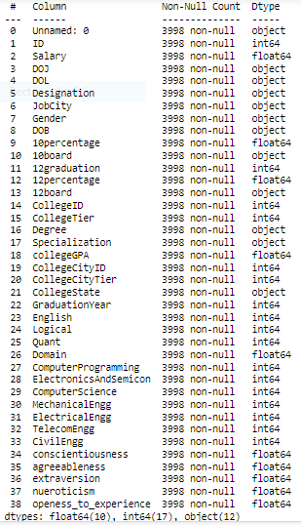
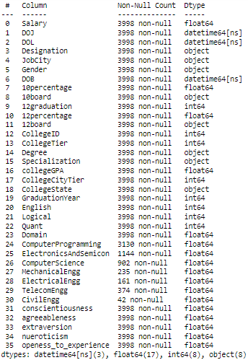
Data Cleaning
Before
After

Slide 8
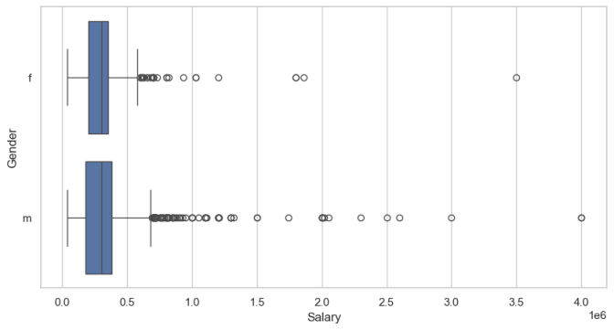
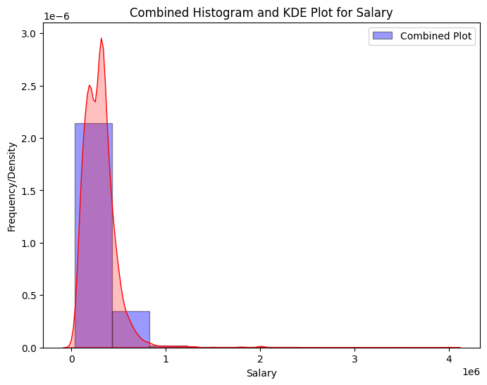
Univariate Analysis
BoxPlot
INSIGHT
1)It is noted that there are many outliers in the salary data and
there is not much difference between median salary for both genders.
2)We can also observe male have more outliers indicating they are more people getting higher pays in male than female category.
INSIGHT
This trend is further affirmed by the combined histogram and KDE plot, illustrating a concentration of data points at the lower salary range and an extended tail towards the right, as depicted in the box plot as wellI

Slide 9
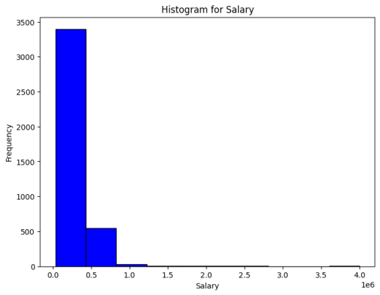
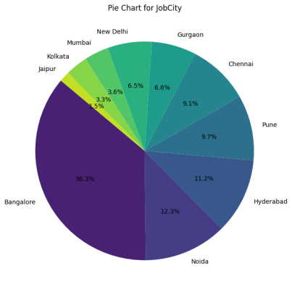
Univariate Analysis

Slide 10
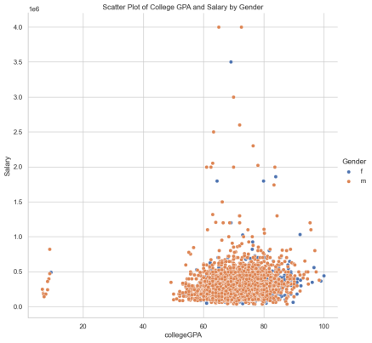
Bivariate Analysis
INSIGHT
Men and women commonly have a CGPA between 70-75, which is considered favorable. There is no apparent correlation between gender, GPA levels (high or low), and their impact on salary, as evidenced by extensive overlap in the distributions

Slide 11
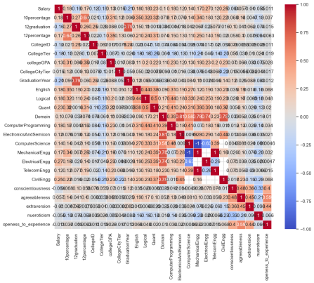
HEAT MAP
Strong positive correlations exist between English and Computer Programming, and Conscientiousness and Agreeableness, indicating alignment in subject scores. Electrical and Civil Engineering show positive correlations within engineering, while the overall relationship between personality traits and academics is less clear, with Conscientiousness positively correlated and Neuroticism showing a less pronounced negative correlation.

Slide 12
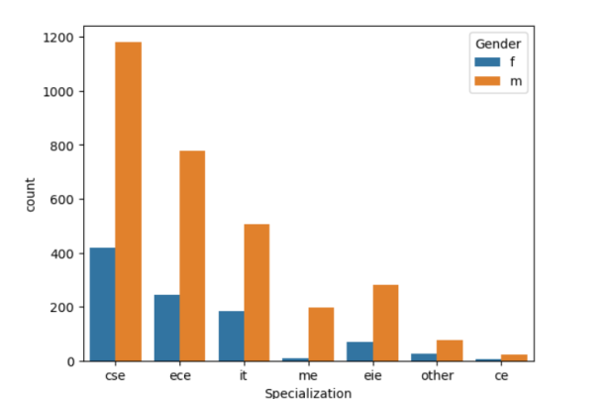
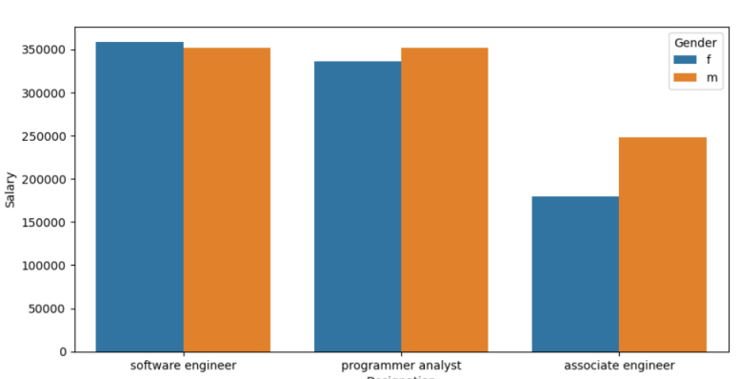
Research Question
The left section of the image depicts a count plot showcasing the gender distribution, highlighting a notable inclination towards Computer Science and Engineering (CSE) with over 33% more individuals compared to those in Electronics and Communication Engineering.
[2:55 PM]On the right side, the image illustrates the salary distribution based on designations within Computer Science and Engineering. Roles such as Software Engineer and Programmer Analyst boast the highest salaries, exceeding the reported range of 2.5 to 3 lakhs by an additional 10,000.

Slide 13
CONCLUSION
1.Over 75% of salary data clusters around ₹3,70,000, with the middle 50% ranging from ₹1,80,000 to ₹3,07,000.
2.Freshers' average salary is around ₹3,00,000 per annum.
3.Both men and women favor Computer Science and Engineering.
4.Similar average salaries for Software Engineering and Programming Analyst positions.
5.No individuals are designated as Hardware Engineers within Computer Science and Engineering.

