Slide 1

Synergy of Wide-field Infrared Survey Explorer (WISE) and the Sloan Digital Sky Survey in Stripe 82
Ph.D. Thesis Defense
Marat Musin
University of Missouri
Department of Physics and Astronomy
Notes:
Our research group is mostly interested in the study of the evolution of the galaxies at different redshifts.
My research is devoted to the construction of the large sample of extragalactic objects that allows us to study the evolution of the stellar mass of the galaxies.

Slide 2
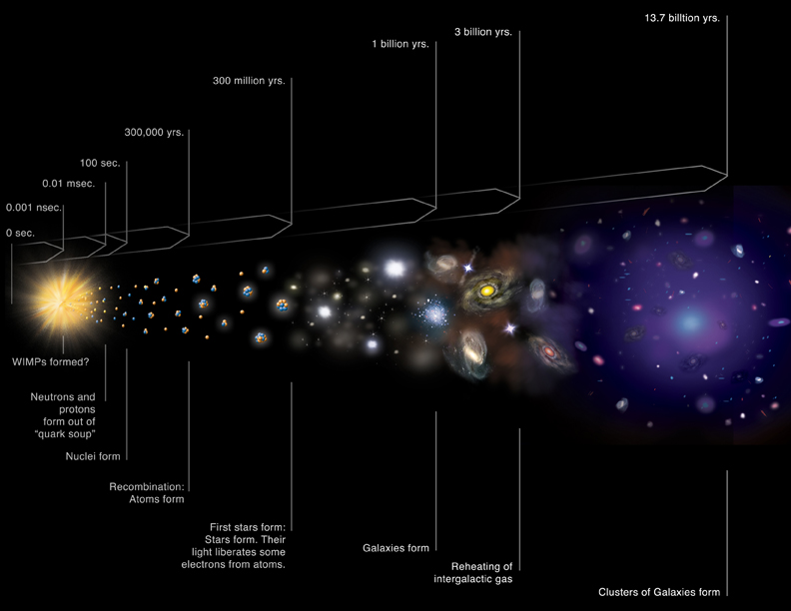
Galaxy formation and evolution
Notes:
Our group studies evolution of galaxies over cosmic time.
One of the way to do it is to study stellar mass of the galaxies i.e., amount of baryonic matter locked into stars
Stellar population is different in different galaxies and it evolves with time. A key aspect in studying galaxy formation and evolution is to understand how their stellar populations evolve in time.

Slide 3
Outline
Context — evolution of galaxies over cosmic time:
  Lilly-Madau diagram, CSFH, GSMD
Stellar masses of galaxies:
  From photometry to SED
  From SED fitting to redshift and mass
Sample — wide field optical and near-IR surveys
  Construction of the largest optical+near-IR catalog
  Unique approach — template fitting to obtain consistent flux measurements
Mass and redshift estimates
  SED fitting
  Calibration and validation of the catalog
  Constraints on GSMD
Results and future work
  Future work with the catalog
  Subsample of WoDrops
Conclusions

Slide 4
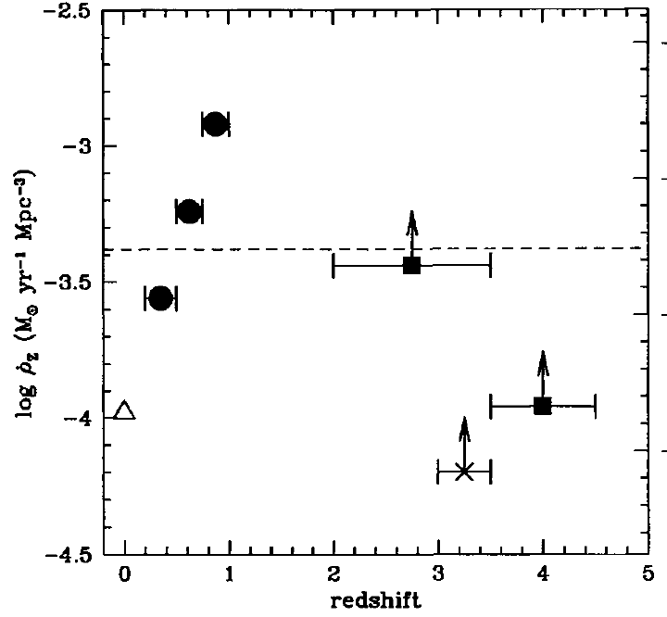
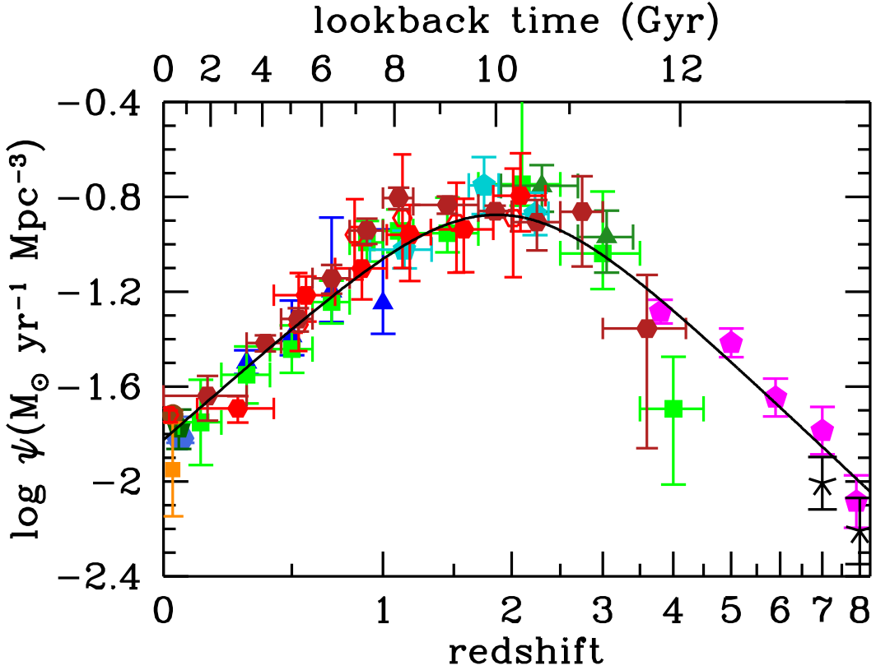
Cosmic Star Formation History
Madau et al. 1996
Madau & Dickinson 2014
One of the first versions of CSFH plot with only 7 data points
The solid curve shows the total GSFRD from various FUV and IR rest-frame measurements
Improvement of our knowledge about CSFH over the last 20 years
Notes:
This is indeed the first plot, unlike Jerry was talking 2 days ago.
Numbers are different because it is dust-corrected on the right and dust not-corrected on the left

Slide 5
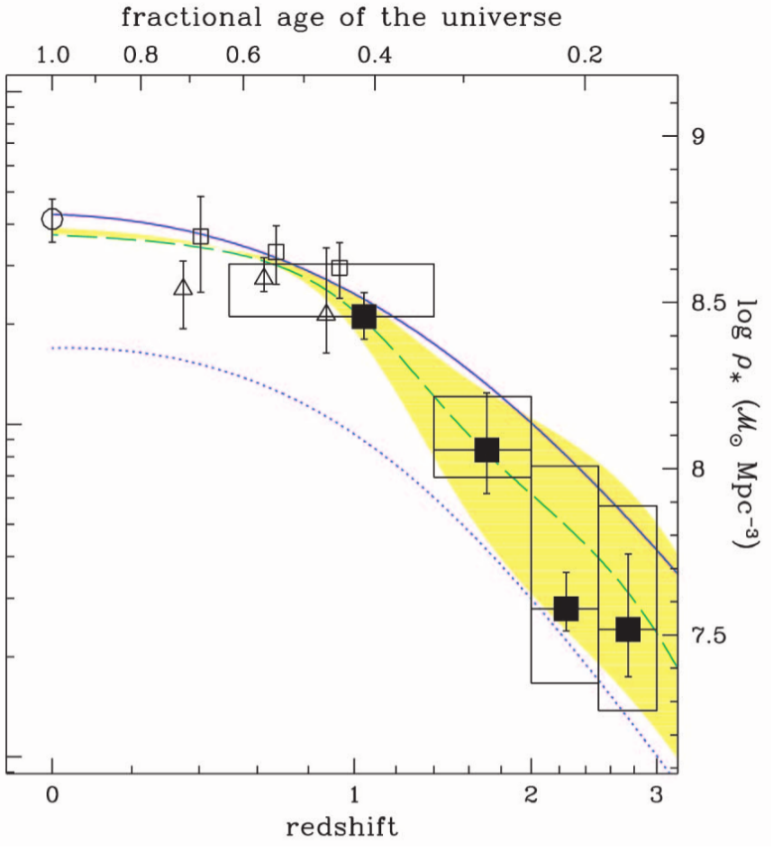
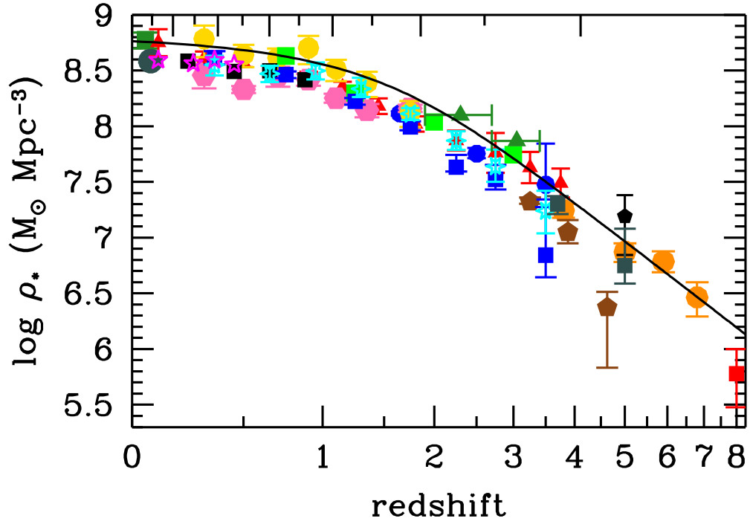
Global Stellar Mass Density
Dickinson et al. 2003
Madau & Dickinson 2014
GSMD traces the same physical processes from a different angle (because integral of SFR over time gives mass), and thus provides an independent venue to investigate the evolution of the Universe
Our goal is to contribute to the study of GSMD at 0<z<0.8 in a unique way so that we can provide the strongest constraints to galaxy evolutionary models
Notes:
People were doing this for years, but:
No large sample
Cosmic variance
Confined to optical regime

Slide 6
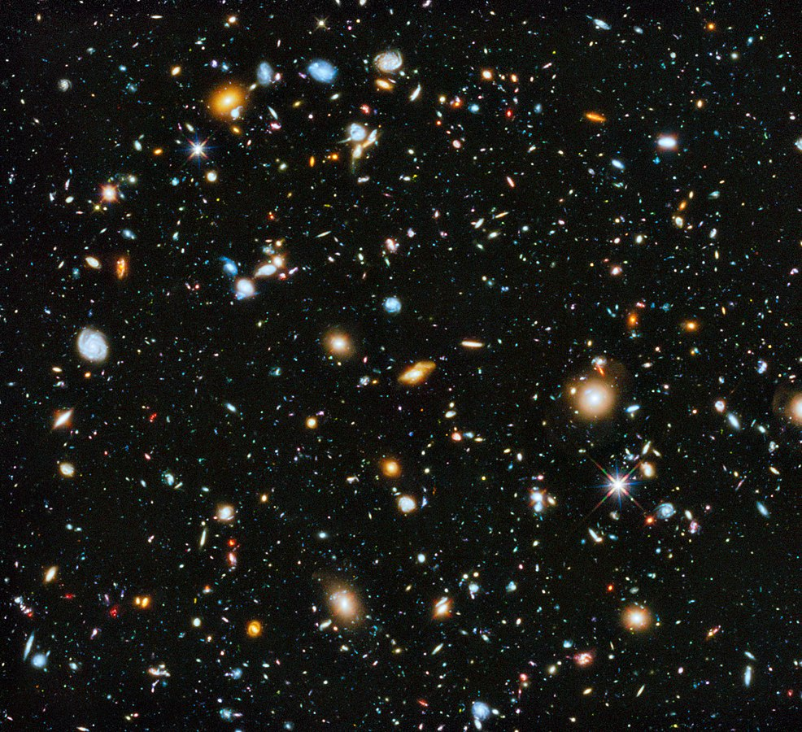
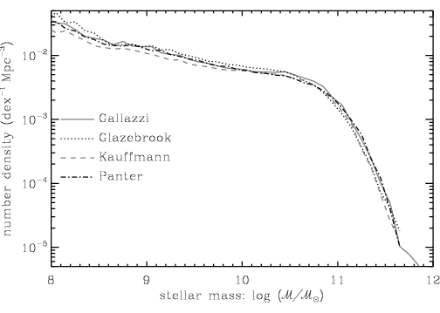
Measuring z & mass from light I.
?
HUDF – 10,000 galaxies in only 3 arcmin FOV
Stellar mass function – number density of galaxies of given mass
How do we go from observations to physical parameters?
Notes:
* Great importance — mass derivation
* Look at the spectra with different components: specific parts of the flux. We can find out what the galaxy «is made of» by looking at its spectrum.
* Mass? SED fitting! In optical => Dust Extinction => near-IR.
* Another advantage near-IR traces low-mass stars that contribute most to the total stellar mass budget of the galaxy.
* SED — standard technique, but no guaranties and always AGN => we need Large Sample
Arp 220 - ULIRG

Slide 7
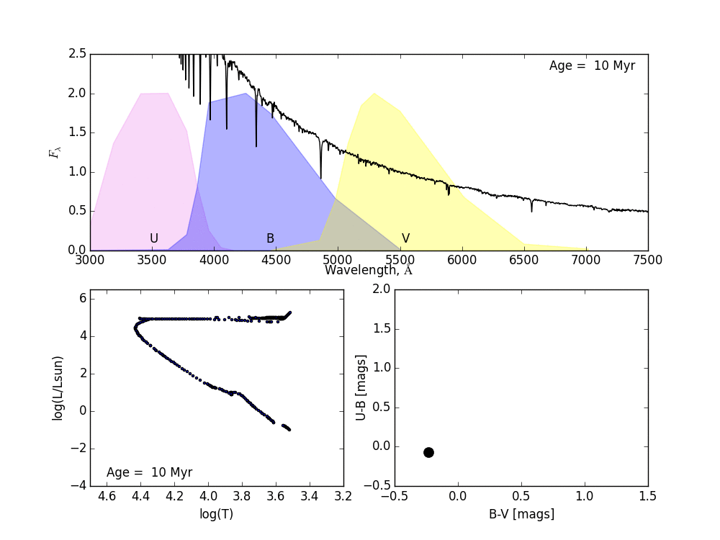
Measuring z & mass from light II. SED fitting
“Color” is the difference of magnitudes in two bands, it is proportional to the ratio of fluxes
M=-2.5*log(Flux density) + C
Ken Duncan
We use stellar population synthesis (SPS) modeling to study how the spectra, masses and colors of a population of stars evolve with time, under different input star formation histories. On this animation an evolving population of stars is formed in a single burst of star formation.
Notes:
Instability strip, supergiant branch,
For the large sample of galaxies we only can study their stellar populations using integrated colors. We use stellar population synthesis (SPS) modeling to study how the spectra and colors of a population of stars evolve with time, under different input star formation histories. Evolving population of stars is formed in a single burst of SF.

Slide 8
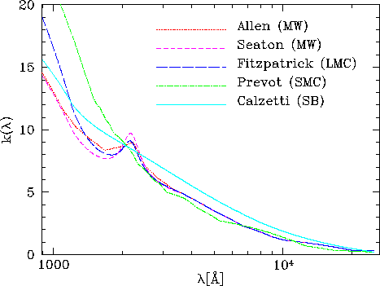
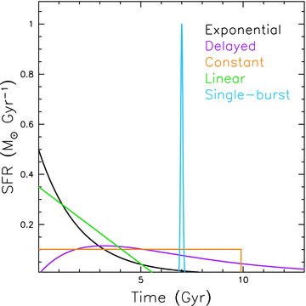
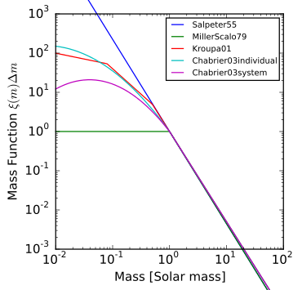
Measuring z & mass from light II. SED fitting
The whole process is very model-dependent:
What SFH we assign to galaxies?
What was the initial mass function (IMF)?
What law describes attenuation best?
What metallicities should be assumed?
Proper choice of SED fitting code is also important
Extinction curves from different laws
Different star formation histories (SFH)
Various initial mass functions
Notes:
extinction only by dust between us and galaxy/QSO
Attenuation – stars are within gas and dust in a galaxy
The most used law in high-redshift studies is derived by Calzetti as a purely empirical result from a sample of near starburst (SB) galaxies.
IMF - function that describes the distribution of initial masses of stars in a galaxy
2175 sm bump - It is thought that the
peak is caused by π-electron resonance produced in small
carbonaceous particles which include graphenes, poly-
cyclic aromatic hydrocarbons (PAH) and possibly small
graphite grains

Slide 9
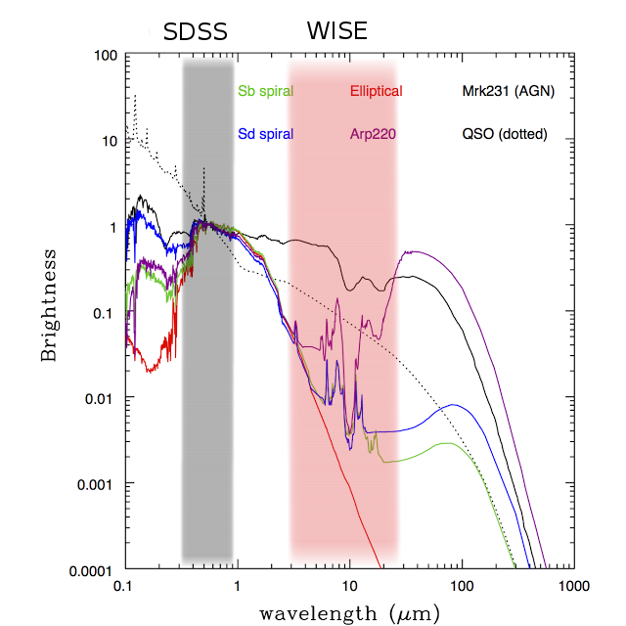

Measuring z & mass from light III. Degeneracy and low-mass stars
Degeneracy of dust vs. age:
Galaxy with red SED can be dusty
May have a very old stellar population
Or both
High metallicity effectively absorb UV
Polletta et al. 2007
Another issue - low-mass stars are cool, red and contribute most to the total stellar mass budget of the galaxy.
Near-IR data are needed to account for them
Notes:
*Spectral energy distributions for typical galaxies - old elliptical galaxy, spiral galaxies, AGN, QSO, and star-bursting galaxy Arp 220. Flux is scaled to unity in optical.
* Great importance — mass derivation
* Bullet point – we need deep data in optical and near-IR
* Mass? SED fitting! In optical => Dust Extinction => near-IR.
* Another advantage near-IR traces low-mass stars that contribute most to the total stellar mass budget of the galaxy.
* Arp 220 - ULIRG

Slide 10
Take out from introduction
We aim to study the evolution of stellar mass density in the Universe
The only way for us to get mass is to measure flux in different filters and do SED fitting
SED fitting heavily depends on models that are applied
But any model is useless if fluxes are not measured consistently – this is our main priority in the project

Slide 11
Outline
Context — evolution of galaxies over Cosmic time:
  Lilly-Madau diagram, CSFH, GSMD
Stellar masses of galaxies:
  From photometry to SED
  from SED fitting to redshift and mass
Sample — wide field optical and near-IR surveys
  Construction of the largest optical+near-IR catalog
  Unique approach — template fitting to obtain consistent flux measurements
Mass and redshift estimates
  SED fitting
  Calibration and validation of the catalog
  Constraints on GSMD
Results and future work
  Future work with the catalog
  Subsample of WoDrops
Conclusions

Slide 12
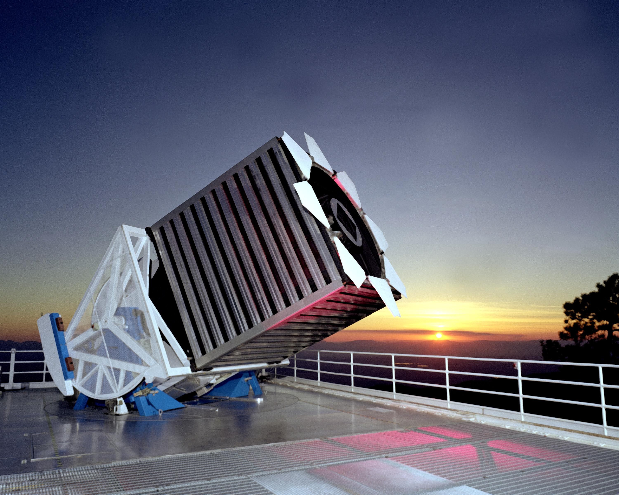
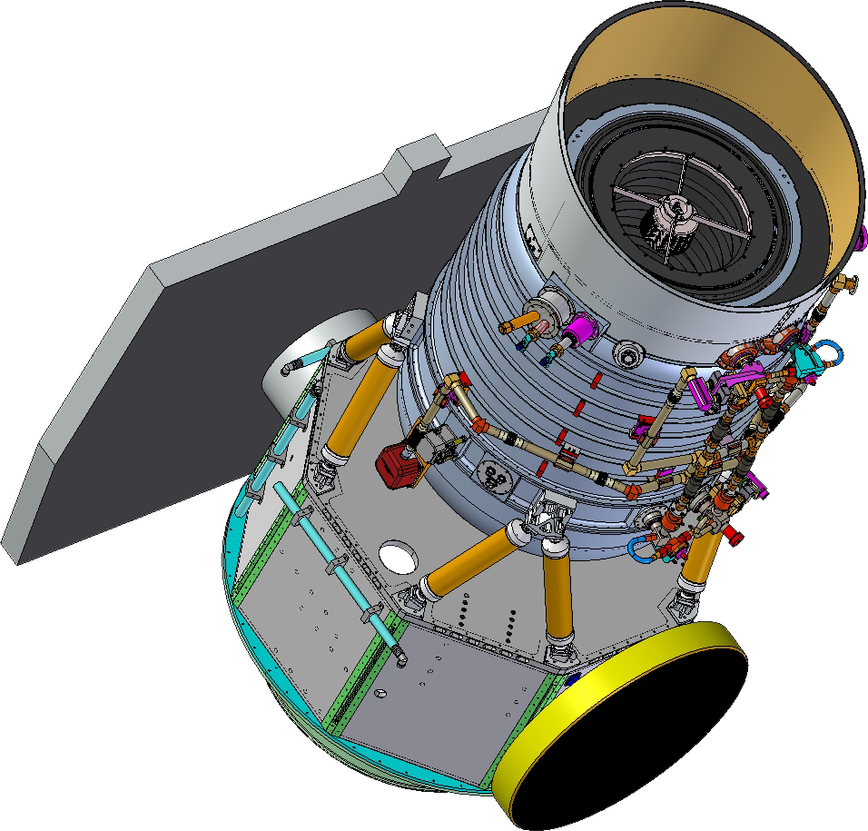
Facility and data I. SDSS and WISE
We need a synergy of optical and near-IR data from as deep and as wide-field data samples as possible
Notes:
* Great importance — mass derivation
* Look at the spectra with different components: specific parts of the flux. We can find out what the galaxy «is made of» by looking at its spectrum.
* Mass? SED fitting! In optical => Dust Extinction => near-IR.
* Another advantage near-IR traces low-mass stars that contribute most to the total stellar mass budget of the galaxy.
* SED — standard technique, but no guaranties and always AGN => we need Large Sample
Arp 220 - ULIRG

Slide 13
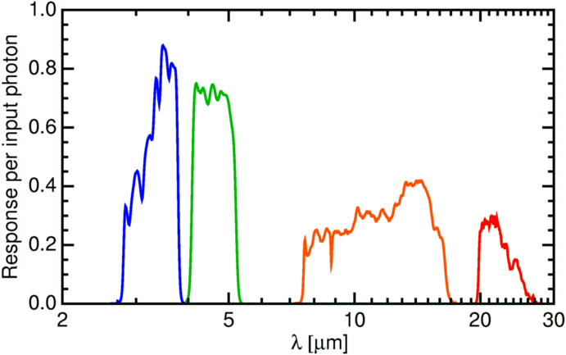
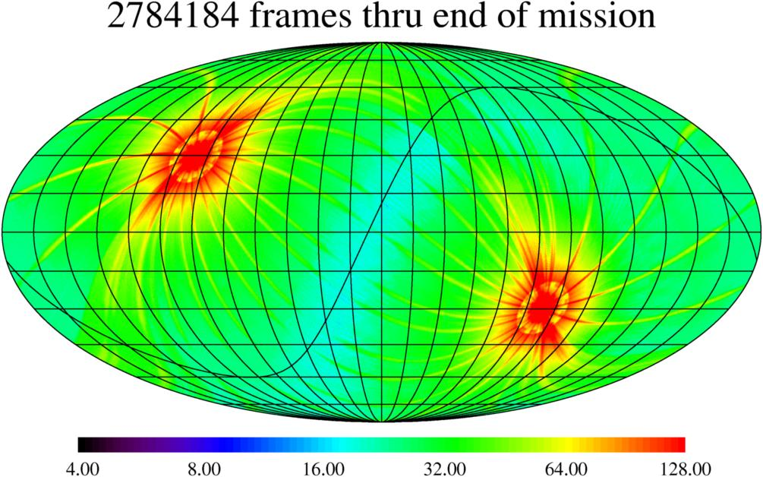
Facility and data II. WISE
WISE team
WISE response per photon (i.e. QE of CCD times the transmission of the optics and filters).
Other near-IR surveys are not suitable for this project:
- 2MASS has low sensitivity;
- Spitzer does not cover sufficient area where we have deep optical data.
Notes:
Telescope is used for detection and observations of intrinsically red objects — dusty galaxies, old galaxies, brown dwarfs, galaxies at high redshifts.

Slide 14
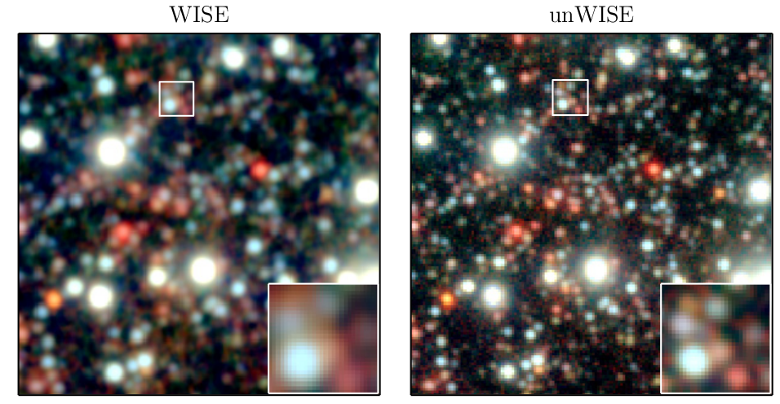
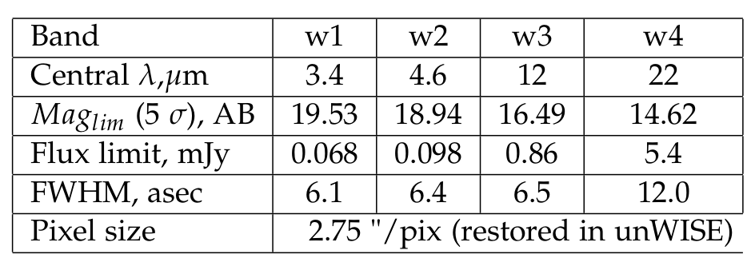
Facility and data II. Not WISE — unWISE
Lang. 2014
The 7' × 7' co-add tile of the north ecliptic pole, three-band composites (w1, w2, w3).
Left: AllWISE Release Atlas Image (1.375 “/pix)
Right: unWISE co-add with restored intrinsic resolution (2.75 “/pix)
Notes:
* Official images blurred (better detection of isolated sources). Method - re-sampling to the co-add pixel grid + extra convolution by the PSF
* problems — blending + decrease of SNR (PSF broadening)
* unWISE — restoration of original resolution and better estimation of the background:
Original unc maps overestimated the variance (broad Gaussian), by constructing inverse-variance maps Lang reduced this broadening to Gaussian with a unit of standard deviation — less varying background => better flux measurements.

Slide 15
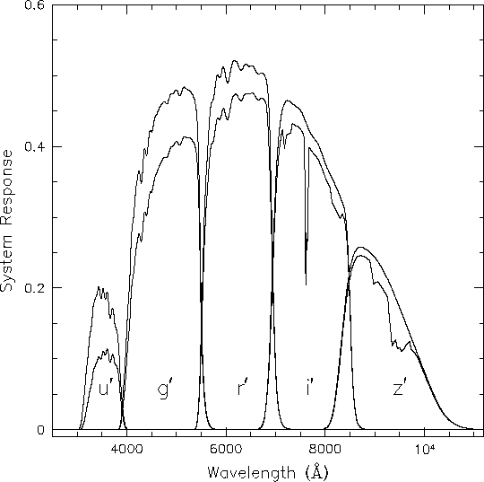
Facility and data III. SDSS
Fukugita et al. 1996
Frieman
SDSS — multi-filter 2.5-m wide-angle optical telescope at Apache Point Observatory in New Mexico
The SDSS system response curves. The curves represent expected total QE of the CCD plus telescope optics.
Band | Central wavelength, Å | Limiting magnitude at 95% completeness
u | 3551 | 22.0 AB
g | 4686 | 22.2 AB
r | 6165 | 22.2 AB
i | 7481 | 21.3 AB
z | 8931 | 20.5 AB
Nominal depth of SDSS can only detect "normal" galaxies up to z<0.4. (Some particular types of objects though, such as quasars, can be probed to higher redshifts).
Notes:
* SDSS - drift scanning technique, which keeps the telescope fixed and makes use of the Earth’s rotation to record small strips of the sky. The image of the stars in the focal plane drifts along the CCD chip, instead of staying fixed as in tracked telescopes. This method allows consistent astrometry over the widest possible field and precision remains unaffected by telescope tracking errors.
* more than 10 000 sq deg
* Extinction => we need restframe near-IR

Slide 16
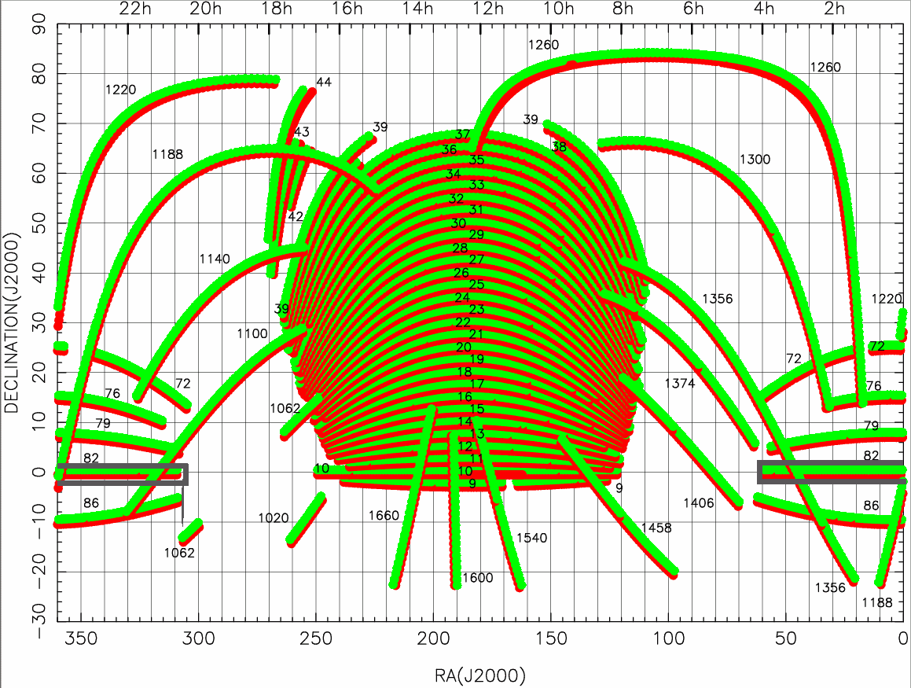
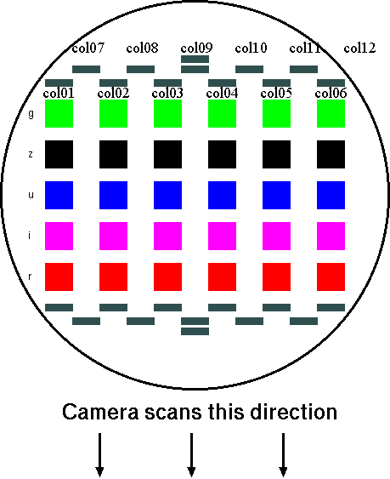
Facility and data III. SDSS Stripe 82
Credits: SDSS Foundation
PSF FWHM, r-band - 1.3 arcsec
Pixel scale - 0.396 arcsec
Exposure time per band - 53.9 sec
Time between observations of each band - 71.72 sec (in riuzg order)
Global astrometric precision - 0.1” rms
Full SDSS Footprint (10 400 square degrees)
with Stripe labels including Stripe 82.
Notes:
* Drift scanning technique
Stripe 82 is a region of the sky close to selectial aquator that was repetedly scanned by SDSS for 70-90 times
Mention that there are Ra and Dec on the left
12 stripes with different psf, usually worse closer to the edges.
Not deep enough for us!

Slide 17
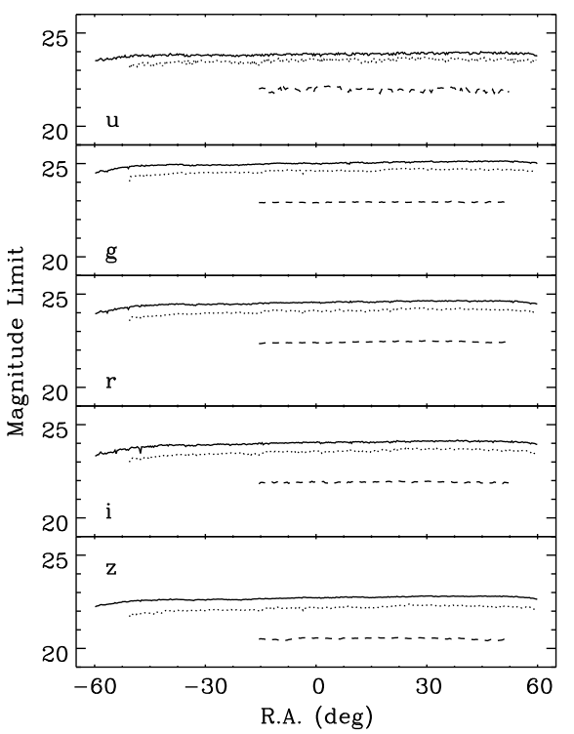
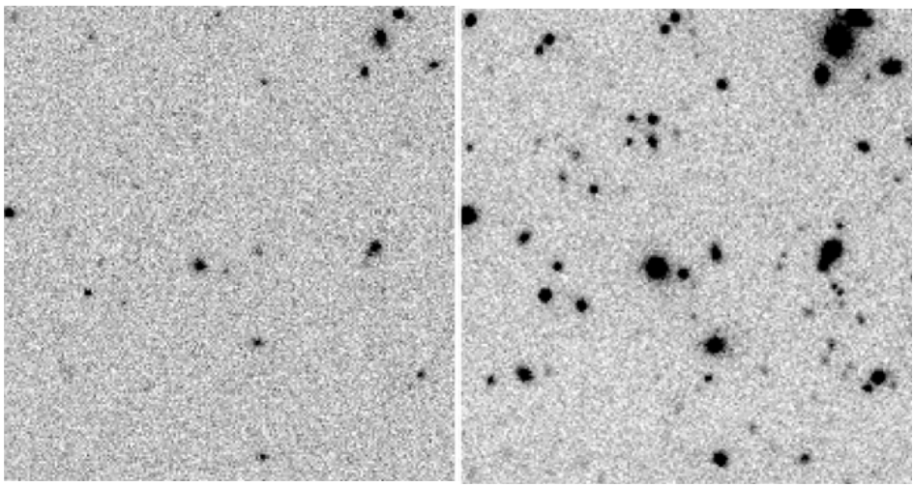
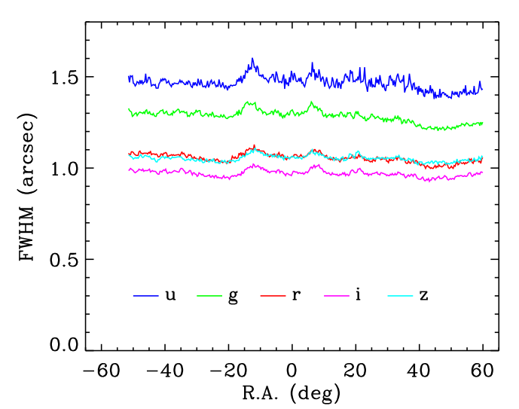
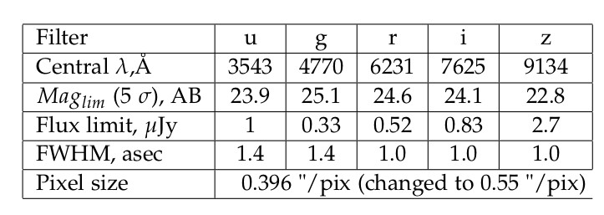
Facility and data III.Stripe 82 co-adds
i-band
Jiang et al. 2014
5σ detection limits of the aperture (1".6) magnitudes for point sources
The co-adds PSF FWHM in the riz bands is ~1".0, and ~1".3–1".5 in ug bands
Notes:
* Best seeing conditions.
* dotted lines — another co-adds by Annis et al. 2011
* Direct comparison between a single-epoch i-band frame and co-add
* Now it's deep enough
* But what's with IR?

Slide 18
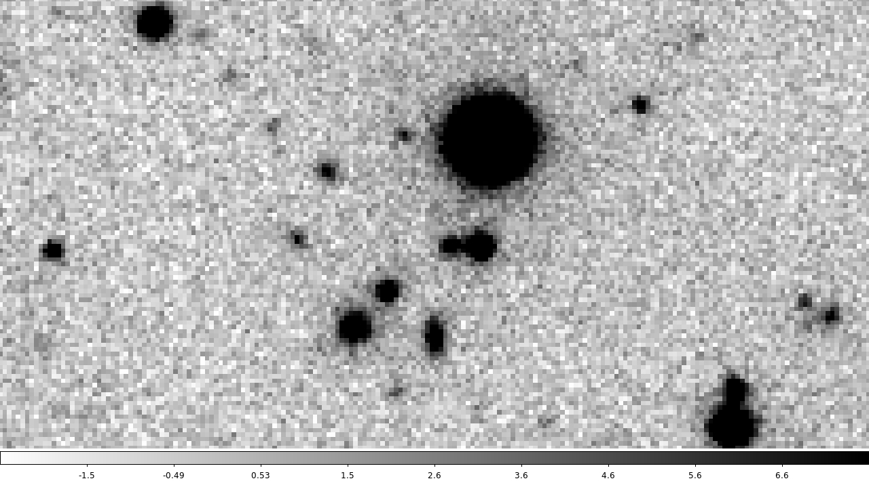
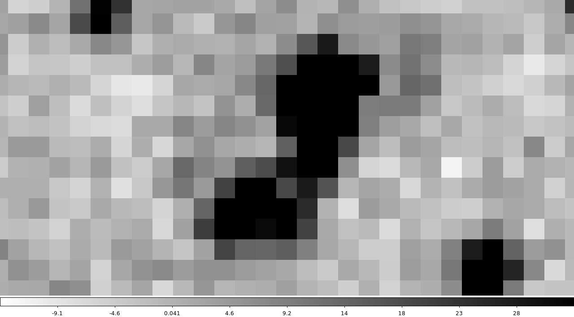
Catalog I. Near-IR - what is the problem?
Critical factor is consistent photometry. It is challenging because the spatial resolutions of WISE is 5-6x worse than that of the SDSS.
Objects detected in WISE suffer from the blending problem.
Photometric apertures appropriate for the WISE images cannot guarantee the same fraction of light being included comparing to SDSS. Such a systematic offset, which is different for every galaxy, can severely skew the SED fitting.
SDSS i-band
WISE w1
Notes:
* Resolution - 5-6 times difference.
* Very important problem :construct correct SEDs we need to be sure that our measurements are consistent and for each band the flux is coming only from that object and it is all flux from that object.
* One of the ways to approach this problem is to do “template fitting”

Slide 19
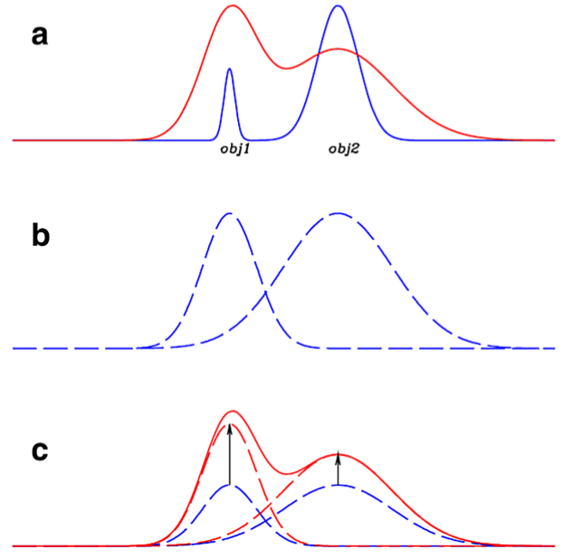
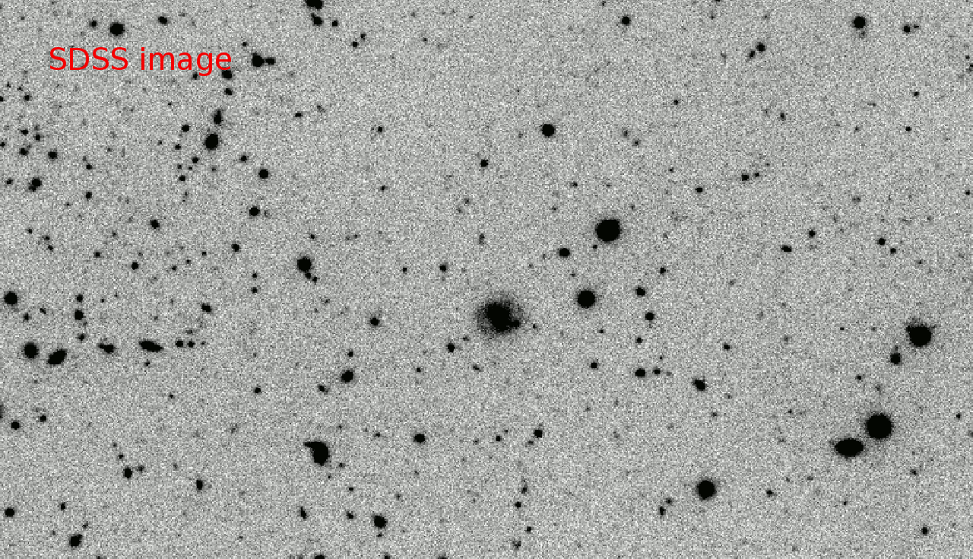
Catalog I. Near-IR - Template fitting
E. Merlin, 2015
Residual images
Catalog with 26,585,000 sources (galaxies, stars, QSO) with consistent fluxes and associated flux errors in 7 bands
Notes:
* Sources in the high resolution image are then individually smoothed to the PSF of the low resolution image, to obtain normalized model templates. Then the intensity of each object is scaled to match the global profile
* Choose i-band for detection — best FWHM and it's close to IR.
* This morphological template fitting produces consistent magnitudes that is extremely important for the construction of trustworthy SED (and subsequent mass estimates).
* Preparation for the run of Tphot is very tedious and requires creating kernels

Slide 20
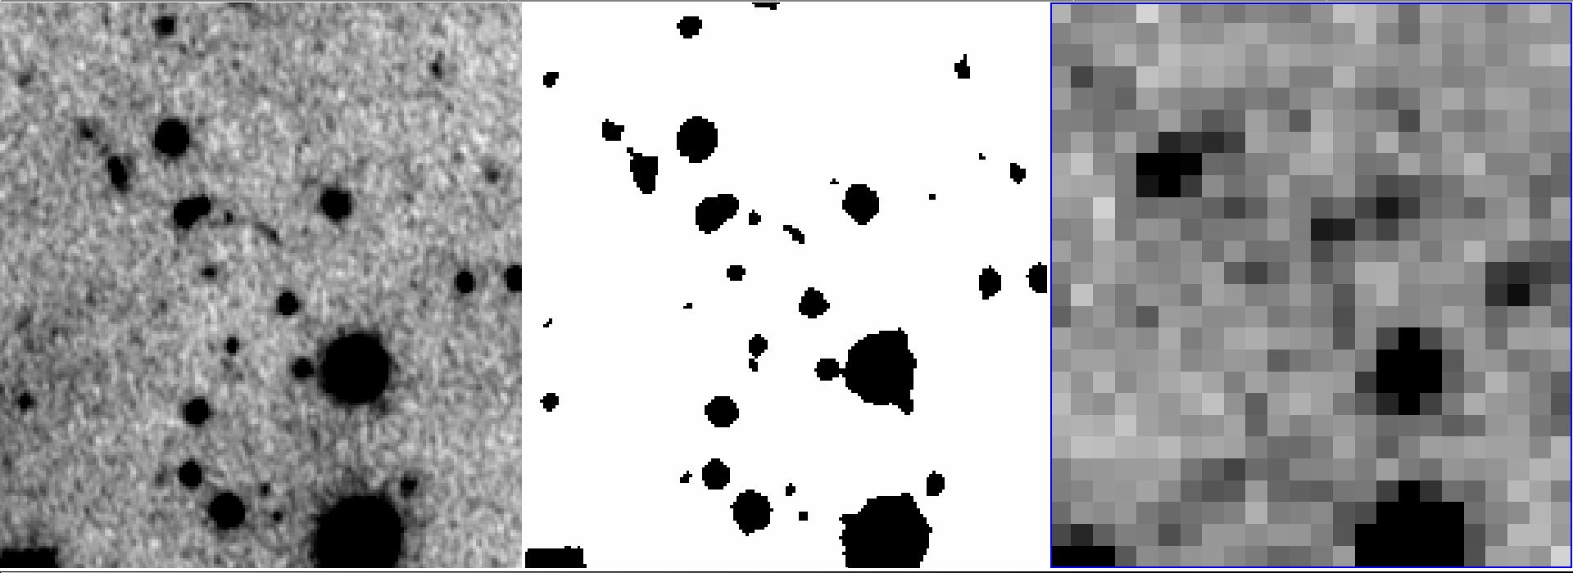
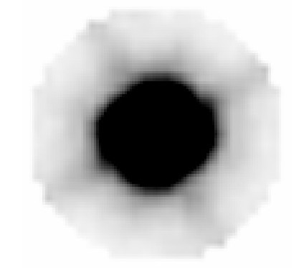
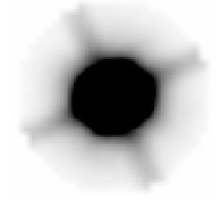
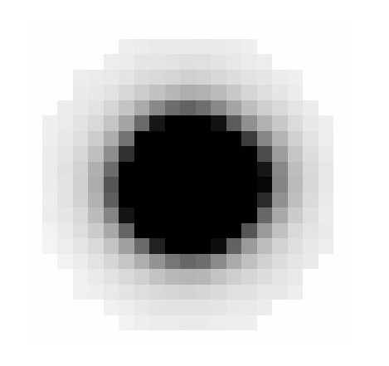
Catalog I. Near-IR - Template fitting
SDSS high-res image SDSS segmentation map unWISE w1-band
Because I know PSF of both high-res and low-res images, sources do not have to be point-like neither in high-res, nor in low-res images to be successfully subtracted
High-res PSF Low-res PSF Kernel
Notes:
* Sources are extended,
* Morphology is preserved

Slide 21
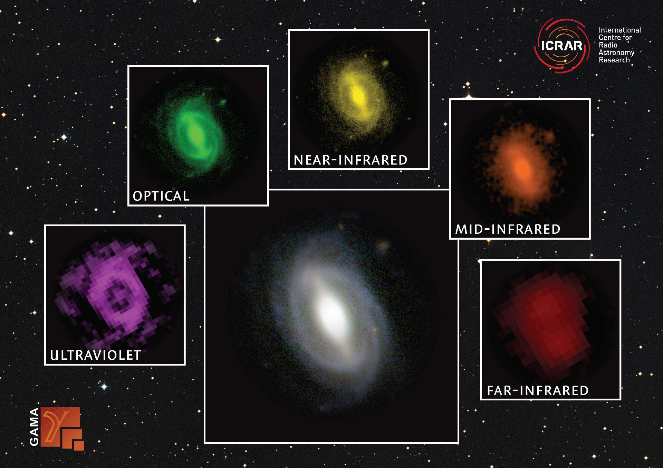
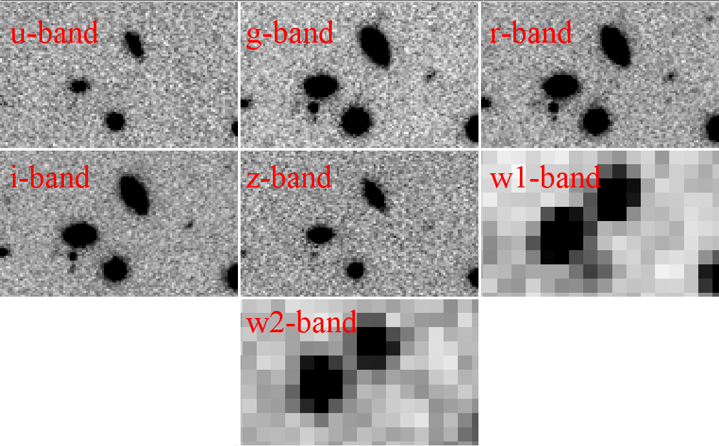
Catalog I. Near-IR - Assumption
“Template fitting” technique suggests that galaxy's morphology is the same in high-res and low-res images. Generally speaking, this is not correct.
But angular size of regular (60kpc in diameter) galaxy at z=0.7 is only 8 pix
Notes:
* Sources in the high resolution image are then individually smoothed to the PSF of the low resolution image, to obtain normalized model templates. Then the intensity of each object is scaled to match the global profile
* This morphological template fitting produces consistent magnitudes that is extremely important for the construction of trustworthy SED (and subsequent mass estimates).
* Preparation for the run of Tphot is very tedious and requires creating kernels
, and we approach this issue from 2 sides:
1. given the angular size of the vast majority of the sources this should not be a big concern.
2. r-band (high-res image) is a red filter, should not be any extreme variations.

Slide 22
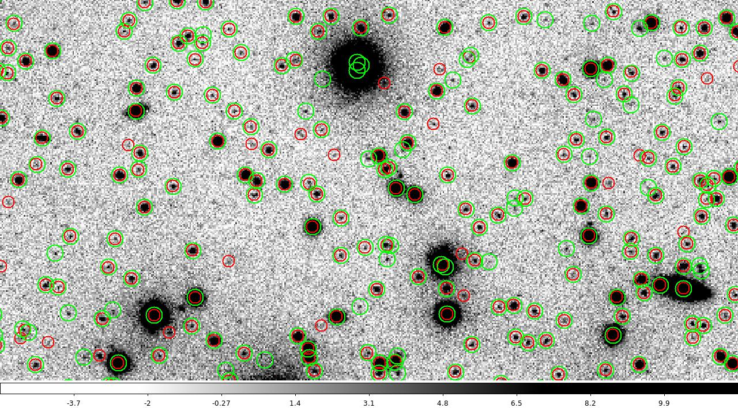
Catalog II. Optical. Why do we need it?
Catalog from Jiang et al. — green circles; our catalog — red circles.
Why do we need to construct our own catalog?
1) Original catalog has to high detection threshold — lots of sources are rejected
2) Catalog is not cleaned out — multiple detections around saturated areas.
Notes:
* Our — red, Their — green.
* We run SExtractor, a tool for doing source photometry. Main parameters are in the appendix.
* Our catalog has 26 million sources – this is the data we are going to work with.
* Now we need to create kernel to match sources in low res and high res images.

Slide 23
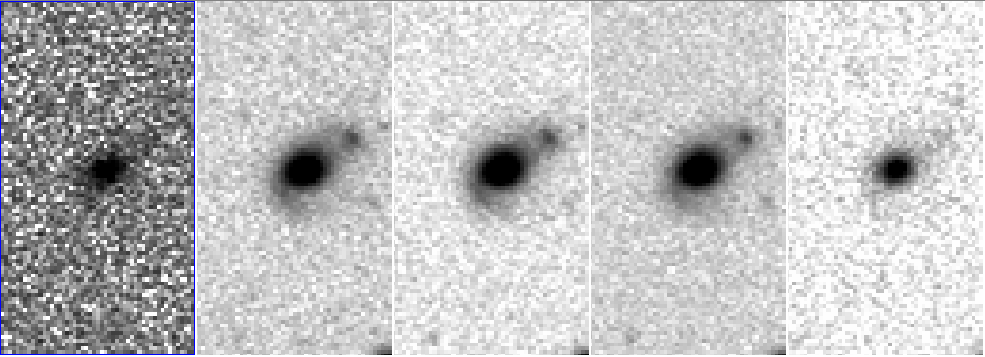
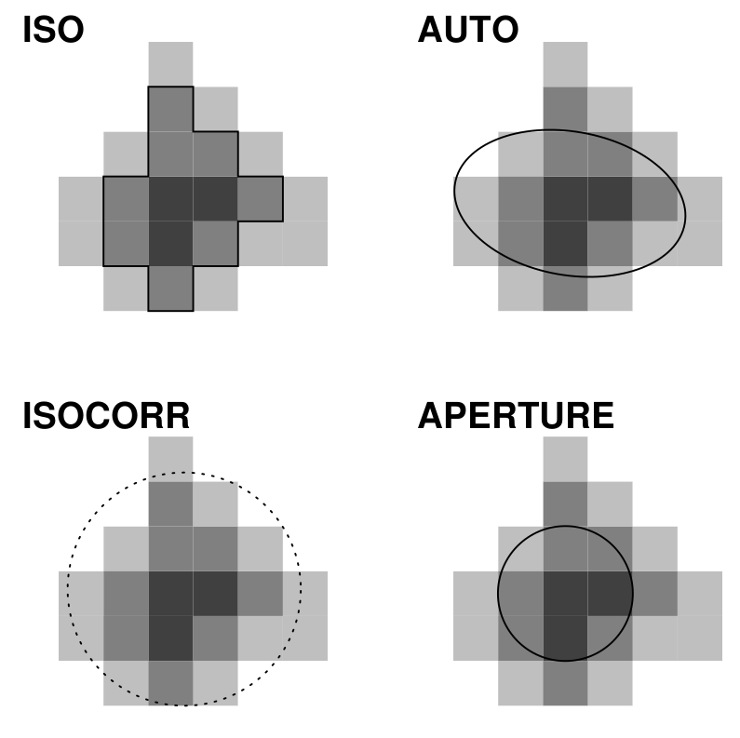
Catalog II. Optical
It is not trivial to extract consistent flux even in SDSS bands due to different FWHM, sensitivity and seeing. Source detection in each individual band
does not include same fraction of the light from a given
source in all bands.
Different possible apertures in SExtractor:
Notes:
(MAG ISO) - detection threshold as the lowest isophote.
(MAG ISOCOR) - Corrected isophotal magnitudes, faint objects recorded on the plate are roughly Gaussian, cheap correction works best with stars
(MAG AUTO)- the most precise estimate for galaxies. Inspired by Kron’s algorithm (1980). We define an elliptical aperture whose elongation and position angle are defined by second order moments of the object’s light distribution.

Slide 24
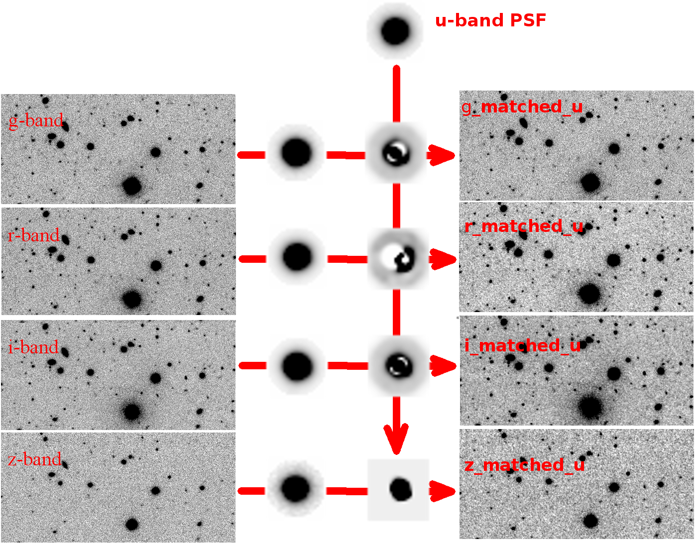
Catalog II. Optical - FWHM
Our approach - convolve all 5 bands to the PSF of u-band
Notes:
* Our — red, Their — green.
* We run Sextractor, a tool for doing source photometry. Main parameters are in the appendix.
* Our catalog has 22 million sources – this is the data we are going to work with.
* Now we need to create kernel to match sources in low res and high res images.

Slide 25
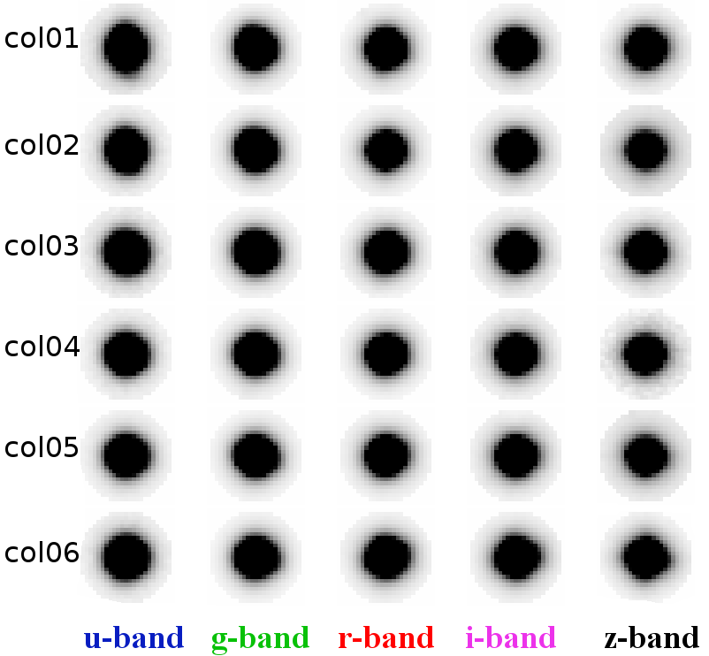
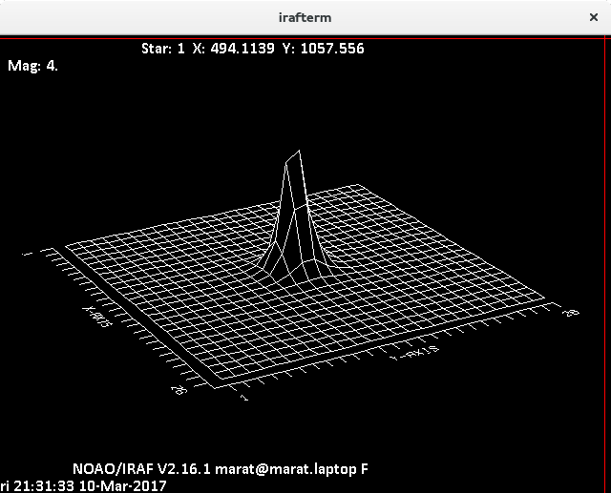
Catalog II. Optical - PSF
We need PSF for every SDSS image – 28,000 PSFs
Each PSF is constructed using ~100 stars
Each PSF needs to be visually inspected
By far the most time-consuming part of the project...
Notes:
It was my zen – to select sources.
Then we made it semi-automatic and my zen was to go over it one by one and fix only the one that are wrong

Slide 26
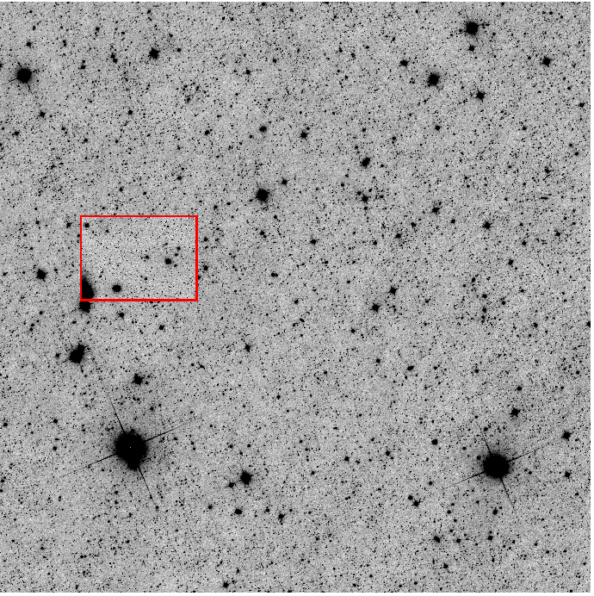
Catalog IV. Multiband - almost complete
Once all PSF were constructed we extracted fluxes in all 5 bands using r-band as detection image
Source is added to catalog if it is detected in r-band with SNR>5
We use position, morphology and flux of the source in r-band to perform template fitting on near-IR bands
Relative sizes of one unWISE frame relative to one SDSS image
Notes:
* Sources in the high resolution image are then individually smoothed to the PSF of the low resolution image, to obtain normalized model templates. Then the intensity of each object is scaled to match the global profile
* Choose i-band for detection — best FWHM and it's close to IR.
* This morphological template fitting produces consistent magnitudes that is extremely important for the construction of trustworthy SED (and subsequent mass estimates).
* Preparation for the run of Tphot is very tedious and requires creating kernels

Slide 27
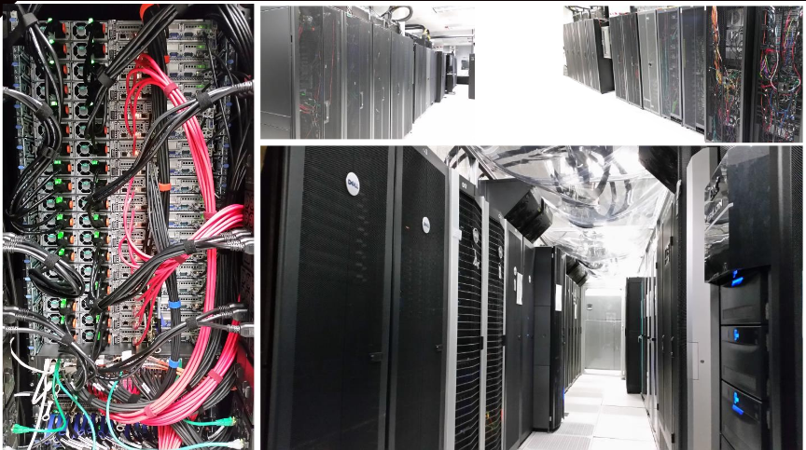
Catalog IV. Multiband - almost complete
It takes ~4 hours of CPU time to process one image as small as 253 arcmin² in one band (w1 or w2)
There are 5556 images per band
We use MU Lewis computational cluster to speed up my graduation
High-Performance Computing is a shared cluster accessible to researchers at the University of Missouri
Relative sizes of one unWISE frame relative to one SDSS image
Notes:
* Sources in the high resolution image are then individually smoothed to the PSF of the low resolution image, to obtain normalized model templates. Then the intensity of each object is scaled to match the global profile
* Choose i-band for detection — best FWHM and it's close to IR.
* This morphological template fitting produces consistent magnitudes that is extremely important for the construction of trustworthy SED (and subsequent mass estimates).
* Preparation for the run of Tphot is very tedious and requires creating kernels

Slide 28
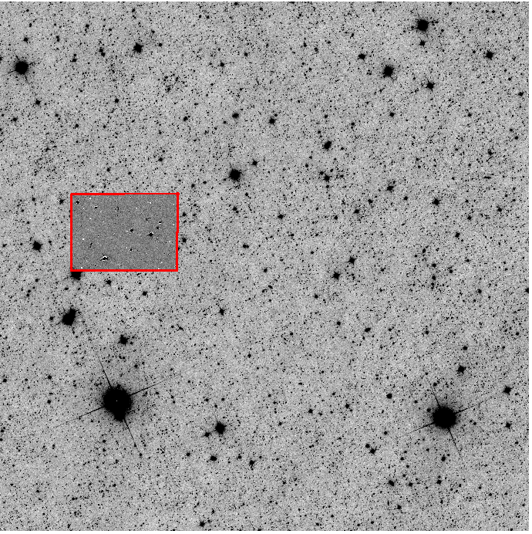
Catalog IV. Multiband - almost complete
It takes ~4 hours of CPU time to process one image as small as 253 arcmin² in one band (w1 or w2)
There are 5556 images per band
We use MU Lewis computational cluster to speed up my graduation
High-Performance Computing is a shared cluster accessible to researchers at the University of Missouri
Relative sizes of one unWISE frame relative to one SDSS image
Notes:
* Sources in the high resolution image are then individually smoothed to the PSF of the low resolution image, to obtain normalized model templates. Then the intensity of each object is scaled to match the global profile
* Choose i-band for detection — best FWHM and it's close to IR.
* This morphological template fitting produces consistent magnitudes that is extremely important for the construction of trustworthy SED (and subsequent mass estimates).
* Preparation for the run of Tphot is very tedious and requires creating kernels

Slide 29
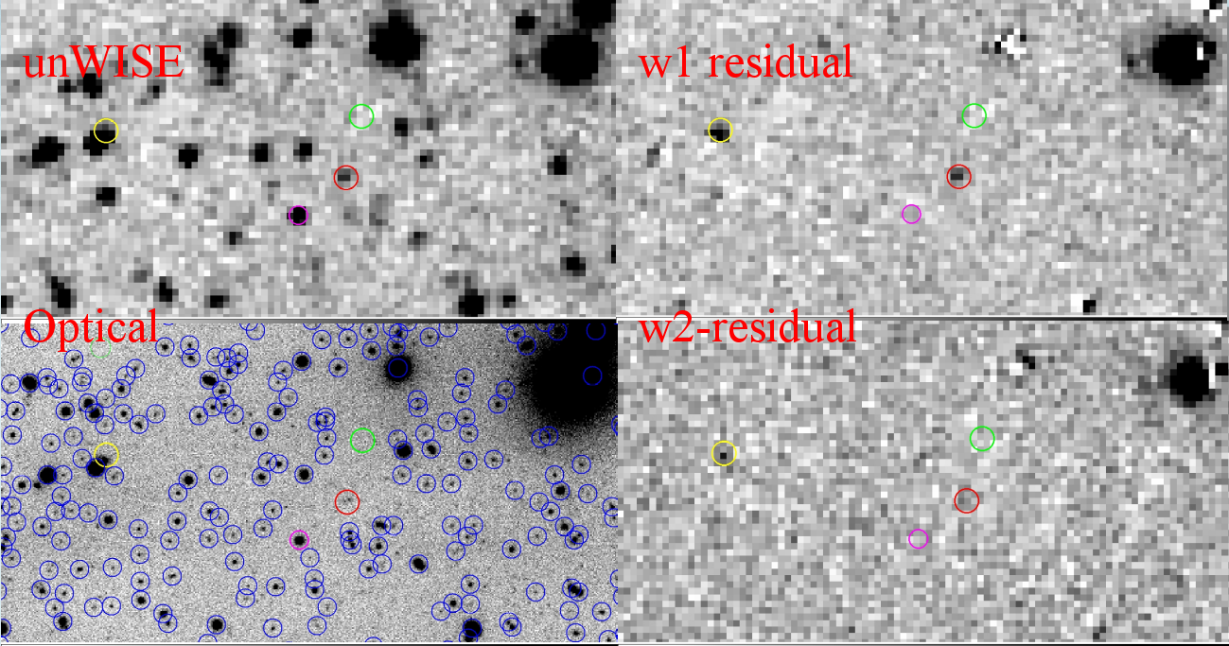
Catalog IV. Multiband - complete
Pixel values of "cleaned out" sources in near-IR are stored to the output catalogs.
We match optical and near-IR catalogs by the source number and validate combined catalogs
Construction of a set of 26,585,000 sources with robust fluxes in 7 bands is complete
Notes:
Green — background. No change
Red — no source (undetected at least)
Purple — detected and well-cleaned source
Yellow - (successful) de-blending

Slide 30
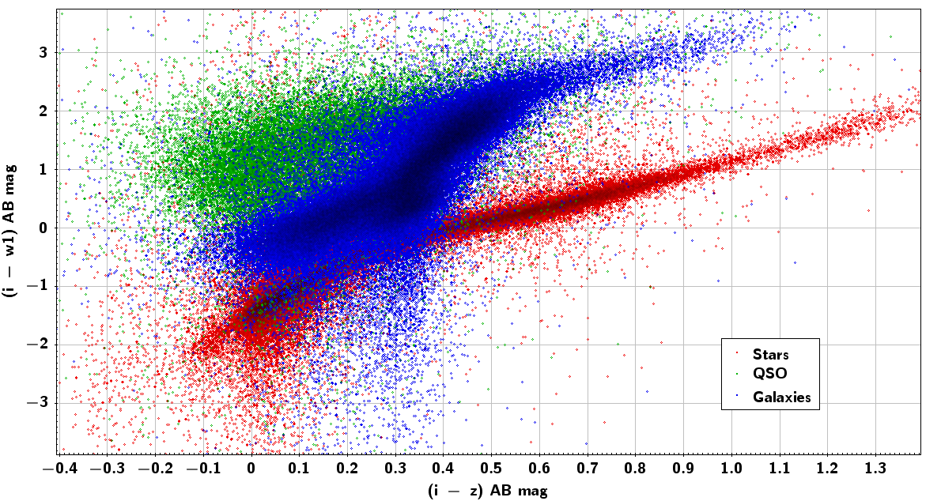
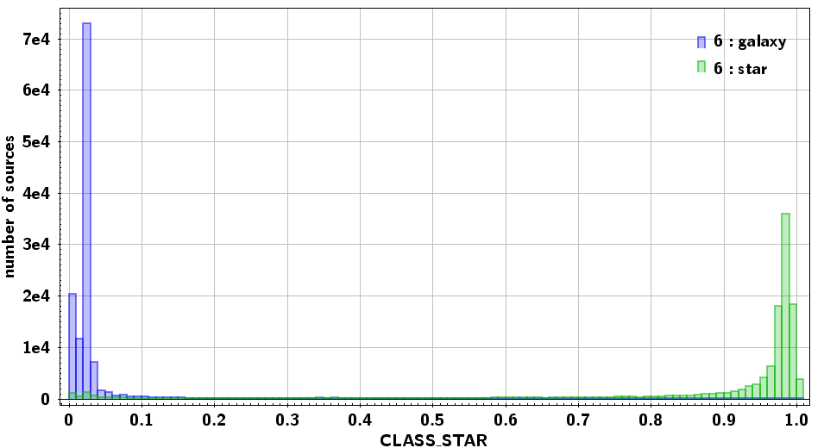

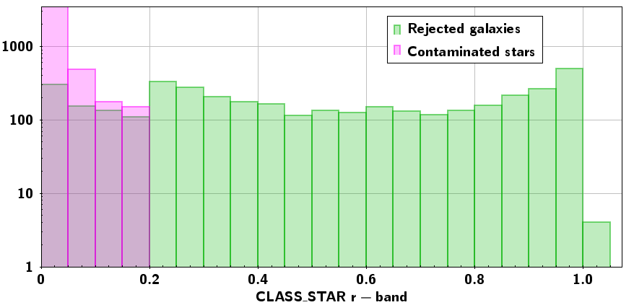
Catalog V. Star-galaxy separation
# Default configuration file for SExtractor 2.8.6
#------------------------- Star/Galaxy Separation ----------------------------
SEEING_FWHM 1.1 # stellar FWHM in arcsec
STARNNW_NAME default.nnw # Neural-Network_Weight table
9,340,700 Galaxies with ~2% contamination by stars and QSO

Slide 31
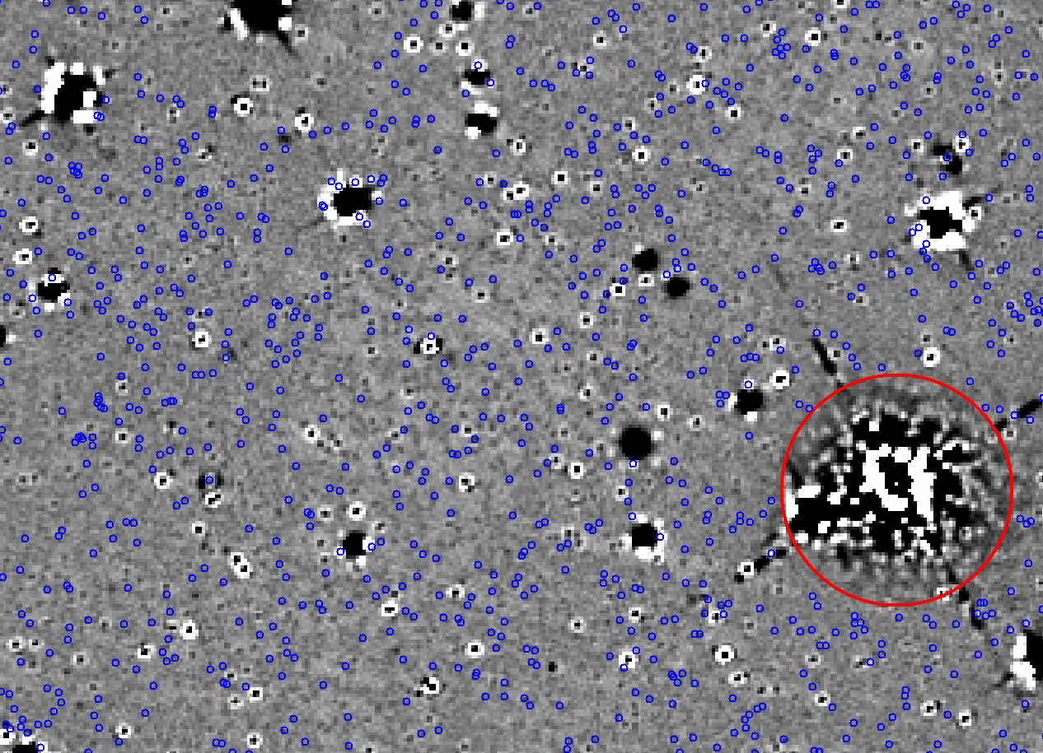
Catalog V. Mask bright/saturated objects
Smithsonian astrophysical observatory star catalog
Bright IR Star Compilation (BSIRC) – IPAC team
300 regions added after visual inspection
In total - 700 masked regions in Stripe 82 with angular radii up to 500”
Final numbers before we start SED fitting:
Total area – 288.212 deg²
Total number of galaxies – 9,294,705, largest catalog with robust fluxes in optical and near-IR bands

Slide 32
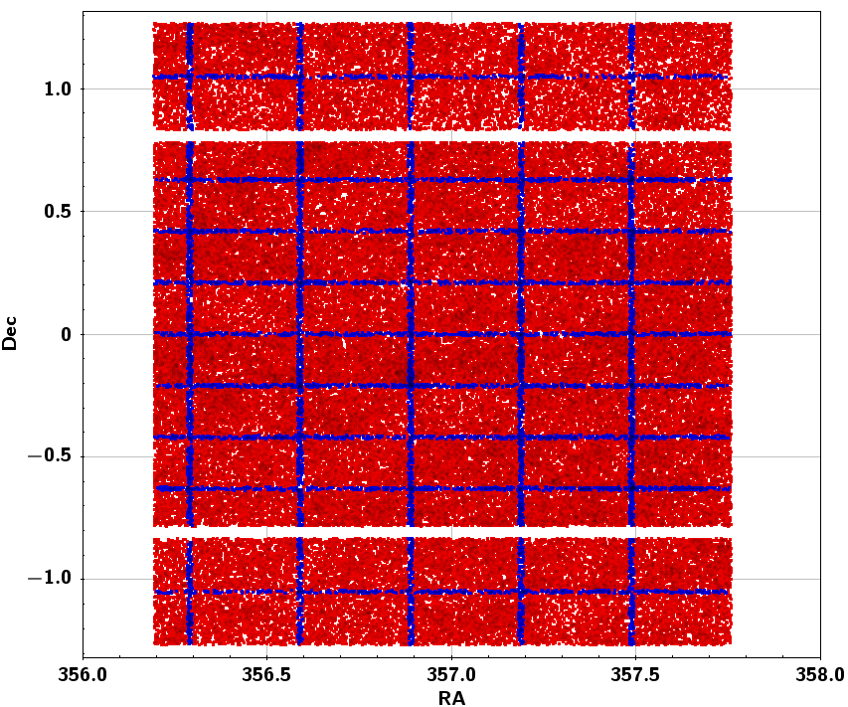
Catalog V. Remove duplicate sources
Final numbers before we start SED fitting for mass estimation:
Total area – 288.212 deg²
2,305,280 point-like stars selected
33,800 PSF constructed
66,700 CPU hours of TPHOT run
741 cups of coffee drunk
Total number of galaxies – 9,061,068 – creates the largest sample with consistent fluxes in optical and near-IR
This catalog creates a solid basis for the future study of the galaxy evolution. Now we can present some preliminary results

Slide 33
Outline
Context — evolution of galaxies over Cosmic time:
  Lilly-Madau diagram, CSFH, GSMD
Stellar masses of galaxies:
  From photometry to SED
  from SED fitting to redshift and mass
Sample — wide field optical and near-IR surveys
  Construction of the largest optical+near-IR catalog
  Unique approach — template fitting to obtain consistent flux measurements
Mass and redshift estimates
  SED fitting
  Calibration and validation of the catalog
  Constraints on GSMD
Results and future work
  Future work with the catalog
  Subsample of WoDrops
Conclusions

Slide 34


SED fitting I. Photometric redshifts
Adam Tomczak, ZFOURGE
Using small sub sample of the catalog we tested different SED fitting codes and parameters.
We decided to utilize SED fitting code EAZY (Brammer et al. 2008) – that computes photometric redshift extremely fast.
Another SED fitting code, FAST (Kriek et al. 2009) was used later on to calculate stellar mass
Histogram of photometric redshifts calculated with EAZY
Notes:
* Sources in the high resolution image are then individually smoothed to the PSF of the low resolution image, to obtain normalized model templates. Then the intensity of each object is scaled to match the global profile
* Choose i-band for detection — best FWHM and it's close to IR.
* This morphological template fitting produces consistent magnitudes that is extremely important for the construction of trustworthy SED (and subsequent mass estimates).
* Preparation for the run of Tphot is very tedious and requires creating kernels

Slide 35



SED fitting I. Photometric redshifts
Range in redshift for which we can get reasonable data was estimated from comparison to the “golden standard” - SDSS DR14 spectroscopic data
Galaxies in general follow 1:1 line up to z~0.7
Large scatter and trends needs more thoughtful analysis, several most obvious reasons were already discarded
Mean value (spec_z-phot_z)=0.02
Standard deviation = 0.077
Photometric redshift estimation tests with and without near-IR bands
Notes:
Compare to z~0.4 for usual single-pass SDSS

Slide 36

SED fitting II. Models for mass estimation
Mass estimation is model-dependent, no golden standard to verify our parameters.
We used FAST code with Bruzual&Charlot'03 stellar population synthesis models
Chabrier IMF, Calzetti attenuation law, solar metallicity
We only implemented single stellar population with exponentially declining star formation history with varying tau:
SFR(t) ~ e^(-t/tau)
Animation shows evolution of galaxy in SFR, mass, magnitude and color with exponentially declining star formation rates for 4 different free parameters “tau”.
Notes:
From here: http://burro.case.edu/Academics/Astr222/Galaxies/Intro/sfrprops.html

Slide 37

SED fitting III. Stellar masses
Stellar masses for the whole sample of galaxies. We constrained redshift range, but not the mass.
Normal stellar mass range for galaxies is 7 < Log10(M/Msun) < 12
Can you find our Milky Way?

Slide 38

SED fitting III. Compare stellar masses
Comparing our data to other group's estimates. No golden standard here – stellar mass is always model dependent

Slide 39


GSMD I. Redshift binning
We take 4 comoving volume bins of equal size– 20 Gpc^3.
Red points – sample is highly incomplete and will bias our estimates.

Slide 40


GSMD II. Our results
Global stellar mass density – evolution of the stellar mass in a given volume bin in time

Slide 41


GSMD III. A few words about completeness
We are incomplete in the low-mass region, this still needs to be corrected

Slide 42





GSMD III. Blue cloud and red sequence
z1 z2 z3
Observed bi-modality between late-type (spiral) and early type (elliptical) galaxies in different redshift bins
z4
 | λ, nm @z=0 | Color @z=0 | λ, nm @z=0.7 | Color @z=0.7
u-band | 355.1 | NUV | 603.7 | orange
g-band | 468.6 | blue | 778.6 | red/IR
z-band | 893.1 | near-IR | 1518.3 | IR
Colors are not in the rest frame
λ
=
(
1
+
z
)
⋅
λ
observed
emitted

Slide 43


GSMD III. Blue cloud and red sequence
“Blue, star-forming galaxies are shutting off their star formation on global scales and are fading onto the red sequence.”
Bell et al. 2007

Slide 44
Outline
Context — evolution of galaxies over Cosmic time:
  Lilly-Madau diagram, CSFH, GSMD
Stellar masses of galaxies:
  From photometry to SED
  from SED fitting to redshift and mass
Sample — wide field optical and near-IR surveys
  Construction of the largest optical+near-IR catalog
  Unique approach — template fitting to obtain consistent flux measurements
Mass and redshift estimates
  SED fitting
  Calibration and validation of the catalog
  Constraints on GSMD
Future work and conclusions
  Future work with the catalog
  Byproduct: WoDrops
  Conclusions

Slide 45



Future work and conclusions I.
Moving deeper Moving on
Spitzer telescope has 2 imaging instruments: IRAC (3.6µm, 4.5µm, 5.8 µm, 8 µm) and MIPS (24µm, 70 µm, 160 µm)
Images in SHELA region are 80% complete to 22.0 AB mag
As of now 53% of the sources fall below 3σ detection limit in w1. New data were released 2 months ago – NEOWISER. Limiting mag is 0.38 deeper. And not just deeper – artifacts and transients are removed after stacking images taken at different time. Detection is now more robust.
It should not take long to make 480 new PSFs and run the computational cluster all over.
The Spitzer Deep, Wide-Field Survey (SDWFS) is complete to 22.56 AB mag

Slide 46


Future work and conclusions I.
Moving wider Moving on
Spitzer telescope has 2 imaging instruments: IRAC (3.6µm, 4.5µm, 5.8 µm, 8 µm) and MIPS (24µm, 70 µm, 160 µm)
Images in SHELA region are 80% complete to 22.0 AB mag
Panoramic Survey Telescope and Rapid Response System (Pan-STARRS) for wide-field imaging
1.8 meter telescope,1.4 Gpx camera, 7 deg² FOV
Filters g, r, i, z, y with 3σ limit 23.8, 23.7, 23.6, 22.8 and 21.8
Observes ¾ of the sky (all you can get from Hawaii)
AKARI Deep Field South (ADF-S) is a ~12 sq. deg. region near the South Ecliptic Pole that has been observed by optical and IR (Spitzer and Herschel) facilities

Slide 47

Future work and conclusions I.
Moving wider Moving deeper
Panoramic Survey Telescope and Rapid Response System (Pan-STARRS) for wide-field imaging
1.8-m telescope, 1.4 Gpx camera, 7 deg² FOV
Filters g, r, i, z, y with 3σ limit 23.8, 23.7, 23.6, 22.8 and 21.8 Ab mag
Observes ¾ of the sky (all you can get from Hawaii)
Dark Energy Survey (DES)
4-m Victor M. Blanco Telescope, 3.8 deg² FOV
Filters g, r, i, z, y with 24 AB mag limit in i-band
5000 deg² in the southern sky

Slide 48


Future work and conclusions II. WoDrops
Example of WoDrop in Stripe 82
u g r i z w1 w2
Follow up observations of two selected WoDrops with WHIRC
J H Ks
J H Ks
Notes:
* no w3 or w4 – not a rising SED!
* not a trainsient
* do not fit Galactic brown dwarfs colors
* too bright and abundant to be high-redshift (z>7) QSO
* WISE Optical Dropouts (WoDrops)

Slide 49




Future work and conclusions II. WoDrops
Example of WoDrop in Stripe 82
LBTO proposal
Such galaxies must be at low redshift (z < 0.5), and their dominant population should be high-mass (~10^11 Msun), maximally-old and with very large amount of dust extinction (E(B-V)> 1.0 mag). 5-σ limits of WIYN/WHIRC observations are indicated by blue symbols

Slide 50
Summary
We studied galaxy evolution over last 6 Gyr through the growth of the stellar mass density
We used deep optical data in SDSS Stripe 82 field and near-IR images from WISE to construct the largest to date photometric catalog – over 9 million of galaxies
“Template fitting” technique was used to derive consistent fluxes and colors in optical and near-IR, which has much worse resolution and suffers blending
7-band photometry broke color degeneracy and allowed us to derive robust redshifts, masses and mass densities
We constructed GSMD up to z~0.8 that is consistent with results of other groups and place strict constraints on the lower limit of the SMD
We plan to continue this project with deeper near-IR data
An interesting sub-sample of sources, “WoDrops” was discovered. Its nature is still a mystery and requires follow-up observations
This thesis will be presented at AAS meeting in Denver, June 2018

Slide 51
Acknowledgments
I would like to thank my academic adviser
Professor Haojing Yan
and members of the committee:
Professor Angela Speck
Professor Adam Helfer
Professor Sergei Kopeikin
I also thank members of our research group,
Zhiyuan Ma
James Runge
Chenxiaoji Ling

