Slide 1
Synergy of Wide-field Infrared Survey Explorer (WISE) and the Sloan Digital Sky Survey in Stripe 82
Comprehensive exam
Marat Musin
University of Missouri
Department of Physics and Astronomy
October, 25 2016

Slide 2
Content of this talk:
Our area of interest — galaxy evolution and growth of its stellar content.
Our sample — wide field optical and IR surveys
Our unique approach — template fitting
Our preliminary results
Our another result — optical dropouts
Conclusions and future work.

Slide 3
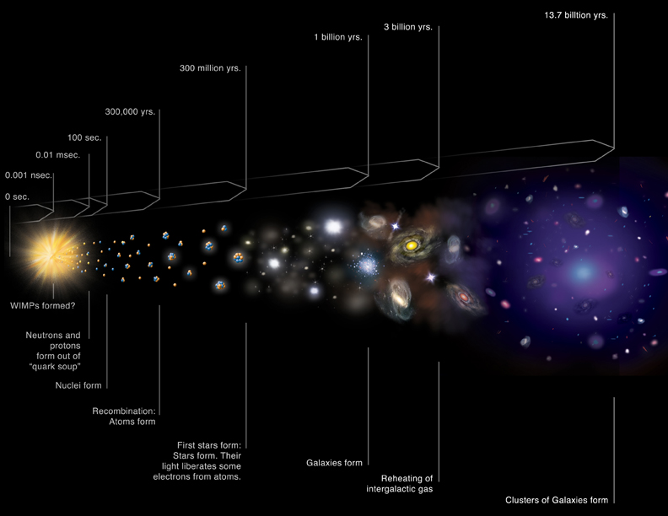
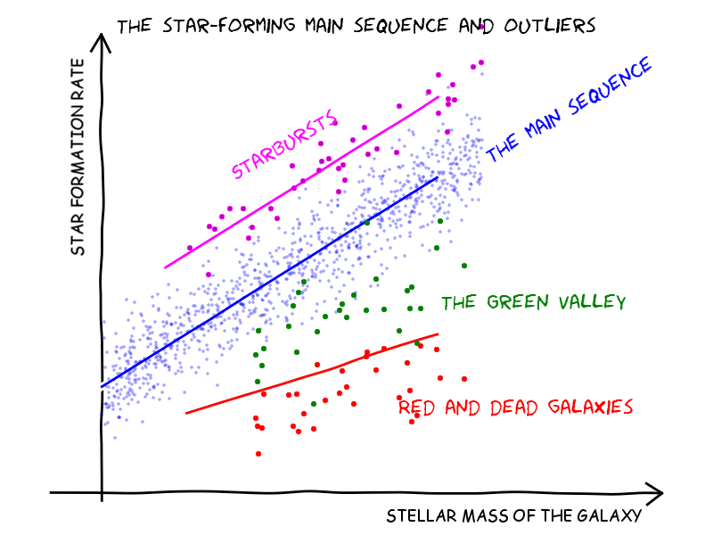
Galaxy formation and evolution
Stellar population is different in different galaxies and it evolves with time. A key aspect in studying galaxy formation and evolution is to study how their stellar populations evolve

Slide 4
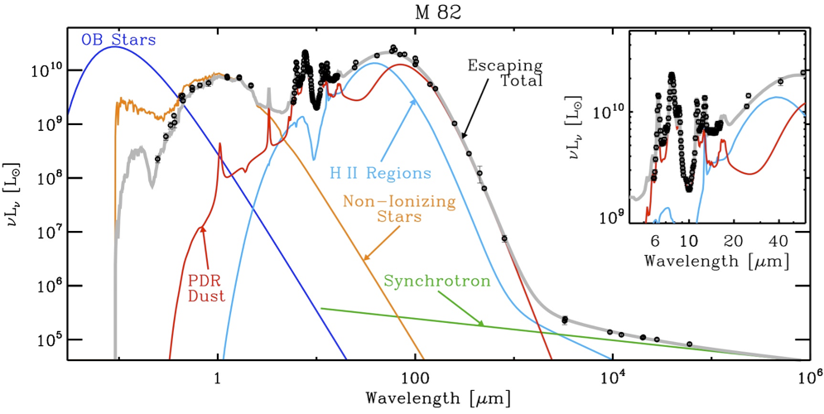
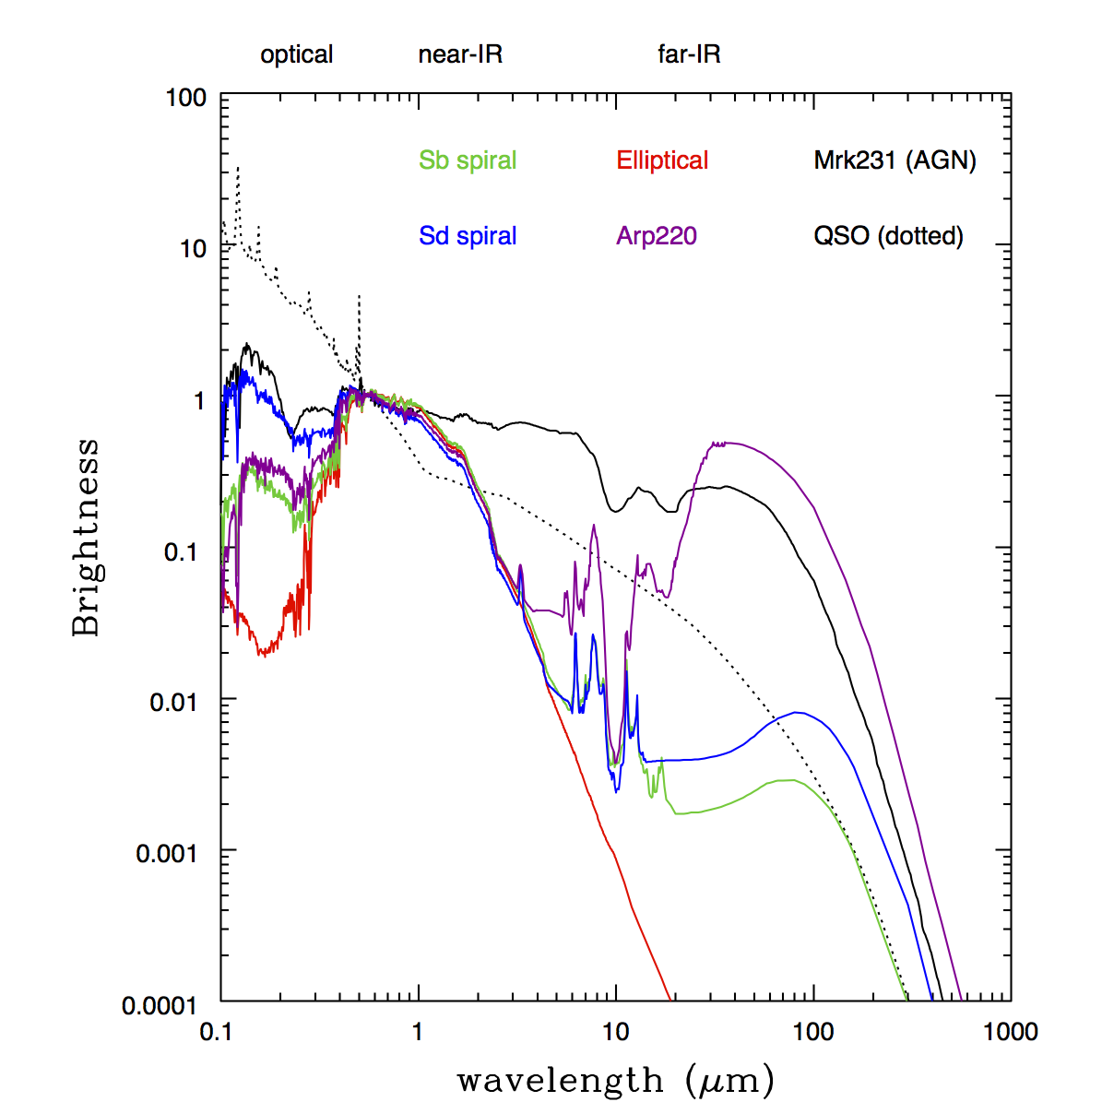
What makes galaxies so different?
Credits: Galliano et al 2008
The multiphase SED of a starburst galaxy M82, highlighting the combined complexity of the various stellar sources, the dust emission and synchrotron radiation
Credits: Polletta et al. 2007
Spectral energy distributions for typical galaxies - an old elliptical galaxy, two types of spiral galaxies, an AGN (Markarian 231), a QSO, and a merging and star-bursting galaxy Arp 220.
Notes:
Different components of a galaxy invest specific part of the flux in different parts of EM spectra. We can find out what the galaxy «is made of» by looking at its spectrum.
Different telescopes work in different bands.
To find mass content of a galaxy we need to trace cool low mass stars that brings most of the stellar mass of the galaxy.
In the top of the figure the wavelength ranges of the main infrared to millimeter observatories are overlaid. (Galliano et al. 2008)

Slide 5
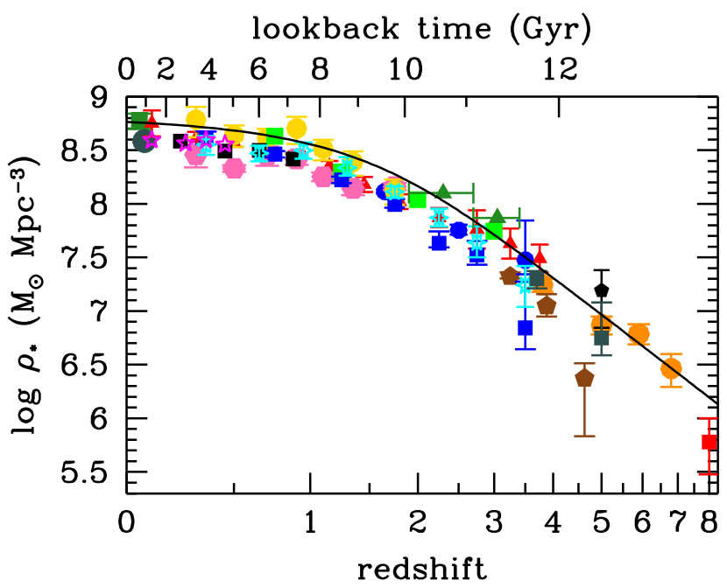
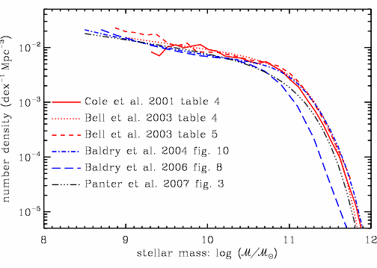

Stellar mass functions
Credits: Baldri et al. 2008
Credits: Madau & Dickinson. 2014
Mass funsction described by Press-Schechter (1974) model: power law for low-mass galaxies and exponential «choke» for massive galaxies.
The evolution of the stellar mass density. The data points are from literature. The solid line shows the global stellar mass density obtained by integrating the best-fit instantaneous star-formation rate density

Slide 6
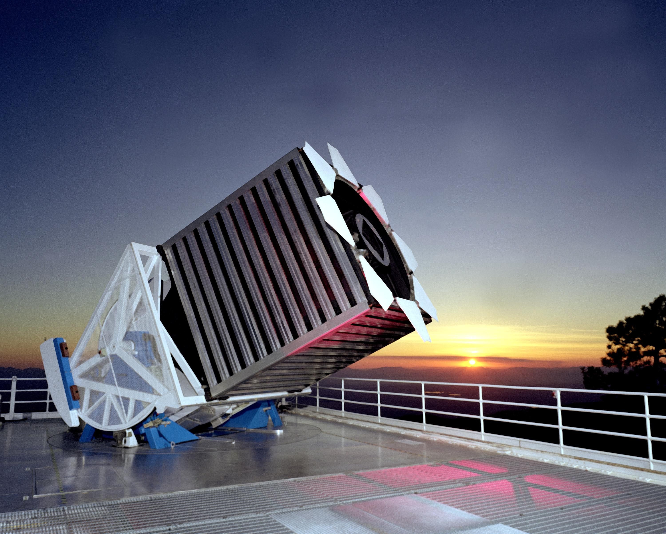
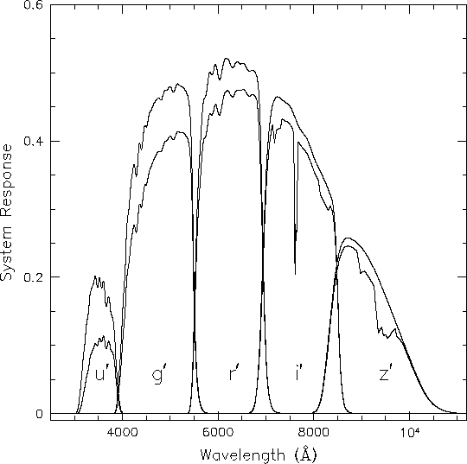
Facility and data: SDSS
Credits: Frieman
Credits: The Astrophysical Research Consortium
SDSS — multi-filter 2.5-m wide-angle optical telescope at Apache Point Observatory in New Mexico, United States
The SDSS system response curves. The responses are shown without atmospheric extinction (upper curves) and with modified extinction at 1.2 airmasses (lower curves). The curves represent expected total QE of the CCD plus telescope optics.
SDSS, is mostly useful for «normal» galaxies up to z<0.4. Some particular types of objects though, such as quasars, can be probed to higher redshifts
Notes:
The SDSS telescope uses the drift scanning technique, which keeps the telescope fixed and makes use of the Earth’s rotation to record small strips of the sky. The image of the stars in the focal plane drifts along the CCD chip, instead of staying fixed as in tracked telescopes. This method allows consistent astrometry over the widest possible field and precision remains unaffected by telescope tracking errors.

Slide 7
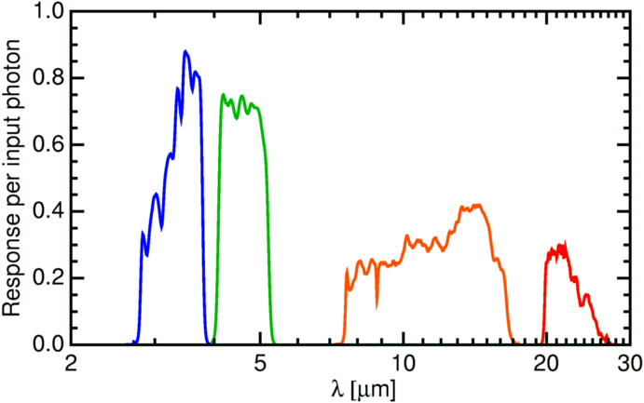
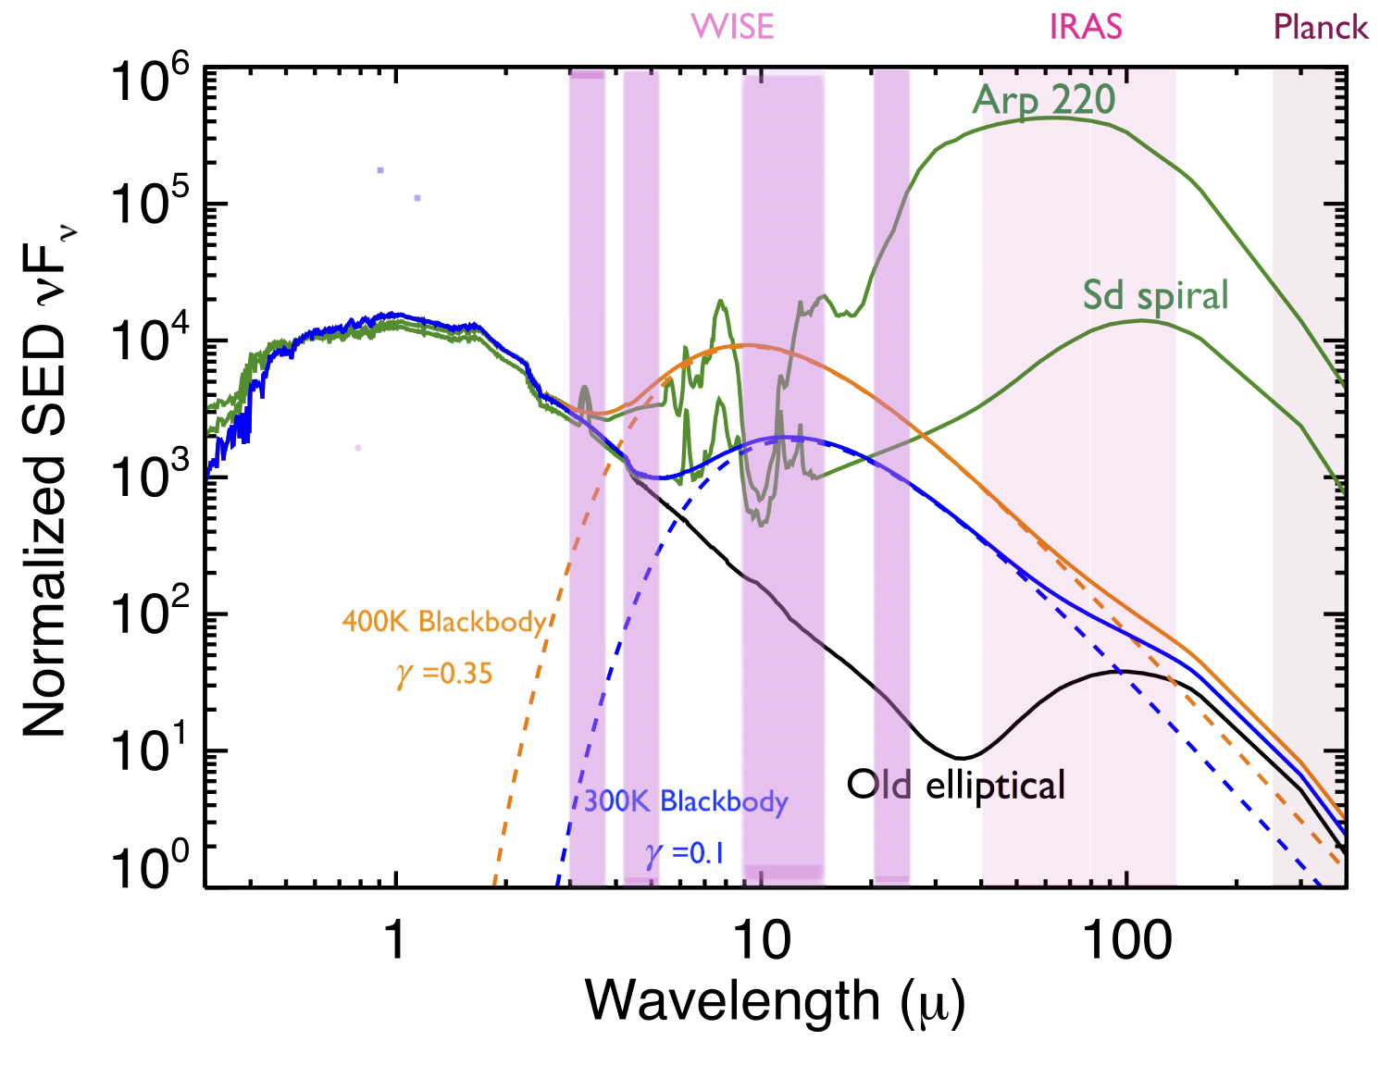
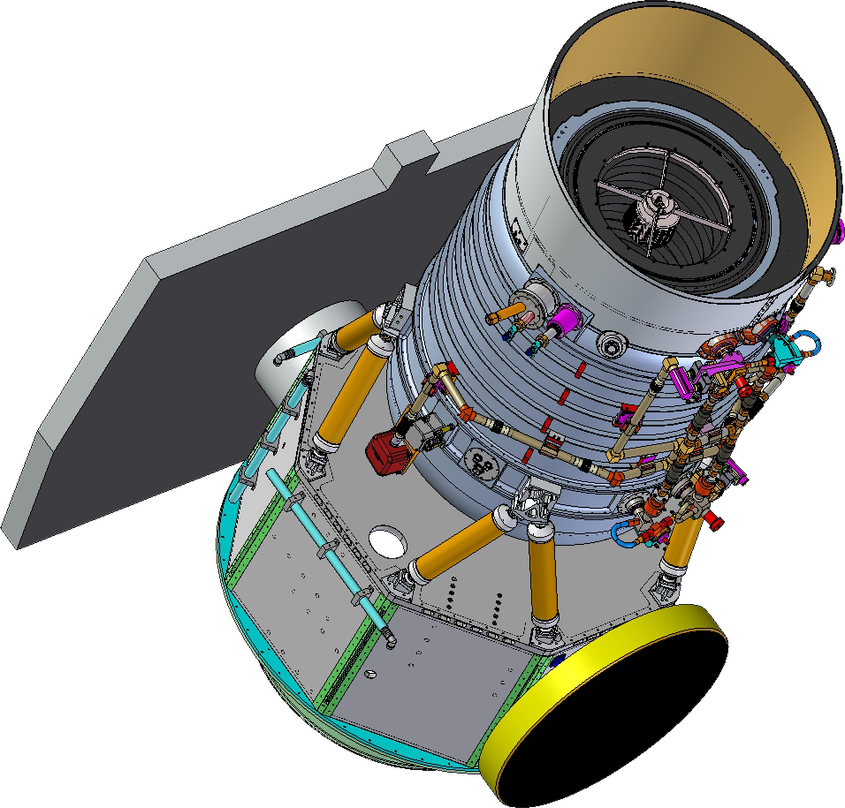
Facility and data: WISE
Credits: WISE team
WISE response per photon (i.e. QE of CCD times the transmission of the optics, beamsplitters and filters.
Credits: Jason Wright
Other Surveys are not that good:
- 2MASS is too shallow
- Spitzer IRAC only covered some high-z sources (Menanteau et al. 2011)
- Herchel (HerS and HeLMS) has low resolution and work in far-IR and submm
SEDs for an old elliptical, a typical spiral, and Arp 220 (starburst galaxy).
Notes:
WISE, all-sky near-IR telescope with 4 bands with different sensitivity (third band is significantly larger and in turms of PSF and limiting flux is closer to w1 and w2).
Telescope is used for detection and observations of intrinsically red objects — dusty galaxies, old galaxies, brown dwarfs, galaxies at high redshifts.

Slide 8
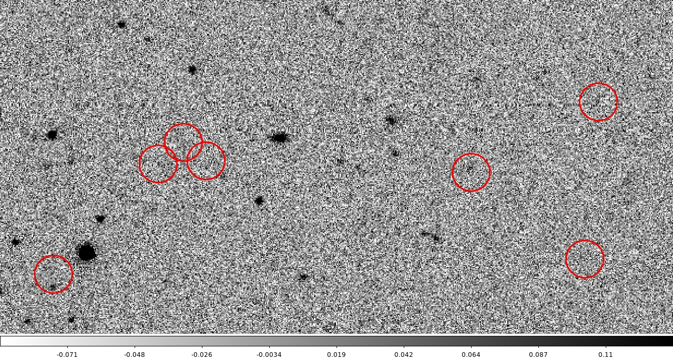
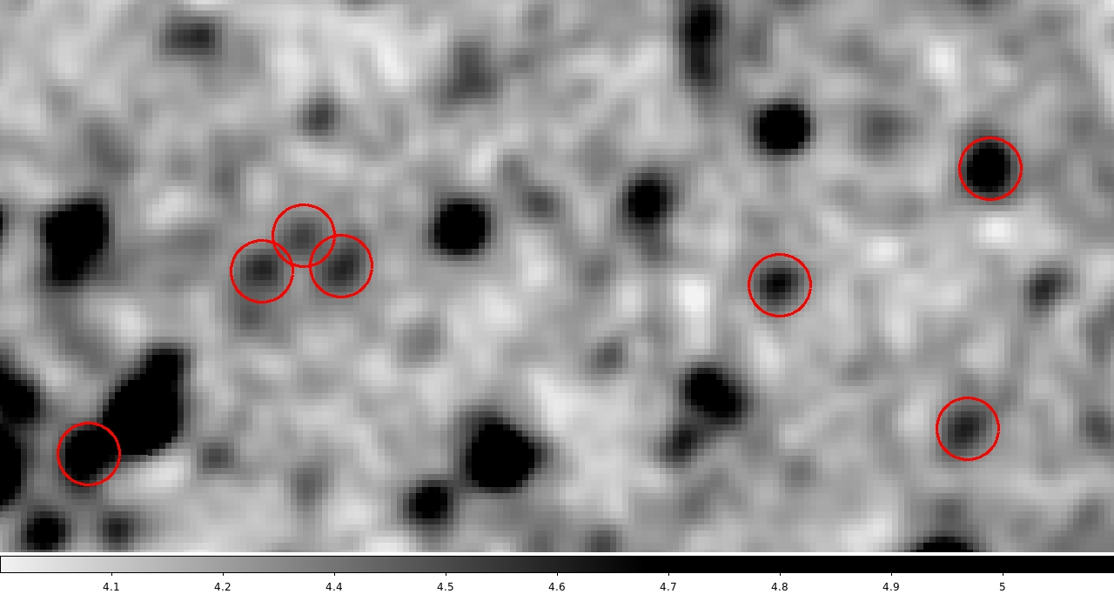
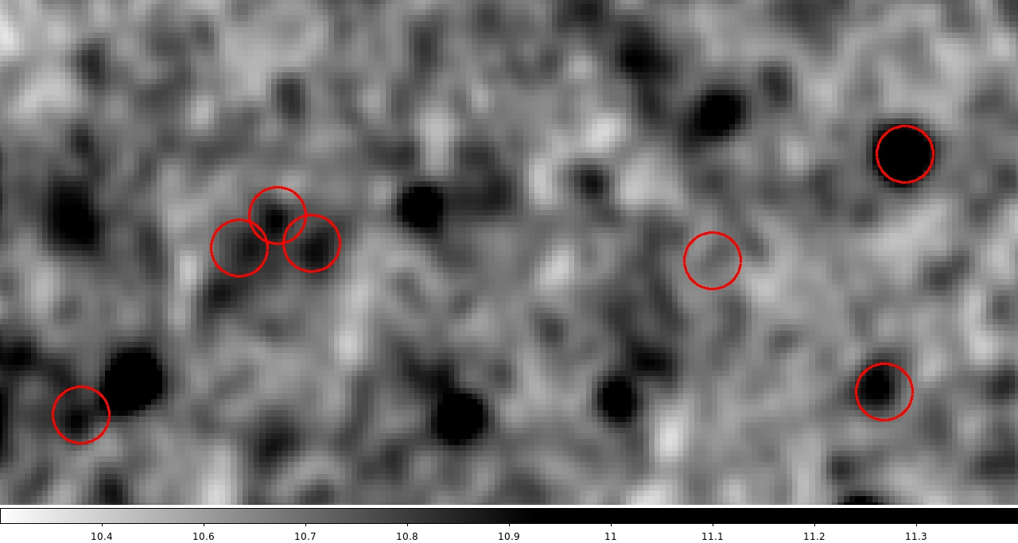
Is SDSS deep enough? Is WISE good enough?
SDSS
WISE w1
WISE w2
There is significant number of SDSS-undetected sources that are visible in WISE. This will degrede the reliability of our SED fitting. We need deeper wide field data in optical.
Also some objects detected in optical are blended in IR.

Slide 9
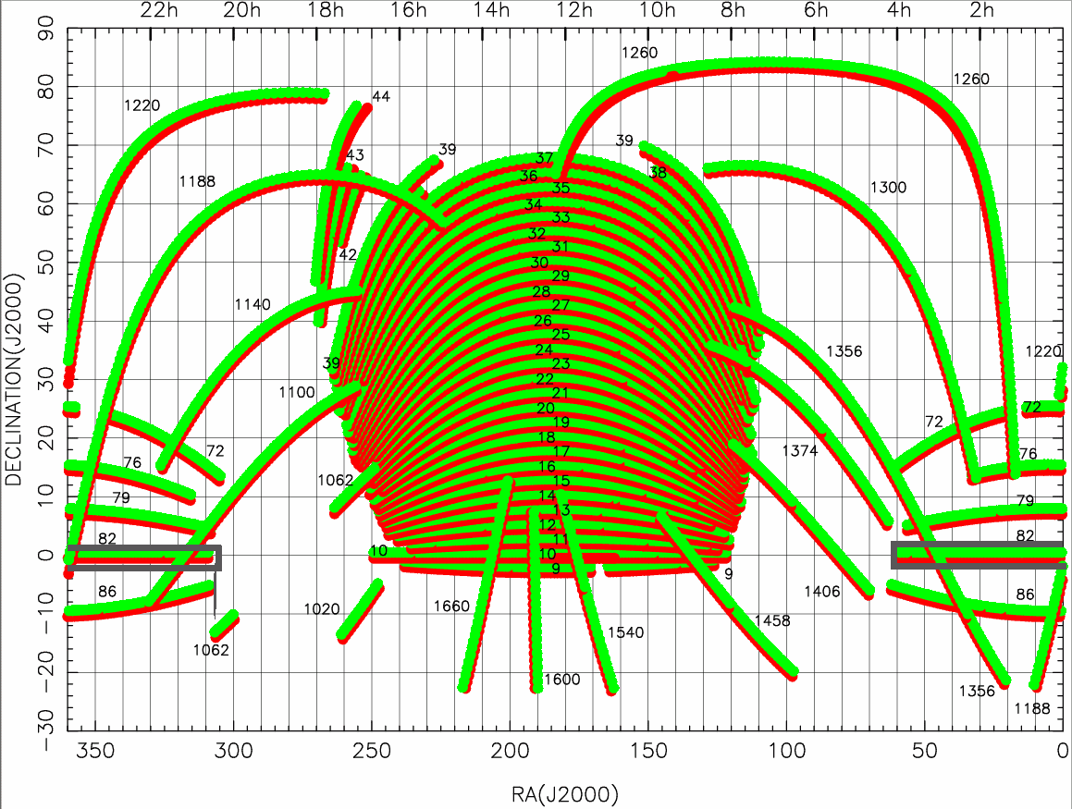
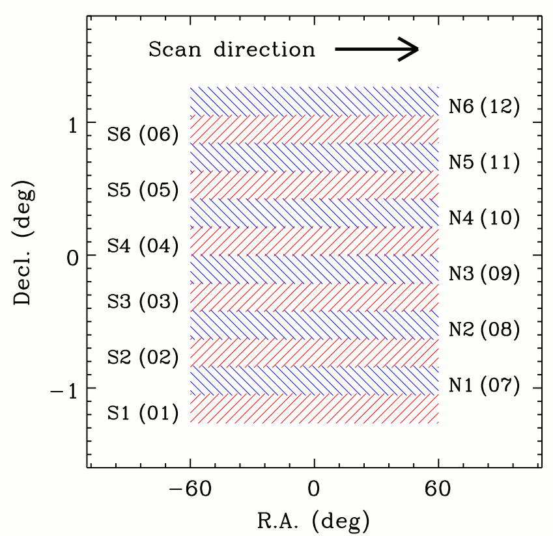
Our field — SDSS Stripe 82
Credits: Jiang et al. 2014
Credits: SDSS Foundation
Full SDSS Footprint (10 400 square degrees)
with Stripe labels including Stripe 82.
Stripe 82 is used for calibrations and has been extensively scanned for 70-90 times.
Notes:
Stripe 82 is a region of the sky close to selectial aquator that was repetedly scanned by SDSS for 70-90 times
Mention that there are Ra and Dec on the left
12 stripes with different psf, usually worse closer to the edges.

Slide 10
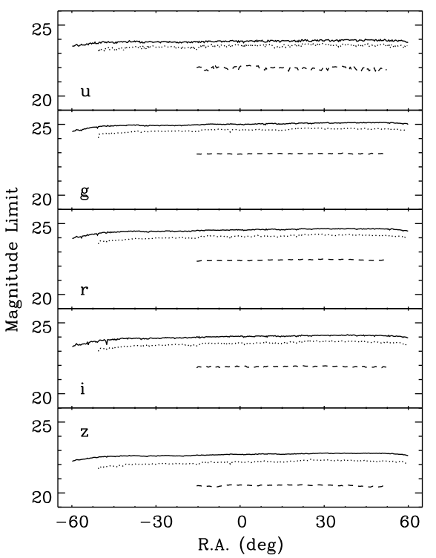
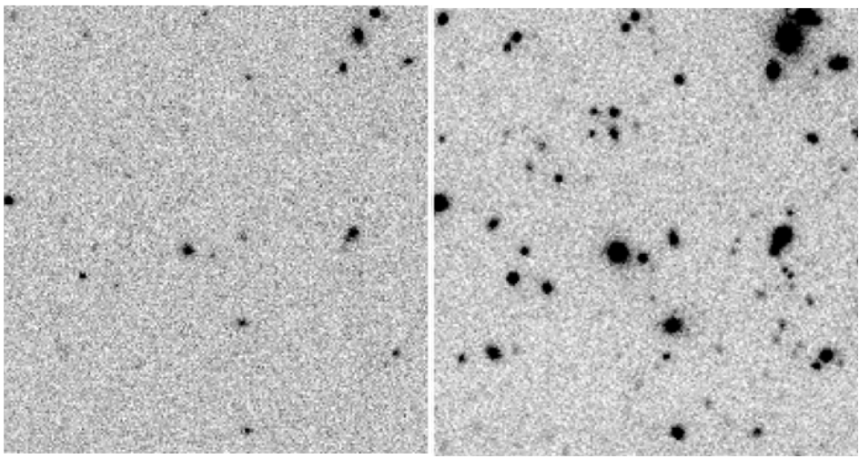
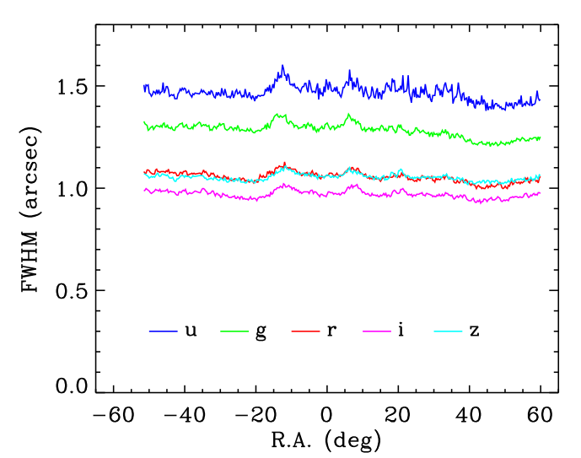
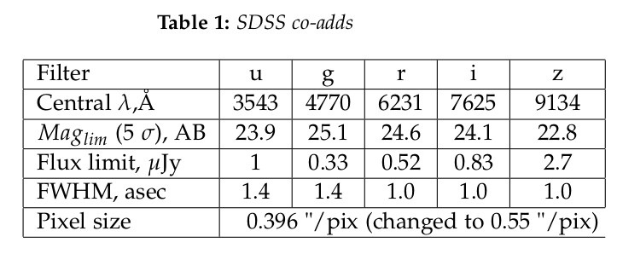
SDSS co-adds
All credits: Jiang et al. 2014
5σ detection limits of the aperture (1".6) magnitudes for point sources
The co-adds PSF FWHM in the riz bands is roughly 1".0, and is about 1".3–1".5 in ug bands
Notes:
Jiang's et al. co-added images increased limiting mag to 1-2 mag deeper than single pass images.
They took only images with the best seeing so FWHM is also very increased.
Those images explain our choice of i-band as a high-resolution image for the next steps.
Important: take a note about FWHM and mag limit of i-band

Slide 11
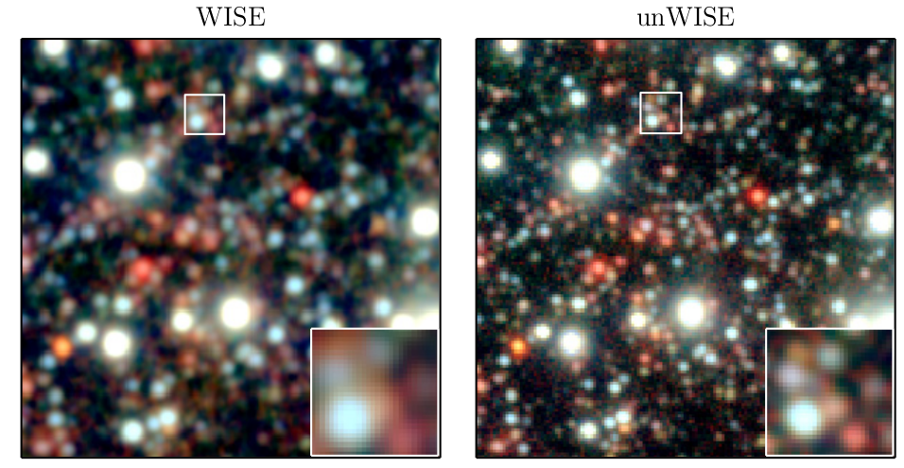
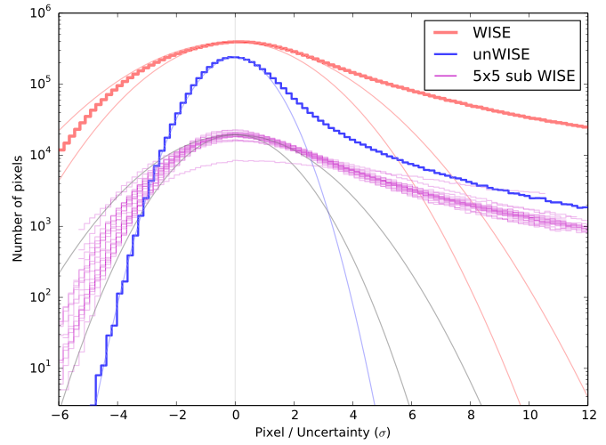
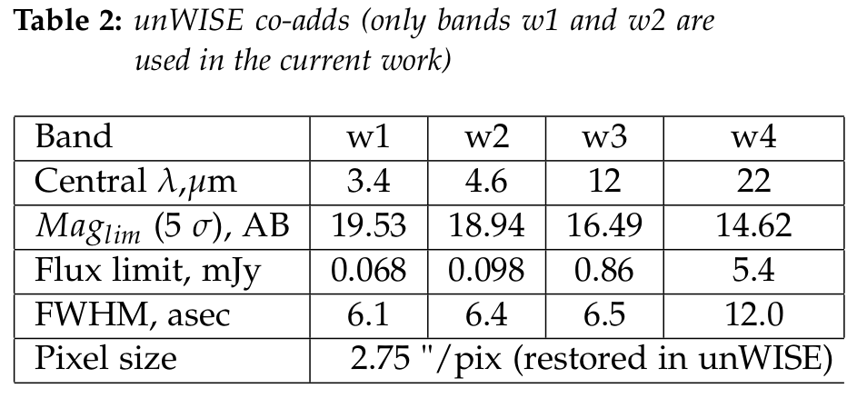
Not WISE - unWISE
Credits: Lang. 2014
The 7“ × 7“ coadd tile of the north ecliptic pole, three-band composites (w1, w2, w3).
Left: AllWISE Release Atlas Image.
Right: unWISE coadd with restored intrinsic resolution
The insets show a zoom-in on a region containing crowded sources. In the AllWISE they are blended together, while in the unWISE they are clearly distinct.
Credits: Lang. 2014
Coadd pixel distributions for one tile, band w1. Coadd intensity values divided by the per-pixel uncertainty values
Notes:
Lang's co-adds with restored WISE pixel scale (2.75 instead of 1.375).
Two ways to show improvement:
1) more sources are resolved
2) decrement in the sky variance and unWISE ratio of pixel/per-pixel uncertainty is now close to the unit Gaussian (plus source tail from real sources)

Slide 12
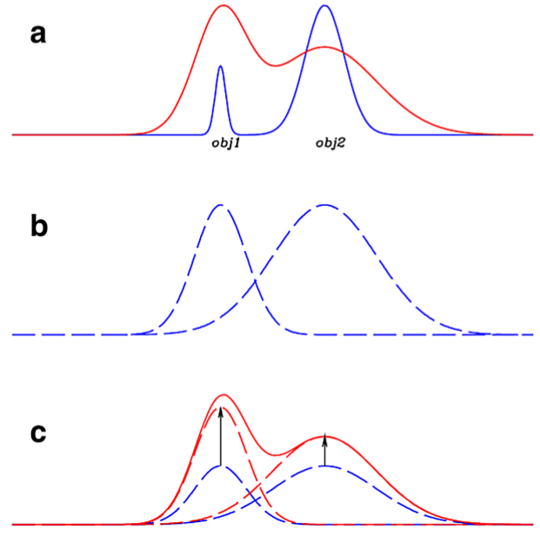
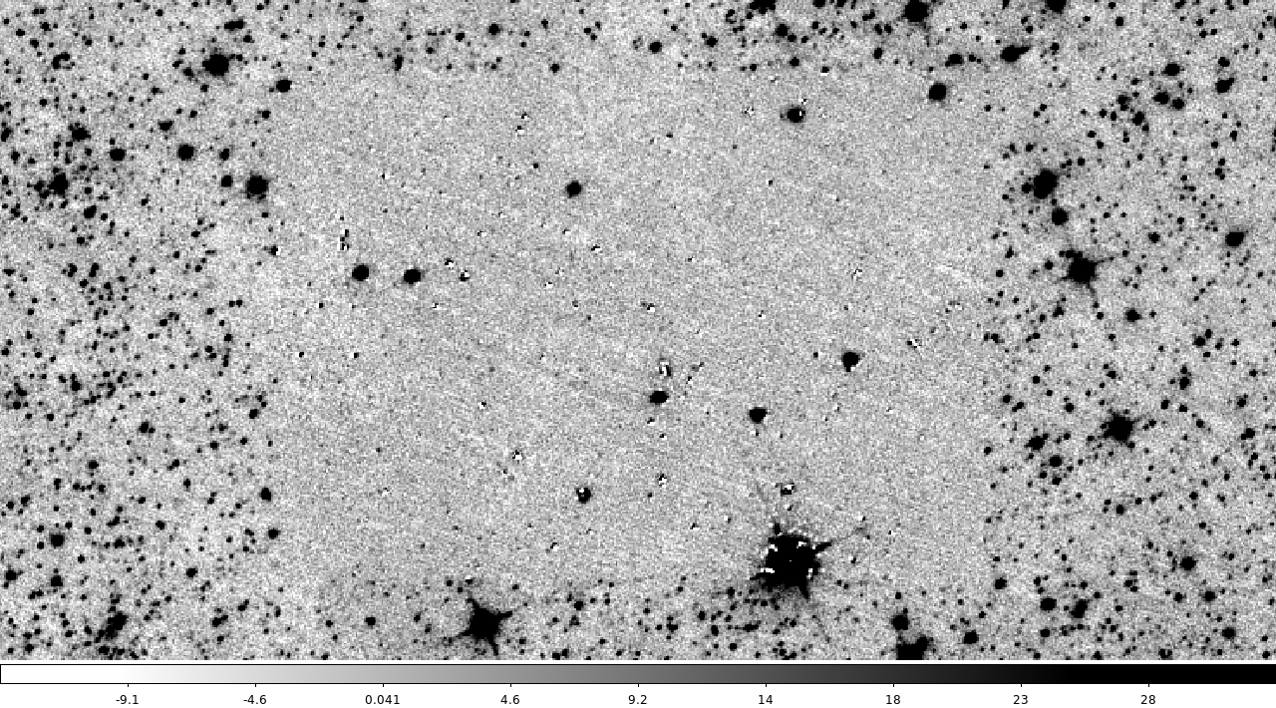
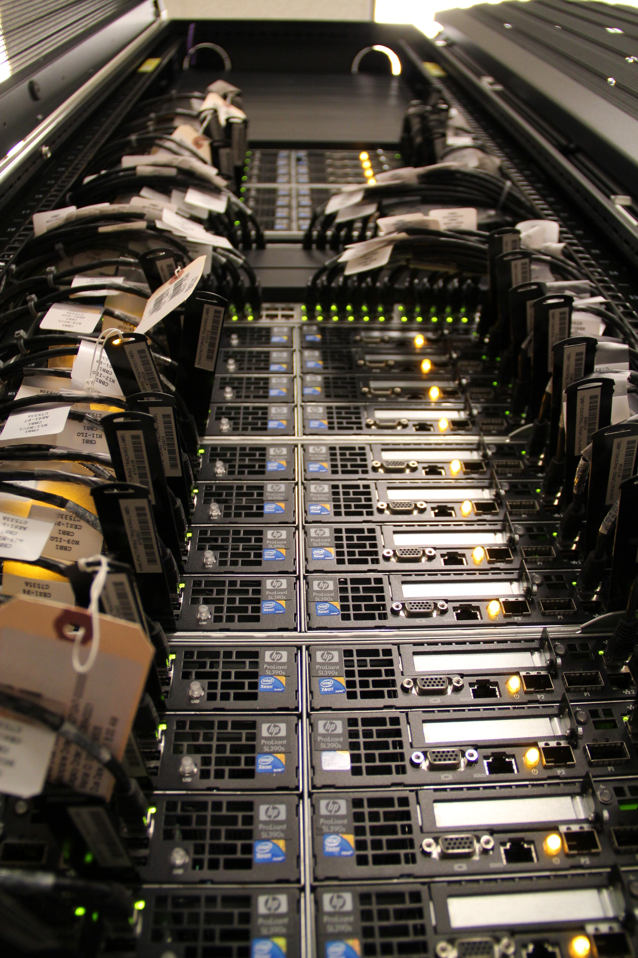
Tphot — "template fitting"
Credits: E. Merlin, 2015
All cleaned sources with appropriate flux and flux variance are added to the catalog.
Tphot residual images — 72 runs needed for just 1 WISE frame in 1 band. It takes more than a day. Stripe 82 has 80 WISE frames!
We need MU Lewis 4 cluster...

Slide 13


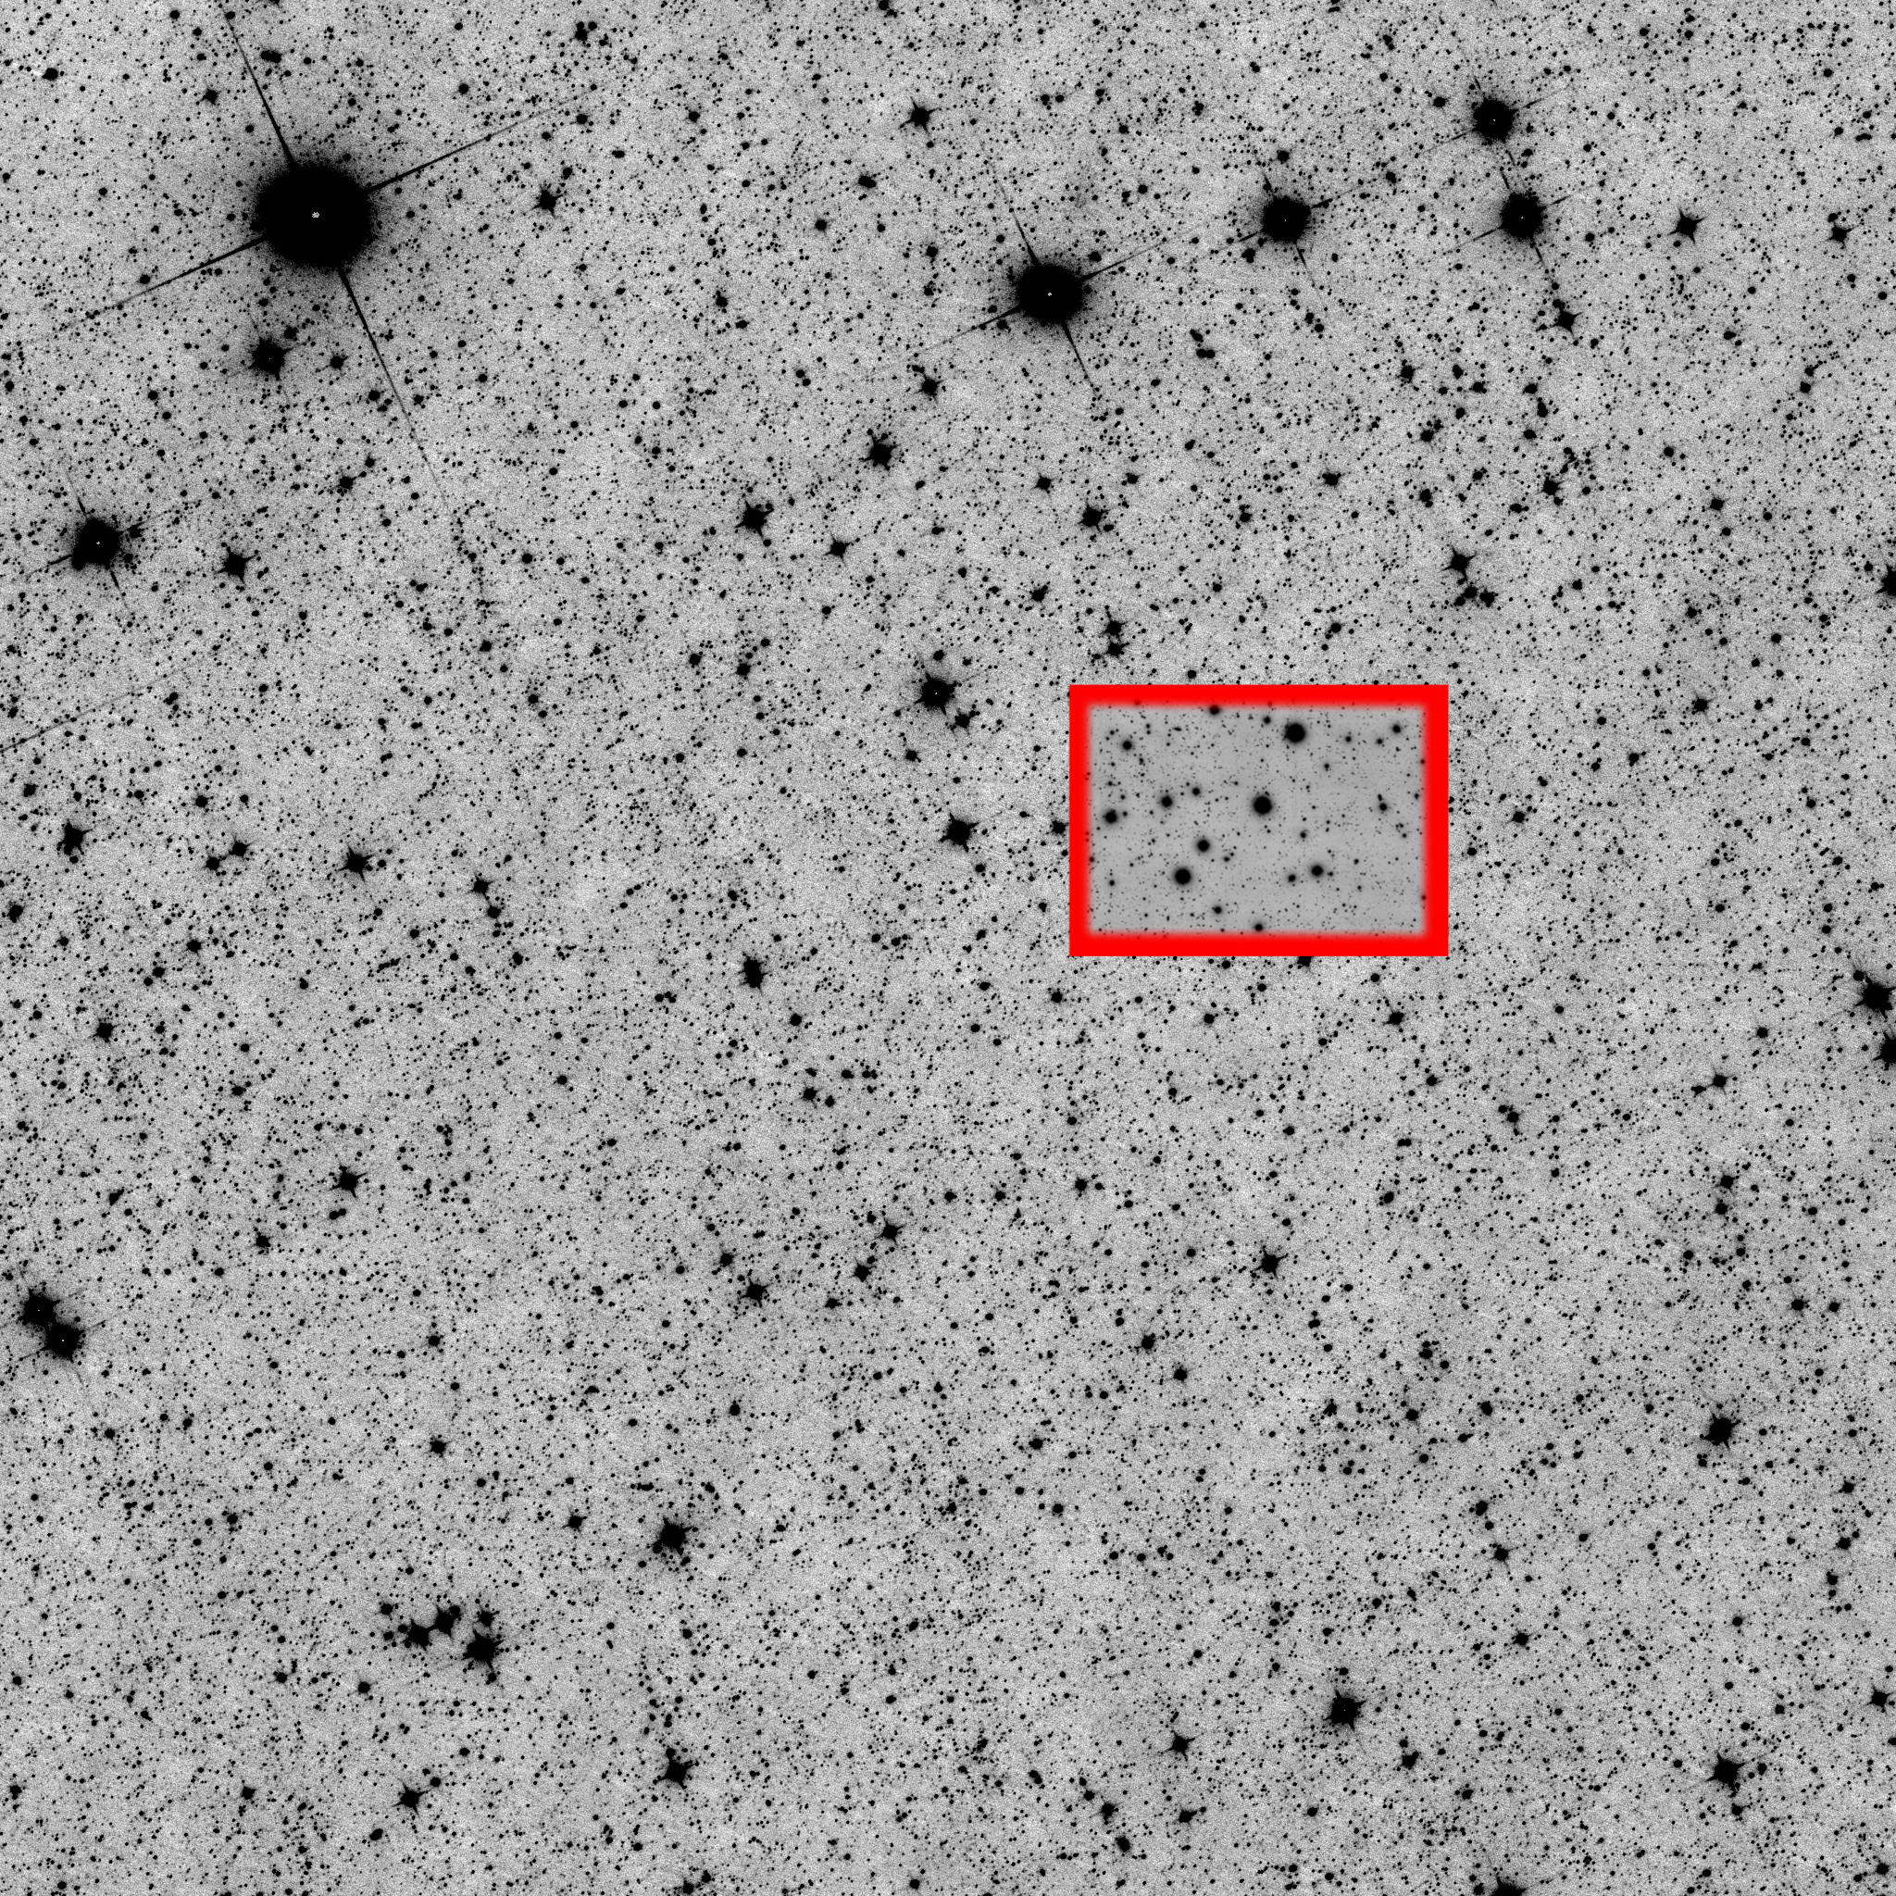
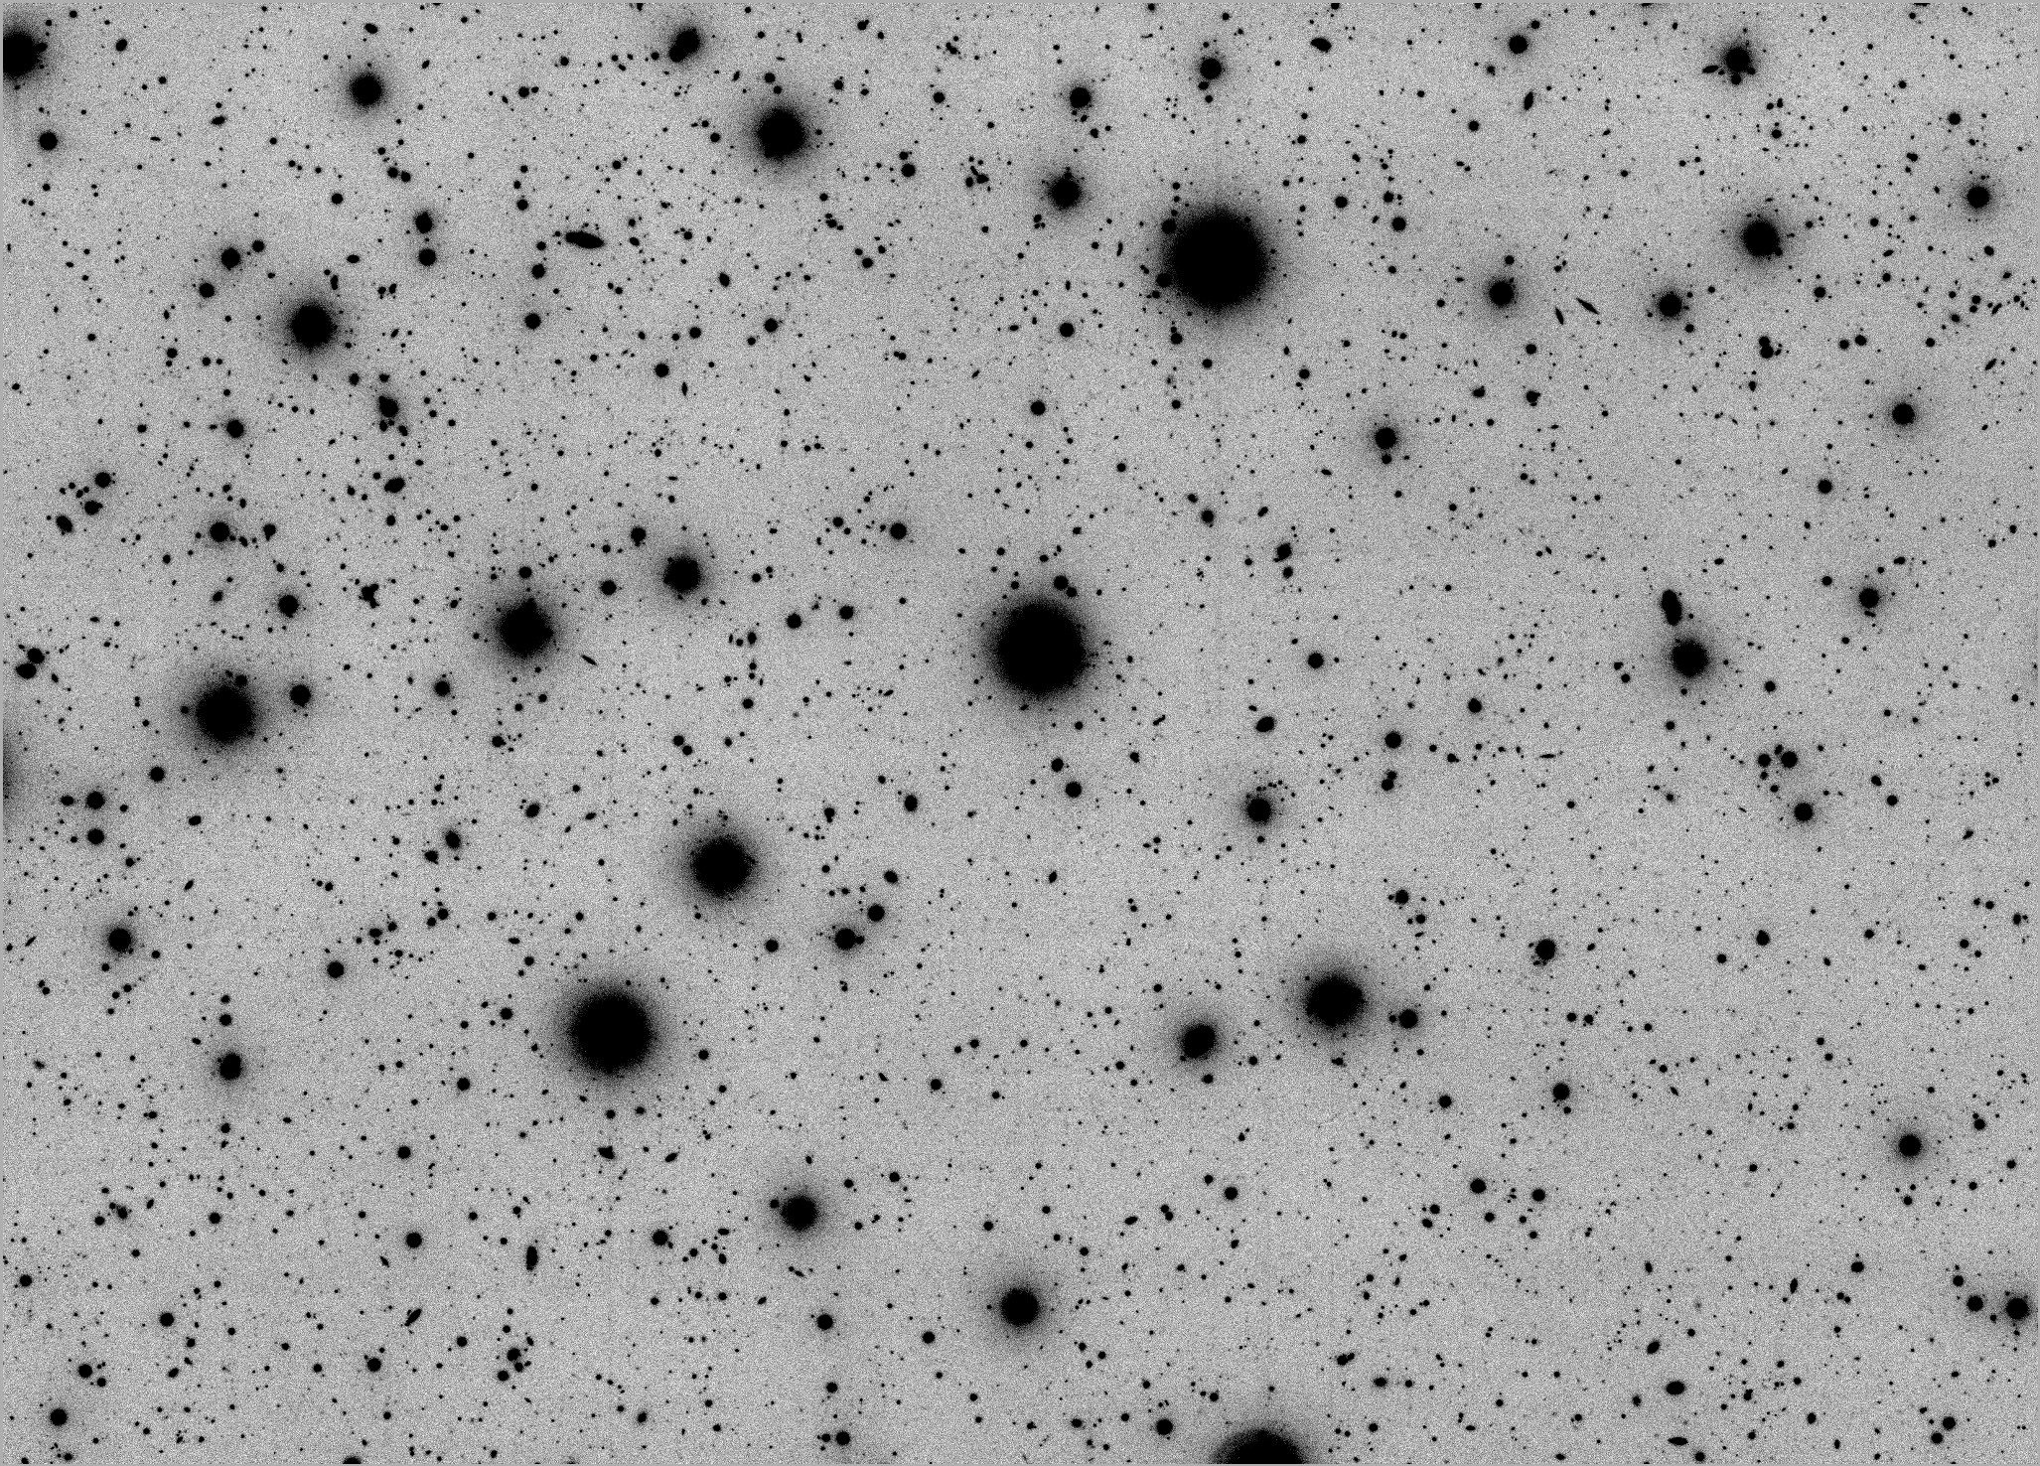
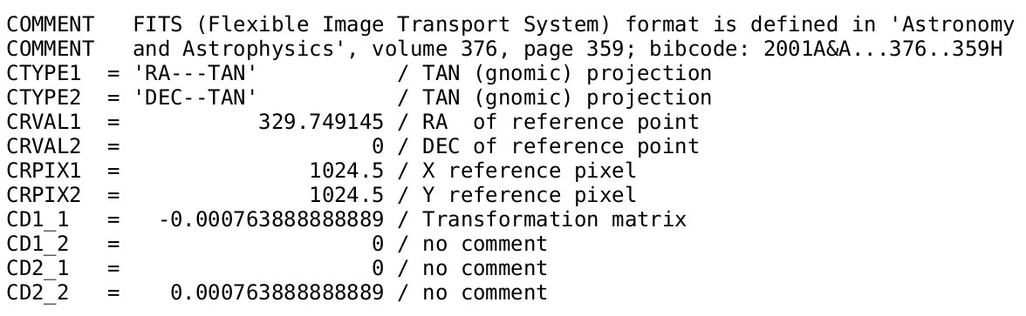
Alignment and change of pixel scale
To do "template fitting" we changed pixel scale and reference pixel value of high-res images so that SDSS and WISE have integer pixel scale ratio and are alligned.

Slide 14
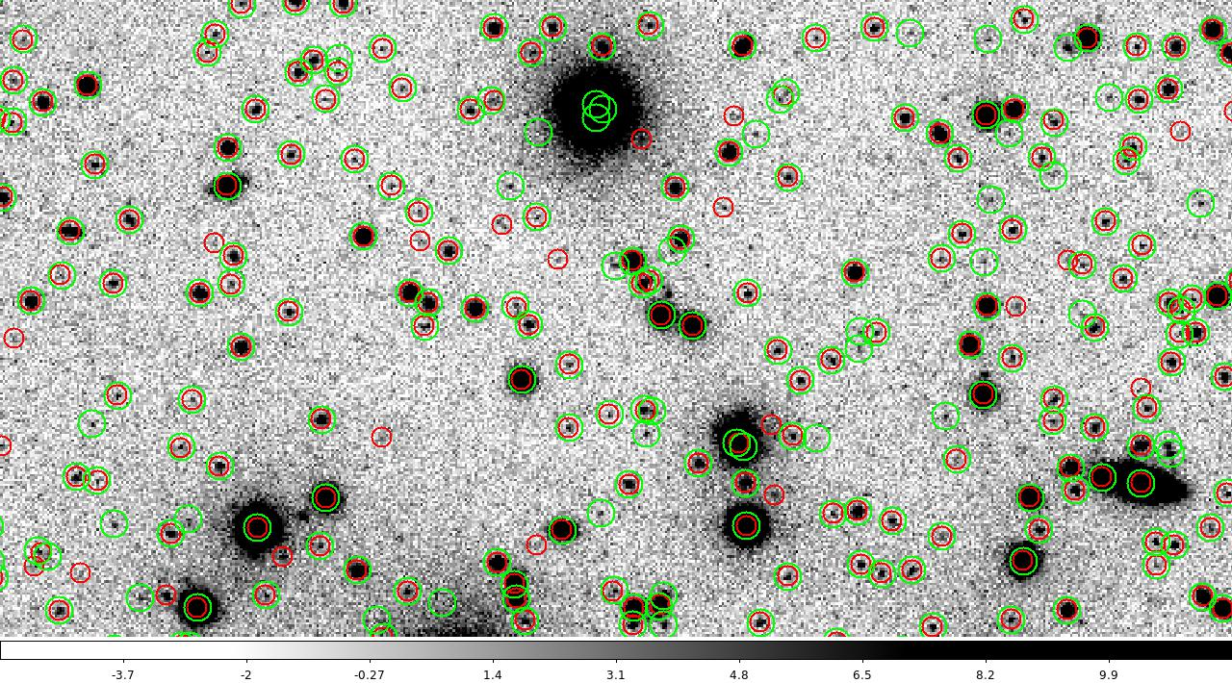
Catalog construction
Why do we need to construct our own catalog?
1) Original catalog has to high detection threshold — lots of sources are rejected
2) Catalog is not cleaned out — multiple detections around saturated areas.
More than 22 million sources detected in ~300 square degrees.
Notes:
Different components of a galaxy invest specific part of the flux in different parts of EM spectra. We can find out what the galaxy «is made of» by looking at its spectrum.
Different telescopes work in different bands.
To find mass content of a galaxy we need to trace cool low mass stars that brings most of the stellar mass of the galaxy.
In the top of the figure the wavelength ranges of the main infrared to millimeter observatories are overlaid. (Galliano et al. 2008)

Slide 15
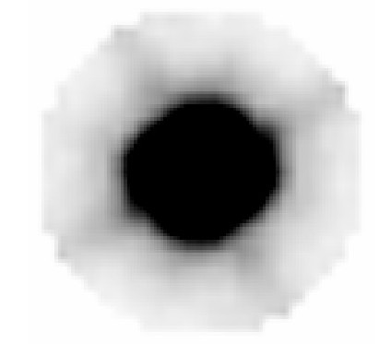
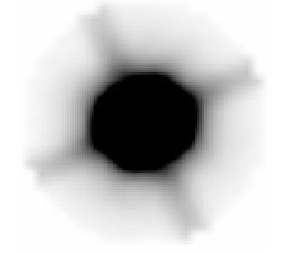
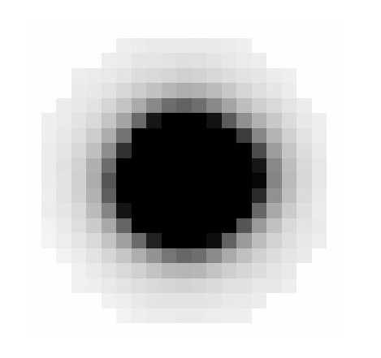
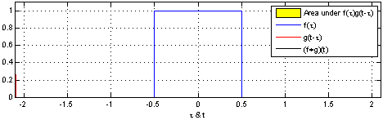
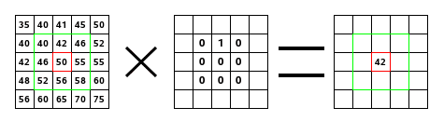
PSF kernel
All credits: Wikipedia, Brian Amberg
In order to do “template fitting“ we need to construct the kernel K such that PSF_lores = PSF_hires * K.
Each of 4812 SDSS and 480 unWISE image has its own PSF due to different seeing conditions.

Slide 16
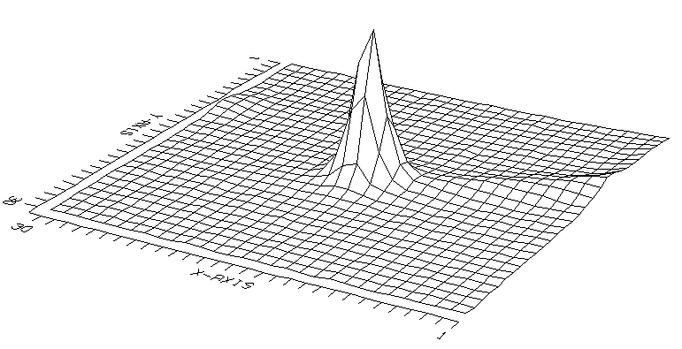
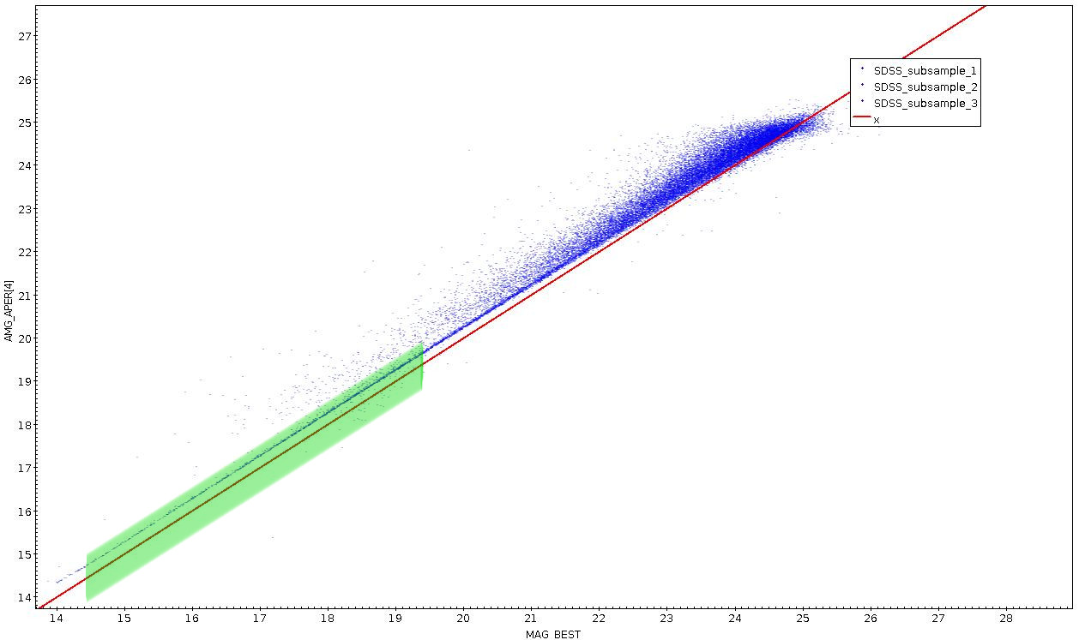
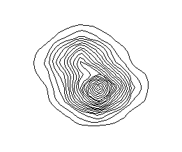
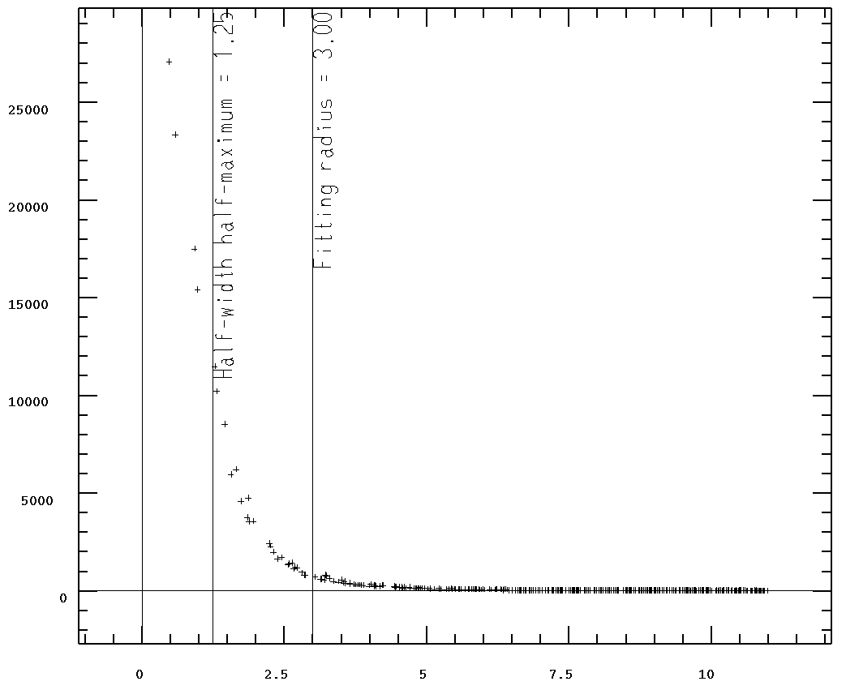
PSF construction
Auto selection crteria:
FLAG_STAR > 0.85 & MAG_BEST < 19.5 & MAG_BEST > 14.5 & |MAG_BEST - MAG_APER[4]| < 0.4 & FLUX_AUTO / FLUXERR_AUTO > 6 & X > 10 & X < 2040 & Y > 10 & Y < 1460

Slide 17
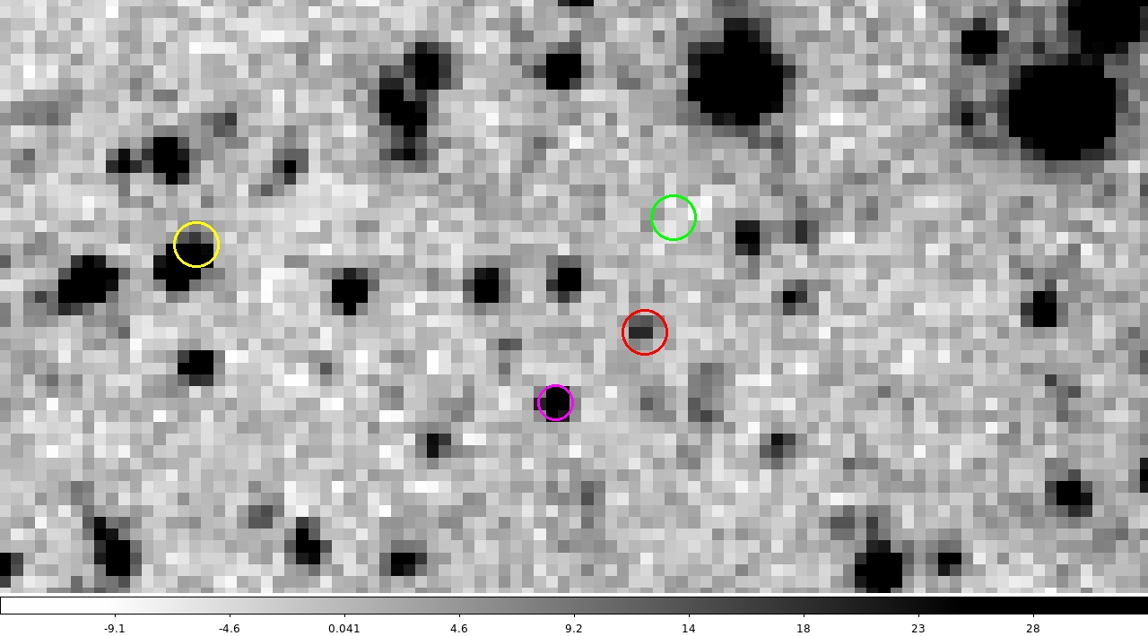
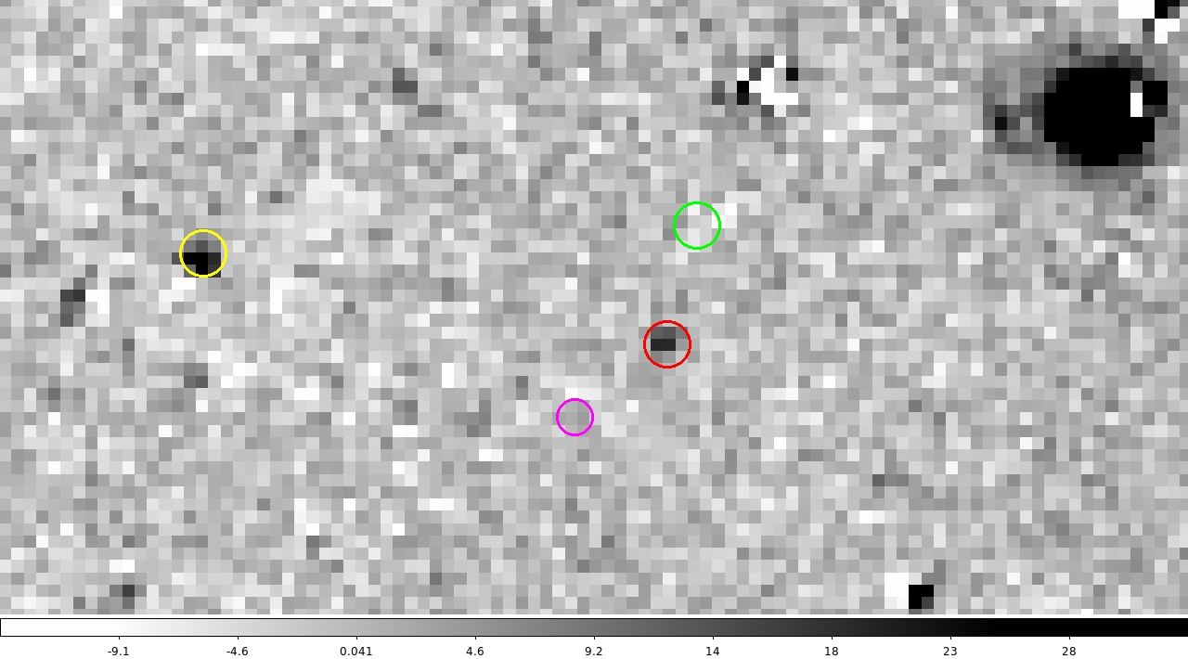
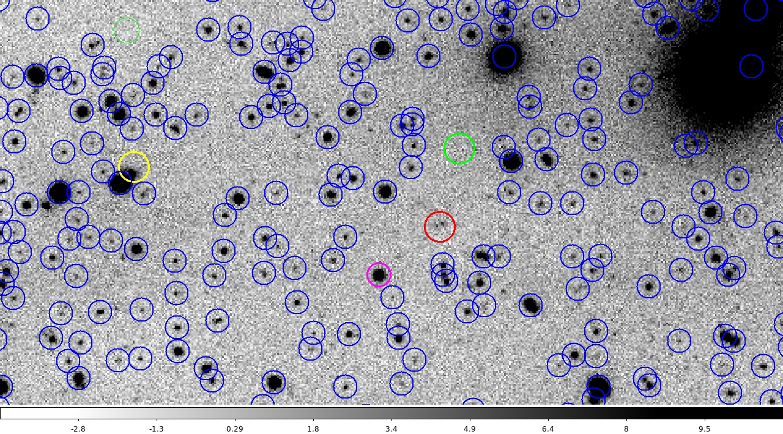
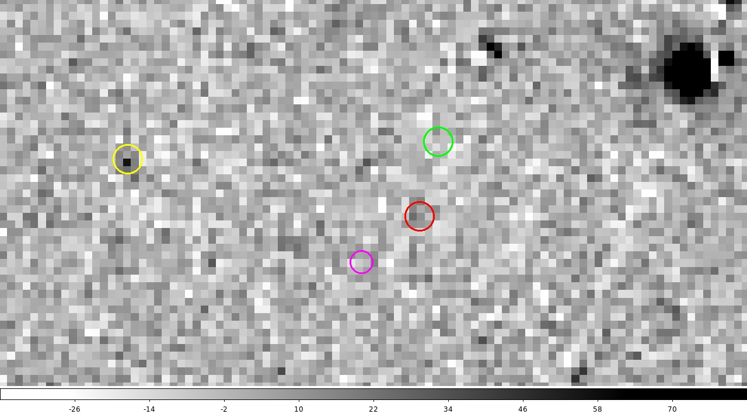
Residual images (zoomed in)
unWISE
Residual w1
SDSS
Residual w2
Pixel values of "cleaned out" sources are converted to flux and are used in our final catalog.
Notes:
Green — background. No change
Red — no source (undetected at least)
Purple — detected and well-cleaned source
Yellow - (successful) de-blending

Slide 18
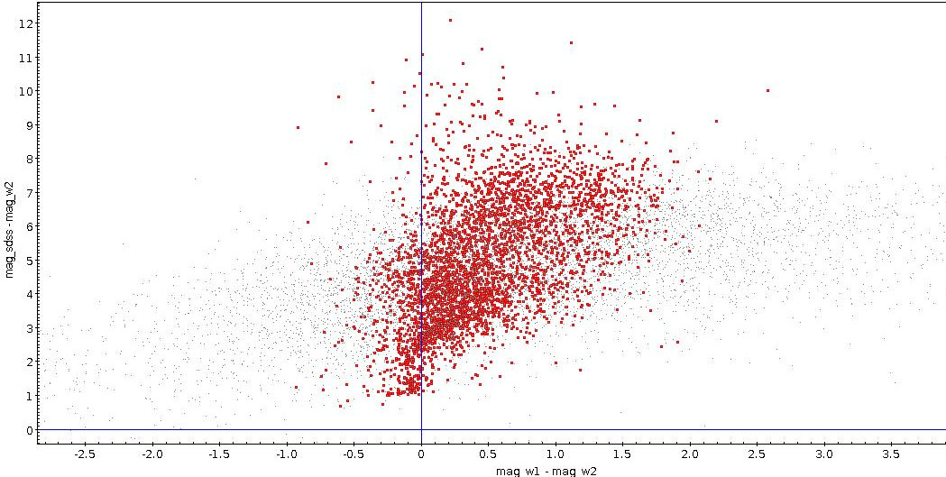
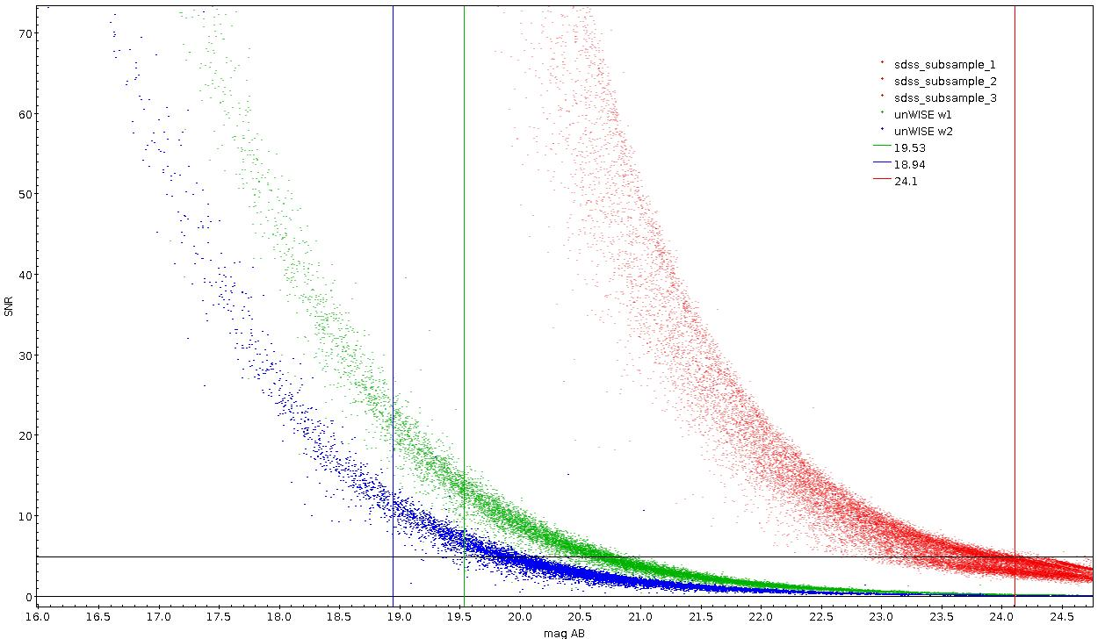
Our catalog. Colors and magnitudes.
Color-color plot for sources from the catalog. Grey dots — all sources. Red dots — sources with SNR > 2
Magnitudes vs SNR for SDSS, unWISE w1 and w2 "template fitting" catalogs. Black line — SNR =5.
Color lines — AB limiting magnitudes
Notes:
Different background because it“s scaled, but the absolute value stays the same

Slide 19
SED
On this slide there there will be 1 constructed SED with Jiang's data for u,g,r,i,z and our data for i, w1,w2 and matched spectra, also parameters of this galaxy will be shown

Slide 20
Mass and redshift histograms from HyperZ
If I have time to run Hyperz several times I will show mass histogram and redshift histogram for a small region of Stripe 82 an mention that those sources will be matched with origianl catalog to correct for magnitudes and gind potential spectroscopic redshifts.

Slide 21
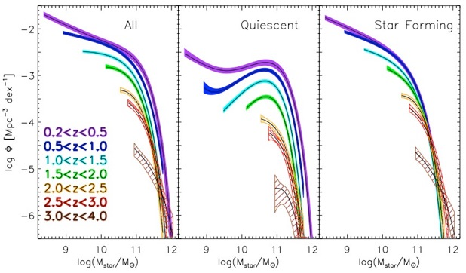
Mass Function, GSMD
Credits: Muzzin et al. 2013
Stellar mass functions of all galaxies, quiescent galaxies, and star-forming galaxies in different redshift intervals. At low-redshift a double Schechter function fit is required to reproduce the total SMF.
Credits: Madau & Dickinson. 2014
The evolution of the stellar mass density. The data points are from literature. The solid line shows the global stellar mass density obtained by integrating the best-fit instantaneous star-formation rate density ψ(z) with included return fraction.
Notes:
Mass functions from literature, Press-Shechter formalism. Upper-right image — from Muzzin for Ultravista, for high-z galaxies. Bottom image — From Madau & Dickinson, 2014.

Slide 22
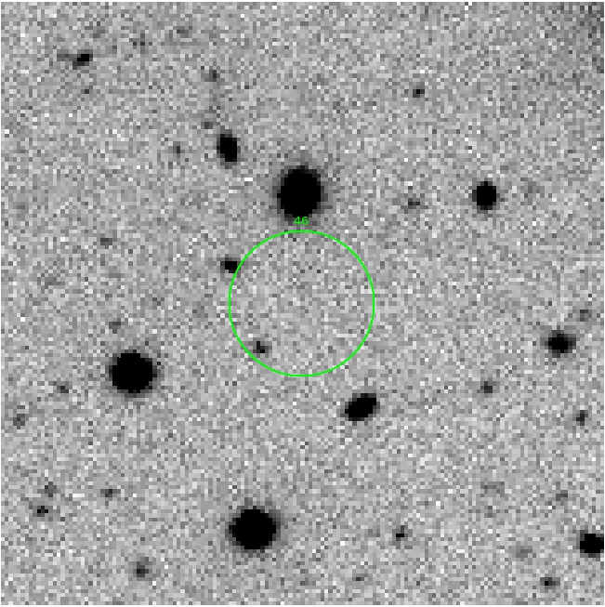
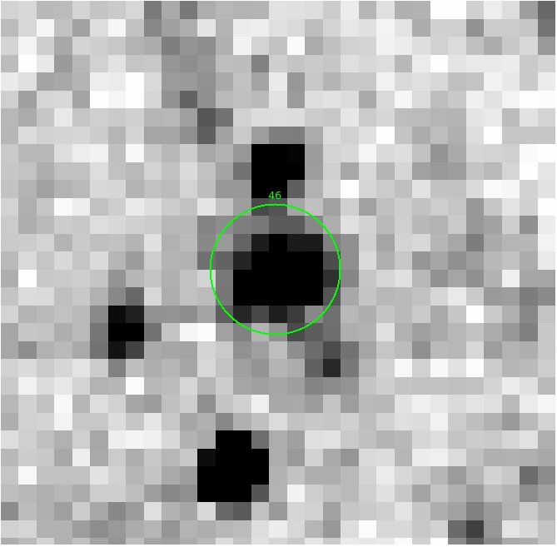
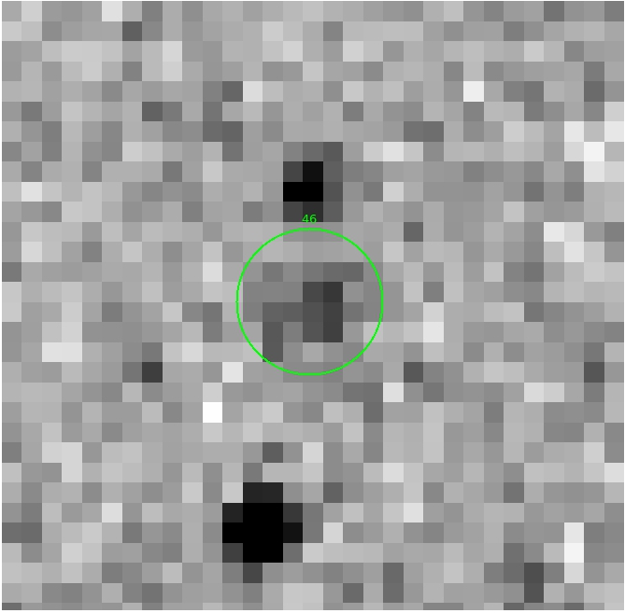
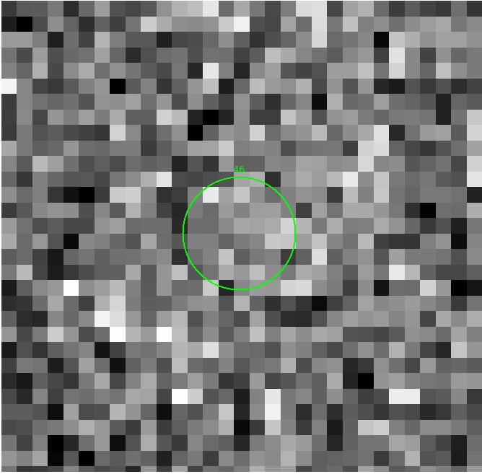










Dropouts. images
SDSS unWISE w1 unWISE w2 unWISE w3 unWISE w4 residual w1 residual w2
Tphot residuals with bright sources in w1 and w2 but no detection in SDSS

Slide 23

Dropouts. SED
Matched spectra for the dropout sources.
Plot of the oldest possible dropout galaxies.
Notes:
Classical indicators of what is going on:
•The so-called 4000A break is produced by the absorption of metallic lines of a variety of elements in various states of ionization, including:
Ca II, H and K high-order lines of the Balmer series (see Hamilton 1985), The opacity suddenly increases for photons bluer than this wavelength, which produces an intensity drop. It is enhanced in
old stellar populations
•The Balmer lines become deeper and broader with time from the starburst, with a characteristic time-scale of the order of one Gyr.
* Balmer break is most prominent in A-type stars with surface temperatures 10000K
* Therefore it is an efficient tool for identifying relatively quiescent (quenching) systems with current star formation rates significantly lower than the past average.

Slide 24
Conclusions, Future work.

