Slide 1
MACHINE LEARNING IN CYBERSECURITY
Path Traversal
Attack Detection
🛡️
Using Machine Learning Classification
Student Name: [Marawan Elgammal] | ID: [24100919]

Slide 2
Problem Statement & Motivation
The Problem
Why Machine Learning?
Path traversal (CWE-22) lets attackers read sensitive files outside the web root using "../" sequences
Targets: /etc/passwd, /etc/shadow, config files, private keys
Listed in OWASP Top 10 — consistently exploited in real-world breaches
Rule-based WAFs fail against obfuscated or encoded payloads
Learns patterns from data — adapts to unseen attack variants
Fast inference suitable for real-time web traffic inspection
Lightweight feature extraction — no deep packet inspection needed
Complementary layer to existing WAF and firewall defenses
CWE-22
100%
4 Features
Real-Time
OWASP Category
Pattern Match Rate
Engineered Signals
Detection Speed

Slide 3
Literature Review
Kruegel & Vigna (2003)
Pioneered anomaly detection for web attacks using URL structural features. Established that path length, character distribution & query structure are strong attack indicators.
[1]
ACM CCS '03
Buczak & Guven (2016)
Comprehensive survey of ML for intrusion detection. Key finding: Random Forest consistently outperforms single classifiers; ensemble methods are most robust.
[2]
IEEE Comm. Surveys & Tutorials
Liang et al. (2019)
CNN-based character-level detection of web vulnerabilities including path traversal. Achieves state-of-the-art but requires more compute than classical ML.
[3]
IEEE ITNEC '19
Key Takeaway: Domain-informed feature engineering + ensemble ML = effective, deployable web attack detection

Slide 4
Methodology Overview
1
2
3
4
5
Dataset
Generation
▶
▶
▶
▶
Feature
Engineering
Model
Training
Evaluation
& Analysis
Deployment
App
1,000 synthetic paths
500 malicious / 500 benign
Balanced classes
4 features extracted:
has_dotdot, num_slashes
length, has_sensitive
80/20 train-test split
Random Forest
Logistic Regression
Accuracy, Precision
Recall, F1, AUC-ROC
Confusion Matrix
Streamlit web app
Real-time prediction
joblib model export
Tools & Libraries: Python 3 | scikit-learn | pandas | NumPy | Matplotlib | Seaborn | Streamlit | joblib

Slide 5
Implementation Details
Engineered Features
Model Configuration
Feature
Type
Captures
Random Forest
has_dotdot
Binary
../ traversal
• n_estimators = 100
• criterion = Gini
num_slashes
Integer
Path depth
• Bootstrap = True
length
Integer
String length
• random_state = 42
has_sensitive
Binary
etc/passwd/shadow
Logistic Regression
• solver = L-BFGS
• C = 1.0 (L2 reg)
• max_iter = 100
• random_state = 42
Train/Test Split: 80% Training (800 samples) | 20% Testing (200 samples) | Stratified, random_state=42
Train/Test Split: 80% Training (800 samples) | 20% Testing (200 samples) | Stratified, random_state=42

Slide 6
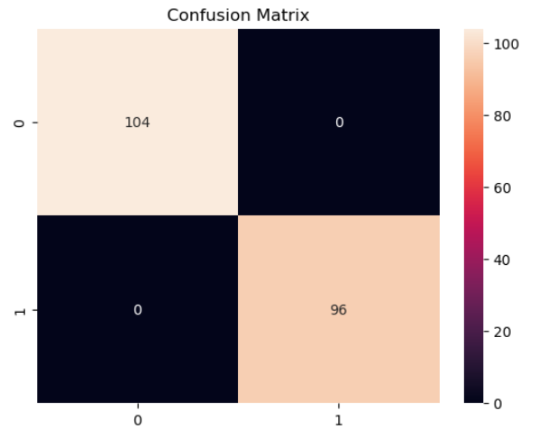
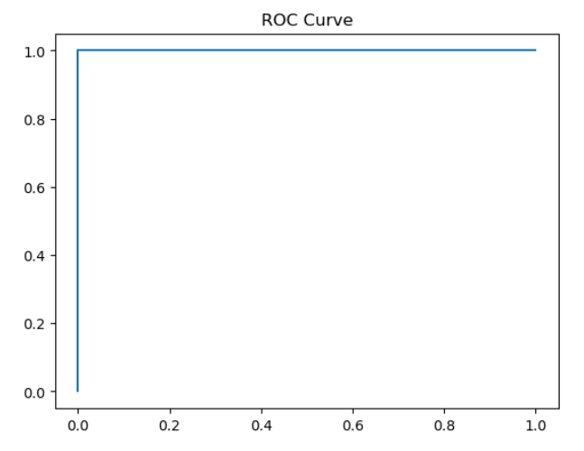
Results & Performance Metrics
100%
1.00
1.00
1.00
Accuracy
(Both Models)
Precision
(Macro Avg)
Recall
(Macro Avg)
AUC-ROC
(Random Forest)
Confusion Matrix
ROC Curve (AUC = 1.00)

Slide 7
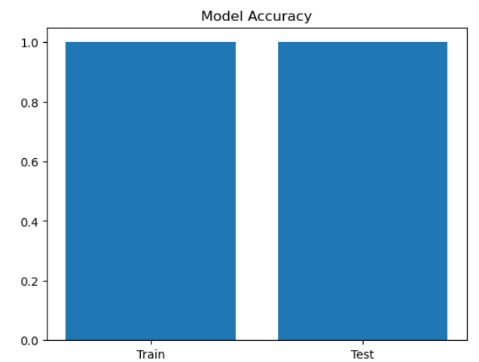
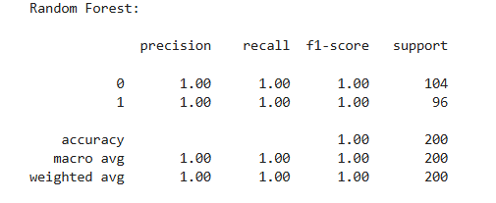
Model Visualizations & Streamlit Demo
Training vs Test Accuracy
Random Forest Report
🌐 Streamlit Web Application
User enters a URL or file path → app extracts features in real-time → Random Forest model predicts attack or safe
Visual feedback: ⚠️ Red warning for attacks | ✅ Green success for safe inputs
Deployed locally via: python -m streamlit run app.py

Slide 8
Challenges Faced
⚠️ Synthetic Data Limitations
🔧 Feature Scope
The dataset was generated from a fixed set of known patterns. Real-world attacks include encoded variants (%2e%2e%2f), double-encoding, and novel obfuscation, which may not match the learned features.
The four engineered features provide excellent coverage for known patterns but may not generalize to adversarial inputs. Extending to character n-grams or embedding-based representations is a recognized future need.
⚖️ Class Distribution in Production
🔒 Generalization & External Validation
The balanced 50/50 class split does not reflect real web traffic where benign requests vastly outnumber attacks. Imbalanced learning techniques (SMOTE, cost-sensitive learning) are needed for production deployment.
Perfect scores on synthetic test data do not guarantee real-world performance. External validation on public datasets (CSIC HTTP, CICIDS 2017) is required before production use.

Slide 9
CONCLUSION & FUTURE WORK
✅ Conclusions
🚀 Future Work
• ML successfully detects path traversal attacks from 4 simple string features
• Validate on real-world labeled HTTP traffic (CSIC, CICIDS 2017)
• Random Forest & Logistic Regression both achieve 100% accuracy on synthetic test set
• Add URL-encoded & obfuscated attack variant samples
• AUC-ROC of 1.00 confirms perfect class separation
• Explore CNN / Transformer character-level detection
• Streamlit app demonstrates real-time deployment feasibility
• Incorporate HTTP context: method, headers, status codes
• Feature engineering outweighs model complexity for this structured problem
• Production deployment with middleware integration & batch logging

