Slide 1

LULC and LST Variation in Lahore from 1998 - 2021
Muhammad Abdul Rahman

Slide 2
Background
Lahore has seen a rapid growth in urban population from 5.14 million to 11.12 million between 1998 and 2017, a 116 % percent increase.
This urbanization has been accompanied by a change in Land Use/Land Cover (LULC), replacing agricultural and vegetation lands with built-up areas.
Consequently, this has led to an increase in Land Surface Temperature (LST) and the formation of an Urban Heat Island (UHI).
Even though it is quite stark, few studies have focused on this phenomenon in developing countries, especially Pakistan.

Slide 3
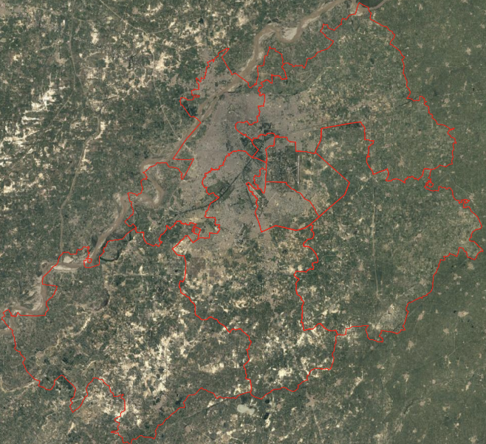
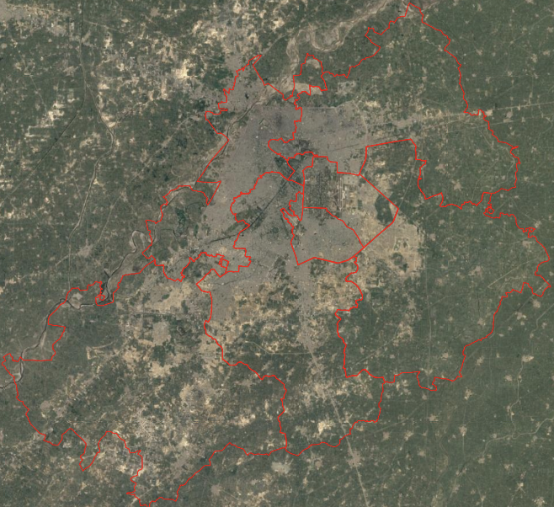
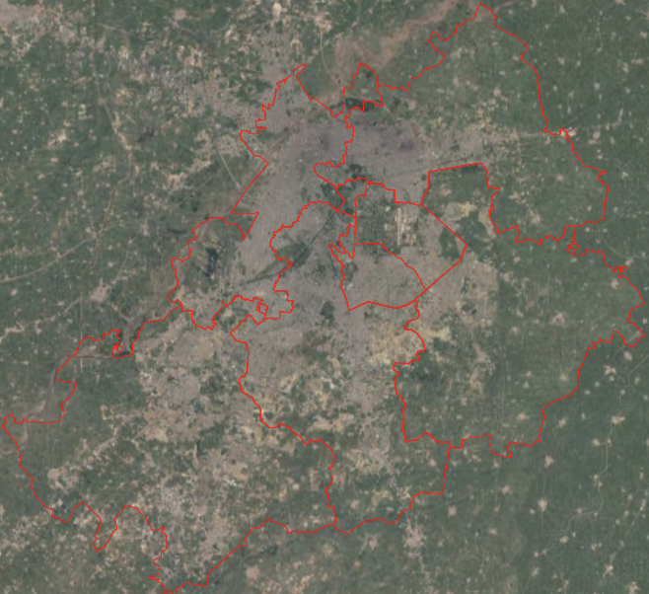
Lahore Over the Years
1998
2010
2021

Slide 4
Background
Developments in the availability of satellite imagery and remote sensing software have made it possible to focus on these regions as well.
In their paper, Spatiotemporal Analysis of Urban Growth and Land Surface Temperature: A Case Study of Lahore, Pakistan, Basheer et al. focus on quantifying LULC and LST changes.
They use Landsat 5 and 8 images for predicting soil, water, vegetation, and built-up areas using supervised classification and traditional remote sensing methods for LST calculations.
These quantifications help identify unchecked urbanization and are the first step towards remedial measures.

Slide 5
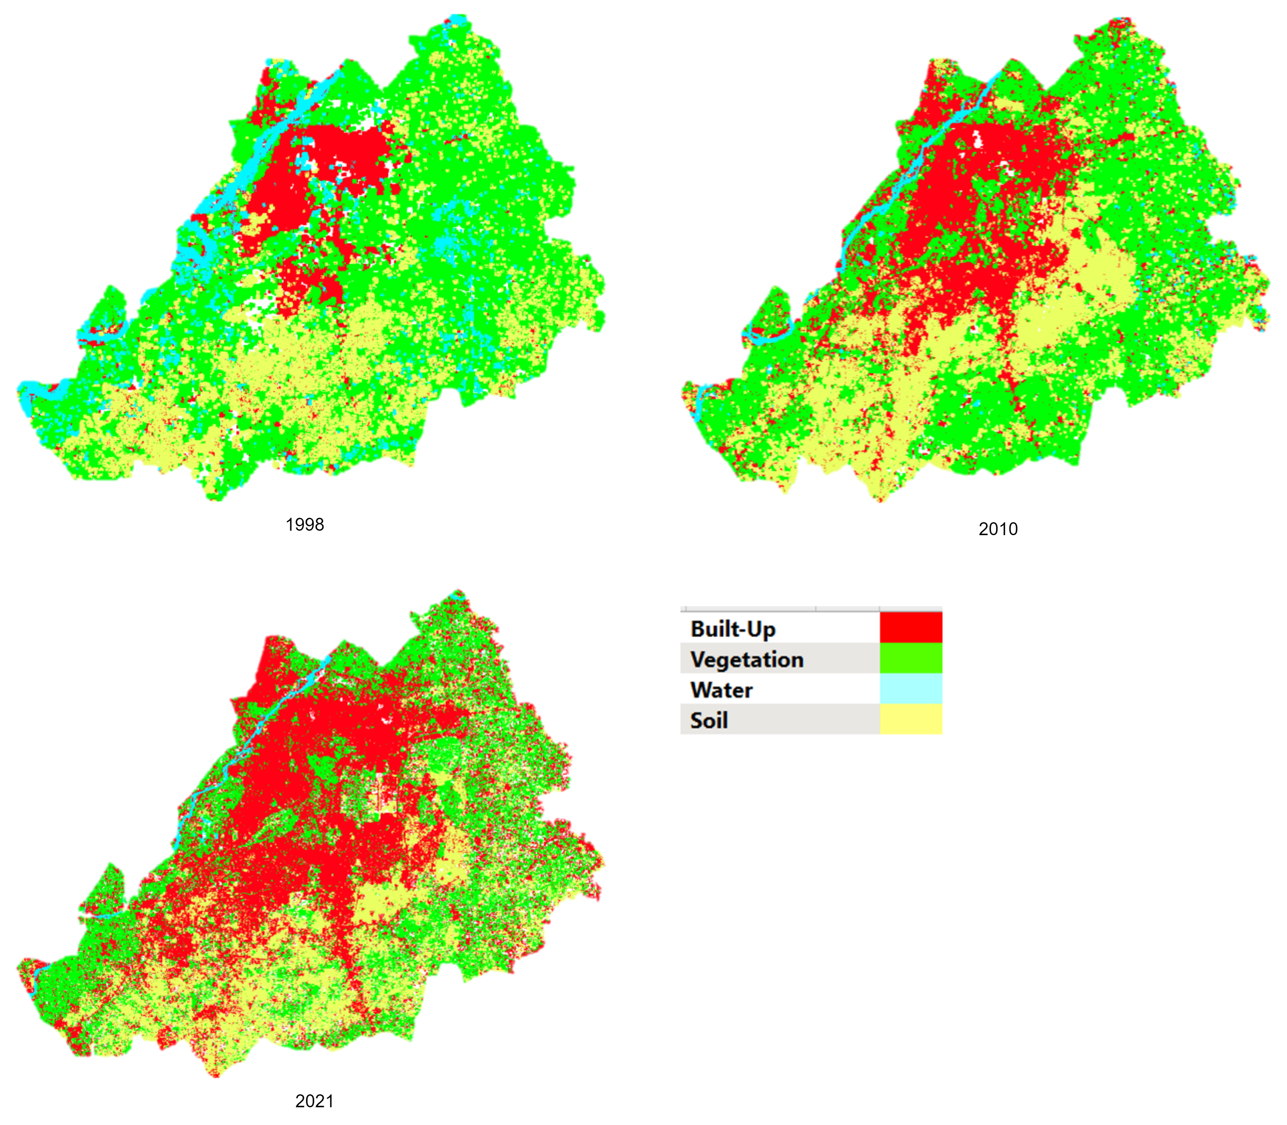
LULC Variation
The built-up area in Lahore has grown a staggering 29 % during the study period.
In contrast, vegetation, waterbodies, and soil all decreased by 20, 8, and 3 percent, respectively, from 1998 to 2021.
Generally, a greater change was seen in the 2010 – 2021 years compared to 1998 - 2010.

Slide 6
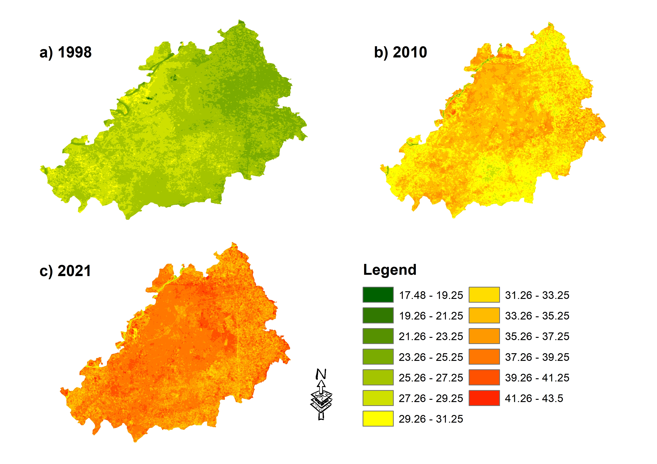
LST Variation
In 1998, 2010, and 2021, the average LST was 26.52°C, 32.87°C, and 37.40°C, respectively.
Overall, Lahore saw an average increase of 0.47 °C per year.

Slide 7
LULC and LST Interaction
UHI affects not only concrete structures but the natural environment as well.
Unsurprisingly, built-up areas witnessed the greatest change in LST, followed by soil, vegetation, and water.

Slide 8
But The Question Is…
Is environmental degradation an inevitable part of urban growth? Can cities ever be “sustainable” in an ecological sense? What level is justified?
What role can satellite imagery-driven methods play in data-scarce regions? Can they replace a census? A survey? Perhaps complement them?

Slide 9
Citations
Basheer, M. A., & Waseem, M. A. (2022). Spatiotemporal analysis of urban growth and Land Surface Temperature: A case study of Lahore, Pakistan. The International Archives of the Photogrammetry, Remote Sensing and Spatial Information Sciences, XLVIII-4/W5-2022, 25–29. https://doi.org/10.5194/isprs-archives-xlviii-4-w5-2022-25-2022

Slide 10
That’s all, Folks!

