Slide 1
Representational State Transfer
Fred Marble

Slide 2
The Role of Rest in the Modern Web
Representational State Transfer or REST is a type of architecture that provides standards between computer systems on the web.
RESTful systems a typically characterized by how they separate things that concern the client(computer) and server.
What the above means is that anytime we interact with a User Interface (UI) different computers can perform the same actions and receive the same responses because the came across the same REST endpoints.

Slide 3
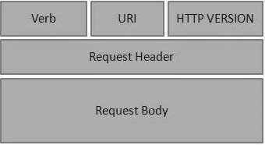
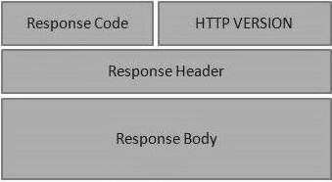
Relationship between HTTP Messages & REST
A Computer sends a message in a format that the Server can understand.
The server receives the message, processes the information, and sends the response so that the computer understands it.
Below are what the HTTP request (left) & Response (right) look like.

Slide 4
Key Features of REST
Client-Server Based Architecture
Stateless
Cacheable
Multiple Layered System
Representation of Resources
Implementational Freedom

Slide 5
Stateless Client/Server Protocol
Stateless Client/Server Protocol doesn’t require the Sever to retain information about each interaction.
Nor does it require the server to remember the states of each communicating partner during multiple requests.
This means that until there is an update that needs to be pushed to the server or client there is no connection.

