Slide 1
SPRINT 1 · PUMP IT UP: DATA MINING THE WATER TABLE
What is associated with
waterpoint condition?
Investigate features of Tanzania's waterpoints linked to pump status (functional, functional needs repair, or non-functional). Sprint 1 research questions guides the analysis.
Functional
Functional needs repair
Non-functional
Notes:
[Goodfriend | 35 sec]
Hello, I'm Goodfriend. Today I'm presenting with Morisade and Tari from Team WTM. Our project looks at water pump functionality in Tanzania. We want to know which features are linked to a pump working, needing repair, or being broken. In Sprint 1, we focused on understanding the data and looking at these relationships. I wrote the research framework that guided our work this sprint. Now I will hand over to Morisade, who will talk about the data quality.
Next: Morisade — Data quality affects what we can conclude.

Slide 2
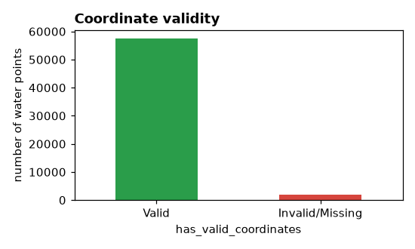
DATASET & QUALITY FINDINGS
Data quality affects what we can conclude
59,400
35%
3.1%
waterpoints recorded in the training set
have an unknown construction year — stored as a 0 placeholder, not a real date
of coordinate pairs fail a basic plausibility check for Tanzania
36 rows are duplicated once the id column is excluded - removed before analysis.
Missing values are concentrated in a few columns: scheme_name (28,810), scheme_management (3,878), installer (3,655), funder (3,637) and permit (3,056).
Several numeric fields use 0 as a silent “missing” placeholder rather than a true zero — construction_year and population both needed this check.
installer and funder are recorded as free text, so the same organisation appears under many spellings — this needs a documented cleaning step before modelling.
Notes:
[Morisade | 55 sec]
Before we trust any pattern in this data, we need to understand its limits. The training set has 59,400 water points. About 35% are missing a real construction year — these are stored as 0, so we treat them as unknown, not as built in year zero. 3.1% of the GPS coordinates are outside Tanzania, so we remove those from the map — you can see that in this chart. We also found 36 duplicate rows, and missing values in a few columns like scheme_name and installer. Installer and funder names are also written in many different ways, so we still need clear rules for cleaning them. None of this stops the analysis, but it does mean the numbers on the next slides come from slightly different totals. Now Tari will talk about the target classes.
Next: Tari — The repair class is small, and several characteristics show clear differences.

Slide 3
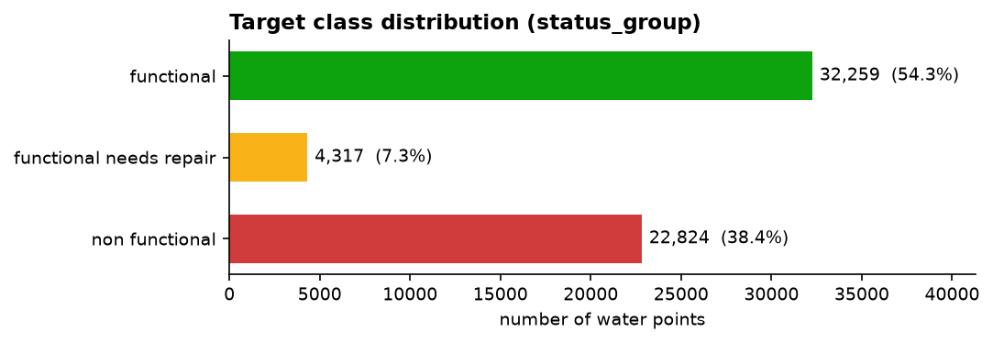
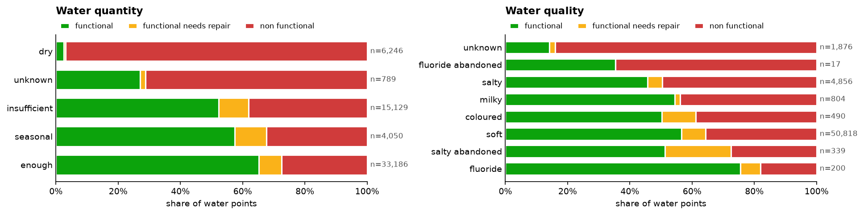
TARGET CLASSES & CATEGORICAL FINDINGS
The repair class is small — several features show clear differences.
0.31
0.03
strongest categorical association: quantity (Cramér's V)
weakest: permit (Cramér's V)
97% of waterpoints recorded as “dry” are non-functional — a strong signal, but close to the target itself, so we flag it as a possible leakage risk.
The functional needs repair class is only 7.3% of the data; any model we build must be checked on this class specifically, not just on overall accuracy.
Notes:
[Tari | 75 sec]
Our target has three classes, and they are not equal in size: 54.3% of water points are functional, 38.4% are non-functional, and only 7.3% need repair. This small class is the one our model most needs to find. To see which features are related to the pump's condition, we ranked every category using a statistic called Cramér's V. Water quantity — how much water is available — was the strongest, at 0.31. Permit status was the weakest, at 0.03, so it barely matters. Looking at this chart: 97% of pumps recorded as dry are non-functional. This is a strong pattern, but it is very close to the target itself, so it might be a kind of leakage. We need to test this carefully in Sprint 2. The pump's extraction type also shows clear differences, and management or payment also differ, but those groups are uneven in size, so we are careful there. The main point for modelling: the repair class is small, so we must check our model separately on this class. Now I'll move on to geography and age.
Next: Tari (same speaker, continuing) — Functionality varies with location and age.

Slide 4
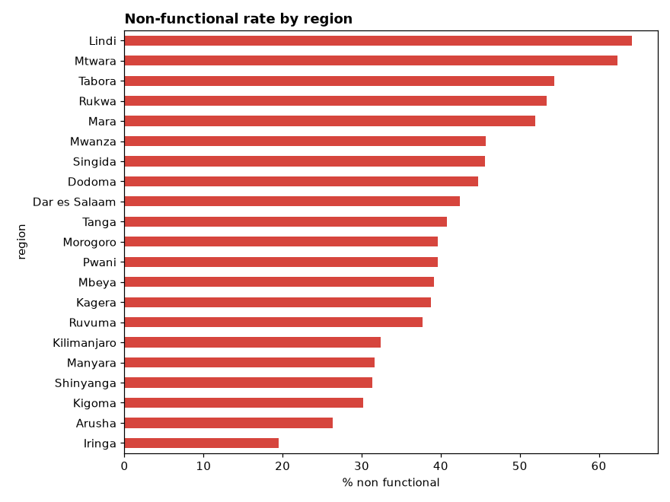
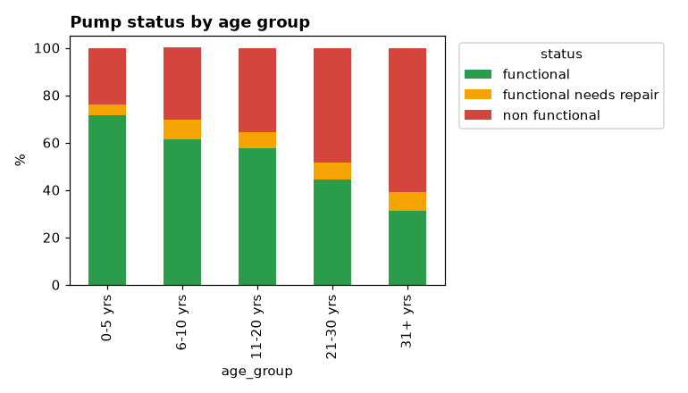
GEOGRAPHY & PUMP AGE
Functionality varies with location and age.
Among recorded pumps, Lindi and Mtwara have the highest non-functional share (~64% and ~62%); Iringa and Arusha the lowest (~19–26%) — location matters.
Functionality declines steadily with age: pumps 0–5 years old are about 72% functional, falling to about 31% for pumps 31+ years old.
These figures come from the shared integration branch (docs/3-sprint1-integration). Next: a quick look at the full interactive map.
Notes:
[Tari | 75 sec]
Both location and age matter here. Looking at the regions, Lindi has the highest share of non-functional pumps, at about 64%, and Mtwara is close behind. Iringa has the lowest, at about 19%. This is a big difference, and it might be linked to how well pumps are maintained, or when they were built in each region. Age shows an even clearer pattern: pumps that are 0 to 5 years old are about 72% functional. That share goes down step by step, until pumps over 31 years old are only about 31% functional. I also made an interactive map of every pump, coloured by status. It's not part of this short talk, but I'm happy to show it afterwards if anyone wants to see it. These numbers come from our shared integration branch, and they match the data quality and category findings we just showed. Now I'll hand over to Goodfriend to bring this together for Sprint 2.
Next: Tari (same speaker, continuing) — a quick look at the full interactive map.

Slide 5
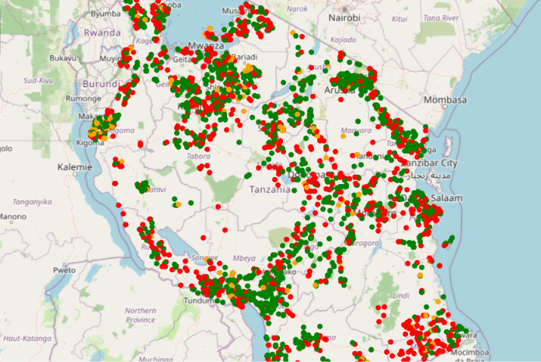
INTERACTIVE GEOSPATIAL MAP
Every waterpoint, mapped and colour-coded by status.
[ MAP SCREENSHOT GOES HERE ]
Functional
Needs repair
Non-functional
Notes:
[Tari | ~20 sec]
Here's that same data as a map — every recorded waterpoint, colour-coded green for functional, orange for needs repair, red for non-functional. You can already see the regional clustering we just talked about. The full interactive version is in our notebook if anyone wants to explore it afterwards.
Next: Goodfriend — Sprint 1 gives us a practical modelling plan.

Slide 6
CONCLUSIONS & SPRINT 2 PRIORITIES
Sprint 1 gives us a practical modelling plan.
1
2
3
Agree on one data-preparation step
Compare baseline and candidate models
Evaluate every class, especially “needs repair”
Implement a single, shared, documented cleaning function — 0-placeholders, duplicates, invalid coordinates — that every notebook and the model pipeline reuse.
Use the most promising features identified this sprint — quantity, pump age, region, extraction type — to compare a baseline against stronger candidate models.
Report class-specific precision, recall and F1 — not just overall accuracy — so the smallest, most operationally important class isn't hidden by the two larger ones.
Sprint 2 will test whether these patterns are actually predictive — comparing models and reporting results per class, not just overall.
Notes:
[Goodfriend | 40 sec]
To finish: our findings support looking further into age, location, water availability, technology, and management. First, we need one shared and written-down way to clean the data — the same steps for zeros, duplicates, and coordinates that we showed today, used by every notebook and the final pipeline. Second, in Sprint 2 we will test if these features can really predict pump status. We will compare a simple baseline model against stronger models, and check for possible leakage, especially around water quantity and the dry category. Third, and most important: we will check every class on its own, especially needs repair, and report results for each class, not just overall accuracy. Through all of this, we remember that a pattern is not the same as a cause. That's Team WTM's Sprint 1 — thank you, and we are happy to take questions.
Next: none — open the floor for Q&A.

