Slide 1
London, Paris here I come!
QUANTITATIVE SIMILARITY ANALYSIS OF LONDON AND PARIS NEIGHBORHOODS
By Marc Gou

Slide 2
Introduction
Are you moving from London (Paris) to Paris (London)? Let’s see which neighborhood of your future city will suit the most!
The goal of this project is to provide insights for individuals or families which are moving from one of those cities to the other, which district(s) would fit them the most by using a quantitative approach and real-world location and venue data.

Slide 3
Data
For this project we will mainly use the Foursquare location data. Foursquare is a technology company providing mobile search-and-discovery services. Foursquare features also a developer API that lets third-party applications make use of Foursquare's location data.
London and Paris neighborhoods are obtained through the relevant Wikipedia pages.
Geographical coordinates of the neighborhoods are located via Nominatim (from geopy), which is a tool to locate addresses, neighborhoods and interest points by using the data of Openstreetmap.

Slide 4
Methodology – Step 1
Preparation of data
Creation of Neighborhood datafames
Locate the geographical coordinates of the neighborhoods
Explore the venues around the neighborhoods
Clean the irrelevant data
Prepare the data for next steps

Slide 5
Methodology – Step 2
Clustering
K-Means algorithm
Selection of k in order to obtain theoretically the same number of neighborhoods by Cluster
Run the algorithm separately for London and Paris neighborhoods to obtain an independent set of result per city

Slide 6
Methodology – Step 3
Classification
Question: For a given neighborhood from one city, what would be the similar neighborhoods from the other city ?
Problem modeling: multi-class classification problem
Support vector machines with parameters adjusted for this class of problem
Split of dataset to a training set (75%) and a testing set (25%)
Usage of Jaccard Index to assess the prediction accuracy
Two models obtained: one trained for predicting the best cluster in London and another for predicting the best cluster in Paris
Prediction using the models obtained.

Slide 7
Results (1)
The final results are registered in the two following dataframes:
london_final_wParis_df: London neighborhoods (column “Location”) with their corresponding computed cluster in Paris (column “Paris Cluster”)
paris_final_wLond_df: Paris neighborhoods (column “Quartiers”) with their corresponding computed cluster in London (column “London Cluster”)
A few samples are visualized by using the library Folium

Slide 8
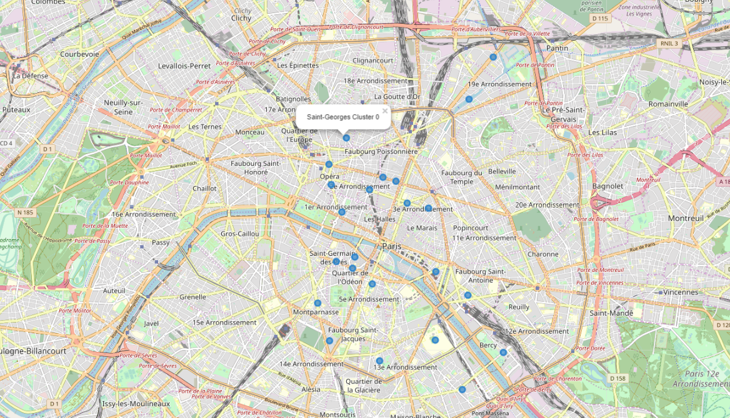
Results (2)
What are the best neighborhoods in Paris to move for a Londoner who loves living at Westminster ?

Slide 9
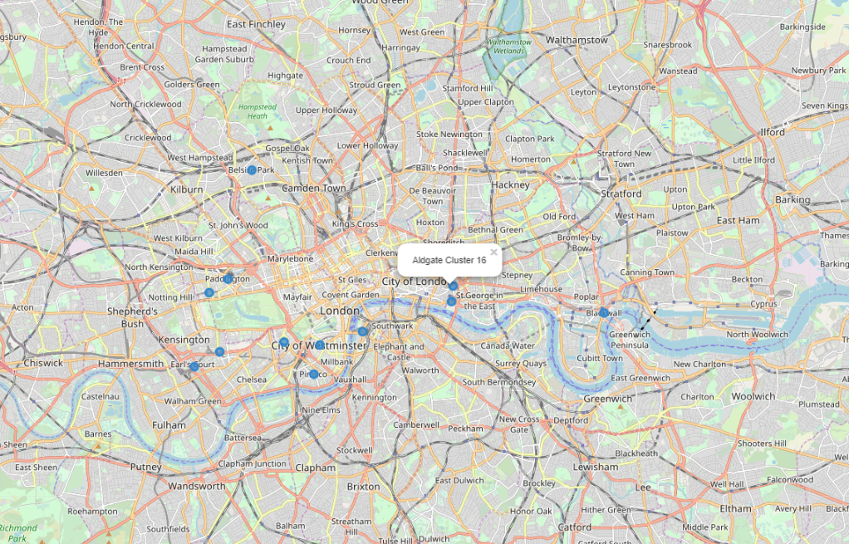
Results (3)
What are the best neighborhoods in London to move for a Parisian who loves living at Place-Vendôme (Arrondissement 1) ?

Slide 10
Discussion
A few ideas to improve the accuracy of the current model:
Review the selection of k for K-means clustering
Considering the usage of other classification algorithms
Other ideas to dive deeper to this topic:
Include other data for the analysis such as criminality-related data, demographic data

Slide 11
Conclusion
This project allows any people who lives in a specific neighborhood of London or Paris and who need to relocate to the other city in a near future to identify, with a quantitative approach, the neighborhoods in the other city that would be the best-fit from a venue category availability perspective.
A good first step to dive into this topic

