Slide 1

Crashing into
Machine Learning
Predicting Vehicle Accident Blame
Team
Celina, Myles, Sedra, Nithin, Omar
Design by: http://www.free-powerpoint-templates-design.com

Slide 2
Table of Contents
Introduction: Crash Dataset
Data Cleaning
Exploratory Data Analysis
Predicting Crash Outcomes with ML

Slide 3
Introduction
Crash Dataset

Slide 4
Introduction
Crash Dataset
99,275
39
Data Limitations:
Few Numeric Variables
Many Categories per Variable
Incorrect Inputs
Location Might Be Too Specific
Rows
Categorical
Variables
Information:
Causes of Accidents
Driving Conditions
Who is at Fault
Vehicle Information
Source: data.world.com
Montgomery County, MD
Year Range: 2018-2019

Slide 5
Data Cleaning

Slide 6
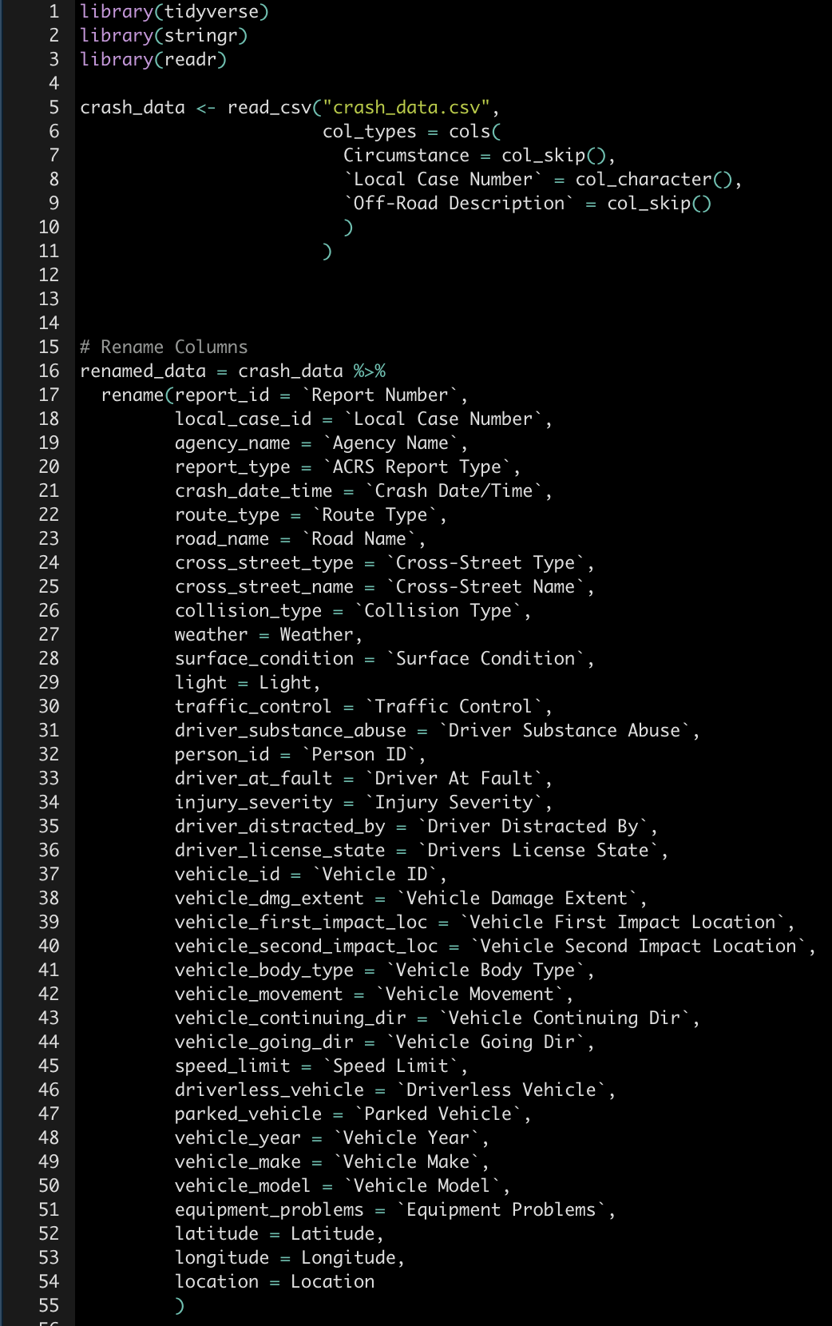
Data Cleaning
Renamed Columns
Technology Used
R with Regex, Tidyverse, Readr, and Stringr

Slide 7
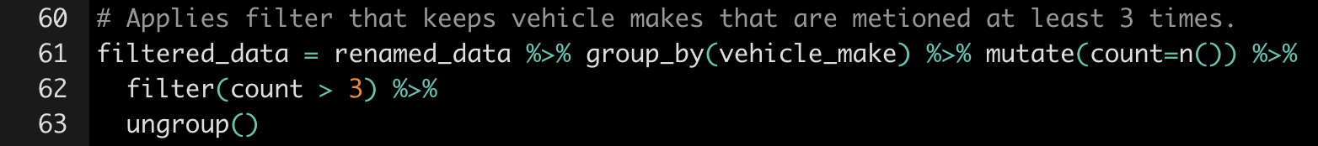
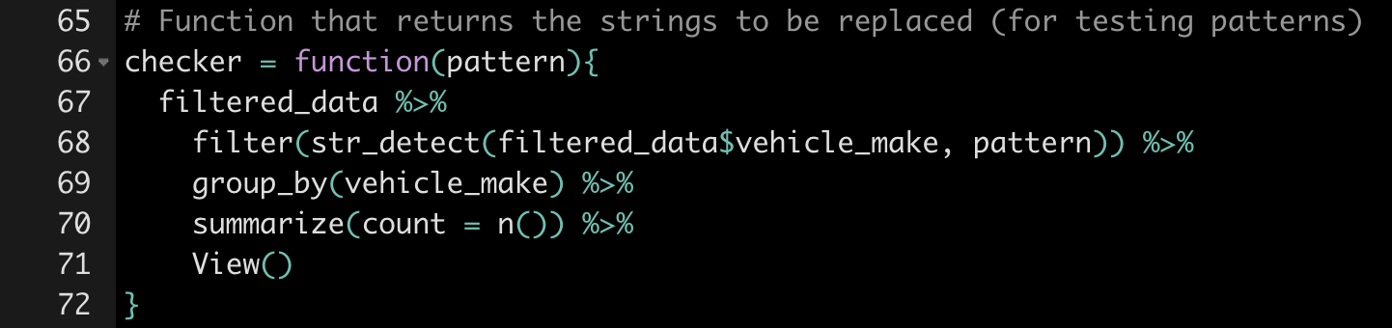
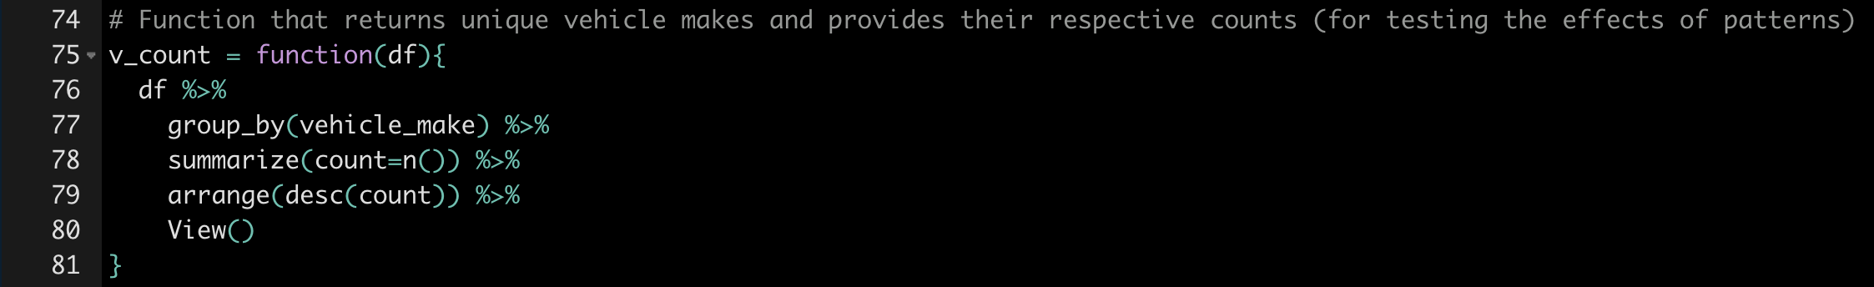
Data Cleaning
4
Define patterns to search for with Regex
Create helper functions
3
Remove obscure car makes
2
1
Drop columns with too many ‘NA’ values

Slide 8
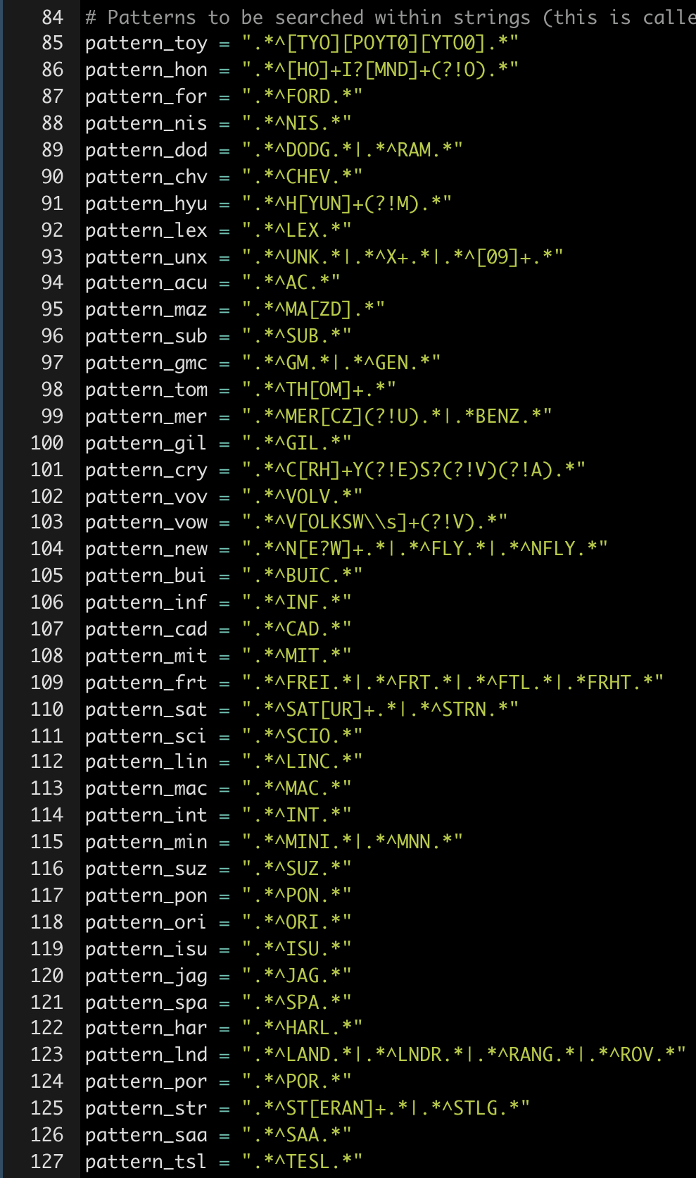
Beautiful
Regex

Slide 9
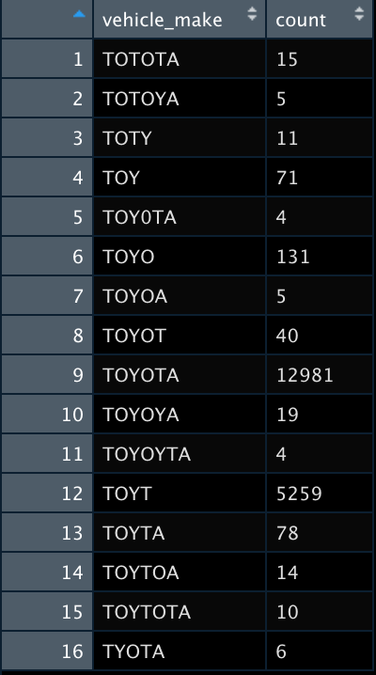
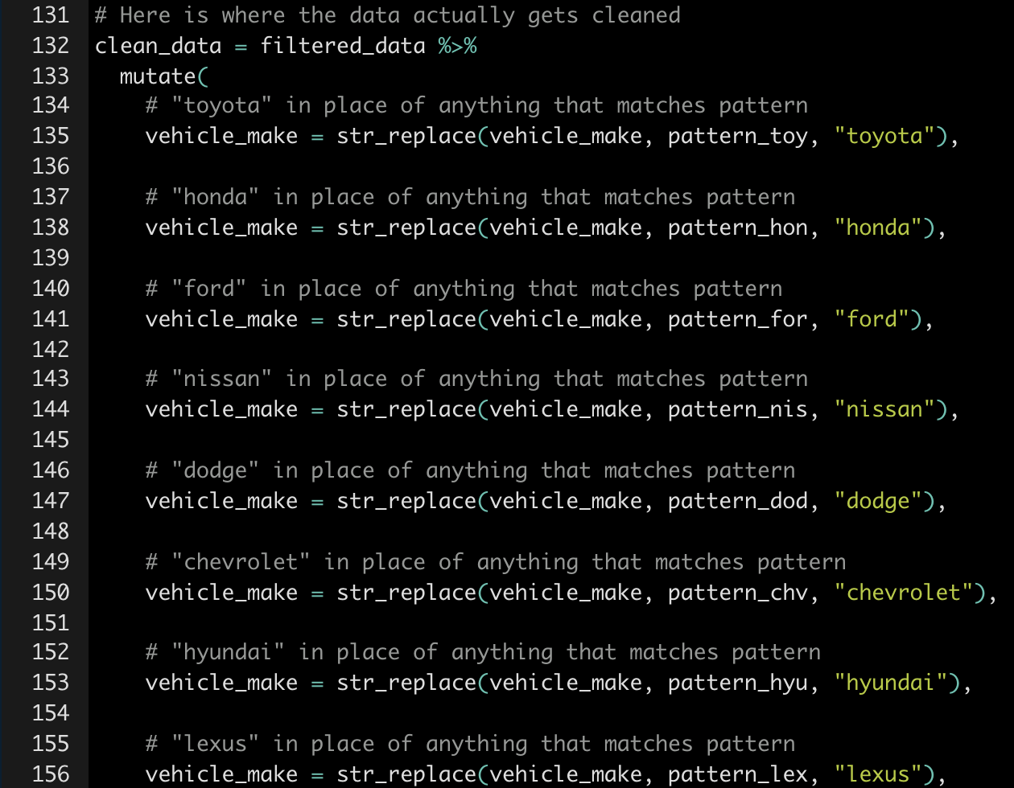
Data Cleaning
“Checker” function at work:
String replacement:

Slide 10


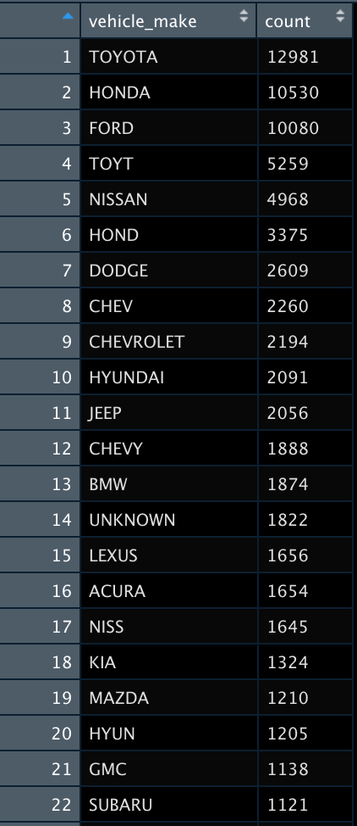
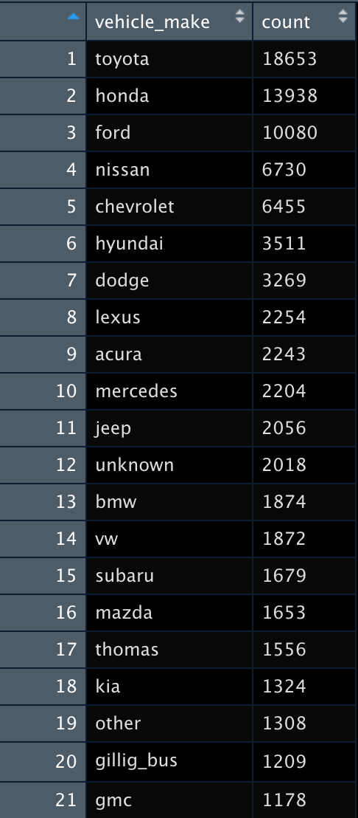
Data Cleaning
Before Cleaning:
After Cleaning:

Slide 11
Predicting Crash Culpability
Linear SVC Model

Slide 12
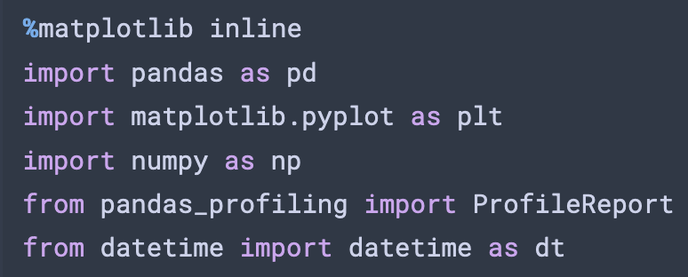
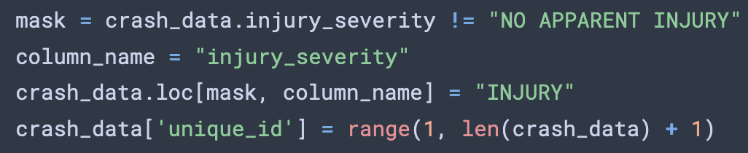
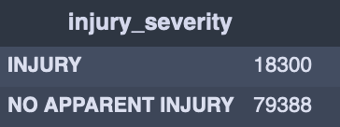
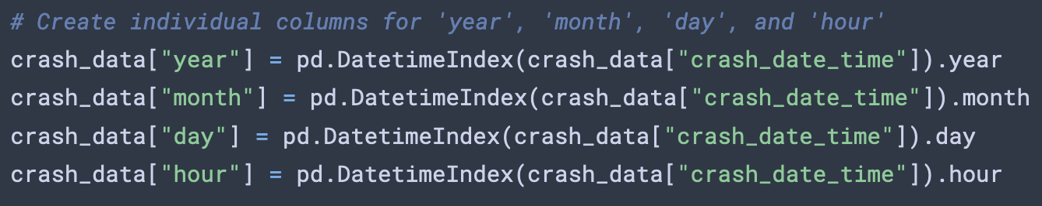
Predicting Crash Culpability: Driver at Fault?
Linear SVC Model — Dependencies and Columns
Import Dependencies & Data
Simplify Columns

Slide 13
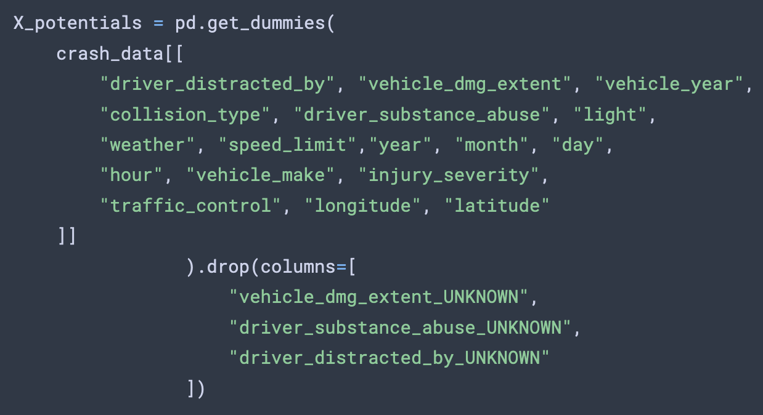
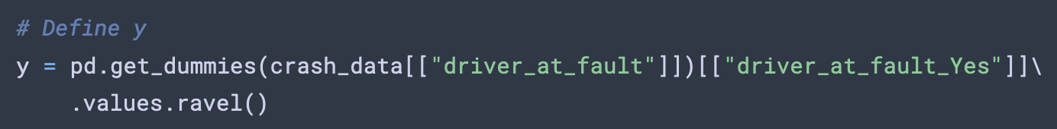
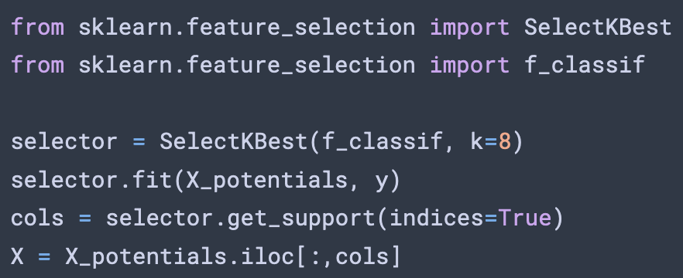
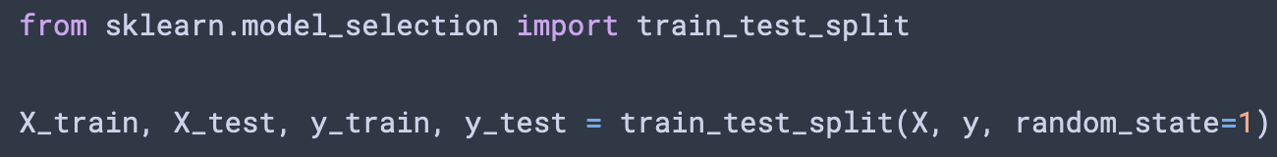
Predicting Crash Culpability: Driver at Fault?
Linear SVC Model — Defining X & y
Define X
Define y
Train/Test Split

Slide 14
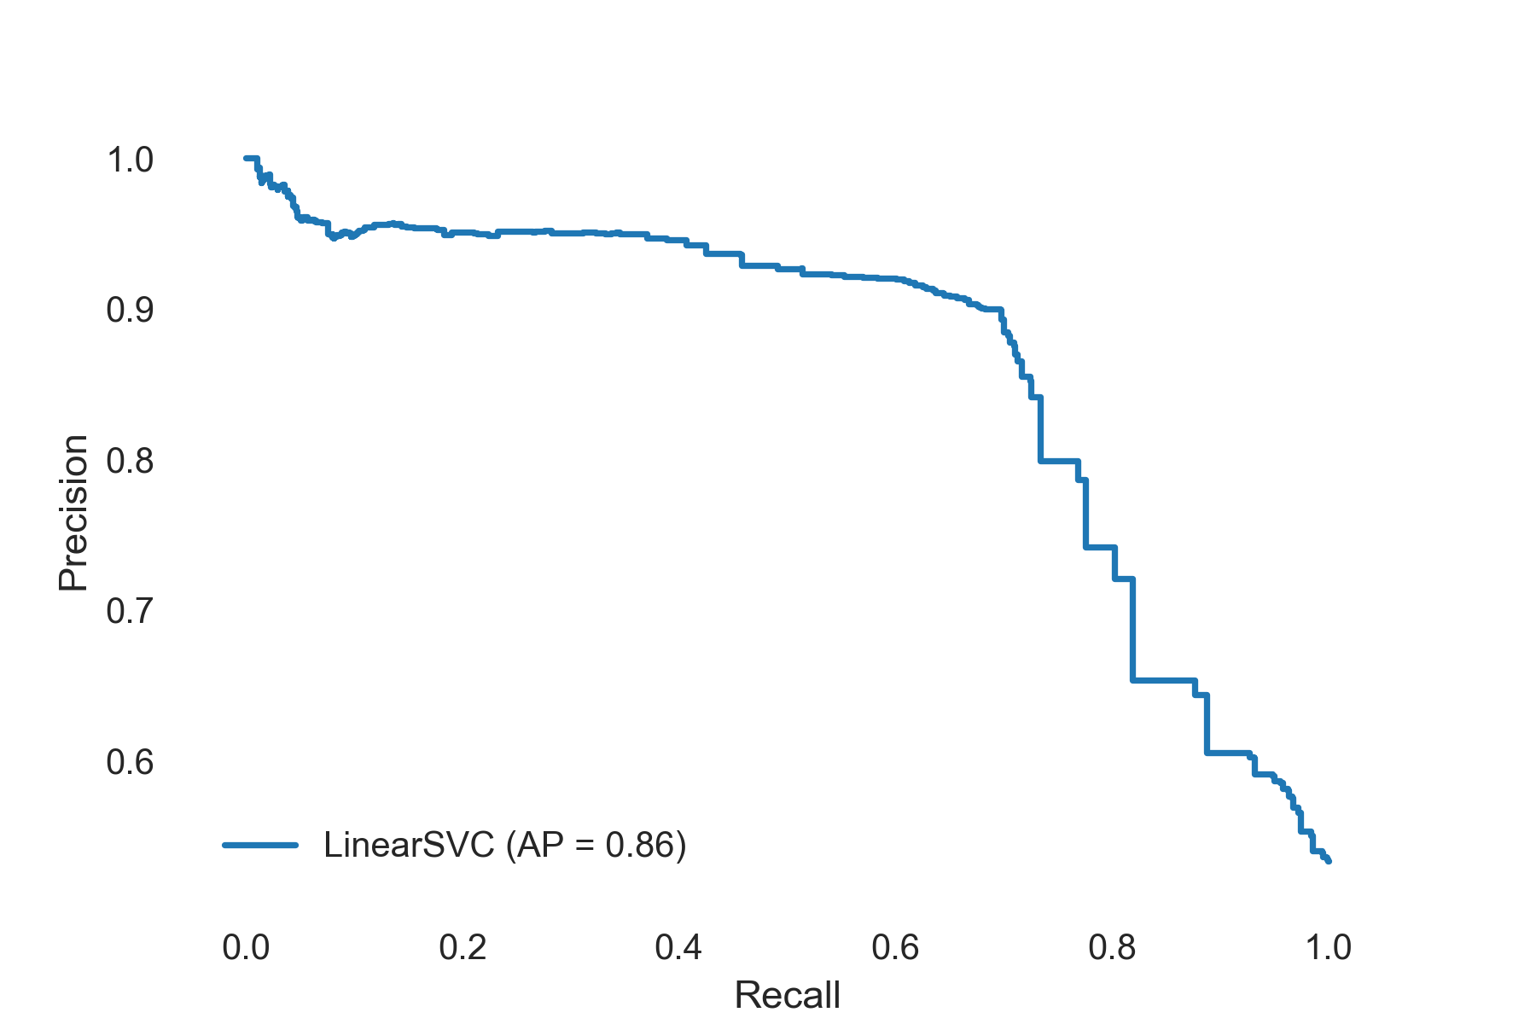
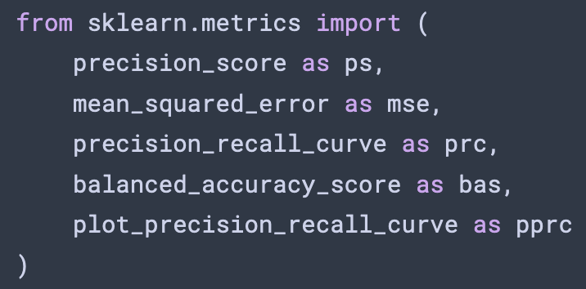

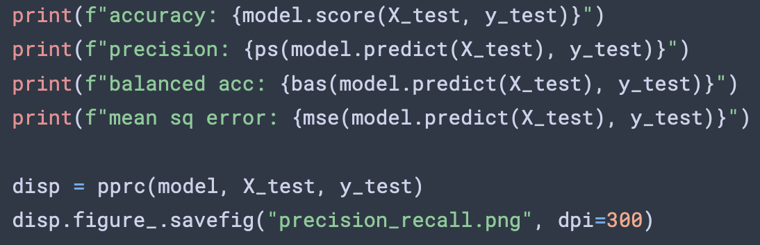
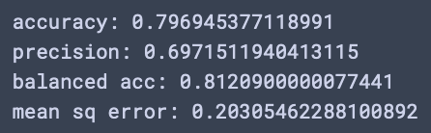
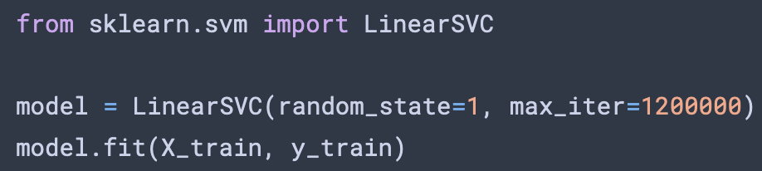
Predicting Crash Culpability: Driver at Fault?
Linear SVC Model — Modeling & Metrics
Precision-Recall Curve
Model Metrics
Confusion Matrix
TP
FP
10420
979
FN
TN
Accuracy, Precision,
Balanced Accuracy, & MSE
4117
8906
Train Model

Slide 15
Thank you for your time!

