Slide 1
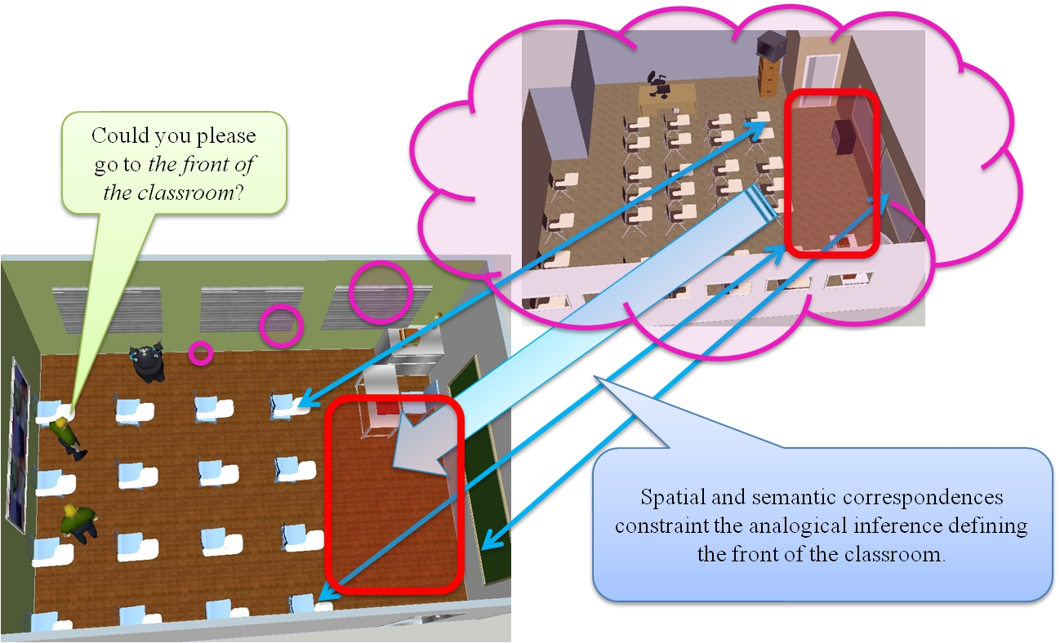

Slide 2
PlayerStage Sensor Data
Points
x, y, area
Computing the region of a room
Perhaps just the linemap information and we can ignore the points
(roomArea ((x0 y0)(x1 y1)…(xn yn)))
Object detection
x, y, type

Slide 3
Spatial Entities
Room
ID, and a Region Boundary
(room Room1)
(roomBoundary Room1 (<list-of-points>))
Objects
ID, x, y, type
(desk Object1)
(objectLocated Object1 (<x> <y>))
Object Groups
ID, Type, Boundary, Entities
(group Group1)
(hasEntity Group1 Object1)
(groupBoundary Group1 (<list-of-points>))

Slide 4
Qualitative Spatial Representations
Topological: RCC-8s between regions
Disjoint, edge connected, partially overlapping, tangential part, non-tangential part…
(rcc8-NTPP Group1 Room1) – Group1 is inside of Room1 and not touching the edge.
For regions that are points (only Disjoint, edge-connected, and non-tangential part)
Is there any research/discussion on this?
Directionality
above, left
Talk to Jeff about how these are computed?

Slide 5
Base Description
1
2
3
4
Target Description
1’
a
b

Slide 6
YMinXFewestFn
boundary
Segment
YMaxXFewestFn
Base
Group
xMinusYZero
Group
xMinusYZero
CDSR1
region
Type
front
Desk1
Desk4
Desk5
Desk2
correspondences
YMinXFewestFn
boundary Segment
YMaxXFewestFn
Target
Candidate Inference
Group
xMinusYZero
CDSR2
region
Type
front
Desk11
Desk12

Slide 7
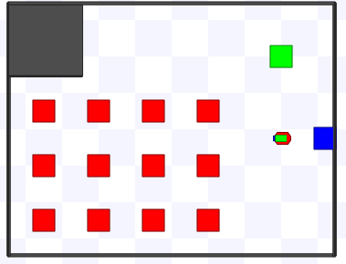

Slide 8
Representing Context-Dependent Spatial Regions
regionBoundary <regionID> <symbolic>
<symbolic> - an object in the environment
A point on a region (BottomLeftFn <RoomID>)
How can these be automatically generated?
regionType <regionId> <semanticType>
Example – This describes a region (CDSR1) with four points.
(regionType CDSR1 FrontRegion)
(regionBoundary CDSR1 (BottomLeftFn Room1))
(regionBoundary CDSR1 (BottomRightFn Room1))
(regionBoundary CDSR1 (BottomLeftFn Group1))
(regionBoundary CDSR1 (CentriodFn Object1))

Slide 9
Analogical Processing
Transfer is based on anchor points and object alignment
Candidate inferences will include regionBoundary and regionType statements.
(regionType (:skolem CDSR1) FrontRegion)
(regionBoundary (:skolem CDSR1) (BottomLeftFn Room2))
What to do about skolems, or unmapped entities in these statements.
Probably just drop them for now.
What to do about other information, such as the rcc8’s and positional concerning the region being transferred?
What to do when they do not agree in the new situation?

Slide 10
Handling Orientation Problems
We will pass on this for now, leave it to future work
Should be a simple translation process of positional relations and anchor points.
When performing a match, try 8 rotations to see which provides the best match.

