Slide 1
IC Design HW3 Tutorial
Ming-Shan Huang
Professor：Tzi-Dar Chiueh
2022/11/10

Slide 2
Outline
Introduction to Verilog
Module
Value & number
Data type
Ncverilog simulation & nWave tool

Slide 3
Introduction to Verilog
Module
Value & Number
Data Type

Slide 4
What is Verilog
Verilog is a Hardware Description Language (HDL)
Describe digital electronic system at multiple levels of abstraction
Model the timing
Express the concurrency of the system operation
Test the system
Notes:
是一種硬體描述語言，
之所以要有這個是因為
由於現在的設計都具有數十億個電晶體，透過這個語言+EDA TOOL就可以很方便地完成電路設計的整個流程。
可以不同層級的描述電路，
並且能模擬電路於不同時間的行為，
也可用來驗證整個系統。

Slide 5
Behavioral Model of Circuits
System
concept
Algorithm
Architecture
Increasing
detailed
realization &
complexity
Increasing
behavioral
abstraction
Register Transfer Level
Gate Level
Transistor Level
Notes:
Behavioral level
Describe a system by the flow of data between its functional blocks. It is used when we don't worry about how the hardware looks-like. We use this to model any block if we just know how the input output should be.
Register Transfer Level (RTL)
Describe a system by the flow of data and control signals between and within its functional blocks
Gate level
Describe a system by connecting predefined components

Slide 6
Verilog-Supported Levels of Abstraction
Behavioral
Structural and procedural like the C programming language
Describe algorithm level and RTL level Verilog models
Register Transfer Level (RTL)
Describe the flow of data between registers and how a design process these data.
Structural
Describe gate-level and switch-level circuits.
High
Low

Slide 7
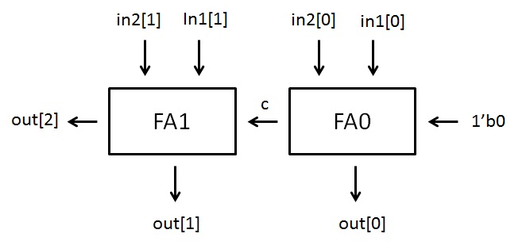
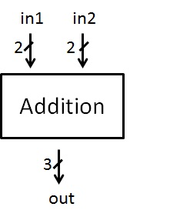
The Verilog Module
Basic building blocks .
Begin with module,
end with endmodule
module <module name>(<port lists>);
//module description
endmodule
Notes:
使用Verilog描述硬體的基本設計單元是模組（module）。

Slide 8
Module Ports
Modules communicate through ports
input
output
inout (bidirectional)
module FA1(CO,S,A,B,CI);
output S,CO;
input A,B,CI; //module description
endmodule
A
S
B
FA1
CO
CI

Slide 9
4-Value Logic System
0
zero, false, low
1
one, true, high
Z
high impedance, floating
X
unknown, occurs at un-initialized storage elements or un-resolvable logic conflicts

Slide 10
Value and Number
[[<size>]’<radix>]<value>
Size
The size in bits
Default size is 32 bits
Radix
b (binary), o (octal), d (decimal), h (hexadecimal)
Default radix is decimal
Value
Any legal number in selected radix, including “x” and “z”
Radix and value are case-insensitive

Slide 11
Value and Number – Examples
4’b1001 // 4-bit binary
5’d3 // 5-bit decimal
12’h7ff // 12-bit hexadecimal
3’bx10 // 3-bit binary with unknown MSB
4’b101x // 4-bit binary with unknown LSB
12’hx // 12-bit unknown
-8’d6 // phrase as -(8’d6)
underline usage
16’b0001_0101_0001_1111
32’h12ab_f001
X and Z is sign-extended
Ex. 12-bit a
a = ‘h x; // yields xxx
a = ‘h 3x; // yields 03x
a = ‘h 0x; // yields 00x

Slide 12
Data Type Classes
wire
wire [MSB:LSB] variables;
input, inout, output are default to be wire.
Used to describe combinational circuit!
reg
reg [MSB:LSB] variables;
Used to describe combinational or sequential circuit.

Slide 13
Assign a value to wire
wire
“assign “
wire a;
assign a = 1’b1;
Output port
wire a;
wire b;
assign b = 1’b0;
NOT n0(a, b);
Every wire can be only assigned once!!!
wire a;
wire b;
assign b = 1’b0;
NOT n0(a, b);
assign a = 1’b0; //Wrong!!!

Slide 14
Module Instances (1/2)
Create a higher-level system by connecting lower-level components
Reg2
module Reg2 (q, d, clk, rst);
output [1:0] q; input [1:0] d; input clk, rst;
FD2 f0(q[0], d[0], clk, rst); FD2 f1(.Q(q[1]), .D(d[1]), .CLK(clk), .RESET(rst));
endmodule
d[1]
FD2
q[1]
d[0]
clk
FD2
q[0]
rst
Module name
Instance name
Notes:
描述複雜的硬體電路，設計人員總是將複雜的功能劃分為簡單的功能，模組是提供每個簡單功能的基本結構。設計人員可以採取「自頂向下」的思路，將複雜的功能模組劃分為低層次的模組

Slide 15
Module Instances (2/2)
module Reg2_2 (q, d, clk, rst);
output [1:0] q; input [1:0] d; input clk, rst;
wire [1:0] w;
Reg2 r0(w, d, clk, rst); Reg2 r1(q, w, clk, rst);
endmodule
Reg2_2
w
d
Reg2
Reg2
q
2
2
2
clk
rst

Slide 16
Net Concatenations
Representation | Meaning
{b[3:0],c[2:0]} | {b[3] ,b[2] ,b[1] ,b[0], c[2] ,c[1] ,c[0]}
{a,b[3:0],w,3’b101} | {a,b[3] ,b[2] ,b[1] ,b[0],w,1’b1,1’b0,1’b1}
{4{w}} | {w,w,w,w}
{b,{3{a,b}}} | {b,a,b,a,b,a,b}
wire a;
assign a ={b[3:0],c[2:0]};

Slide 17
Standard Cell Library (lib.v)
Choose what you need
Compose your circuit according to I/O connections
module AN3(Z,A,B,C);
output Z;
input A,B,C;
// netlist
and g1(Z,A,B,C);
// specify block, declare local
// timing constant
specify
// delay parameters
specparam Tp_A_Z = 0.275;
specparam Tp_B_Z = 0.275;
specparam Tp_C_Z = 0.275;
// path delay (full connection)
( A *> Z ) = ( Tp_A_Z );
( B *> Z ) = ( Tp_B_Z );
( C *> Z ) = ( Tp_C_Z );
endspecify
endmodule

Slide 18
Standard Cell Library (lib.v) - 2/2
IV // not
AN3
AN4
AN2
EN // xnor
EN3
EO // xor
EO3
FA1 // full adder
FD1 // DFF
FD2
ND2 // nand
ND3
ND4
NR2 // nor
NR3
OR2 // or
OR3
OR4
HA1 // half adder
MUX21H // 2-to-1 MUX

Slide 19
Notification
In this HW, all the logic operation MUST consist of standard cell. You can NOT use logic operators.
wire a, b, c;
assign a = b & c;
wire a, b, c;
AN2 an(a, b, c);

Slide 20
Example
module ADDER (out, in1, in2);
output [2:0] out;
input [1:0] in1, in2;
wire c;
FA1 fa0(c, out[0], in1[0], in2[0], 1’b0);
FA1 fa1(out[2], out[1], in1[1], in2[1], c);
endmodule

Slide 21
Flow chart
tb_kendall.v
lib.v
i0.dat
i1.dat
i2.dat
i3.dat
golden0.dat
*.fsdb
Verilog
nWave
Your job
(Write Verilog file)
kendall.v
All these files should be placed under the same folder

Slide 22
Your Job
module kendall(kendall, i0_x, i0_y, i1_x, i1_y, i2_x, i2_y, i3_x, i3_y);
input [3:0] i0_x, i0_y, i1_x, i1_y, i2_x, i2_y, i3_x, i3_y;
output [3:0] kendall;
// Write your design here
wire [?:0] …;
My_module_0 M0(?, ?, … , ?);
…….. My_module_x Mx(?, ?, … , ?);
endmodule
i0
kendall
4
i1
4
i2
My_module_0
?
My_module_x
kendall
4
4
i3
4

Slide 23
Ncverilog Simulation & nWave Tool

Slide 24
Test and verification your circuit
By applying input patterns and observing output responses
Testbench
Device under test (*.v)
Device under test (*.v)
(tb_*.v)
(tb_*.v)
(*.fsdb)
(*.fsdb)
Test patterns
Output response

Slide 25
Compile and debug (1/4)
Source
source /usr/cadence/cshrc
Include the testbench & lib.v files to run simulation
ncverilog +access+r tb_kendall.v kendall.v lib.v

Slide 26

Compile and debug (2/4)

Slide 27
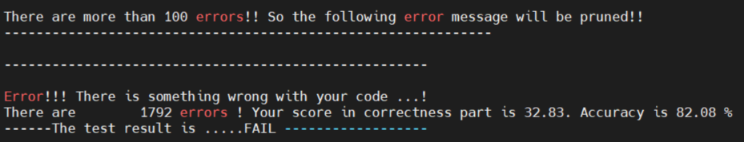
Compile and debug (3/4)

Slide 28
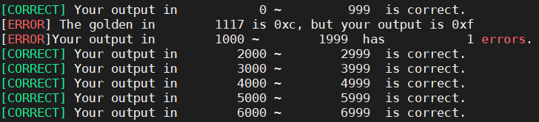
Compile and debug (4/4)
Use tb_kendall_pattern.v as your testbench.

Slide 29
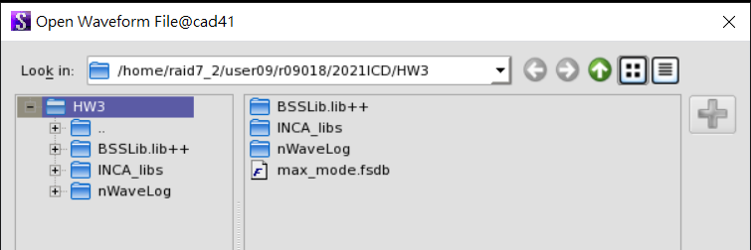
Execute nWave & Open *.fsdb
Execute : nWave &
Open waveform file:
File -> Open -> max_mode.fsdb

Slide 30
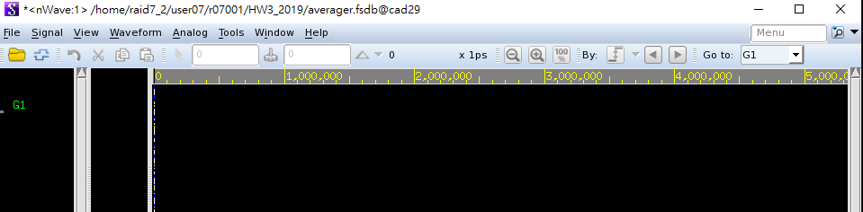
Get signals

Slide 31
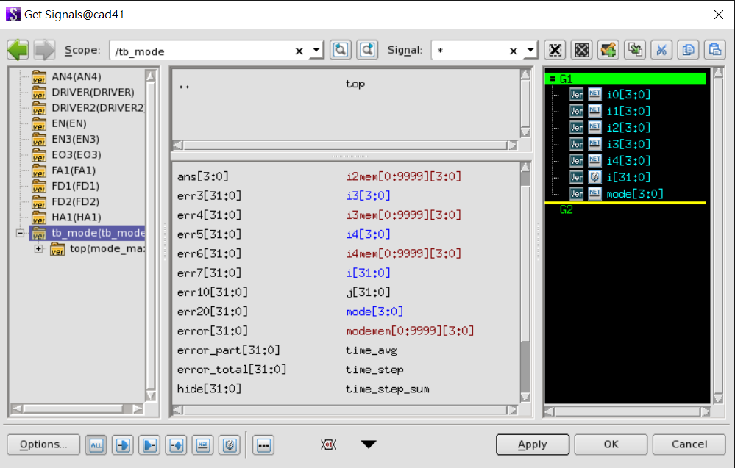
Find Top Module & Choose signals

Slide 32
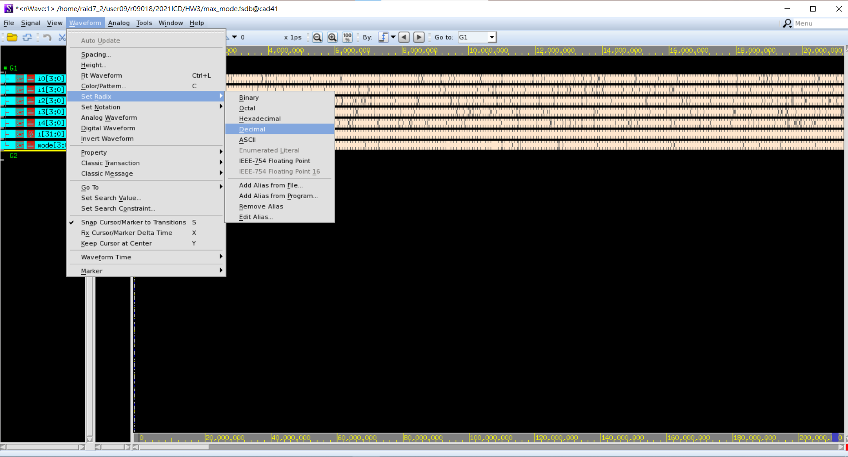
Change the radix to be decimal
Select the signal you want to change first.

Slide 33
Reminder
Due to 2022/11/24 09:00
Any further questions, please contact…
r10943003@ntu.edu.tw

