Slide 1

WebRTC multipoint conferencing
with recording using a Media Server

Slide 2
Goal: WebRTC conferencing prototype that
allows more than four participants to communicate simultaneously
supports recording of conversations
allows participants in restrictive network environments to take part in conversations
optionally allows SIP-Clients (soft/hard phones), and Teleconferencing systems to connect to a conference

Slide 3
WebRTC introduction
Peer-to-Peer based communication solution for all devices
Not dependent on OS, proprietary plugins or other programs
Most known for video chats between Google Chrome and Mozilla Firefox
Uses SDP to instantiate sessions
No signaling method is defined
Jointly defined by the W3C WebRTC Working Group (browser API) and the IETF RTCWEB Work Group (protocols)

Slide 4
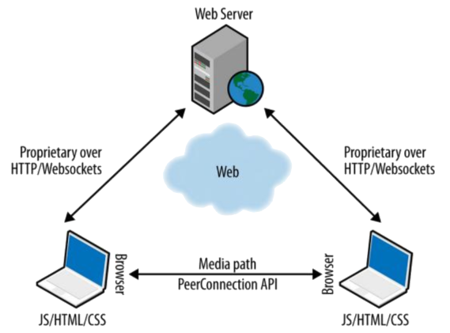
WebRTC triangle
Source: Iya Grigorik, 2013 High-performance browser networking

Slide 5
Important bits – The API
RTCPeerConnection main object used by a web application in the browser
Create connections between peers
Handle SDP offers and answers
ICE agent to find and negotiate usable IP addresses and port numbers (ICE candidates)
Receive and send media streams
media stream requested using the MediaStream API
Multiple video and audio tracks
RTCDataChannel TCP based, used to send arbitrary non-media data

Slide 6
Device types
UDP based protocols for the peer connection and TCP based ones for the data channel including encryption with TLS and DTLS
WebRTC device conforms to the protocol specifications
WebRTC browser WebRTC device that also supports the full ECMAScript API.
WebRTC gateway WebRTC device that mediates media traffic to non-WebRTC devices and may not conform to all protocol specifications.
Connect WebRTC browser to a multicast endpoint
Connect PSTN telephone and WebRTC browser

Slide 7
Goals: WebRTC conferencing prototype that
allows more than four participants to communicate simultaneously
supports recording of conversations
allows participants in restrictive network environments to take part in conversations
optionally allows SIP-Clients (soft/hard phones), and Teleconferencing systems to connect to a conference

Slide 8
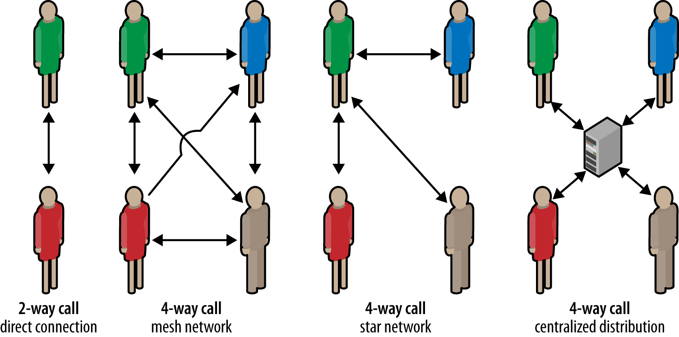
Multipoint conferencing
Source: Ilya Grigorik, 2013 High-performance browser networking

Slide 9
Who records a conference
conference participant
dedicated client
- High processing power on client
- Distribution complicated
- Additional device needed
- Distribution complicated
- One more connection for every participant
Recording with a centralized entity
Each participant records himself
Uploads recording to center
Entity distributes streams to participants
Stores the streams

Slide 10
Restrictive network environments
To establish a direct connection, a publicly accessible IP address is needed
ICE (Interactive Connectivity Establishment)
STUN (Session Traversal Utilities for NAT) UDP, TCP, http, https
TURN (Traversal using Relays around NAT)

Slide 11
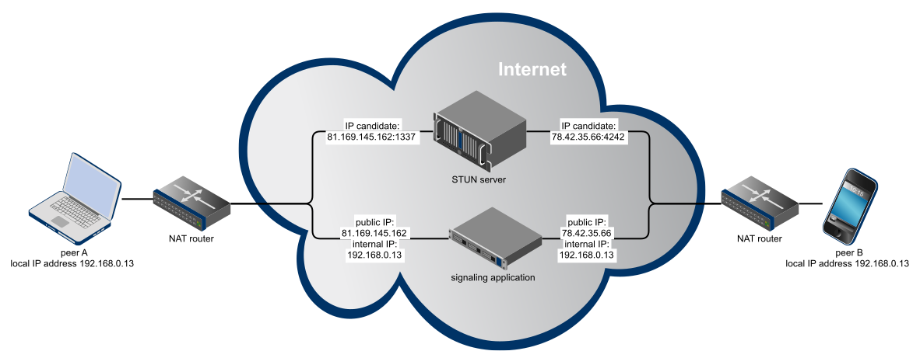
Restrictive network environments

Slide 12
Connecting SIP devices
Session Instantiation Protocol
Text based protocol
Uses SDP to describe media streams (and their initialization parameters)
No mandatory codecs – transcoding is needed
PSTN telephone behaves the same as a teleconferencing solution with four cameras and microphones

Slide 13
Media Server
Comparison of multipoint architectures

Slide 14
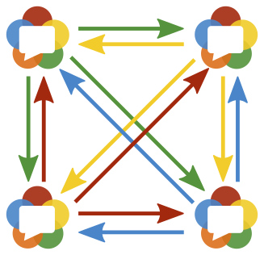
Participant in a full mesh conference
4 Participants
Each participant
3 uploads
3 downloads
3 Mbit/s bandwidth each up- and downstream for VGA video
7 participants:
Bandwidth of 12Mbit/s
WLAN 802.11b does not suffice

Slide 15
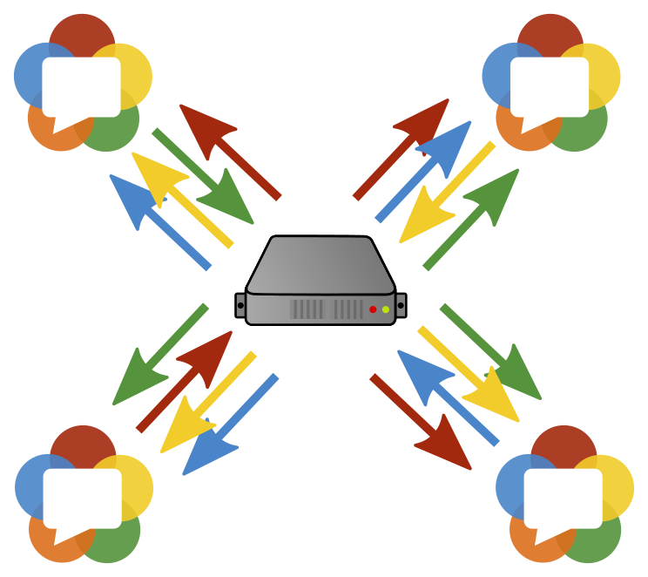
Participant in a relayed conference
4 Participants
Each participant
1 upload
3 downloads
4 Mbit/s bandwidth for VGA video
10 participants:
Bandwidth of 18.4Mbit/s
WLAN 802.11g needed

Slide 16
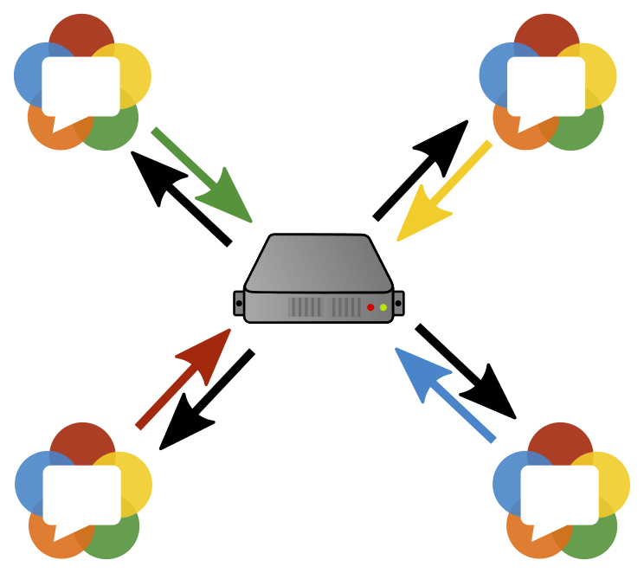
Participant in a mixed conference
4 Participants
Each participant
1 upload
1 download
2 Mbit/s bandwidth for VGA video
25 participants:
Bandwidth of 2 Mbit/s
Might work on 3G

Slide 17
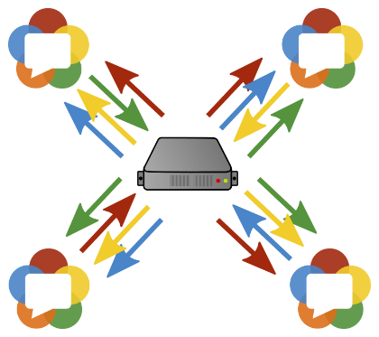

Media Server
Relayed conference
2 participants: 4.1 Mbit/s needed
4 participipants: 16.4 Mbit/s needed
7 participants: 50.2 Mbit/s needed
10 participants: 102.4 Mbit/s needed
Mixed conference
2 participants: 4.1 Mbit/s needed
4 participants: 8.2 Mbit/s needed
7 participants: 14.3 Mbit/s needed
10 participants: 20.5 Mbit/s needed
High strain on network device
High processing power needed

Slide 18
Bandwidth recommendations (at 15fps)
Entry | Resolution | Recommended bandwidth | Minor hickups (1 freeze per minute) | Maximum used bandwidth
QCIF | 176x144 | 384kbit/s | 200kbit/s | 700kbit/s
CIF | 352x288 | 700kbit/s | 384kbit/s | 2000kbit/s
VGA | 640x480 | 1024kbit/s | 512kbit/s | 2100kbit/s
HD 720p | 1280x720 | 1900kbit/s | 1024kbit/s | 2500kbit/s
HD 1080p | 1920x1080 | - | - | -
One stream was tested on a virtual network device that was limited using the Network Emulator Toolkit

Slide 19
Open Source Media Servers
Kurento http://www.kurento.org/ (LGPL)
Kurento http://www.kurento.org/ (LGPL)
Doubango https://code.google.com/p/telepresence/ (GPL)
Jitsi https://jitsi.org/Projects/JitsiVideobridge (MIT)
Licode http://lynckia.com/licode/ (MIT)

Slide 20
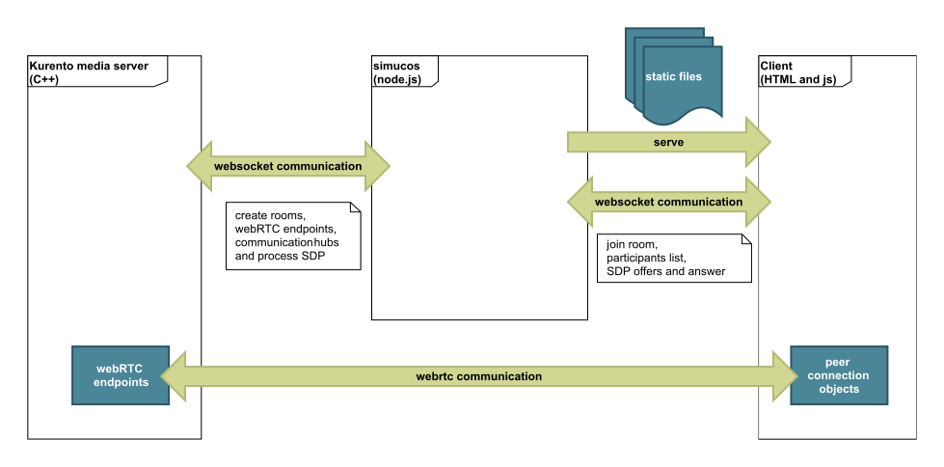
Architecture

Slide 21
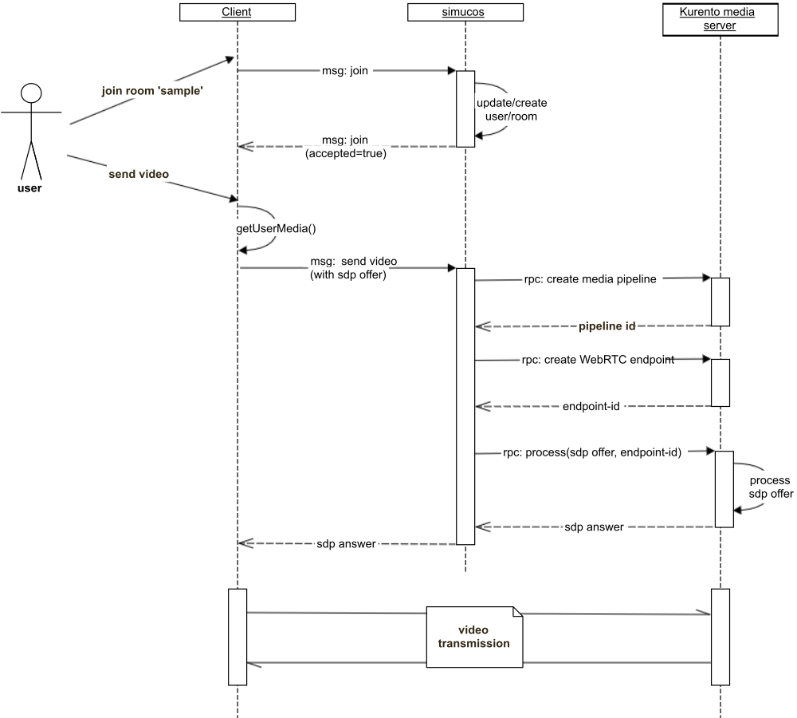
Example: Start a conversation

Slide 23
Goals
Most of the goals for this thesis were achieved with the simucos prototype:
Conferences can be recorded on the media server as VP8 or h.264 video files.
Many clients may participate in a conference, the highest number tested was 25 in a mixed conference, and 14 in a relayed conference.
Participants in restrictive network environments can connect to a conference using a STUN or TURN server.
Only the optional goal to add support for SIP clients into simucos was not implemented due to the chosen Node.js architecture.

Slide 24
Conclusion and prospect
WebRTC is a mature technology
WebRTC has disruptive qualities:
Solutions are achievable that would need more experience, more man-power and more time with other communication solutions

Slide 25
Future ideas
Switching a peer-to-peer conference to a media server
Hybrid architecture approach
Lessen strain on media server by using peer-to-peer meshes
Dynamic architecture approach
Develop algorithms to optimize the hybrid architecture approach
Peer-to-peer broadcasting of one presenter
Tree based structure
Ring structure

Slide 26
Bright future for WebRTC
New features in WebRTC 1.0
Unified statistics API
Promises instead of callbacks
Object RTC (ORTC)
Effort to create the next version of WebRTC (backed by Microsoft and Google)
Exchange text-based SDP with a JS object model
Developers gain access to lower-level functions (e.g. Codec settings per track)
More powerful and flexible JavaScript API

Slide 27

www.mikogo.com Questions?
Thesis available at:
https://github.com/marc136/thesis
Email: mwalter@mikogo.com

Slide 28
More Time?
Image sources
Title page:
Top left: http://lifestyle.beiruting.com/wp-content/uploads/2011/09/business-man-resume.jpg
Top center: http://www.jenningswire.com//wp-content/uploads/2014/01/Businessman1.jpg
Top right: http://bizblog.cosmobc.com/files/2015/03/Business-Man.jpg
Bottom left: http://ak3.picdn.net/shutterstock/videos/4885424/preview/stock-footage-businessman-enjoying-book-on-digital-ebook-reader-device-on-train-journey.jpg
Bottom center: http://www.careerealism.com/wp-content/uploads/2011/11/Mature-Businessman-Thinking.jpg
Bottom right: http://thumbs.dreamstime.com/z/picture-confused-woman-smartphone-bright-32589001.jpg
28: http://www.kurento.org/docs/current/introducing_kurento.html
Some other stuff...

Slide 29
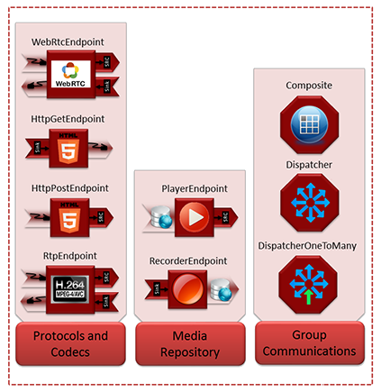
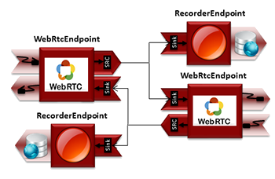
Kurento Media Server
Sample media pipeline

Slide 30
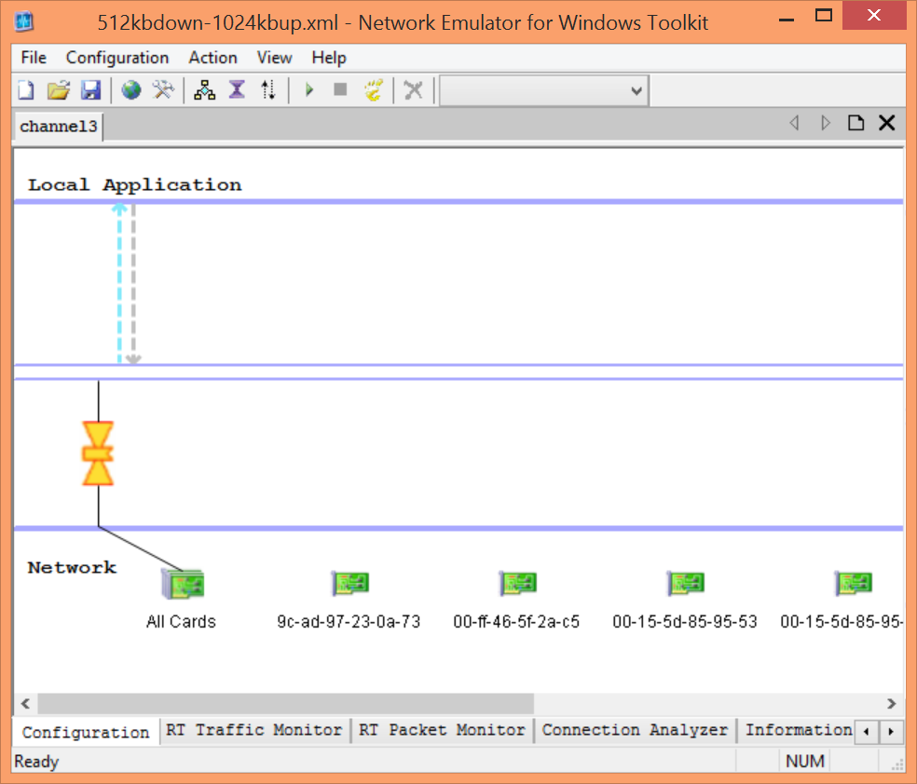
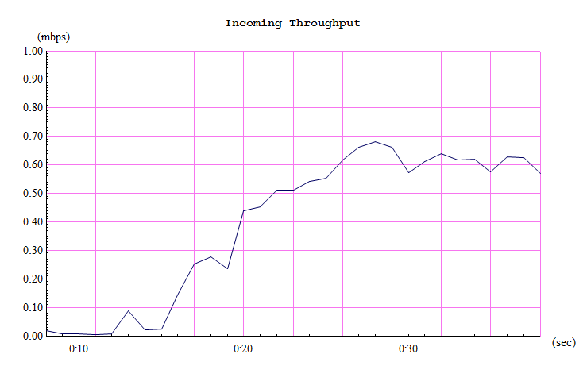
Network Emulation Toolkit (NEWT)
Limit bandwidth
Simulate high traffic
Simulate packet loss
http://blogs.msdn.com/b/lkruger/archive/2009/06/08/introducing-true-network-emulation-in-visual-studio-2010.aspx
https://blog.mrpol.nl/2010/01/14/network-emulator-toolkit/

Slide 31
ICE Candidate Gathering

Slide 32
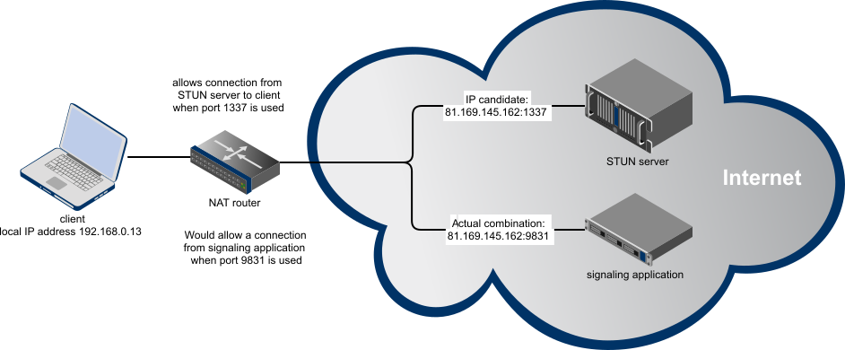
Symmetric NAT

