Slide 1

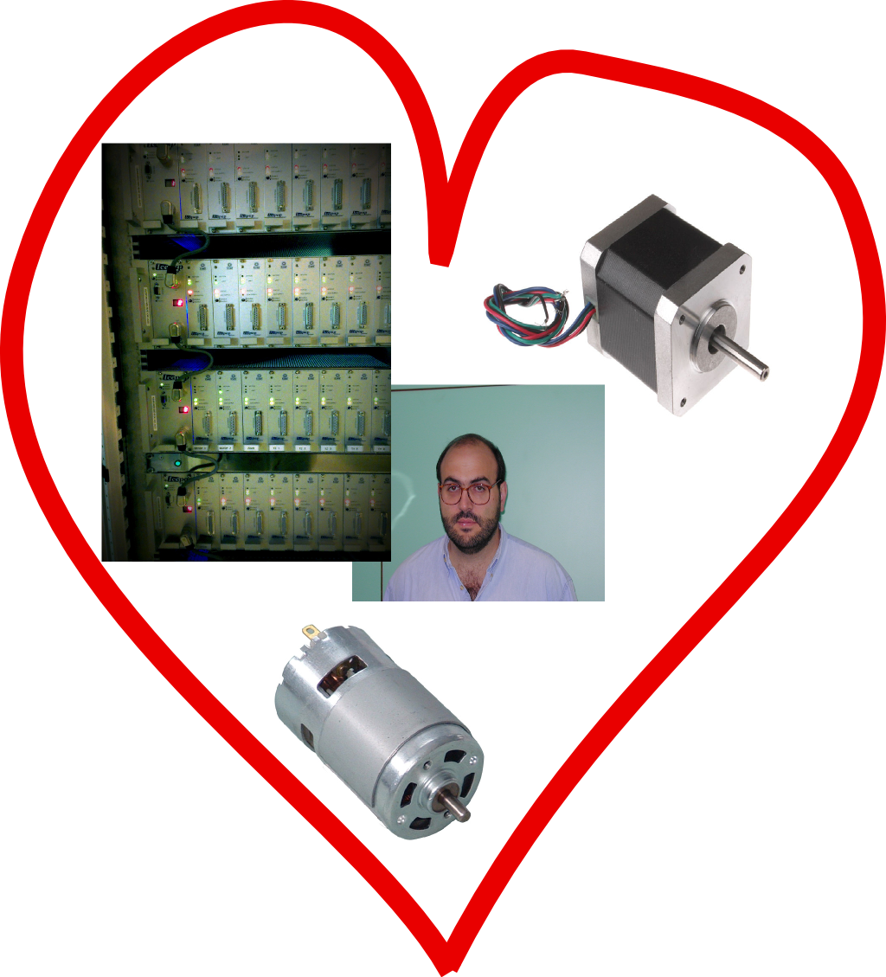
Introducing E-motion
Driving motors, with feelings
Baked with love by M. Guijarro, C. Guilloud, M. Perez
BCU meeting, 27th of March, 2014

Slide 2
What is E-motion ?
In short: Lima for motor controllers
Emotion project
Library “clients”
Tango server
IPython
Emotion library
Controller plugins
Icepap
FlexDC
PI-E753
PI-E517
Technology
Python
gevent: coroutine-based networking, synchronous API on top of libevent loop
pydispatcher: signals/slots
BCU meeting, 27th of March, 2014

Slide 3
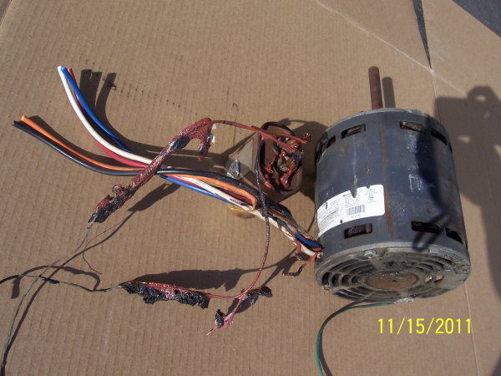
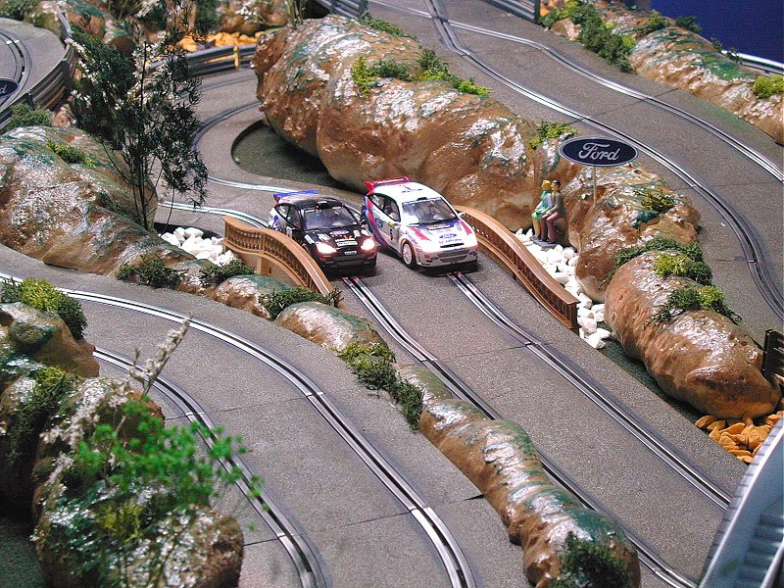
What is E-motion ?
from
BCU meeting, 27th of March, 2014

Slide 4
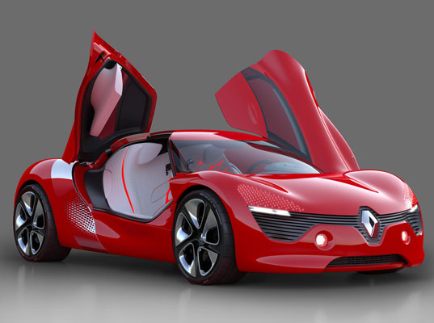
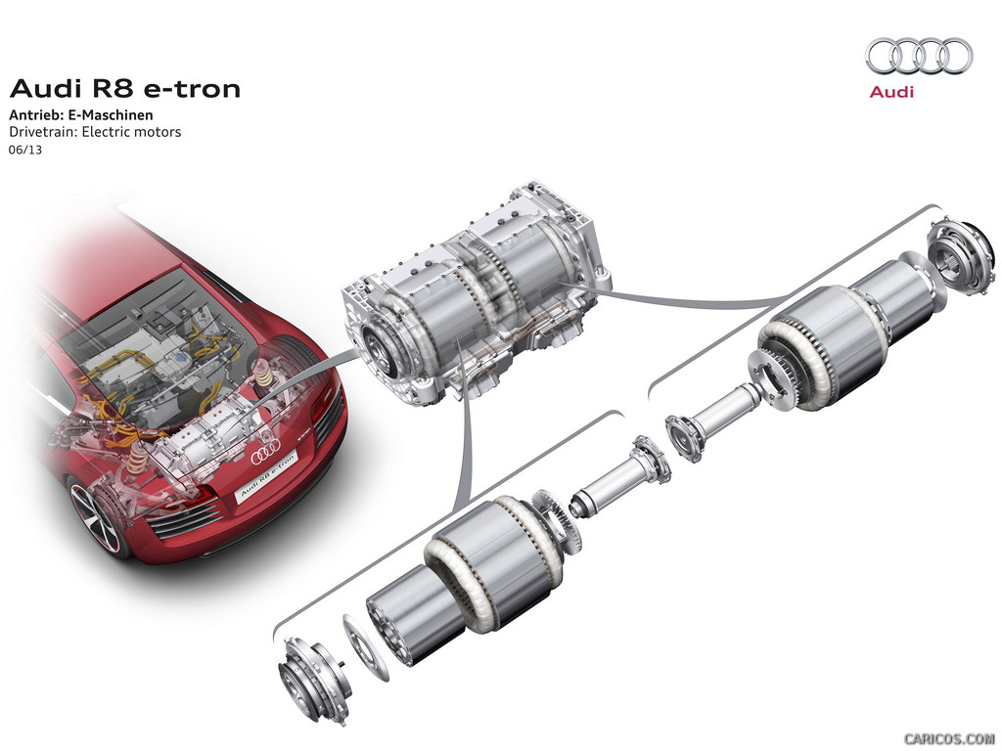
What is E-motion ?
Tribute to M.G. ☺
to
BCU meeting, 27th of March, 2014

Slide 5
4 main components
Config, Controller, Axis, Group
Axis
Emotion library
Config.
Group
Axis
Controller
Calc
Controller
BCU meeting, 27th of March, 2014

Slide 6
Configuration
A single XML file
Basic principles
Controllers export Axis objects
Groups contain Axis objects
Unique names, naming is optional for controllers
Each controller has a class (plug-in class name, = kind of controller)
Lazy evaluation: Axis and Group objects are passive until used
XML tags
4 main ones: config (root), controller, axis, group
Additional tags depend on controller class
some predefined ones: velocity, acctime, backlash…
Short notation, using attributes
BCU meeting, 27th of March, 2014

Slide 7
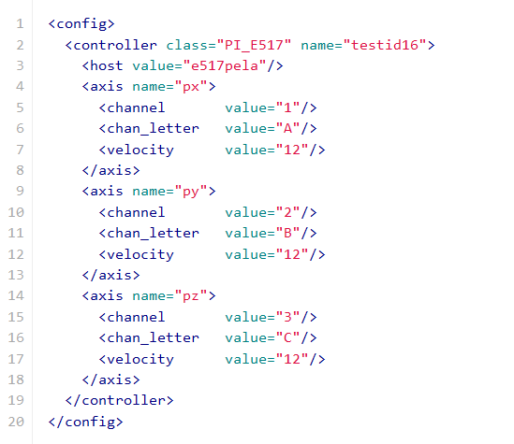
Configuration
A single XML file
BCU meeting, 27th of March, 2014

Slide 8
Configuration User API
Loading, and getting axes and groups
import emotion
emotion.load_cfg_fromstring(xml_str)
Or emotion.load_cfg(filename)
Then:
pz = emotion.get_axis(“pz”)
Same for getting a group:
grp = emotion.get_group(group_name)
BCU meeting, 27th of March, 2014

Slide 9
Writing a standard Controller
Entry points
initialize_axis(axis)
prepare_move(motion)
start_one(motion)
start_all(*motion_list)
stop(axis)
stop_all()
state(axis)
read_position(axis, measured=False)
set_position(axis, new_position)
read_velocity(axis)
set_velocity(axis, new_velocity)
read_acctime(axis)
set_acctime(axis, new_acctime)
Settings
any change triggers a callback (if registered)
configuration stores the default value
BCU meeting, 27th of March, 2014

Slide 10
More details
Interesting features
Communication module: emotion/comm/*
At the moment, only TCP (serial line in progress !)
Optimized code for commands/replies scenario (if controller supports it)
Automatic reconnection
Groups
can mix axes from any controller
optimize calls whenever it is possible
BCU meeting, 27th of March, 2014

Slide 11
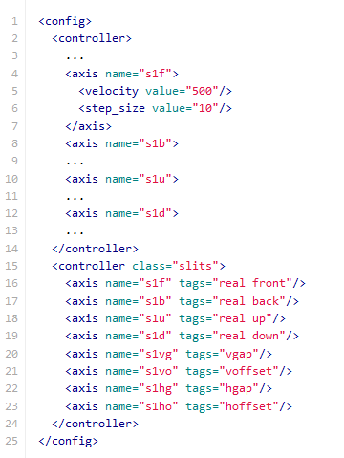
More details
Interesting features
emotion.controller.CalcController
base class derived from Controller
allows to create virtual axis (= macro motors in spec)
in configuration, real axes are tagged “real”
additional roles can be given to axes with other tags
2 methods to overwrite
calc_from_real(positions_dict)
calc_to_real(axis_tag, positions_dict)
BCU meeting, 27th of March, 2014

Slide 12
More details
Interesting features
Mockup controller
allows to test the library
Tests coverage
69 % (with TestMockupController.py, TestLogging.py, TestGroup.py, TestTcpComm.py)
not included : each individual controller with real hardware
BCU meeting, 27th of March, 2014

Slide 13
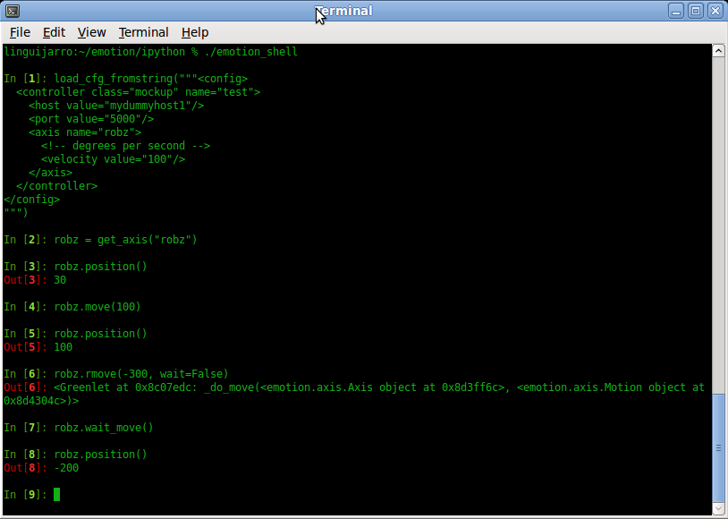
E-motion shell
Test bench for controller developers
Just IPython started in console mode + required imports already done
BCU meeting, 27th of March, 2014

Slide 14
SPEC
Hardware macro-motor : tango_mot
Emotion IRL
Tango
Emotion.py PyTango device server
SPEC
Tango server
IPython
Emotion library
Icepap
FlexDC
PI-E753
PI-E517
BCU meeting, 27th of March, 2014

Slide 15
ATK-Panel
BCU meeting, 27th of March, 2014

Slide 16
ID16 Piezo Hexapod
BCU meeting, 27th of March, 2014

Slide 17
TODO list
Foreseen developments
Limits
Specific features
And even more to come !
Trajectories
..
BCU meeting, 27th of March, 2014

Slide 18
Acknowledgements
Many thanks to
S. Petitdemange
T. Coutinho
BCU meeting, 27th of March, 2014

Slide 19
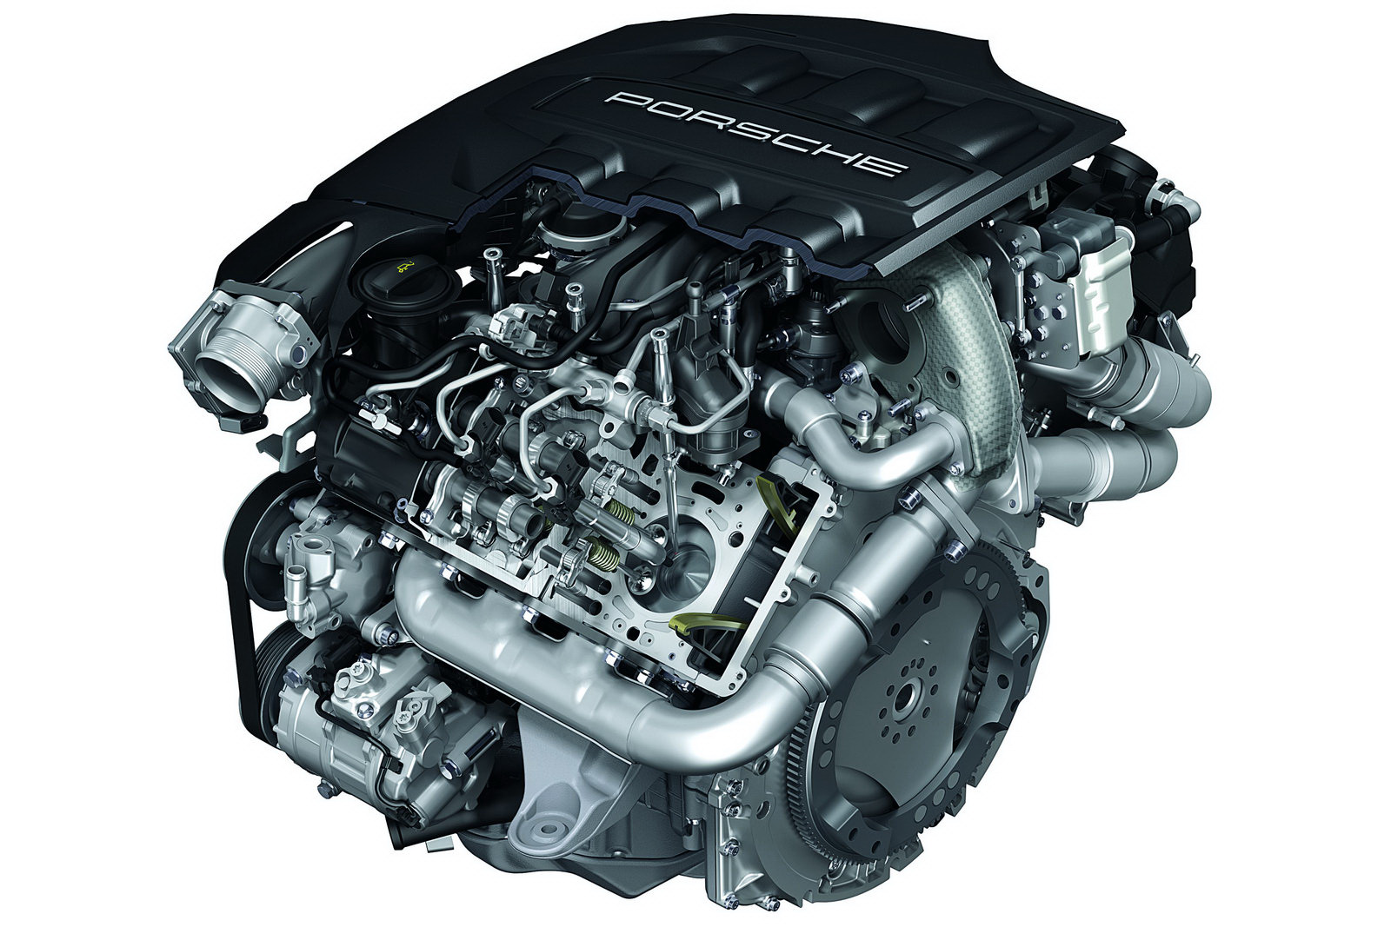
Limitations
BCU meeting, 27th of March, 2014

Slide 20
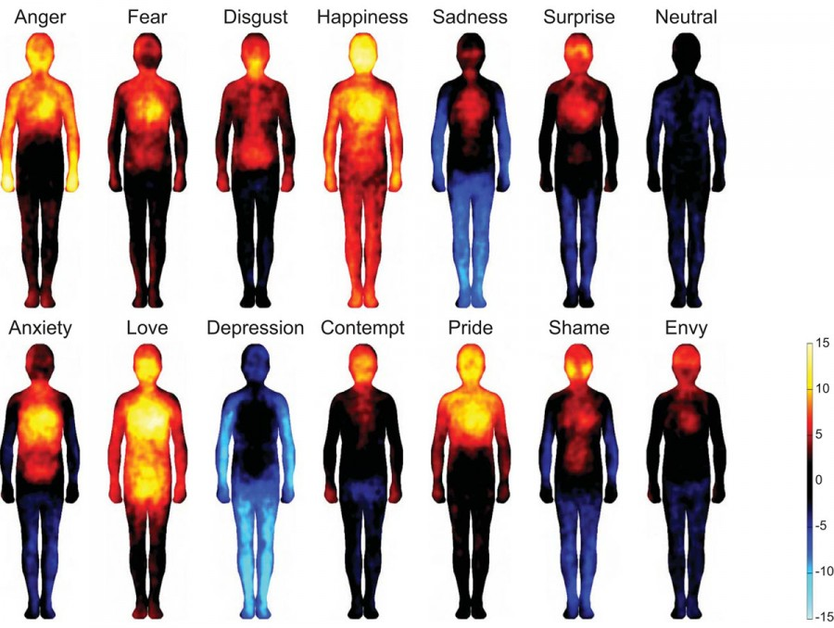
The end !
Any questions ?
BCU meeting, 27th of March, 2014

