Slide 1


Slide 2
E-Motion
-
Design & beamline integration
Cyril GUILLOUD
Manuel PEREZ
Matias GUIJARRO
BLISS
ESRF - ISDD - BLISS day-out 21 November 2014

Slide 3
E-Motion : why ?
- great number of motor controllers and requirements for new ones.
- costly due to : maintenance, migration and implementation of new features :
ZAP, helical scans, trajectories...
- not a strong standardization (SPEC macro motors)

Slide 4
E-Motion
- A generic python library for motor control.
- Easy end rapid way to interface motor controllers.
- Common API for standard features.
- Specific functions for special features.
- E-Motion is to motors what “Lima” is to cameras.

Slide 5
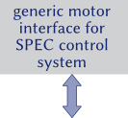
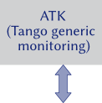




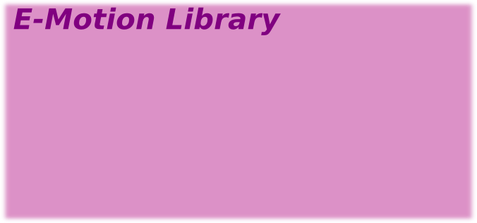
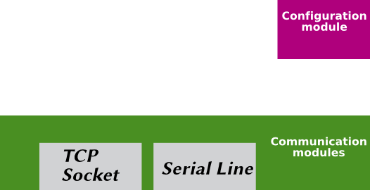
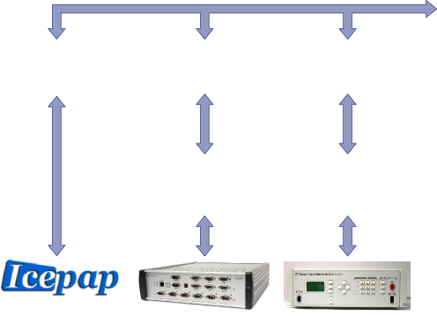

E-Motion : design

Slide 6
E-Motion : gevent
- Gevent is a coroutine-based python networking library.
- provides :
- fast event loop
- lightweight execution units
- allows asynchronous calls in E-Motion motions management

Slide 7
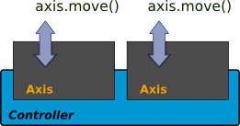
Axis
axis is the basic element

Slide 8
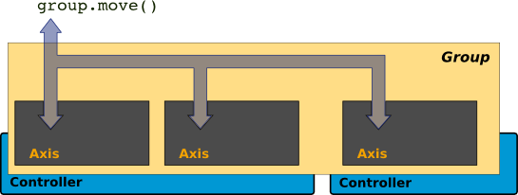
Groups
Group is a concept used for synchronous movements and trajectories.

Slide 9
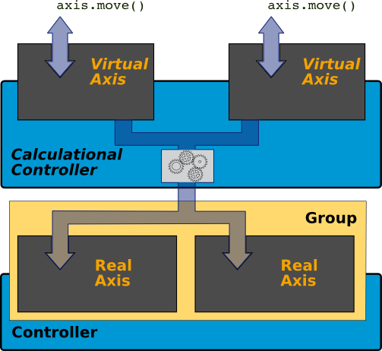
Calculational Controllers

Slide 10
Supported controllers
FlexDC (Nanomotion ; piezo-motors)
Mockup (Test and simulation)
IcePaP (ESRF ; stepper motors)
PI-E753 (PI ; piezo actuators)
PI-E517 (PI ; piezo actuators)
PMD206 (Piezomotors ; piezo-motor)
NF8753 (Newport ; piezo actuators)
DMC213 (Galil ; DC motor)
VSCANNER (ESRF ; voltage)
NEW !!!

Slide 11
Calculational controllers
Slits (standards ESRF slits)
Tab3 (3-legs table)
KB (alignment)
Spectro_eh1 (ID26 new spectro portotype)
Trans4 (Qsys 4 dof transfocator support)
TangoEMOT (remote emotion tango DS)
PJ31 (piezo + stepper on same axis)
setpoint (Tango attribute for ramps and scans)
NEW !!!

Slide 12
E-Motion deployment
ID16a : tomography; mapping; alignment
ID16b : mirror and mono. alignment
ID30 : all motors (icepap + newfocus + galil)
ID26 : new spectrometer prototype
ID22 : Qsys transfocator support

Slide 13
E-Motion on your beamline
Installation : blissinstaller
Configuration : xml config file
Integration :
    Python
    Tango motor
    Spec macro-motor

Slide 14
E-Motion : next steps
Configuration
More controllers
Features for continuous scans
To use it !!!!

