Slide 1
Bank Database Design
Introduction:
There are only two types of accounts at this time: Checking and Savings accounts. The provided column list should be separated into appropriate entities (tables) with relationships between these entities defined. The most efficient choices as far as your primary key constraints and foreign key constraints, and picked the appropriate data types for each of the columns.
Project Goals:
The goal of the project is to understand database entities in more depth and have practical experience of working with different objects of SQL.
3

Slide 2
Other Criteria
When an employee opens an account, performs a transaction on or reactivates an account there must be a record of which employee performed the action.
Every person who opens a savings account does not get the same rate.
Because the bank charges an overdraft fee, a record must be maintained on any transaction that causes an account to go into overdraft.
Extra error information is required to be stored when a transaction fails. The bank uses this information for fraud detection and to diagnose periodic problems within their networks and applications.
Customers have a user logins to allow them to access all of their accounts. If a user fails a login attempt, for instance because they have forgotten their password, a record of that failed attempt needs to be kept.
The information for checking and saving accounts is very similar to each other as are the transactions that update those accounts.
More than one customer is allowed on each account, and any transaction record should reflect which customer made the transaction.

Slide 3
Column List
DateOpened
AccountStatus
OpeningBalance
CurrentBalance
AccountID
CustomerID
OverdraftAccountID
TransactionID
FailedTransactionID
TransactionTypeID
TransactionTypeName
TransactionAmt
SavingsInterestRate
TransactionDate
TransactionAmount
TransactionType
OldBalance
NewBalance
CustomerFirstName
CustomerMiddleInitial
CustomerLastName
CustomerAddress1
CustomerAddress2
City
State
Zipcode
Email
SSN
UserLogin
UserPassword
UserSecurityQuestion
•
•
•
•
ErrorLogID
ErrorTime
UserName
FailedTransactionErrorID
FailedTransactionXML
FailedTransactionErrorTime
EmployeeID
EmployeeFirstName
EmployeeMiddleInitial
EmployeeLastName
EmployeeIsManager
AccountReactivationLogID
ReactivationDate UserSecurityQuestion2
UserSecurityQuestionAnswer2
UserSecurityQuestion3
UserSecurityQuestionAnswer3
UserSecurityQuestionAnswer •
HomePhone WorkPhone CellPhone

Slide 4
Designed Entities
Categorized columns, * are Primary Keys
Account
*AccountID CurrentBalance
AccountType AccountStatus
Customer
*CustomerID
CustomerAddress1 CustomerAddress2 CustomerFirstName CustomerLastName CustomerMiddleInitial City, State, Zipcode Email
HomePhone, CellPhone WorkPhone
SSN
UserSecurityQuestions
*UserSecurityQuestionID UserSecurityQuestion
UserSecurityQuestion2 UserSecurityQuestion3
TransactionLog
*TransactionID
TransactionType TransactionDate
DateOpened ReactivationDate
TransactionAmount
TransactionAmt
NewBalance
OpeningBalance
OldBalance
Employee
*EmployeeID EmployeeFirstName EmployeeLastName EmployeeMiddleInitial EmployeeIsManager UserLogins
*UserLogin
UserName UserPassword LoginErrorLog
*ErrorLogID ErrorTime
SavingsInterestRates
*SavingsInterestRateID SavingsInterestRate
TransactionType
*TransactionTypeID TransactionTypeName
AccountReactivationLogID
UserSecurityAnswers
*UserAnswerID UserSecurityQuestionAnswer
UserSecurityQuestionAnswer2 UserSecurityQuestionAnswer3
OverDraftLog
OverdraftAccountID
FailedTransactionLog
*FailedTransactionID FailedTransactionXML, ErrorTime
FailedTransactionErrorType
*FailedTransactionErrorID FailedTransactionErrorTime

Slide 5
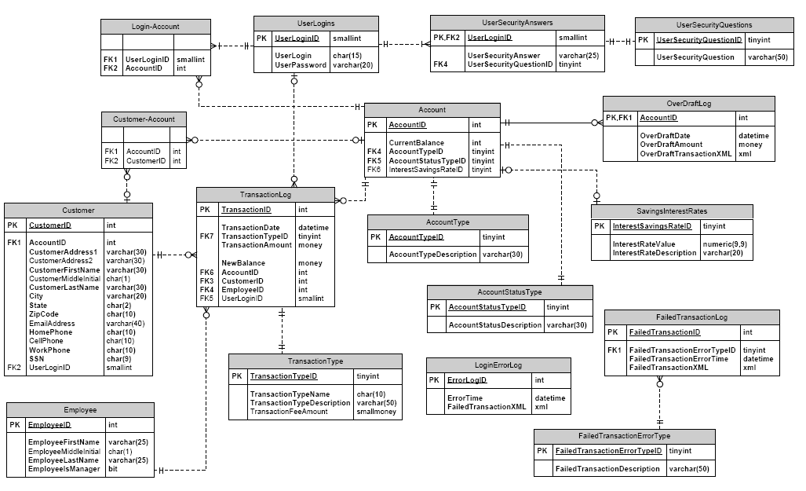
Entity-Relationship Diagram
7

