Slide 1


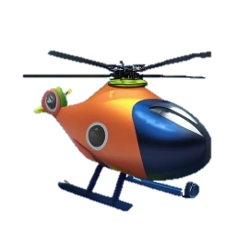

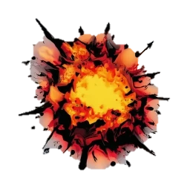
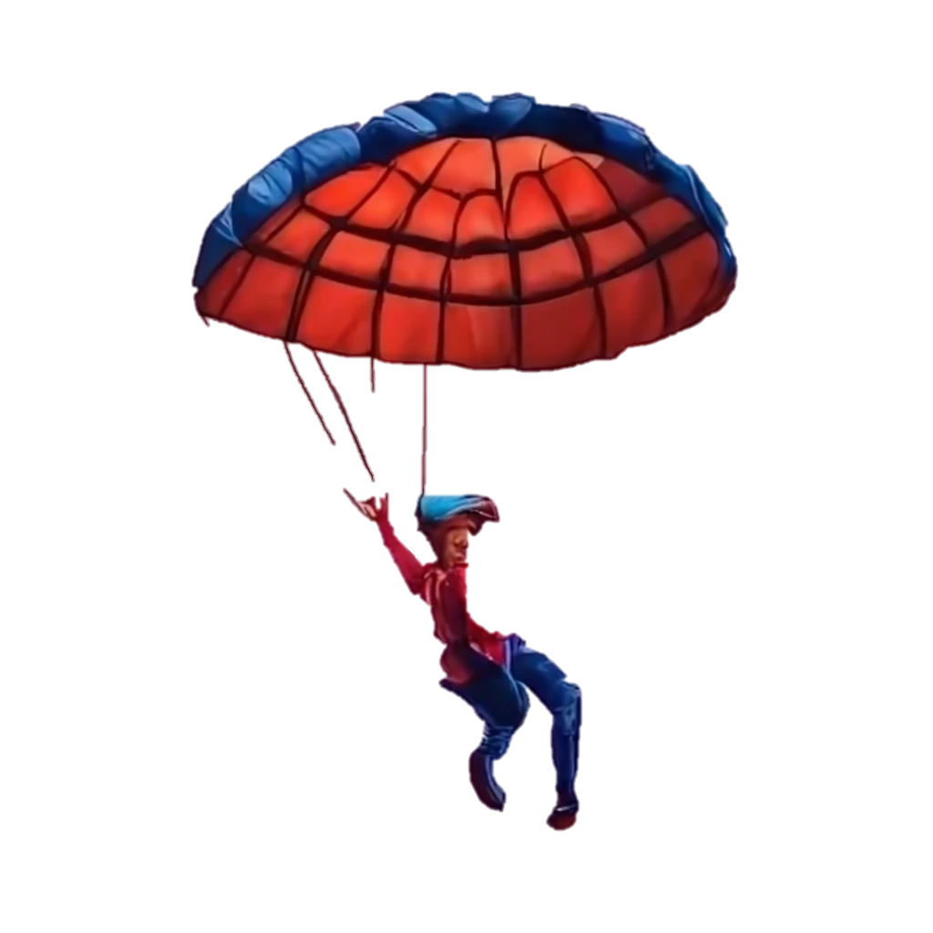
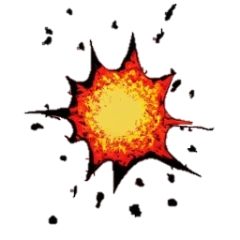
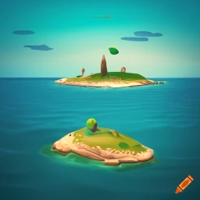
Ever wanted to launch from a helicopter onto a tiny island, falling between anti-grav bombs? ParaZXland places you under the parachute! You’ll need one eye on the target and one on the bombs as you fight against the wind. Avoid the hazards, reach your target, save the world!
An exciting full colour Boriel ZX Basic game.
ParaZX land
ParaZX land
2023

Slide 2
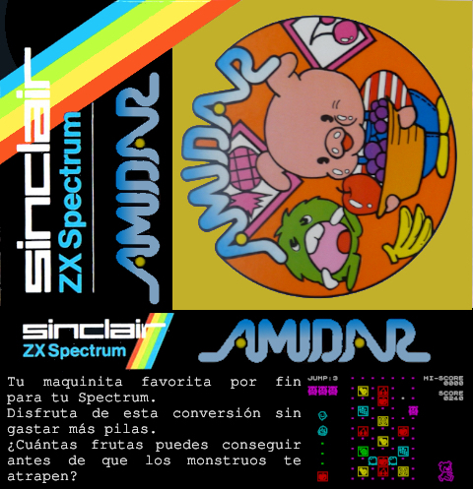

Slide 3


