Slide 1
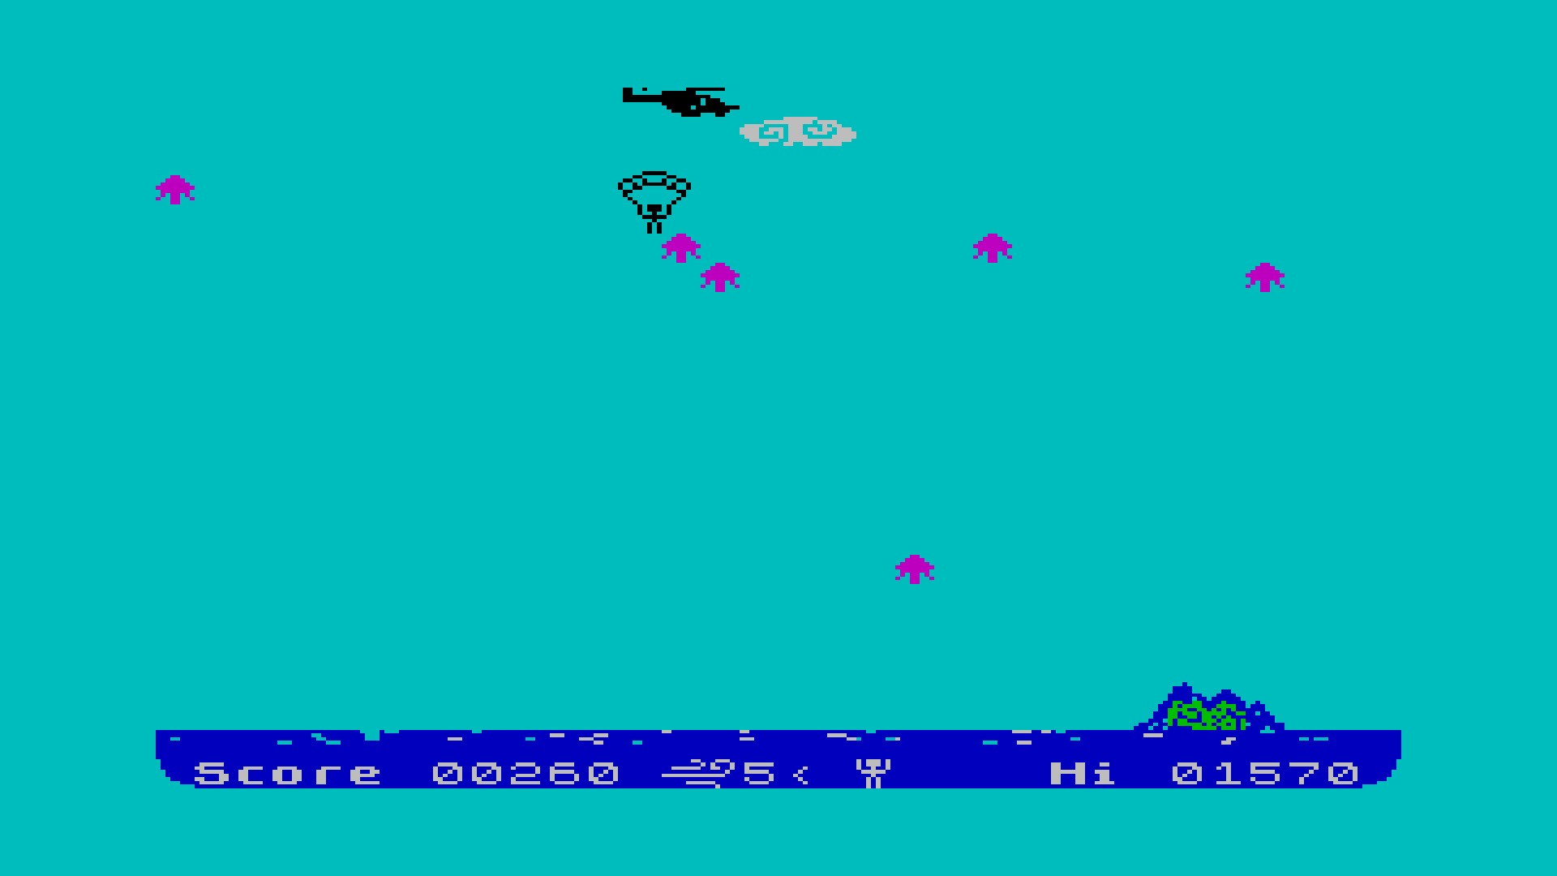
Helicopter
Bombs
This is you!
Anti-grav bombs
Extra points
Island
Score
Wind
Lives
Hi-score

Slide 2
Helicopter
Anti-grav bombs
Bombs
Extra points
This is you!
Island
Current Score
Wind
Lives
Hi-score

