Slide 1
PyShark Graphing: Visual Network Protocol Analyzer
CSC 842: Security tools
BY MAR CASTRO

Slide 2
Prerequisite – Knowledge of System Administration and Programming
Should know how to install python along with the modules and libraries.
Basic knowledge of using Wireshark application.
Knowledge of using OS (Linux/Unix).
You should use Linux because PyShark/MatPloblib does not work on Windows live capture.

Slide 3

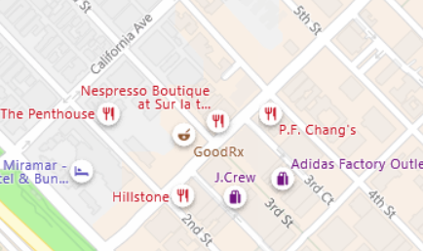
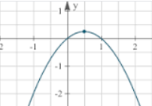
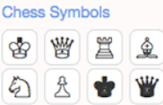
Network Protocol Capture Analyzer (Data Visualization) - What
Graphical Representation of data – Represented symbos
Data visualization is converted into visual context.
Maps
Graphs
Charts
Notes:
1. Why need visualization?
Data visualization is the act of taking information (data) and placing it into a visual context, such as a map or graph. Data visualizations make big and small data easier for the human brain to understand, and visualization also makes it easier to detect patterns, trends, and outliers in groups of data.
https://www.searchenginejournal.com/what-is-data-visualization-why-important-seo/288127/#close
We’ll discuss visualization why it is important.
2. https://www.tableau.com/learn/articles/data-visualization
A chart is a graphical representation of data, in which "the data is represented by symbols, such as bars in a bar chart, lines in a line chart, or slices in a pie chart". A chart can represent tabular numeric data, functions or some kinds of qualitative structure and provides different info.
Data visualization is the graphical representation of information and data. By using visual elements like charts, graphs, and maps, data visualization tools provide an accessible way to see and understand trends, outliers, and patterns in data.
In the world of Big Data, data visualization tools and technologies are essential to analyze massive amounts of information and make data-driven decisions.
3. Map
A map is a symbolic depiction emphasizing relationships between elements of some space, such as objects, regions, or themes. Many maps are static, fixed to paper or some other durable medium, while others are dynamic or interactive
4. Graph
a diagram showing the relation between variable quantities, typically of two variables, each measured along one of a pair of axes at right angles.
5. Charts
a sheet of information in the form of a table, graph, or diagram.
"a chart showing how much do-it-yourself costs compared with retail"

Slide 4
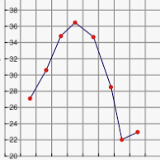
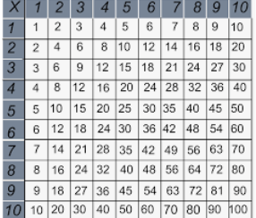
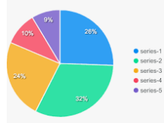
Early Days - Visualization
Common way to create data…very effective strategy
Example, take information from spreadsheet and transform into the chart below.
bar graph, pie chart, or table.
Notes:
https://www.searchenginejournal.com/what-is-data-visualization-why-important-seo/288127/#close
In the early days, the easiest and most common way to create a data visualization was to take the information from an Excel spreadsheet and transform it into a bar graph, pie chart, or table.
This method is still extremely effective, but the art of data visualization has also come a long way in the past 20+ years.
2. I show visual here to let you know what it looks like…..picture worth a thousand words

Slide 5
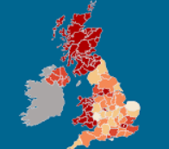
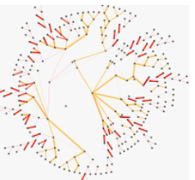
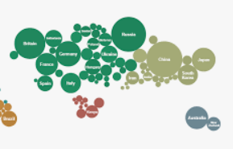
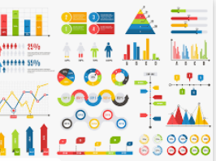
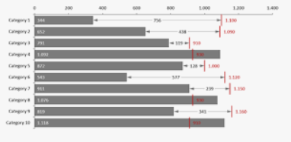
Nowadays – Data Visualization (Big Data) – Infinite?
Bubble clouds –
social, econ. Medical.
Bullet graphs – compare
values
Heat maps – hot/cold
Radial trees – type of info graphic
Infographics – written words
And more.
Heat Wave
Radial Trees
Bubble Cloud
Infographics
Bullet graphs
Notes:
Nowadays you also have the option to create more intricate visualizations such as:
Bubble clouds - Bubble Graph is used to display three dimensions of data. ... Bubble Charts can facilitate the understanding of social, economical, medical, and other scientific relationships. A Bubble Chart can be plotted on both Cartesian coordinate grid and Scatter coordinate grid.
Bullet graphs - Bullet graphs are used to compare one value, represented by a horizontal bar, to another value, represented by a vertical line, and relate those to qualitative ranges. Bullet graphs can be displayed in the context of a graphical table or, separately, in a text area.
Heat maps - But they’re much more than that. What many people don’t realize, is that Heat Maps can be applied to a handful of data visualizations. Because of their reliance on color to communicate values, Heat Maps are perhaps most commonly used to display a more generalized view of numeric values. This is especially true when dealing with large volumes of data, as colors are easier to distinguish and make sense of than raw numbers. However, Heat Maps are multifaceted and can also be used in more literal senses, for example, to showcase ‘hot and cold’ (density) zones on a map.
https://www.dundas.com/resources/dundas-data-visualization-blog/when-and-why-to-use-heat-maps
Radial trees - A radial tree, or radial map, is a method of displaying a tree structure (e.g., a tree data structure) in a way that expands outwards, radially. It is one of many ways to visually display a tree, with examples extending back to the early 20th century. In use, it is a type of information graphic.
Infographics - Infographics are effective because they combine the written word with visual elements to pack big ideas into small spaces. Presenting information in such a compelling fashion encourages visitors to spend time on your site, consuming and sharing more of your content
And more.
When deciding what type of visualization to use, you don’t want to just choose randomly.
First, you want to make sure you have a clean and complete set of data to work with. If there are holes in your numbers, they will be reflected in your visualization.
Then you have to consider the specific type of data you’re working with, as well as who your audience is and what message you want to convey. Sometimes a simple graph is the most effective, whereas other times a more complex visualization is needed to get the job done.
You don’t want any elements of the graph to take away or distract from the data. The data and the visual need to work together to tell a story.
What is big data?
extremely large data sets that may be analyzed computationally to reveal patterns, trends, and associations, especially relating to human behavior and interactions.
"much IT investment is going towards managing and maintaining big data"

Slide 6

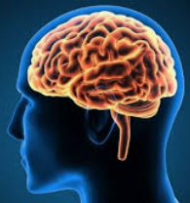
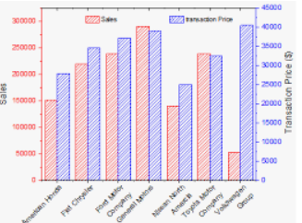
Why Do We Care (data, data, data, & data…
Develop and tailor in-house product cheaply without resorting to expensive software.
Capture and harvest data for the purpose of data science (big data)
Automate forensic analysis
Easy to
understand…
Notes:
Why?
Data visualizations make big and small data easier for the human brain to understand, and visualization also makes it easier to detect patterns, trends, and outliers in groups of data.
Data visualization is the act of taking information (data) and placing it into a visual context, such as a map or graph. Data visualizations make big and small data easier for the human brain to understand, and visualization also makes it easier to detect patterns, trends, and outliers in groups of data.
Why visual is important?
Why Visual Communication Is Important. ... Visual communication is the most effective way of passing information because the human mind processes things in images. The majority of people respond quickly to visual images instead of texts. Any business needs to understand the cognitive functions to maintain customers.Aug 10, 2017
CHEAP:
To develop
DATA SCIENCE:
Why harvest? https://www.nexsoftsys.com/articles/basic-approach-to-snooping-on-network-traffic-in-python.html
https://towardsdatascience.com/a-brief-introduction-to-pyspark-ff4284701873
AUTOMATION
https://books.google.com/books?id=ic6PDwAAQBAJ&pg=PA308&lpg=PA308&dq=purpose+pyshark&source=bl&ots=QPWIBeiS2P&sig=ACfU3U0L1ouEPkGNicxWZ6_2gH3Avr17Nw&hl=en&ppis=_c&sa=X&ved=2ahUKEwjh4bLJhKjmAhVNrp4KHYSuCNcQ6AEwCHoECAoQAQ#v=onepage&q=purpose%20pyshark&f=false

Slide 7

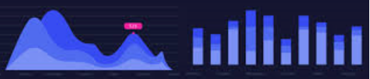
Why do we care –tailored product – inhouse tools
Inhouse tools – tailored to small group of department employees without resorting to expensive and bulky features that are not needed.
Make interface more familiar and easier to use
Some departments don’t have allocated budget to purchase commercial tools and even allowed to use open source tools due to going through the vetting process to the CM.
Therefore, resort to develop your own “Network Protocol Analyzer” visual data (Graphical Representation of the text).
Notes:
It gives you greater control, which is important if your business has specific needs that your average commercial product can't fulfill. Having customized software should also make the interface more familiar and easy to use
Pros The level of customization is perhaps the biggest benefit of custom software. By meeting your exact specifications, you can cover every aspect of your business without unnecessary extras. It gives you greater control, which is important if your business has specific needs that your average commercial product can’t fulfill.
Having customized software should also make the interface more familiar and easier to use.
:
Cons Commercial software can accrue high support and maintenance costs. In order to address any technical issues, you will be at the mercy of a vendor who sets and can change the price of service. There may also be a waiting period for support, and you may have to jump through hoops to reach a technician. This can end up costing time and slow operations.
https://www.business.org/software/apps/the-pros-and-cons-of-developing-your-own-software-versus-outsourcing/

Slide 8
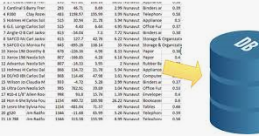

Why do we care –harvested data for data science to create visual text
Network Protocol Data Analyzer – reads data passing through the network.
Tons and tons of data are needed to be analyze in real time as much as possible. You can’t just rely on the manual labor of examining the data.
By placing it in a visual context so that patterns, trends and correlations that might not otherwise be detected can be exposed.
Notes:
https://towardsdatascience.com/introduction-to-data-visualization-in-python-89a54c97fbed
Data visualization is the discipline of trying to understand data by placing it in a visual context so that patterns, trends and correlations that might not otherwise be detected can be exposed.
Python offers multiple great graphing libraries that come packed with lots of different features. No matter if you want to create interactive, live or highly customized plots python has an excellent library for you.
Python offers multiple great graphing libraries that come packed with lots of different features. No matter if you want to create interactive, live or highly customized plots python has an excellent library for you.

Slide 9

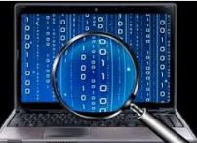
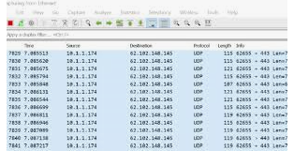
Why do we care – forensic analysis
Wireshark can scan USB(s), Local Area Network, and etc
Capture different protocols passing through the network.
Malware has become significant with our cybercrime community.
During live scan of the network, one should be able to customize a program
to create a pictorial diagram of each protocol and the data passing through.
Notes:
Forensic analysis refers to a detailed investigation for detecting and documenting the course, reasons, culprits, and consequences of a security incident or violation of rules of the organization or state laws. Forensic analysis is often linked with evidence to the court, particularly in criminal matters.
Recently, malware forensics has become more significant with the cybercrime community causing destruction to technology, retail, and financial institutions. Cybercrime can bring danger to private and governmental organizations, and malware is a commonly used tool by cybercriminals for installing things such as worms, Trojans, and botnets to the infected device. The only way for organizations processing sensitive information to defend client and company data is to respond to malware with accuracy and speed.
Digital Forensics: Forensic techniques are used for retrieving evidence from computers. These techniques include identification of information, preservation, recovery, and investigation in line with digital forensic standards.
Mobile Device Forensics: Mobile device forensics refers to that branch of digital forensics that involves evidence found on mobile devices. These include personal digital assistants (PDAs), mobile phones, and tablets – basically, any computing device that has communication capabilities besides being portable. This branch of forensics suddenly gained popularity with smartphones, making it one of the most recent divisions of digital forensics.
Software Forensics: Software forensics determines whether software has been stolen. This is performed by analyzing and comparing a source code, and then detecting any possible correlation. Over the past few years, software forensics has been used in several high-profile intellectual property (IP) litigations.
Memory Forensics: When sophisticated attacks occur, data existing in the hard drive could either be permanently erased or no data is left on the hard drive, leaving almost no evidence for a forensic investigation. Memory forensics is the process of searching for possible artifacts in the computer’s memory (RAM).
https://enterprise.comodo.com/blog/what-is-forensic-analysis/

Slide 10
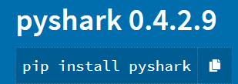
LiveCapture or FileCapture - What can PyShark or other modules do for us?
PyShark is on of the Python modules that capable of extracting/mining data from WireShark.
Converts data to some format needed like csv.
File Capture of “pcap”
…saved capture file, and the latter will sniff from a network interface on the local machine
Live Capture of network data
…will sniff from a network interface on the local machine.
Notes:
https://thepacketgeek.com/pyshark-filecapture-and-livecapture-modules/
What is PyShark?
According to the official page, PyShark is a “Python wrapper for tshark, allowing python packet parsing using wireshark dissectors.” Now if you’re wondering what language that is, don’t worry, it’s rather simple to understand. A wrapper here is essentially Python syntax for tshark commands. Therefore, this allows us to execute tshark commands with PyShark. Now what is tshark you may ask? Well, tshark is the terminal based wireshark, it’s the functionality of wireshark, without the nice GUI. Wireshark is a program used for sniffing and analyzing packets on a network, more info on it can be found here. So thanks to PyShark, we can use wireshark in our python scripts with just a couple lines of code.
FILE CAPTURE
….saved capture file, and the latter will sniff from a network interface on the local machine. Running these modules will return a capture object which I will cover in depth in the next post. For now, let’s see what we can do with these two modules.
Purpose of this Project
I wanted to create a packet sniffer that continuously sniffs packets, and then stores them in a database for easy access in the future. This project captures every packet for 24 hours, then at midnight, refreshes and starts again, this time writing to a different file. Besides PyShark we will also be using Python’s datetime module to create our file names and write to them. Understand? Good, let’s begin our task of capturing packets continuously!
The two typical ways to start analyzing packets are via PyShark’s FileCapture and LiveCapture modules. The first will import packets from a saved capture file, and the latter will sniff from a network interface on the local machine. Running these modules will return a capture object which I will cover in depth in the next post. For now, let’s see what we can do with these two modules.
Both modules offer similar parameters that affect packets returned in the capture object. These definitions are taken directly out of the docstrings for these modules:
interface: [LiveCapture only] Name of the interface to sniff on. If not given, takes the first available.** **
bpf_filter: [LiveCapture only] A BPF (tcpdump) filter to apply on the cap before reading.
input_file: [FileCapture only] File path of the capture (PCAP, PCAPNG)
keep_packets: Whether to keep packets after reading them via next(). Used to conserve memory when reading large caps.
display_filter: A display (wireshark) filter to apply on the cap before reading it.
only_summaries: Only produce packet summaries, much faster but includes very little information.
decryption_key: Optional key used to encrypt and decrypt captured traffic.
encryption_type: Standard of encryption used in captured traffic (must be either ‘WEP’, ‘WPA-PWD’, or ‘WPA-PWK’. Defaults to WPA-PWK).
Making a Capture With PyShark
Great! Now we can get to the meat of the project. In order to sniff packets, must create a capture object. Once we create this object we can use capture.sniff() to collect packets. First we must create the object. It takes several parameters, in this case we will need the interface parameter. Later on, we will add the output_file parameter. Interface refers to what interface we are sniffing on. I will be scanning over my network card as opposed to ethernet, so the interface will be ‘en0’. The output_file is where we output our packets too, we will add this later so don’t worry about it now. Create a new capture object like this:
capture = pyshark.LiveCapture(interface="en0")This takes our interface parameter and creates the capture object, in this case called capture. We can then use this to sniff with just one line of code:
capture.sniff(timeout=10)This will sniff for 10 seconds. As a result, the above code should return something like this.
<br> <LiveCapture (698 packets)>More can be done with this capture, but that’s for another write-up in the future where I will talk about the basics of PyShark. For example, you can also use other parameters to limit the capture duration. We need to capture to a file for this project. The capture we use has an output_file parameter with a file name. Hence, we will create it later. It looks something like this:
capture = pyshark.LiveCapture(interface="en0", output_file=file)

Slide 11
Future Work
Many small and medium business with IT infrastructure that do not have budget to create visual network analyzer should delve into development components for easy transition from “raw data” to pictorial diagram of the Wireshark's data.
There are many modules/libraries available to create visual data derived from PyShark, but it needs lots of formatting to be compatible.
As a result, PyShark must have a module to convert to more data format that are consumable by other modules to present visual data.

Slide 12

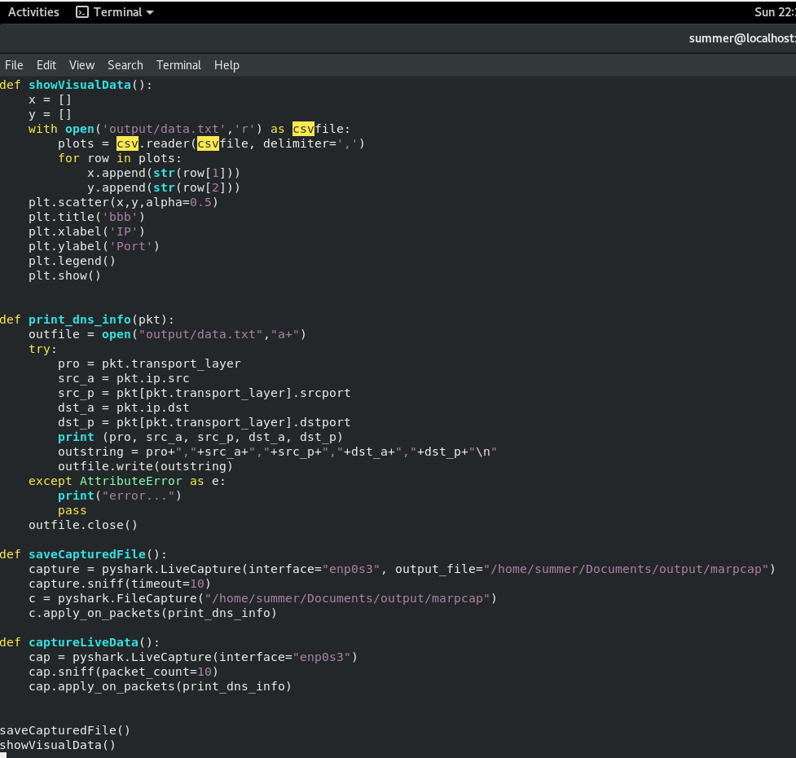
Demo, code- walk-through
Linux Environment
Install Python 3, Pandas, matplotlib, PyShark

Slide 13
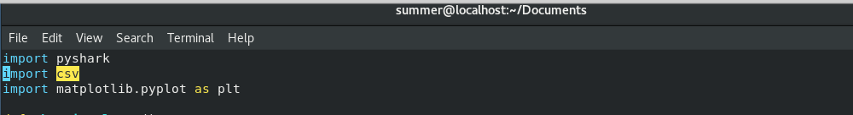
1. Explain how the code works - 3 modules to render visual data of capture network protocol analyzer data.
pyshark - is a wrapper for tshark that enable to break
out all packet details by layer.
csv – used read comma delimited text.
matplotlib – library for rending graphs and chart.

Slide 14
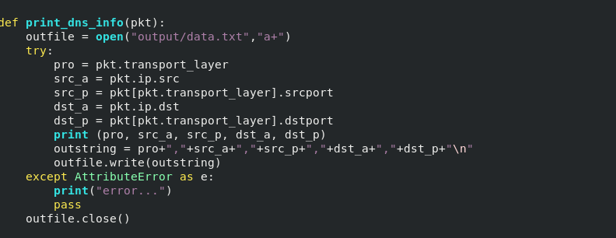
3. Create comma delimited file from “pcap”
pkt – parameter from
pyshark library.
Available methods
Write them out to
the external file

Slide 15
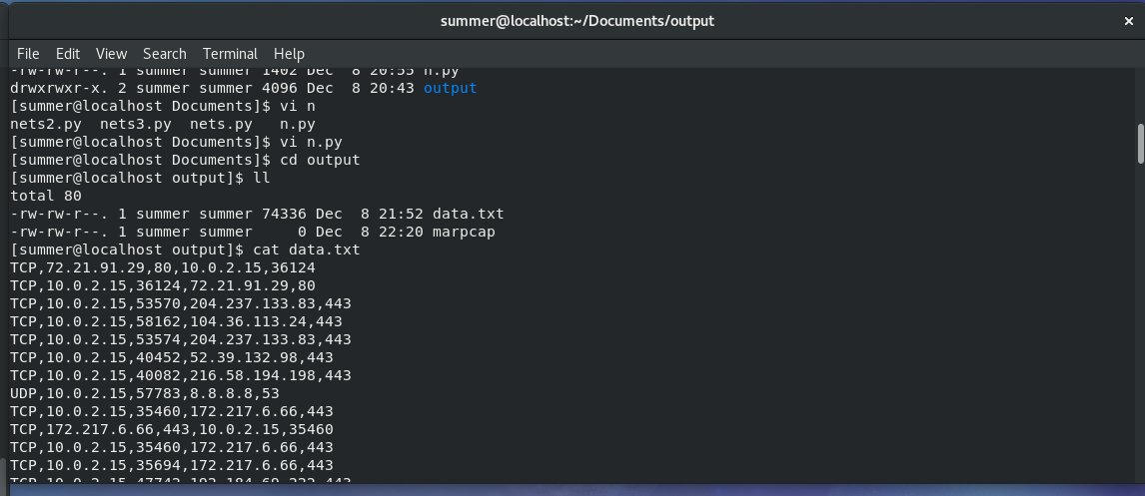
3.1 Create comma delimited file from “pcap” output
Captured network data using pyshark
Data.txt – comma delimited output
From the capture data “marcap”

Slide 16
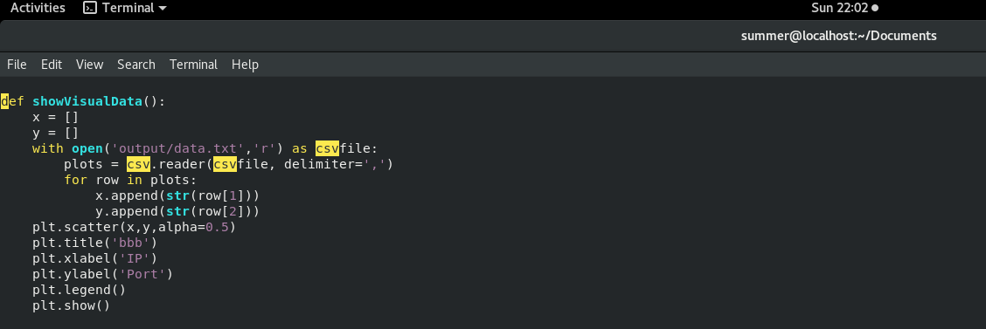
4. Function to create visual data using matlotlib module
Open a file as read only –
comma delimited
Specify which columns to use
Use scatter plot and label them.

Slide 17
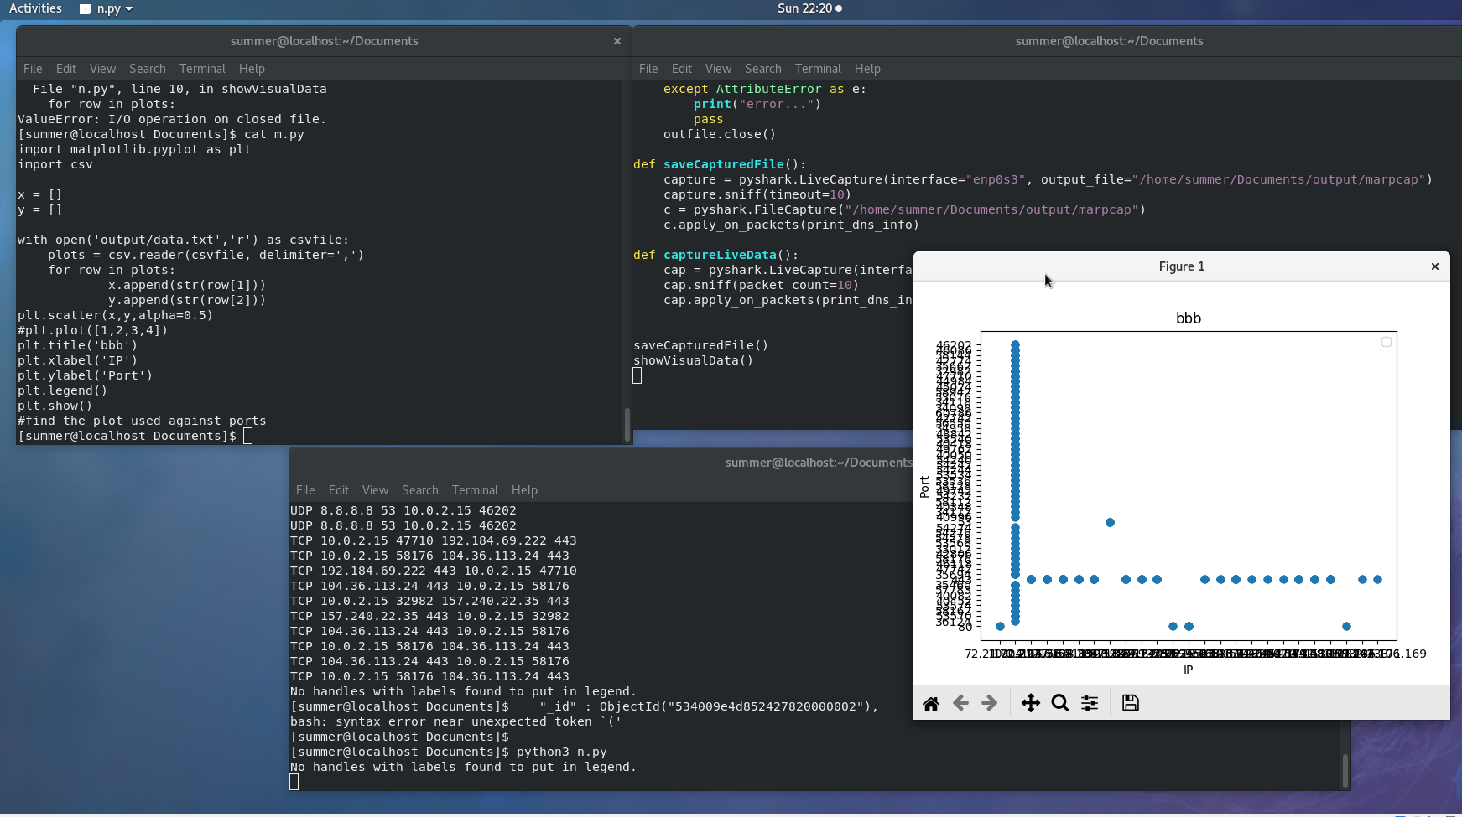
Code output after running…
X =port
X = ip
Printing data
Comma delimited

