Slide 1

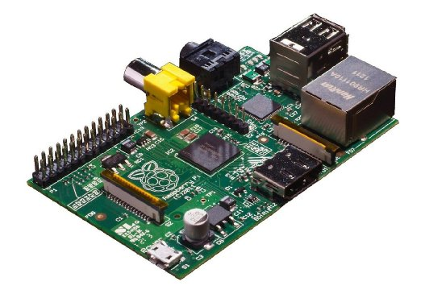
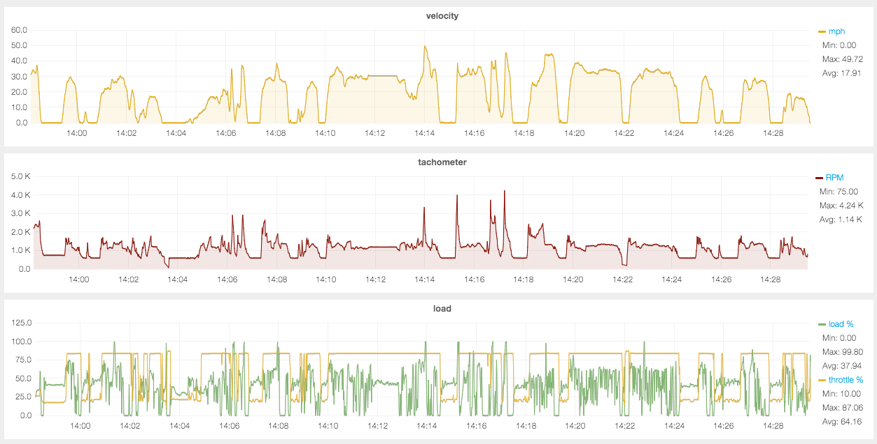

logger/MQ fluentd
sensor data source Raspberry Pi
time series database MapR-DB
Web front-end Grafana

