Slide 1
IoT Intrusion Detection
with Real-Time Drift Monitoring
Multi-class ML system · 9 attack families · CICIoT2023 dataset
9
7.8M+
5
0.830
Attack Classes
Raw Flows
Models Trained
Best Macro-F1
FastAPI
Docker
LightGBM ★
PyTorch MLP
KS Drift Test
CICIoT2023 · University of New Brunswick | Macro-F1 as primary metric (class imbalance)

Slide 2
The Problem — IoT Networks Under Attack
33 raw attack types → 9 families · 7.8M+ labeled flows · extreme class imbalance
Why this matters
9 Attack Families
Smart TVs, cameras, sensors — billions of devices with zero built-in security
Attackers exploit them for DDoS, botnet C2, and lateral movement
Traditional signature-based IDS fails on novel attack patterns
Class imbalance: 27.9x more Benign than rare attack types
We need ML that generalises across 9 different threat families
Benign
Normal IoT traffic
DDoS
Distributed volumetric floods
DoS
Single-source service denial
Mirai
Botnet C2 & propagation
Spoofing
DNS / ARP poisoning
Recon
Port scans, OS fingerprinting
Recon-HostDiscovery
Host discovery sweeps
Web
SQLi, XSS, command injection
DictionaryBruteForce
Password brute force

Slide 3
Dataset & ML Pipeline
CICIoT2023 · 46 features · Stratified sampling → SMOTE → 5 models
1
2
3
4
5
6
7
8
Raw CSV
Map Labels
Sample
Split
SMOTE
Scale
Train
Deploy
7.8M flows 33 labels
33 → 9 families
≤20K/class stratified
70/15/15 temporal
Balance rare classes
StandardScaler +impute
5 models Colab GPU
FastAPI +Docker
Why Macro-F1?
Why Temporal Split?
Why SMOTE?
Accuracy is deceptive with imbalanced data. A model predicting only 'Benign' scores 17% accuracy but catches zero attacks. Macro-F1 penalises equally across all 9 classes.
Random shuffle leaks future data into training. We split by row order (time proxy) to prevent data leakage — the model never sees 'future' traffic during training.
DictionaryBruteForce had only 1,541 training samples. SMOTE synthesises new minority examples by interpolating nearest neighbours, not simple copying.

Slide 4
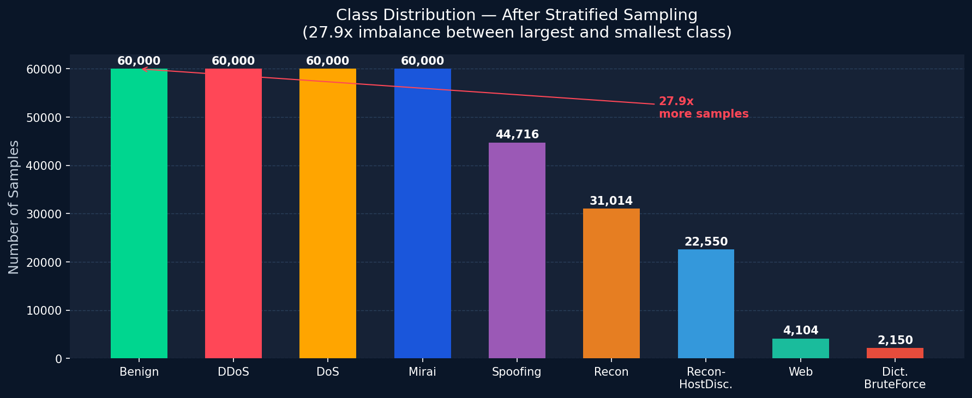
Class Imbalance — The Core Challenge
Raw dataset: 27.9x imbalance between largest and smallest class
Problem: Standard ML trains on majority class — minority attacks get ignored. A naive model always guessing 'Benign' scores 83% accuracy but catches ZERO attacks. Fix: SMOTE + class_weight='balanced'

Slide 5
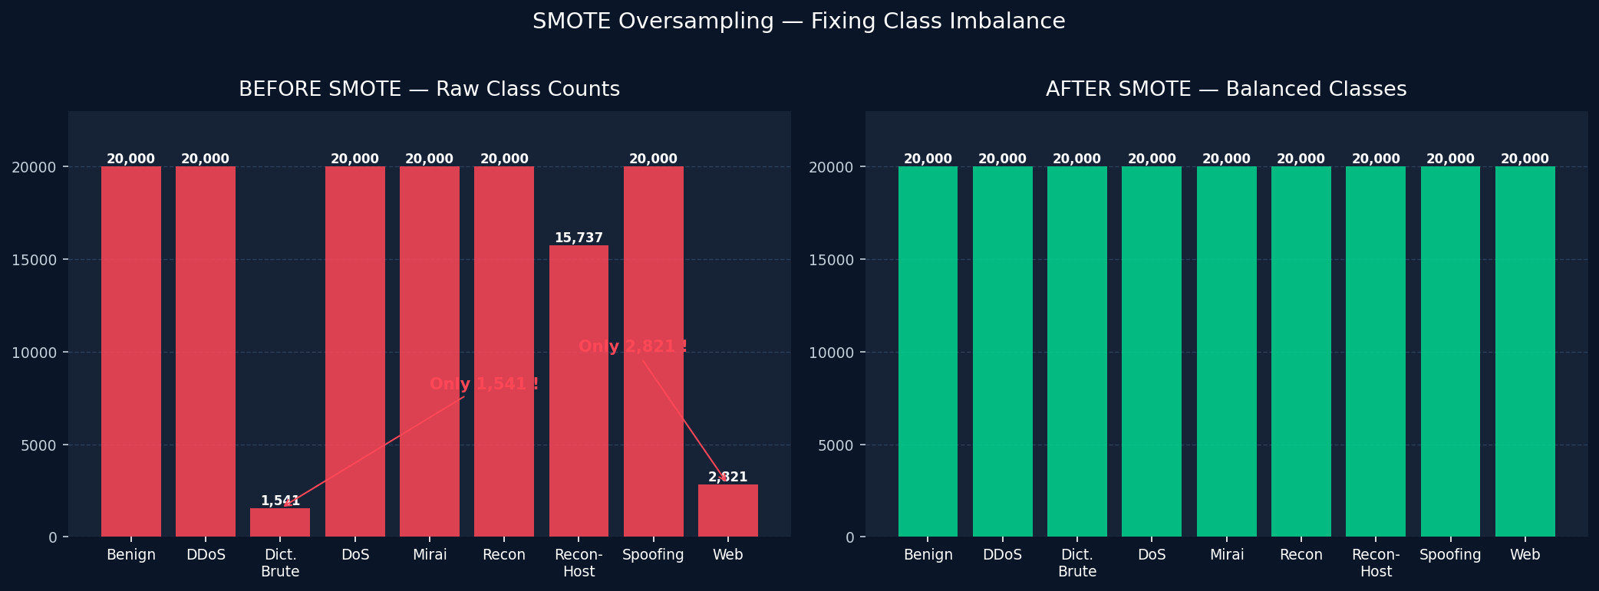
Fixing Imbalance — SMOTE Oversampling
Synthetic Minority Over-sampling: synthesises new examples, not simple copies
Step 1 — Pick minority sample
Step 2 — Find K neighbours
Step 3 — Interpolate
Select a random sample from the minority class (e.g. DictionaryBruteForce)
Find its K nearest neighbours in feature space using Euclidean distance
Synthesise new sample by interpolating between the point and a neighbour

Slide 6
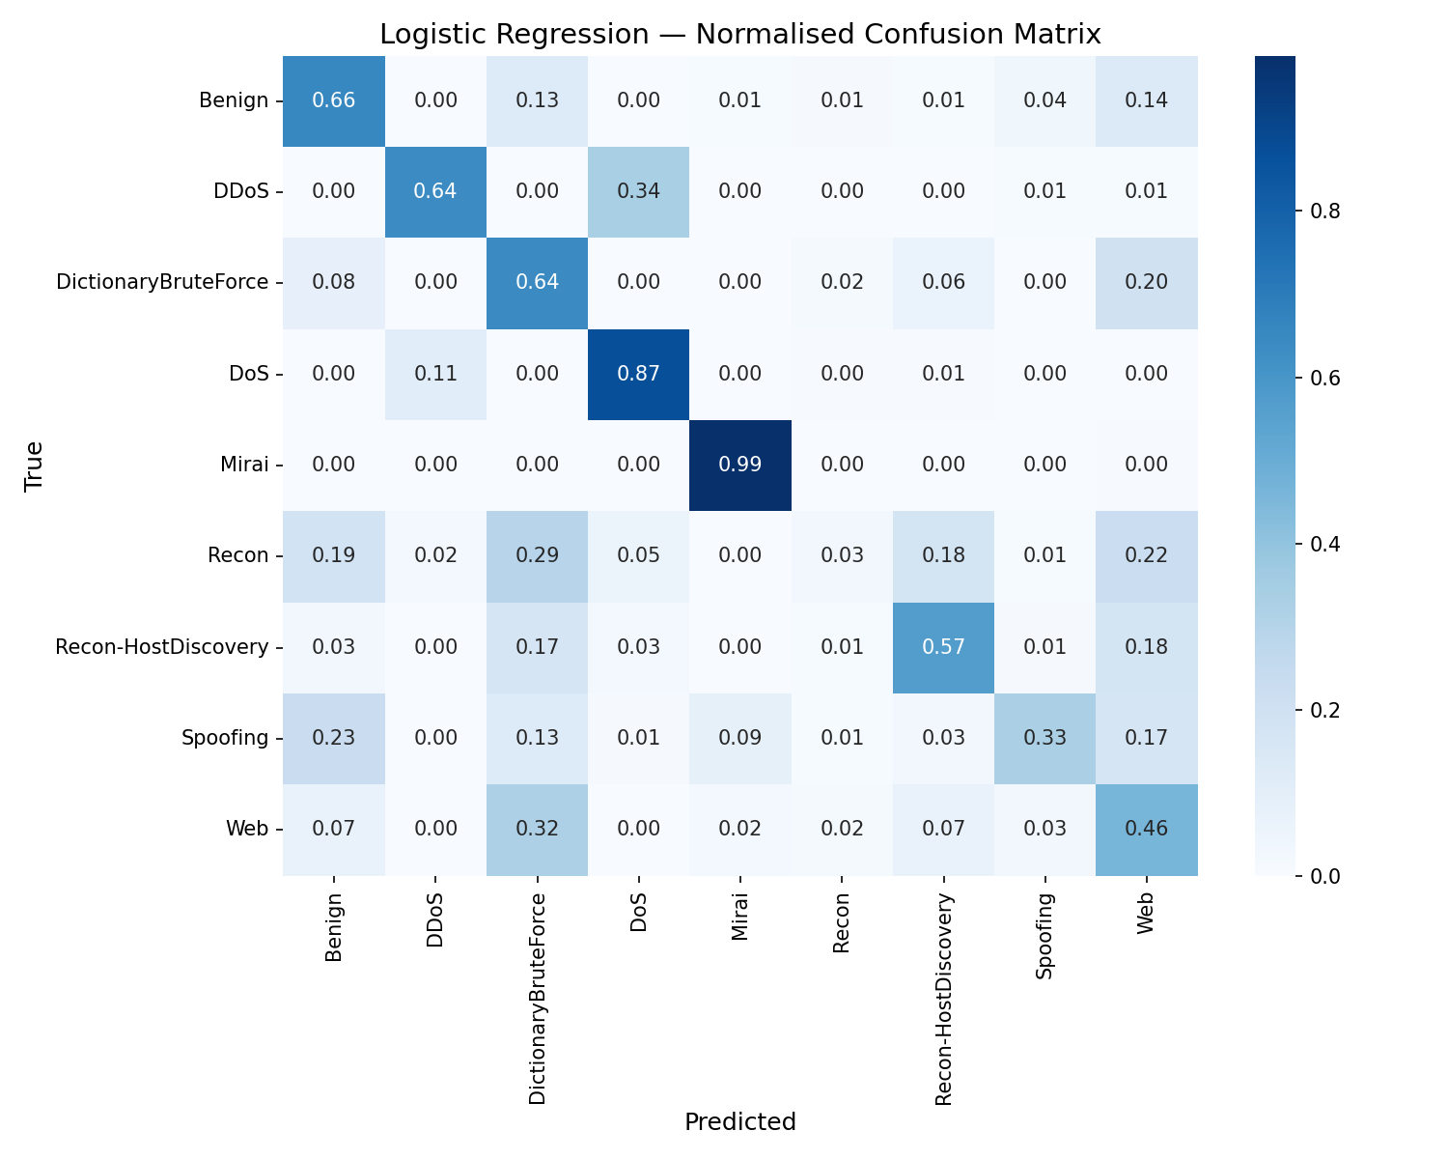
Model 1 — Logistic Regression (Baseline)
Softmax classifier · L2 regularisation · Isotonic calibration · SAGA solver
0.484
0.929
Macro-F1
ROC-AUC
34.2%
Worst
Benign FP%
vs All Models
Why LR struggled
Linear boundary — IoT attacks are non-linear
Recon & Web attacks confused with Benign
34% of benign traffic falsely flagged as attack
BASELINE

Slide 7
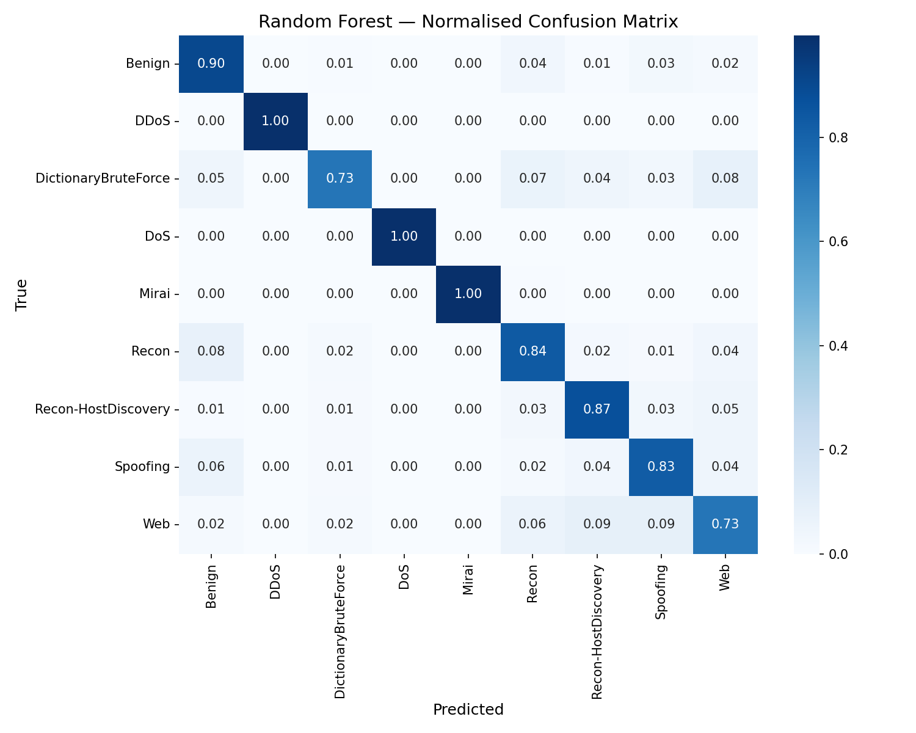
Model 2 — Random Forest
200 trees · Bagging + feature subsampling · balanced_subsample · OOB validation
0.808
0.994
Macro-F1
ROC-AUC
9.5%
+67%
Benign FP%
vs LR Macro-F1
Why RF leaps ahead
200 trees vote — no single tree overfits
balanced_subsample handles imbalance per tree
OOB score used as held-out validation
ENSEMBLE

Slide 8
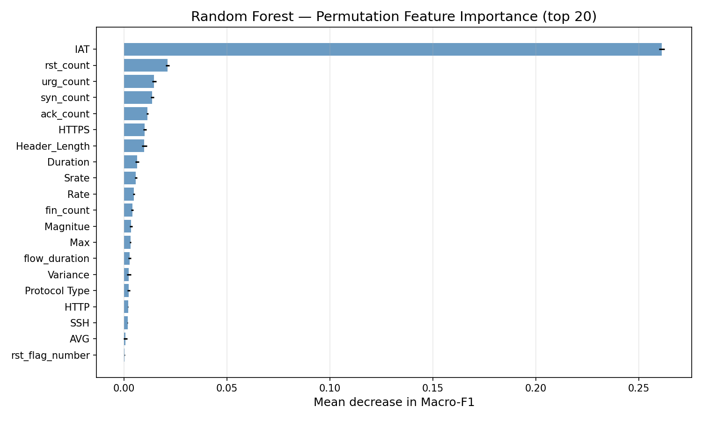
What the Model Looks At — Feature Importance
Permutation importance on Random Forest · Macro-F1 drop when feature is shuffled
syn_flag_number
SYN floods are the signature of DDoS/DoS — top discriminator
Rate
Packet rate immediately reveals volumetric attacks
ack_flag_number
ACK ratio separates normal TCP from attack traffic
flow_duration
Short flows = scans; Long flows = legitimate sessions
Header_Length
Crafted headers expose spoofing & injection attacks

Slide 9


Models 3 & 4 — XGBoost vs LightGBM
Both are gradient boosting ensembles — LightGBM wins with leaf-wise growth
XGBoost F1=0.815
LightGBM ★ F1=0.830
XGBoost
LightGBM ★
Level-wise growth, 2nd-order gradients, exact split search. 300 estimators, lr=0.05, multi:softprob objective.
Leaf-wise growth (deeper branches), GOSS sampling, histogram bins. 10x faster training. Best Macro-F1=0.830.

Slide 10
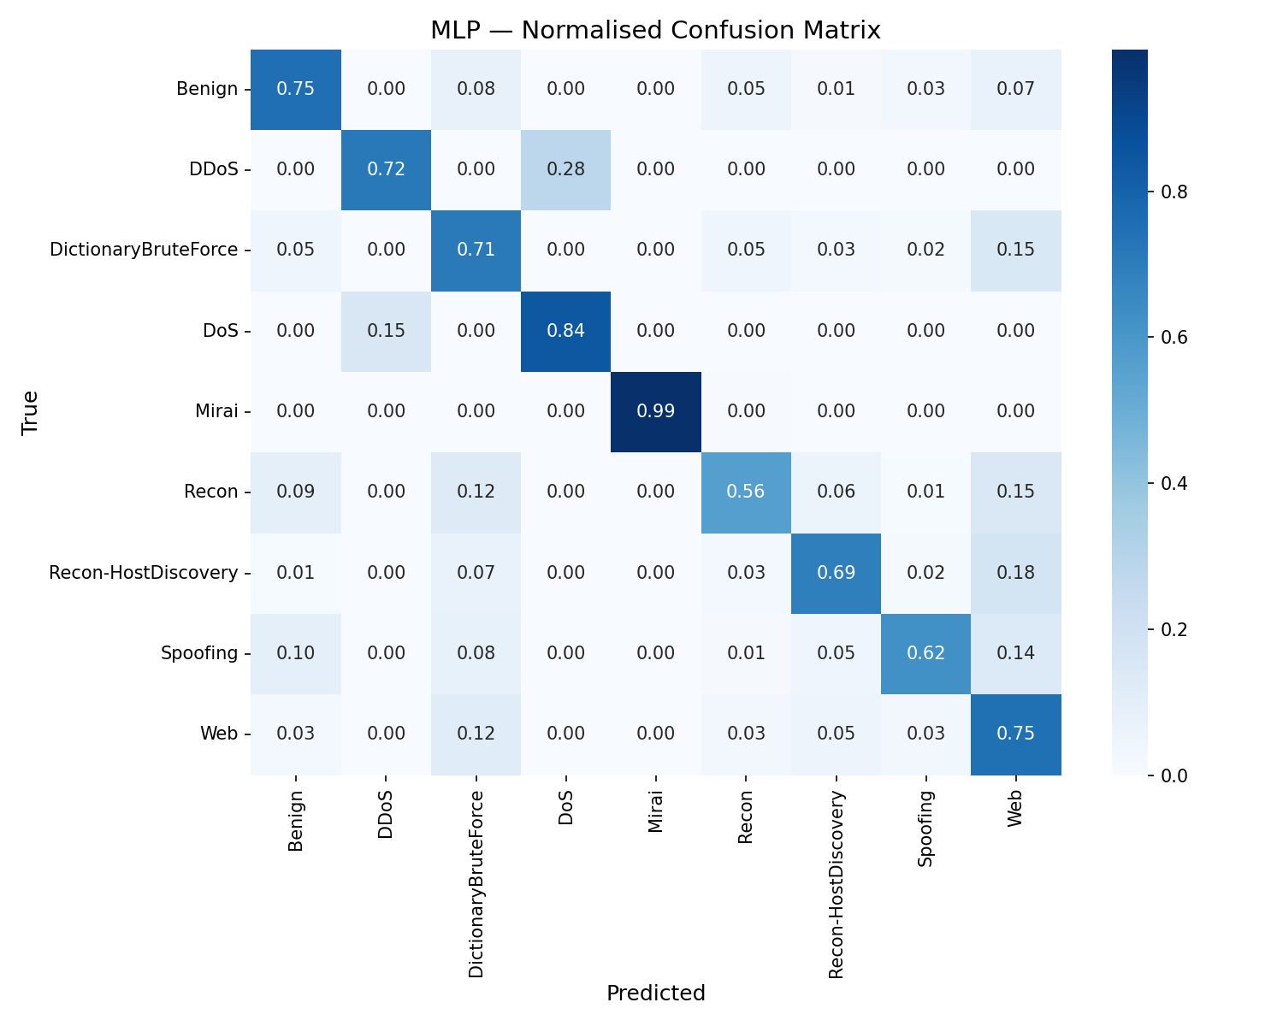
Model 5 — MLP Neural Network (PyTorch)
4-layer network · BatchNorm · Dropout · Adam optimizer · Early stopping on Colab T4 GPU
Input
46 features
Dense 256
+ BatchNorm + ReLU + Dropout(0.3)
Dense 128
+ BatchNorm + ReLU + Dropout(0.3)
Dense 64
+ BatchNorm + ReLU + Dropout(0.2)
0.630
0.976
Output
9 classes (Softmax)
Macro-F1
ROC-AUC
Surprise finding
MLP underperforms LightGBM by 20% on Macro-F1 — tabular data favours gradient-boosted trees over deep learning

Slide 11
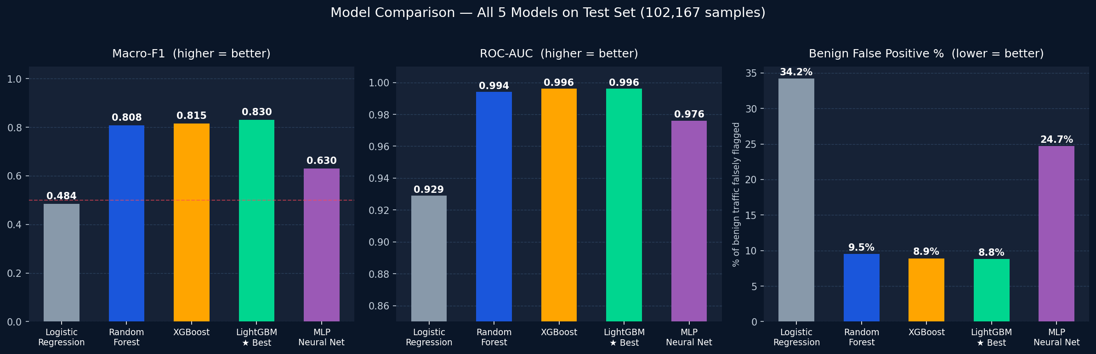
Model Comparison — All 5 Models
Test set: 102,167 samples · LightGBM selected as production model
LR: linear boundary can't separate IoT attacks
RF / XGB / LGBM: tree ensembles dominate tabular data
MLP: needs more data / tuning for tabular tasks

Slide 12
Drift Monitoring — Is the Model Still Valid?
3 complementary checks: KS test · PSI · 3-sigma alert rate monitor
KS
PSI
3σ
KS Drift Test
PSI Score
Alert Rate Monitor
Kolmogorov-Smirnov test compares each feature's distribution between training data and new incoming traffic. p-value < 0.05 means the feature has significantly shifted. Runs every 500 predictions.
Population Stability Index measures distribution shift. PSI < 0.1 Stable PSI 0.1-0.2 Moderate change PSI > 0.2 Significant DRIFT
Tracks % of traffic flagged as attacks in rolling windows. Sudden spike = real attack OR model has drifted. Uses 3-sigma rule: Z-score > 3 triggers CRITICAL warning.
p < 0.05 = DRIFTED
PSI > 0.2 = ACTION
Z > 3 = CRITICAL
API Integration: Every /predict call feeds features into DriftMonitor.update() → drift checked every 500 calls → GET /drift/status returns full PSI + KS report

Slide 13
Live System — FastAPI + Docker Deployment
3-step startup · Swagger UI · 5 REST endpoints · Docker Hub image
REST Endpoints
Start in 3 Steps
POST
/predict
1
git clone github.com/…/cybersecurity
Classify single flow → label + confidence
POST
/predict/batch
2
pip install -r requirements.txt
Classify multiple flows at once
GET
/drift/status
3
py -3.10 -m uvicorn src.api:app --port 8000
PSI + KS drift report
GET
/health
Or with Docker:
Liveness check
docker pull <username>/iot-ids:latest docker run -p 8000:8000 <username>/iot-ids:latest
GET
/docs
Interactive Swagger UI
Example response: { "label": "DDoS", "confidence": 0.9997, "model_used": "LightGBM", "probabilities": {"DDoS": 0.9997, ...} }

Slide 14
Key Takeaways
01
02
03
Trees beat deep learning on tabular data
Imbalance must be fixed, not ignored
Accuracy is a misleading metric
LightGBM outperforms a 4-layer PyTorch MLP by 20% Macro-F1. Tabular IoT features don't benefit from raw neural feature learning — gradient boosting wins.
SMOTE + class_weight='balanced' prevents the model collapsing to majority class. Without it, rare attacks like DictionaryBruteForce are invisible.
A model predicting 'Benign' every time scores 83% accuracy but catches zero attacks. Macro-F1 is the honest metric for imbalanced multi-class problems.
04
05
06
Drift monitoring is production-critical
End-to-end: CSV to live API
Temporal split prevents data leakage
KS test + PSI + 3-sigma alert rate catches both feature distribution shifts and sudden attack spikes automatically every 500 predictions.
Full pipeline: raw CSV → label mapping → SMOTE → 5 trained models → FastAPI → Docker → /drift/status in production. Ready to demo.
Splitting by row order (time proxy) ensures the model is evaluated on 'future' traffic — not shuffled training data sneaking into the test set.

