Slide 1

Evaluating the Impact of Sky View’s Attendance Policy
Using Data to Drive Better Student Attendance
Carter Grant | Andrew McDivitt | Dr. Marc Dotson
Analytics Solutions Center – Spring 2025

Slide 2


The Problem
New Policy: Aimed at reducing absences at Sky View High School.
Key Question: Did the policy cause an improvement in attendance?
Data Provided: Attendance data from the 2023-2024 and 2024-2025 school years.
Our Objective: Determine policy impact by comparing Sky View (SV) and Green Canyon (GC) attendance.

Slide 3
Did the Policy Work?
Key Takeaways
SV’s attendance policy has a significant average effect, with T2 having a bigger impact than T1.
For the first time in two years, SV has fewer absences than GC in T2.
Matching students based on demographics, SV showed smaller increases in absences than their GC counterparts across student segments.

Slide 4
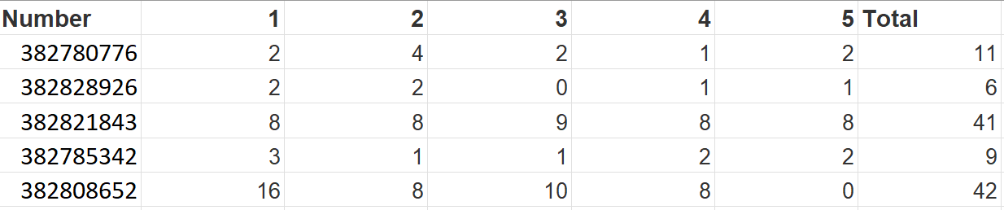
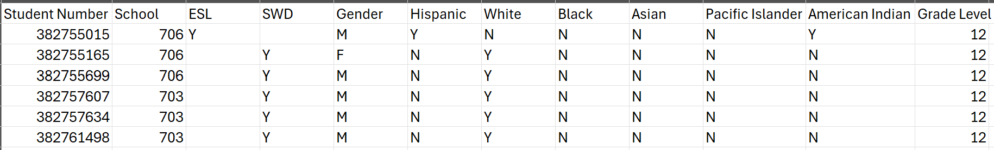
The Data
File: Absences
File: Demographics

Slide 5
Method 0: Raw Numbers
Key Takeaways
SV and GC follow similar trends, across trimesters and periods.
Absences increased from T1 to T2 in 2024-2025, but SV saw a smaller increase compared to GC (+5.92 absences vs. +6.99 absences).
This initial comparison suggests the policy may have helped—but raw numbers can be misleading.

Slide 6
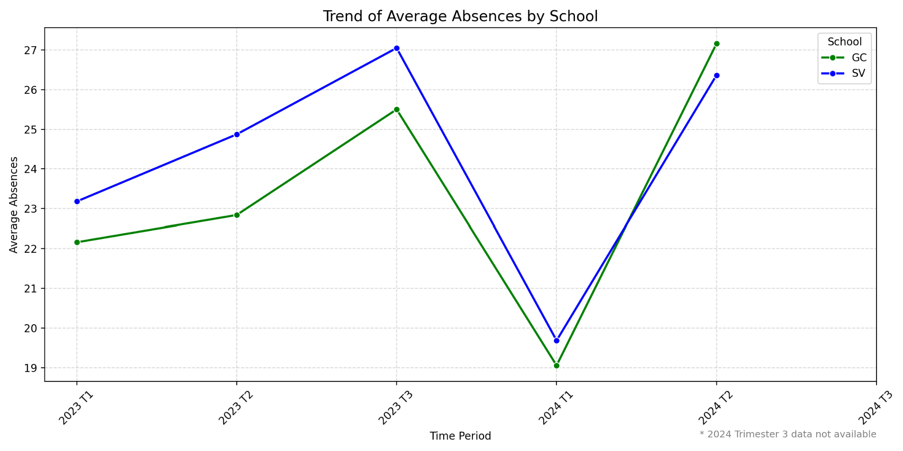

Slide 7
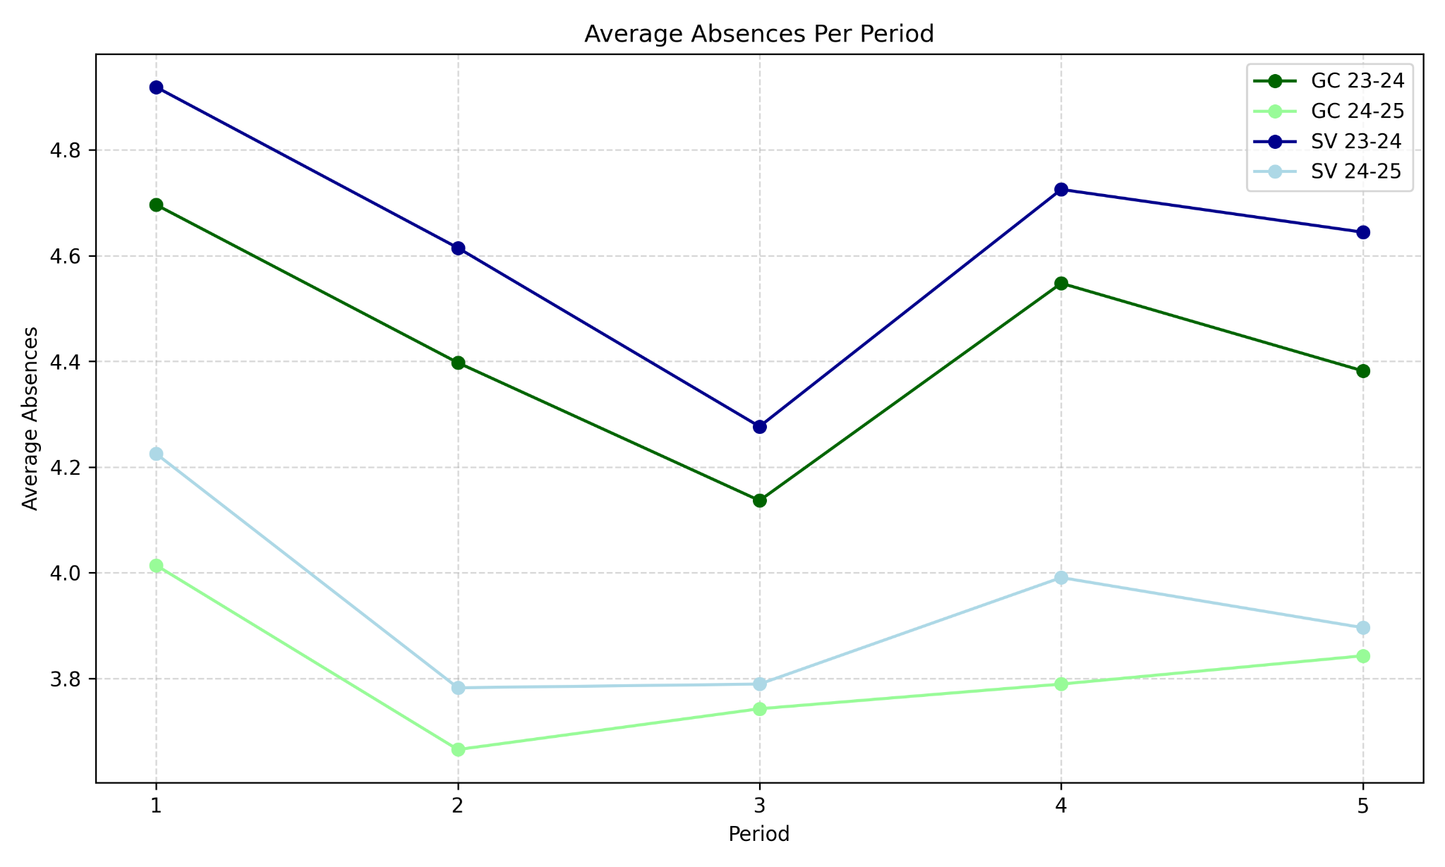

Slide 8
Why Go Deeper?
Changing Populations: GC dropped 133 students (1610 to 1477) and SV increase 13 students (1420 to 1434) between school years.
Demographics Unaccounted For: Raw numbers don’t control for factors like gender or race.
School-Wide Trends: Both schools saw absences fluctuate, so we need to compare relative changes.
Averages Mask Variation: Raw averages don’t show individual student changes.
The Fundamental Problem of Causal Inference: We only observe one of two possible outcomes.

Slide 9
The Fundamental Problem of Causal Inference
Sky View Student | Y¹ Absences w/ the Policy | Y⁰ Absences w/o the Policy | Y¹–Y⁰ Individual Effect
38270865 | 6 | 12 | -6
38270932 | 3 | 3 | 0
38270563 | 2 | 5 | -3
Average Effect |  |  | -3

Slide 10
The Fundamental Problem of Causal Inference
Sky View Student | Y¹ Absences w/ the Policy | Y⁰ Absences w/o the Policy | Y¹–Y⁰ Individual Effect
38270865 | 6
38270932 | 3
38270563 | 2
Average Effect

Slide 11
Method 1: Difference
-in-Differences
Key Takeaways
We assume that GC and SV are similar enough that GC and SV should continue to have parallel trends.
Averaging absences across periods, we can estimate the average effect of the policy by comparing GC and SV before and after the policy.
For 2024-2025, SV in both T1 and T2 has significant changes to attendance from what we would expect from SV with no policy.

Slide 12
Estimating the Average Effect
 | 2024-2025 | 2023-2024 | After–Before
Sky View | T1: 3.94 T2: 5.27 | T1: 4.64 T2: 4.97 | T1: -0.70 T2: 0.30
Green Canyon | T1: 3.81 T2: 5.43 | T1: 4.43 T2: 4.57 | T1: -0.62 T2: 0.86
Average Effect (SV–GC) |  |  | T1: -0.08 T2: -0.57

Slide 13
-0.57 absences (p-value 2.81e-06)
-0.08 absences (p-value 8.92e-06)

Slide 14
Method 2: Propensity Score Matching
Key Takeaways
We use propensity score matching to pair each SV student with a GC student based on demographics.
Think of it like finding a statistical twin for each student, one we can use to impute our missing counterfactual data for SV without the policy.
With matched individuals we can estimate heterogeneous effects.

Slide 15
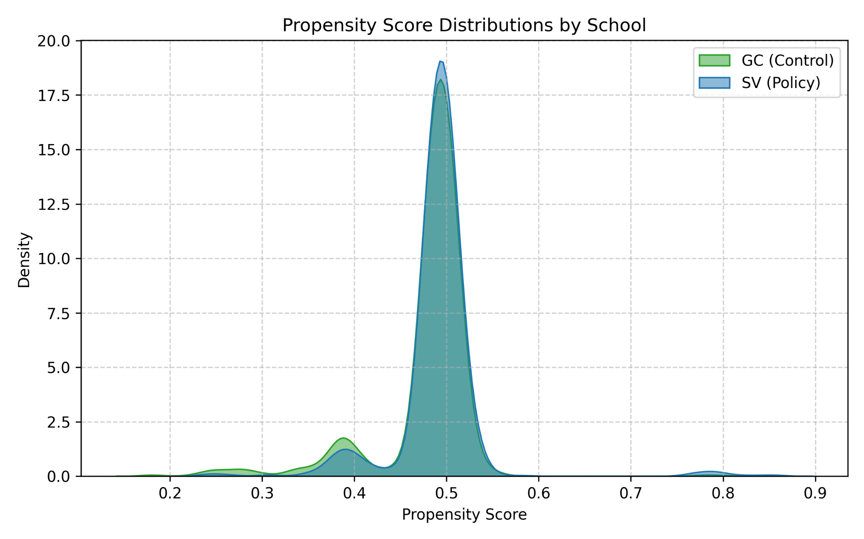
More Overlap = Fairer Comparison
Notes:
“This chart shows how students at each school differ in their background characteristics — like grade level, demographics, and how many days they missed before the policy.
Each curve shows the distribution of students’ likelihood to be at Sky View, based on those characteristics.
You can see the two groups mostly overlap, which is good

Slide 16
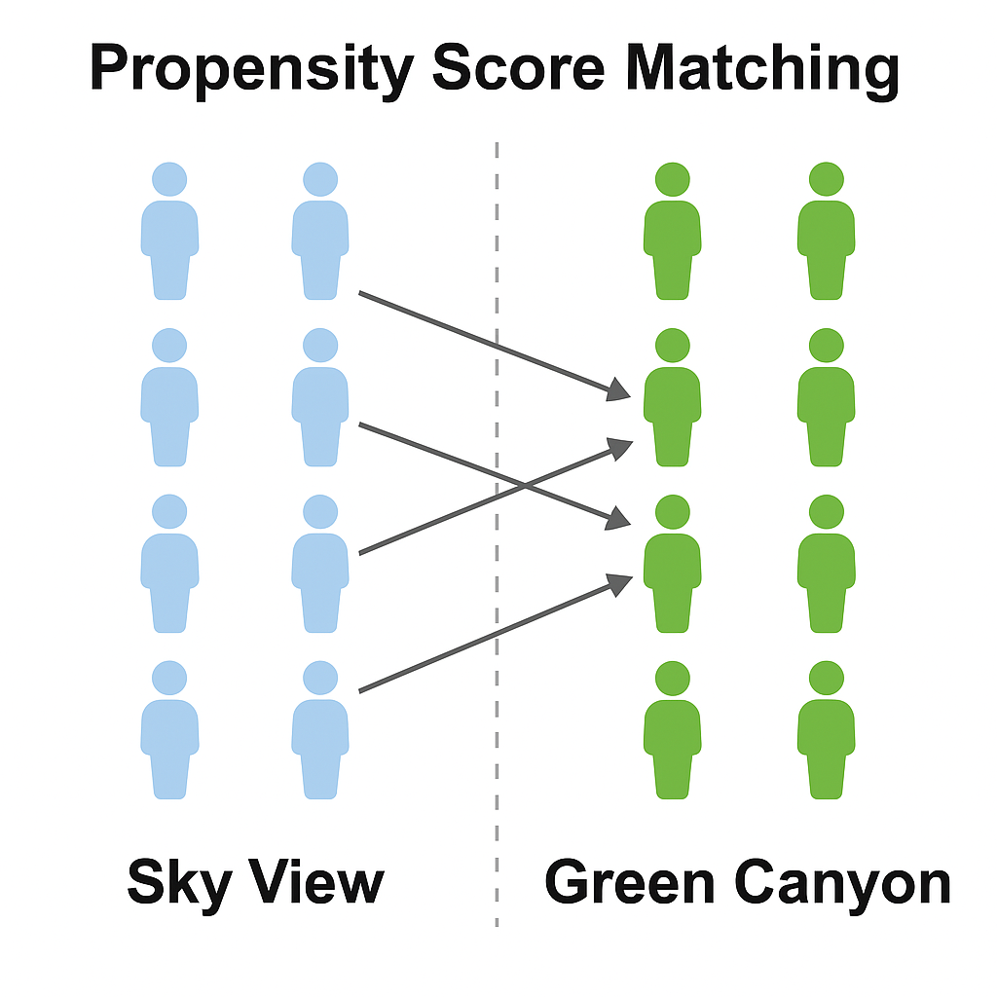
Use the demographics to predict a propensity score.
Make sure no re-weighting is need to match propensity score distributions across SV and GC.
Match each SV student that has had the attendance policy (Y¹) with a GC student that we treat as that same SV student if they hadn’t had the attendance policy (Y⁰).

Slide 17
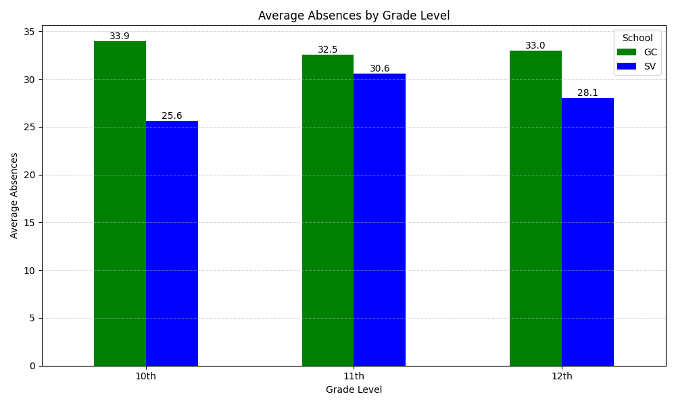

Slide 18
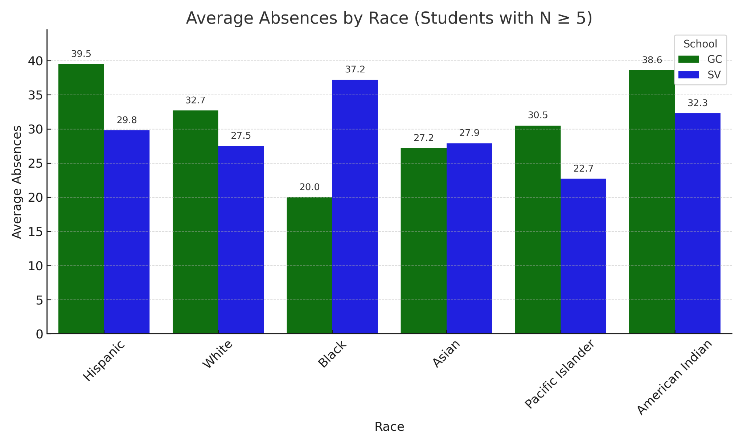

Slide 19
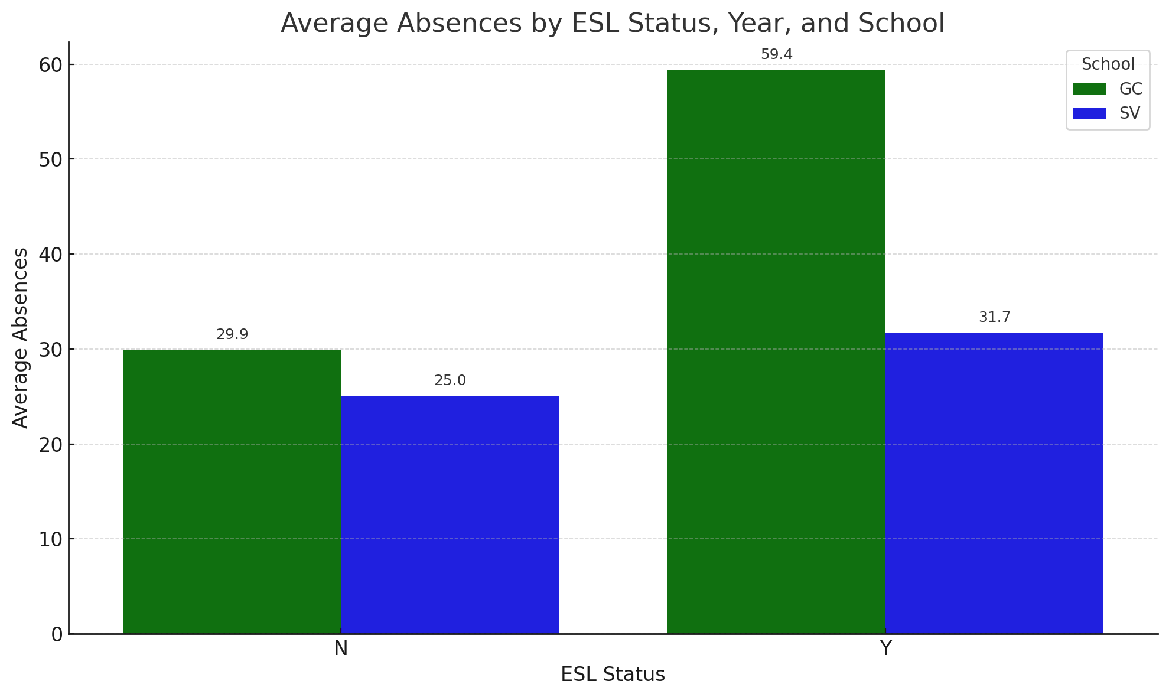
ESL, Gender Graph Needed

Slide 20
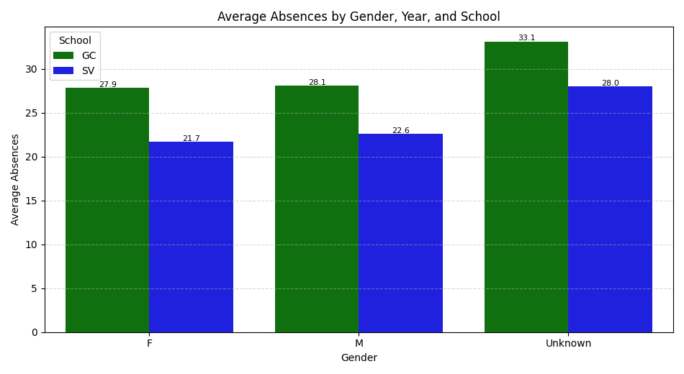

Slide 21
Summary of Findings
Using difference-in-difference, we see that SV’s significant average effect shows student learning with T2 having a bigger impact than T1 and a reversal of the school with the best attendance between SV and GC.
Matching students based on demographics, SV has large heterogeneous effects across student segments, especially ESL, Hispanic, and 10th grade students.

Slide 22
Next Steps
Consider Analyzing Longer-Run Trends
Evaluate Third Trimester
Get Student Segment
Feedback

Slide 23
Questions?

Slide 24

Thank you!

