Slide 1
Hi
That’s the cathedral →

Slide 2
Info
My Name: Marcus Dubreuil
Email: marcusdubreuil@pitt.edu or mld130@pitt.edu
Office Hours (5806 Sennott Square):
1PM - 4PM Friday
Emailing before helps make sure I’ll have time.
I’m here to help!

Slide 3
The point bit.ly/m1501
Mostly live coding.
The algorithms that we live-code will be useful to you for exams/projects/quizzes/etc.
Fill out the link at the top so that I can share with you the live-coding repository.

Slide 4
An introduction to version control systems with Git

Slide 5
Version control systems
Version control systems record changes to a file or set of files over time so that you can recall specific versions later
Many systems have risen to popularity over the years
RCS
CVS
Subversion
We will focus on Git

Slide 6
Why use version control?
These systems help with:
Tracking changes
Short and long term undo
Backup and restore
Synchronization
Collaboration

Slide 7

Local version control systems
Notes:
log changes made to the file, any version can be restored at any time

Slide 8
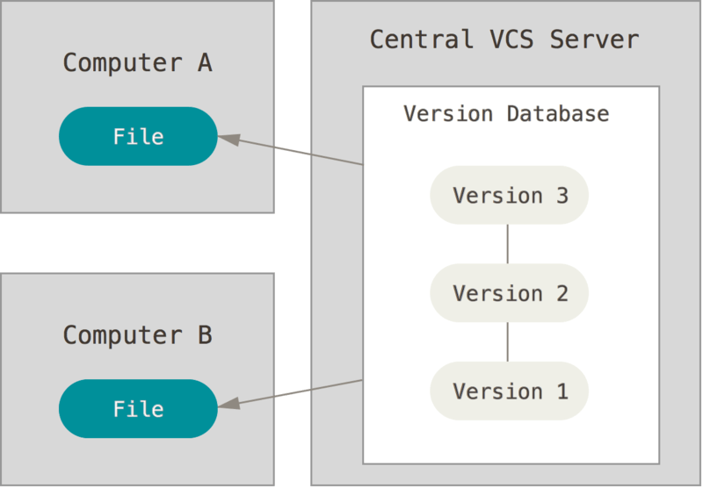
Centralized version control systems
Notes:
now added features to help with synchronization (computers A and B owned by the same user) and collaboration (computers A and B owned by different users)
also introduces problems: single point of failure, can't work offline

Slide 9
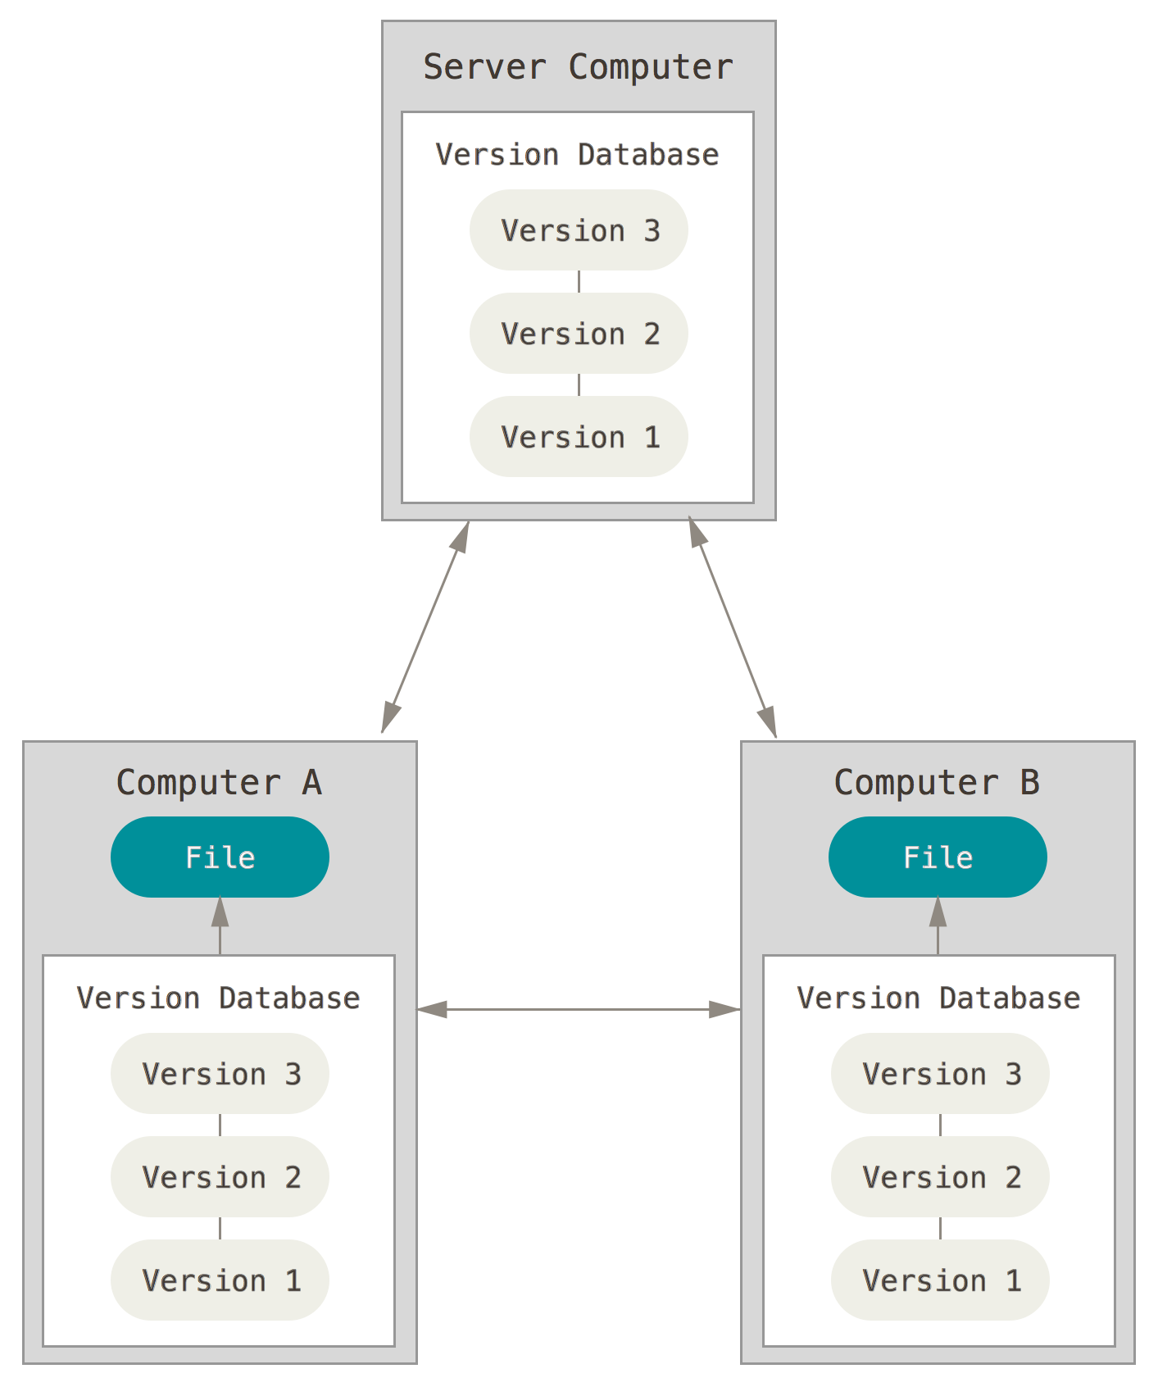
Distributed version control systems
Notes:
Copy of the version database in every working directory

Slide 10
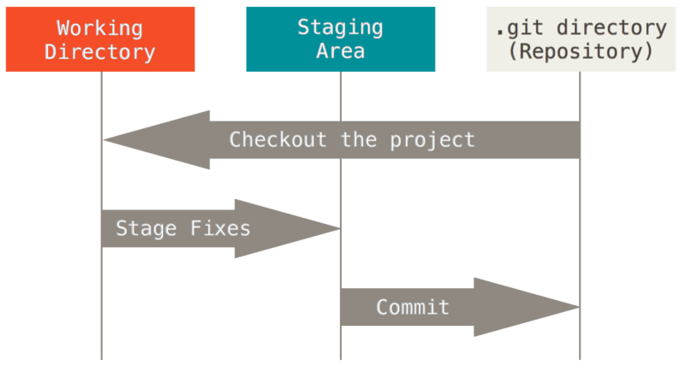
The basic Git workflow
Modify files in your working directory
Stage the files, adding snapshots to your staging area
Commit your changes to your local copy of the repository
Notes:
Modified means that you have changed the file but have not committed it to your database yet. Staged means that you have marked a modified file in its current version to go into your next commit snapshot.
Committed means that the data is safely stored in your local database.

Slide 11
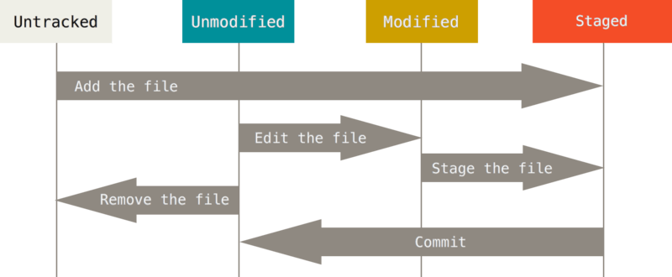
The lifecycle of a file in Git
Git does not necessary keep track of all files in your working directory

Slide 12
GitHub is not Git
But the GitHub student pack is OP (https://education.github.com/pack)
Notes:
Modified means that you have changed the file but have not committed it to your database yet. Staged means that you have marked a modified file in its current version to go into your next commit snapshot.
Committed means that the data is safely stored in your local database.

Slide 13
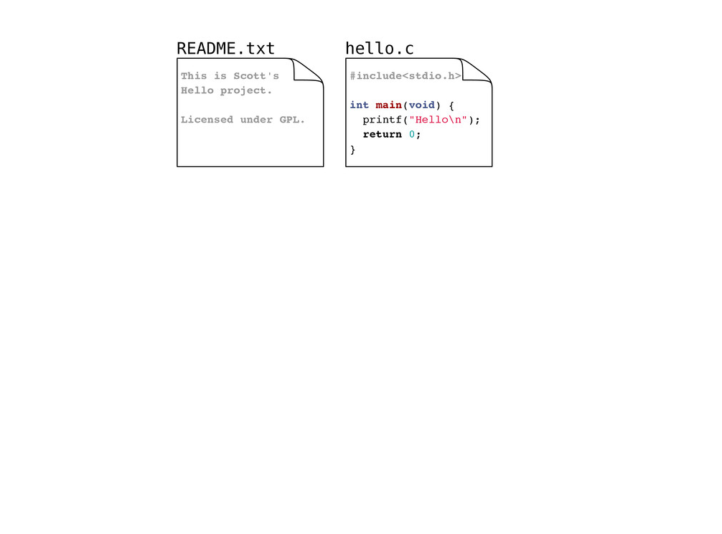
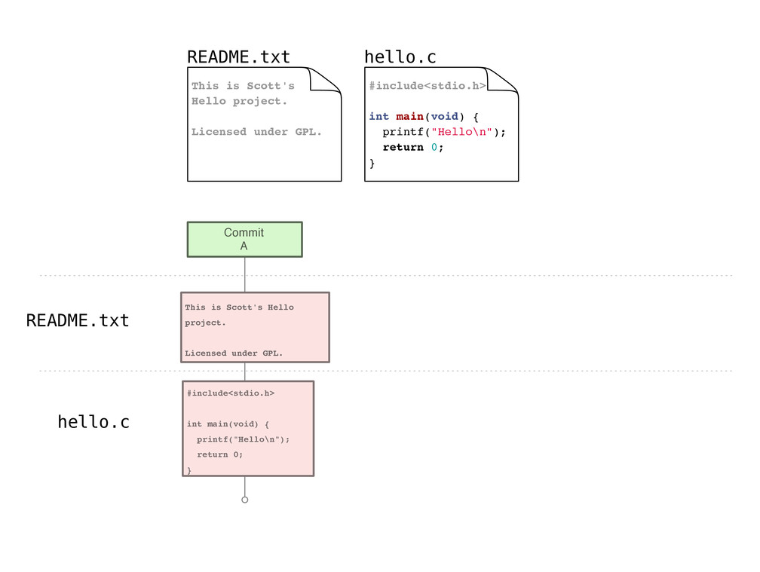
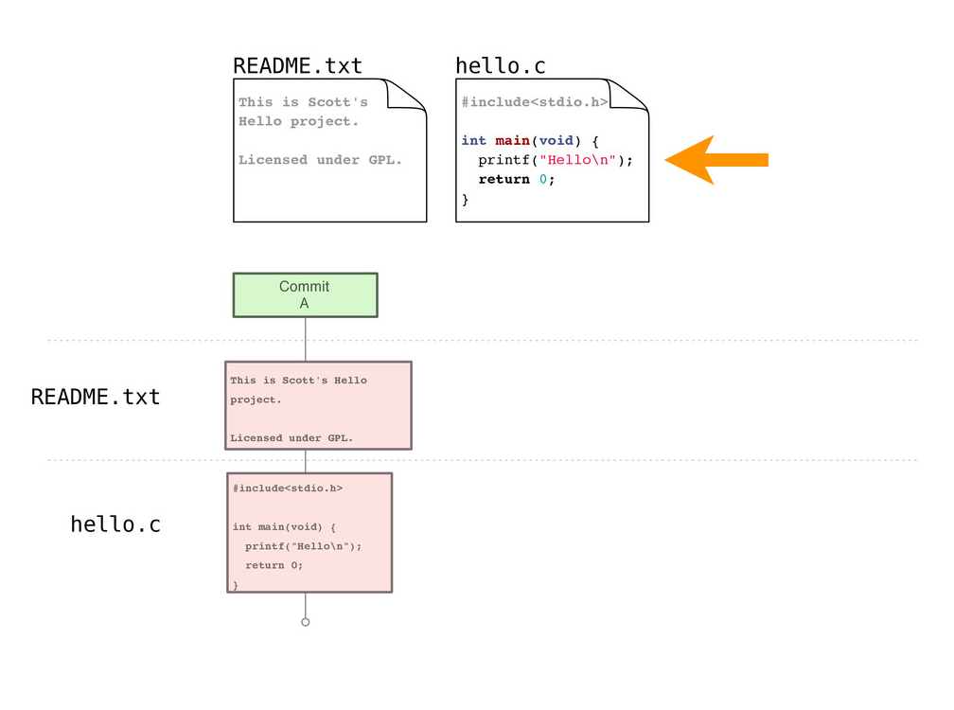

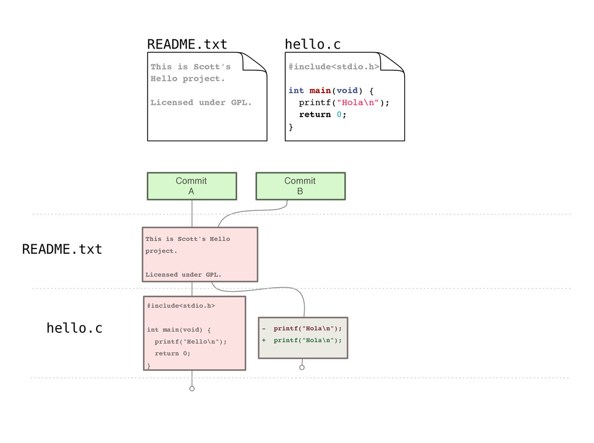
Example repository

Slide 14
Gitting started
Set your identity
$ git config --global user.name "John Doe"
$ git config --global user.email jdoe@example.com
Set other configuration options
$ git config --global color.ui true
Get help
$ git help <verb>
Notes:
Already installed on most Mac systems
Can install Git shell on Windows or use PowerShell Git application

Slide 15
Creating a new repository
$ git init
Creates a new (empty) repository in the current directory
Notes:
When explaining this, show them the repository to see the change.

Slide 16
Copying a repository
For this class, your instructor will create a repository for you, you will just need to copy it from GitHub to your computer using the following command:
$ git clone <repository>
Creates a copy of <repository> in the current directory

Slide 17
Staging files
As you work, you will create new files and modify existing files, when you are satisfied with your changes, you can stage them for commit with:
$ git add <file_pattern>
Notes:
Note this is not just for new files, but also for edited files

Slide 18
Committing changes
Commits create a new version in the repository
Include a commit message describing the new version
$ git commit -m <msg>
Notes:
Note that this is a local operation

Slide 19
Checking working directory status
$ git status
Reports:
Files in the working directory that are not tracked
File modifications not yet staged for commit
File additions and modifications staged for commit

Slide 20
Overviewing commit history
$ git log
Lists commits made to the current repository

Slide 21
Git example (cloning via GitHub)
Notes:
Go through example demonstrating the following commands:
git clone https://github.com/PittCS1501/PITTID-project0.git
ls
cd PITTID-project0
ls
nano P0.txt
Or, use another text editor, use of nano doesn't matter
git status
git diff
nano Status.txt
git status
git diff
git add P0.txt
git status
git add Status.txt
git status
git commit -m "finished project0"
git push
To end, view the repository on github.com, showing that the stuff you pushed appears there

Slide 22
Handy command - comparing versions
It may be handy to see exactly how files changed
$ git diff
Shows modifications not yet staged for commit
$ git diff <commit_id>
Show changes since the commit specified
$ git diff <commit_id1> <commit_id2>
Show changes between two commits

Slide 23
What we've covered here...
… presents only a brief overview of Git
Further topics:
branching
rebasing
tagging
…
Further resources:
https://git-scm.com/book/en/v2
http://gitref.org/
http://gitimmersion.com/

