Slide 1

Spring 2023
Neural networks
Programming and Data Analysis for Modern Neuroscience
NEU 365P/385L
Marcel Goldschen-ohm
Assistant Professor in the Department of Neuroscience, The University of Texas at Austin

Slide 2
Learning Objectives
You will understand the basic concept of a neural network as a function generator.
You will be introduced to PyTorch for building and training a basic feed forward neural network.

Slide 3


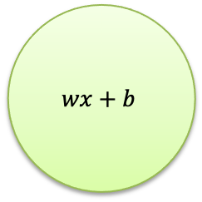

Linear Model
weight
bias
$$wx+b$$
input
$$x$$
$$w$$
$$\hat{y}$$
output
linear
transform

Slide 4
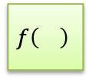
Generalized Linear Model
weight
bias
$$wx+b$$
input
$$x$$
$$w$$
$$f\left(\right)$$
$$\hat{y}$$
output
linear
transform
nonlinear
transform

Slide 5





Generalized Linear Model
weights
bias
$$x_{1}$$
$$w_{1}$$
input
$$f\left(\right)$$
$$\hat{y}$$
output
$$w_{2}$$
$$w_{1}x_{1}+w_{2}x_{2}+b$$
$$x_{2}$$
linear
transform
nonlinear
transform

Slide 6




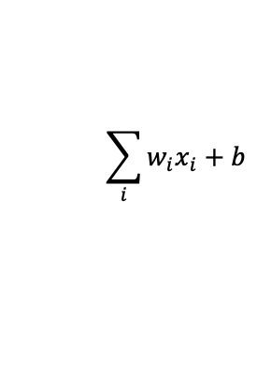


Generalized Linear Model
weights
bias
$$x_{1}$$
$$w_{1}$$
input
$$x_{2}$$
$$w_{2}$$
$$\sum_{i}{w_{i}x_{i}}+b$$
$$f\left(\right)$$
$$\hat{y}$$
output
$$w_{N}$$
$$x_{N}$$
linear
transform
nonlinear
transform

Slide 7
Artificial Neuron
weights
bias
$$x_{1}$$
$$w_{1}$$
input
$$x_{2}$$
$$w_{2}$$
$$\sum_{i}{w_{i}x_{i}}+b$$
$$f\left(\right)$$
$$\hat{y}$$
output
$$w_{N}$$
$$x_{N}$$
linear
transform
activation
function

Slide 8




Artificial Neuron
bias
activation
function
weights
$$x_{1}$$
$$w_{1}$$
input
$$x_{2}$$
$$w_{2}$$
$$b, f$$
$$\hat{y}$$
output
$$w_{N}$$
$$x_{N}$$

Slide 9








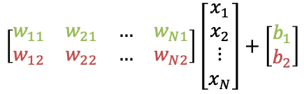



A neural network with two neurons
$$W=\left[N×2\right]$$
$$x_{1}$$
$$w_{11}$$
$$w_{12}$$
$$b_{1},f_{1}$$
$${\hat{y}}_{1}$$
$$w_{21}$$
input
$$x_{2}$$
output
$$w_{22}$$
$$b_{2},f_{2}$$
$${\hat{y}}_{2}$$
$$w_{N1}$$
$$w_{N2}$$
$$x_{N}$$
$$\left[\begin{matrix}w_{11} & w_{21} & … & w_{N1} \\ w_{12} & w_{22} & … & w_{N2}\end{matrix}\right]\left[\begin{matrix}x_{1} \\ x_{2} \\ ⋮ \\ x_{N}\end{matrix}\right]+\left[\begin{matrix}b_{1} \\ b_{2}\end{matrix}\right]$$

Slide 10




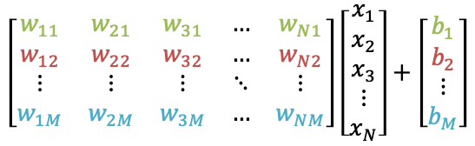







A neural network with $M$ neurons
$$W=\left[N×M\right]$$
$$x_{1}$$
$$b_{1},f_{1}$$
$${\hat{y}}_{1}$$
$$x_{2}$$
$$b_{2},f_{2}$$
$${\hat{y}}_{2}$$
input
output
$$x_{3}$$
$$b_{M},f_{M}$$
$${\hat{y}}_{M}$$
$$x_{N}$$
$$\left[\begin{matrix}w_{11} & w_{21} & w_{31} & … & w_{N1} \\ w_{12} & w_{22} & w_{32} & … & w_{N2} \\ ⋮ & ⋮ & ⋮ & ⋱ & ⋮ \\ w_{1M} & w_{2M} & w_{3M} & … & w_{NM}\end{matrix}\right]\left[\begin{matrix}x_{1} \\ x_{2} \\ x_{3} \\ ⋮ \\ x_{N}\end{matrix}\right]+\left[\begin{matrix}b_{1} \\ b_{2} \\ ⋮ \\ b_{M}\end{matrix}\right]$$

Slide 11









Multiple Layers → Deep Neural Network
$$W_{1 }=\left[N×M\right]$$
$$x_{1}$$
$$W_{2 }=\left[M×2\right]$$
$$b_{11},f_{11}$$
$$x_{2}$$
$$b_{21},f_{21}$$
$${\hat{y}}_{1}$$
$$b_{12},f_{12}$$
input
output
$$x_{3}$$
$$b_{22},f_{22}$$
$${\hat{y}}_{2}$$
$$b_{1M},f_{1M}$$
$$x_{N}$$

Slide 12

Function approximation for scalar target: $y=f\left(x_{1},x_{2},⋯x_{N}\right)$
Age
$$x_{1}$$
Sex
$$x_{2}$$
$$y$$
Diabetes Score
BMI
$$x_{3}$$
Glu
$$x_{N}$$

Slide 13

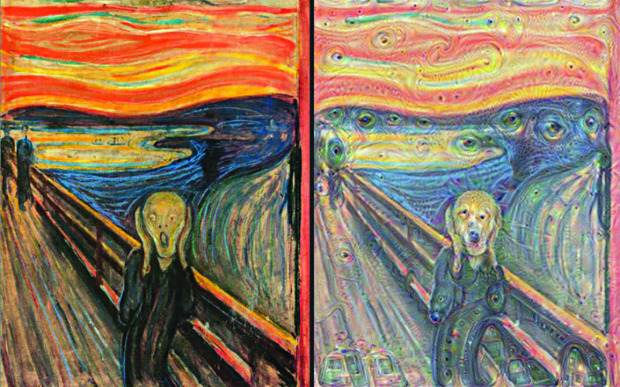




Function approximation for vector target: $\vec{y}=f\left(\vec{x}\right)$
$$x_{1}$$
$$y_{1}$$
$$x_{2}$$
$$y_{2}$$
input
image
pixels
output
image
pixels
$$x_{3}$$
$$y_{3}$$
$$x_{N}$$
$$y_{N}$$

Slide 14
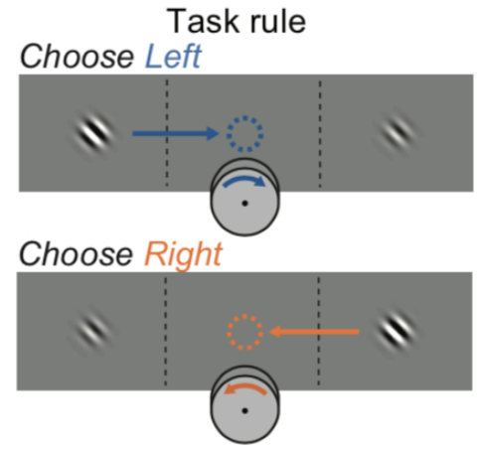
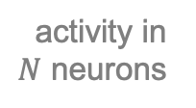
Binary Classifier
$$x_{1}$$
sigmoid
activation
function
$$x_{2}$$
activity in $N$ neurons
$$x_{3}$$
[0,1]
$$x_{N}$$

Slide 15
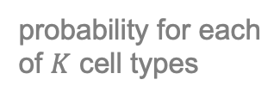

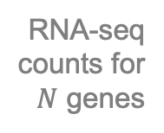
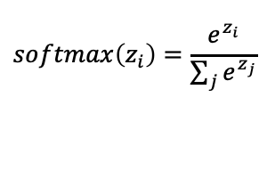


Multiple Classifier
softmax
activation
function
$$softmax\left(z_{i}\right)=\frac{e^{z_{i}}}{\sum_{j}{e^{z_{j}}}}$$
$$x_{1}$$
$$p_{1}$$
$$x_{2}$$
RNA-seq
counts for
$N$ genes
$$p_{2}$$
probability for each
of $K$ cell types
$$x_{3}$$
$$p_{K}$$
$$x_{N}$$

Slide 16




Output layer size and activation function are based on the desired functionality of your network.
softmax
$$x_{1}$$
$$p_{1}$$
$$x_{2}$$
RNA-seq
counts for
$N$ genes
$$p_{2}$$
probability for each
of $K$ cell types
$$x_{3}$$
$$p_{K}$$
$$x_{N}$$

Slide 17
Hidden layer sizes and activation functions?
activation
function?
softmax
$$x_{1}$$
?
$$p_{1}$$
$$x_{2}$$
RNA-seq
counts for
$N$ genes
?
$$p_{2}$$
probability for each
of $K$ cell types
$$x_{3}$$
?
$$p_{K}$$
$$x_{N}$$
number of
neurons?

Slide 18
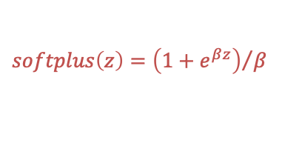


Rectified Linear Unit (ReLU)
$$softplus\left(z\right)={\left(1+e^{βz}\right)}/β$$
$$ReLU\left(z\right)=max\left(0,z\right)$$
$$z$$
$$x_{1}$$
$$w_{1}$$
input
$$x_{2}$$
$$w_{2}$$
$$\sum_{i}{w_{i}x_{i}}+b$$
$$ReLU$$
$$\hat{y}$$
output
$$w_{N}$$
$$x_{N}$$
linear
transform
activation
function
This is how a neural network can approximate a nonlinear function!

Slide 19
ReLU often used for hidden layers
ReLU
softmax
$$x_{1}$$
$$p_{1}$$
$$x_{2}$$
RNA-seq
counts for
$N$ genes
$$p_{2}$$
probability for each
of $K$ cell types
$$x_{3}$$
$$p_{K}$$
$$x_{N}$$
Many ReLUs together can approximate nonlinear functions like a sine wave.

Slide 20


Let’s build this network in PyTorch.
ReLU
ReLU
softmax
$$x_{1}$$
$$p_{1}$$
$$x_{2}$$
$$p_{2}$$
$$x_{3}$$
$$p_{10}$$
$$x_{100}$$
50 neurons
30 neurons
10 neurons

Slide 21
100 input → 50 ReLU → 30 ReLU → 10 softmax output
ReLU
ReLU
softmax
$$x_{1}$$
$$p_{1}$$
$$x_{2}$$
$$p_{2}$$
$$x_{3}$$
$$p_{10}$$
$$x_{100}$$
50 neurons
30 neurons
10 neurons

Slide 22
PyTorch: 100 input → 50 ReLU → 30 ReLU → 10 softmax output
from torch import nn
Import PyTorch nn module.

Slide 23
PyTorch: 100 input → 50 ReLU → 30 ReLU → 10 softmax output
from torch import nn
class MyNeuralNetwork(nn.Module):
…
Derive your neural network from nn.Module.

Slide 24
PyTorch: 100 input → 50 ReLU → 30 ReLU → 10 softmax output
from torch import nn
class MyNeuralNetwork(nn.Module):
def __init__(self):
super(MyNeuralNetwork, self).__init__()
When initializing your network first perform nn.Module’s default initialization.

Slide 25
PyTorch: 100 input → 50 ReLU → 30 ReLU → 10 softmax output
from torch import nn
class MyNeuralNetwork(nn.Module):
def __init__(self):
super(MyNeuralNetwork, self).__init__()
self.layers = nn.Sequential(
nn.Linear(100, 50),
nn.ReLU(),
nn.Linear(50, 30),
nn.ReLU(),
nn.Linear(30, 10),
nn.Softmax()
)
The layers of your network and their activation functions.

Slide 26
PyTorch: 100 input → 50 ReLU → 30 ReLU → 10 softmax output
from torch import nn
class MyNeuralNetwork(nn.Module):
def __init__(self):
super(MyNeuralNetwork, self).__init__()
self.layers = nn.Sequential(
nn.Linear(100, 50),
nn.ReLU(),
nn.Linear(50, 30),
nn.ReLU(),
nn.Linear(30, 10),
nn.Softmax()
)
100 inputs to 50 neurons in the 1st layer.

Slide 27
PyTorch: 100 input → 50 ReLU → 30 ReLU → 10 softmax output
from torch import nn
class MyNeuralNetwork(nn.Module):
def __init__(self):
super(MyNeuralNetwork, self).__init__()
self.layers = nn.Sequential(
nn.Linear(100, 50),
nn.ReLU(),
nn.Linear(50, 30),
nn.ReLU(),
nn.Linear(30, 10),
nn.Softmax()
)
Apply ReLU activation function to all 50 neurons in the 1st layer.

Slide 28
PyTorch: 100 input → 50 ReLU → 30 ReLU → 10 softmax output
from torch import nn
class MyNeuralNetwork(nn.Module):
def __init__(self):
super(MyNeuralNetwork, self).__init__()
self.layers = nn.Sequential(
nn.Linear(100, 50),
nn.ReLU(),
nn.Linear(50, 30),
nn.ReLU(),
nn.Linear(30, 10),
nn.Softmax()
)
50 neurons in the 1st layer to
30 neurons in the 2nd layer.

Slide 29
PyTorch: 100 input → 50 ReLU → 30 ReLU → 10 softmax output
from torch import nn
class MyNeuralNetwork(nn.Module):
def __init__(self):
super(MyNeuralNetwork, self).__init__()
self.layers = nn.Sequential(
nn.Linear(100, 50),
nn.ReLU(),
nn.Linear(50, 30),
nn.ReLU(),
nn.Linear(30, 10),
nn.Softmax()
)
Apply ReLU activation function to all 30 neurons in the 2nd layer.

Slide 30
PyTorch: 100 input → 50 ReLU → 30 ReLU → 10 softmax output
from torch import nn
class MyNeuralNetwork(nn.Module):
def __init__(self):
super(MyNeuralNetwork, self).__init__()
self.layers = nn.Sequential(
nn.Linear(100, 50),
nn.ReLU(),
nn.Linear(50, 30),
nn.ReLU(),
nn.Linear(30, 10),
nn.Softmax()
)
30 neurons in the 2nd layer to
10 neurons in the output layer.

Slide 31
PyTorch: 100 input → 50 ReLU → 30 ReLU → 10 softmax output
from torch import nn
class MyNeuralNetwork(nn.Module):
def __init__(self):
super(MyNeuralNetwork, self).__init__()
self.layers = nn.Sequential(
nn.Linear(100, 50),
nn.ReLU(),
nn.Linear(50, 30),
nn.ReLU(),
nn.Linear(30, 10),
nn.Softmax()
)
Apply softmax activation function to all 10 neurons in the output layer.

Slide 32
PyTorch: 100 input → 50 ReLU → 30 ReLU → 10 softmax output
from torch import nn
class MyNeuralNetwork(nn.Module):
def __init__(self):
super(MyNeuralNetwork, self).__init__()
self.layers = nn.Sequential(
nn.Linear(100, 50),
nn.ReLU(),
nn.Linear(50, 30),
nn.ReLU(),
nn.Linear(30, 10),
nn.Softmax()
)
def forward(self, x):
y = self.layers(x)
return y
Forward pass from inputs to outputs through the network.
x = 100 inputs
y = 10 outputs

Slide 33
Pick initial weights & biases.
What are the odds that your network does anything besides spit out garbage?
$$W_{1 }=\left[N×M\right]$$
$$x_{1}$$
$$W_{2 }=\left[M×2\right]$$
$$b_{11},f_{11}$$
$$x_{2}$$
$$b_{21},f_{21}$$
$${\hat{y}}_{1}$$
$$b_{12},f_{12}$$
input
output
$$x_{3}$$
$$b_{22},f_{22}$$
$${\hat{y}}_{2}$$
$$b_{1M},f_{1M}$$
$$x_{N}$$

Slide 34
How do you find the weights & biases that provide useful output?
$$W_{1 }=\left[N×M\right]$$
$$x_{1}$$
$$W_{2 }=\left[M×2\right]$$
$$b_{11},f_{11}$$
$$x_{2}$$
$$b_{21},f_{21}$$
$${\hat{y}}_{1}$$
$$b_{12},f_{12}$$
input
output
$$x_{3}$$
$$b_{22},f_{22}$$
$${\hat{y}}_{2}$$
$$b_{1M},f_{1M}$$
$$x_{N}$$

Slide 35


Compare the network’s predictions to known outputs.
$$W_{1 }=\left[N×M\right]$$
$$x_{1}$$
$$W_{2 }=\left[M×2\right]$$
$$b_{11},f_{11}$$
$$x_{2}$$
$$b_{21},f_{21}$$
$${\hat{y}}_{1}$$
$$y_{1}$$
$$b_{12},f_{12}$$
input
$$x_{3}$$
$$b_{22},f_{22}$$
$${\hat{y}}_{2}$$
$$y_{2}$$
$$b_{1M},f_{1M}$$
known
output
(training data)
network
prediction
$$x_{N}$$

Slide 36


Choose a loss function $L$ to quantify the error between the network’s predictions and known outputs for training data.
$$W_{1 }=\left[N×M\right]$$
$$x_{1}$$
$$W_{2 }=\left[M×2\right]$$
$$b_{11},f_{11}$$
e.g., $L=MSE(y,\hat{y})$
$$x_{2}$$
$$b_{21},f_{21}$$
$${\hat{y}}_{1}$$
$$y_{1}$$
$$b_{12},f_{12}$$
input
$$x_{3}$$
$$b_{22},f_{22}$$
$${\hat{y}}_{2}$$
$$y_{2}$$
$$b_{1M},f_{1M}$$
known
output
(training data)
network
prediction
$$x_{N}$$

Slide 37

Use gradient descent and backpropagation to iteratively update the weights & biases to minimize the loss function.
$$W_{1 }=\left[N×M\right]$$
$$x_{1}$$
$$W_{2 }=\left[M×2\right]$$
$$b_{11},f_{11}$$
$$\frac{∂L}{∂w_{i}},\frac{∂L}{∂b_{i}}$$
$$x_{2}$$
$$b_{21},f_{21}$$
$${\hat{y}}_{1}$$
$$y_{1}$$
$$b_{12},f_{12}$$
input
$$x_{3}$$
$$b_{22},f_{22}$$
$${\hat{y}}_{2}$$
$$y_{2}$$
$$b_{1M},f_{1M}$$
known
output
(training data)
network
prediction
$$x_{N}$$

Slide 38
Choose a loss function $L$ to quantify the error between the network’s predictions and known outputs for training data.
from torch import nn
# neural network model
class MyNeuralNetwork(nn.Module):
…
model = MyNeuralNetwork()
# loss function
loss_fn = nn.MSELoss()
$$W_{1 }=\left[N×M\right]$$
$$x_{1}$$
$$W_{2 }=\left[M×2\right]$$
$$b_{11},f_{11}$$
e.g., $L=MSE(y,\hat{y})$
$$x_{2}$$
$$b_{21},f_{21}$$
$${\hat{y}}_{1}$$
$$y_{1}$$
$$b_{12},f_{12}$$
input
$$x_{3}$$
$$b_{22},f_{22}$$
$${\hat{y}}_{2}$$
$$y_{2}$$
$$b_{1M},f_{1M}$$
known
output
(training data)
network
prediction
$$x_{N}$$

Slide 39





Use gradient descent and backpropagation to iteratively update the weights & biases to minimize the loss function.
import torch
from torch import nn
# neural network model
class MyNeuralNetwork(nn.Module):
…
model = MyNeuralNetwork()
# loss function
loss_fn = nn.MSELoss()
# stochastic gradient descent (SGD) optimizer
# lr = learning rate
optimizer = torch.optim.SGD(model.parameters(), lr=1e-3)
$$W_{1 }=\left[N×M\right]$$
$$x_{1}$$
$$W_{2 }=\left[M×2\right]$$
$$b_{11},f_{11}$$
$$\frac{∂L}{∂w_{i}},\frac{∂L}{∂b_{i}}$$
$$x_{2}$$
$$b_{21},f_{21}$$
$${\hat{y}}_{1}$$
$$y_{1}$$
$$b_{12},f_{12}$$
input
$$x_{3}$$
$$b_{22},f_{22}$$
$${\hat{y}}_{2}$$
$$y_{2}$$
$$b_{1M},f_{1M}$$
known
output
(training data)
network
prediction
$$x_{N}$$

Slide 40
The amount by which the parameters are updated on each iteration is scaled by the learning rate.
import torch
from torch import nn
# neural network model
class MyNeuralNetwork(nn.Module):
…
model = MyNeuralNetwork()
# loss function
loss_fn = nn.MSELoss()
# stochastic gradient descent (SGD) optimizer
# lr = learning rate
optimizer = torch.optim.SGD(model.parameters(), lr=1e-3)
$$W_{1 }=\left[N×M\right]$$
$$x_{1}$$
$$W_{2 }=\left[M×2\right]$$
$$b_{11},f_{11}$$
$$\frac{∂L}{∂w_{i}},\frac{∂L}{∂b_{i}}$$
$$x_{2}$$
$$b_{21},f_{21}$$
$${\hat{y}}_{1}$$
$$y_{1}$$
$$b_{12},f_{12}$$
input
$$x_{3}$$
$$b_{22},f_{22}$$
$${\hat{y}}_{2}$$
$$y_{2}$$
$$b_{1M},f_{1M}$$
known
output
(training data)
network
prediction
$$x_{N}$$

Slide 41
Use gradient descent and backpropagation to iteratively update the weights & biases to minimize the loss function.
def train(model, X, y, loss_fn, optimizer, n_epochs):
# put model into training mode
model.train()
for i in range(n_epochs):
# Compute loss (i.e., prediction error)
y_pred = model(X)
loss = loss_fn(y_pred, y)
# backpropagation
optimizer.zero_grad()
loss.backward()
# update model parameters
optimizer.step()

Slide 42
Use gradient descent and backpropagation to iteratively update the weights & biases to minimize the loss function.
import torch
from torch import nn
# neural network model
class MyNeuralNetwork(nn.Module):
…
model = MyNeuralNetwork()
# loss function
loss_fn = nn.MSELoss()
# stochastic gradient descent (SGD) optimizer
# lr = learning rate
optimizer = torch.optim.SGD(model.parameters(), lr=1e-3)
# train model on training data using stochastic gradient descent
n_epochs = 1000
train(model, X, y, loss_fn, optimizer, n_epochs)

Slide 43
Evaluate the loss on withheld test data.
def test(model, X, y, loss_fn):
# put model into testing (evaluation) mode
model.eval()
# no need to waste effort computing gradients
# that we only need during training
with torch.no_grad():
y_pred = model(X)
loss = loss_fn(y_pred, y)
test_loss = loss.item()
return test_loss

Slide 44
PyTorch tensors
import np as np
import torch
# numpy arrays X, y as for sklearn
X = np.array(…)
y = np.array(…)
# PyTorch has its own tensor object, so you must
# convert your data from numpy arrays to torch tensors
X = torch.tensor(X).float()
y = torch.tensor(y).float()

Slide 45
CPU vs GPU
import torch
if torch.cuda.is_available():
device = "cuda"
else:
device = "cpu"

Slide 46
A model can exist on either the CPU or the GPU.
import torch
if torch.cuda.is_available():
device = "cuda"
else:
device = "cpu”
# move model to GPU if possible
model = MyNeuralNetwork().to(device)

Slide 47
A model on the GPU does not work with data on the CPU and vice-versa.
import torch
if torch.cuda.is_available():
device = "cuda"
else:
device = "cpu”
# move model to GPU if possible
model = MyNeuralNetwork().to(device)
# move data to same place as model
X = X.to(device)
y = y.to(device)
Google Colab offers you free online use of GPUs so you can try this out even if you don't have a CUDA compatible NVIDIA GPU.

