Slide 1

Spring 2023
bootstrap resampling
Programming and Data Analysis for Modern Neuroscience
NEU 365P/385L
Marcel Goldschen-ohm
Assistant Professor in the Department of Neuroscience, The University of Texas at Austin

Slide 2

Learning goals – Sampling distribution
You will understand what a sampling distribution is.
You will understand the Central Limit Theorem.
You will appreciate how the Central Limit Theorem explains why normal-ish distributions are frequently observed in biological measurements.

Slide 3
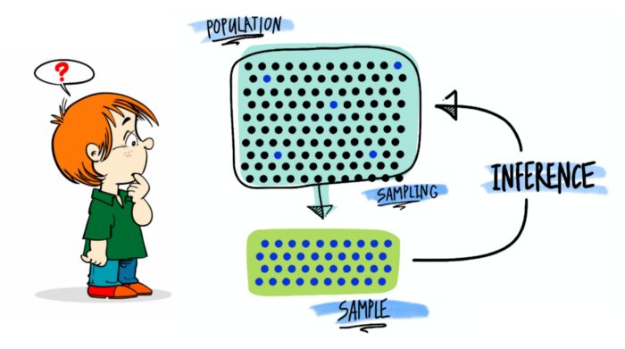
Sampling and statistical inference

Slide 4





Population vs. Sample
Population
$$μ, σ^{2}$$
$$n$$
$$\overline{x},s^{2}$$
Random Sample of size $n$
$$n$$

Slide 5
















Sampling Distribution
Population
$$μ, σ^{2}$$
$$n$$
$$n$$
$$n$$
$${\overline{x}}_{1},s_{1}^{2}$$
$$n$$
$$n$$
$$n$$
$$n$$
$${\overline{x}}_{2},s_{2}^{2}$$
Distribution of sample means
$$n$$
$$n$$
$$n$$
$${\overline{x}}_{3},s_{3}^{2}$$
$$n$$
…
PDF
$${\overline{x}}_{1}$$
$${\overline{x}}_{2}$$
$${\overline{x}}_{3}$$
$$\overline{x}$$

Slide 6
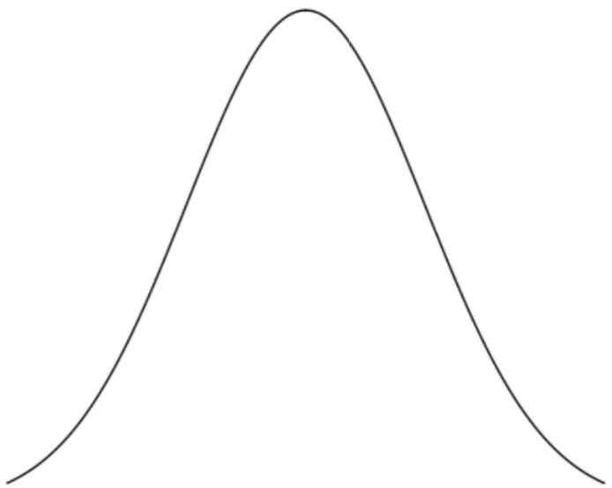
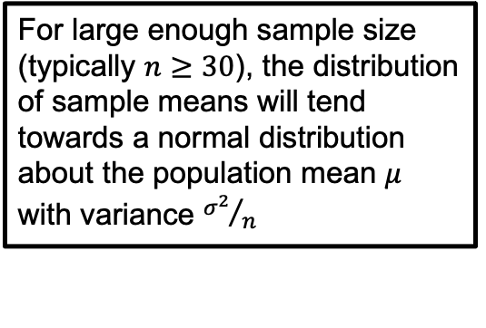


Central Limit Theorem
For large enough sample size (typically $n≥30$), the distribution of sample means will tend towards a normal distribution about the population mean $μ$ with variance ${σ^{2}}/n$
Population
$$μ, σ^{2}$$
$$n$$
$$n$$
$$n$$
$${\overline{x}}_{1},s_{1}^{2}$$
$$n$$
$$n$$
$$n$$
$$n$$
$${\overline{x}}_{2},s_{2}^{2}$$
$$n$$
$$n$$
$$μ$$
$$n$$
$${\overline{x}}_{3},s_{3}^{2}$$
$$n$$
…
$$\frac{σ}{\sqrt{n}}$$
PDF
$${\overline{x}}_{1}$$
$${\overline{x}}_{2}$$
$${\overline{x}}_{3}$$
$$\overline{x}$$

Slide 7


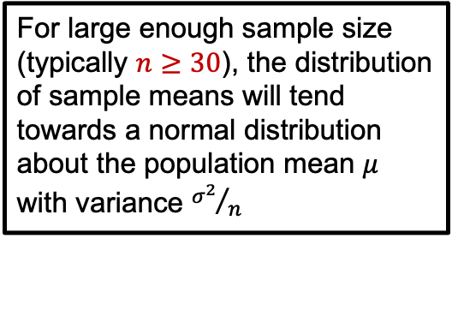

Central Limit Theorem
For large enough sample size (typically $n≥30$), the distribution of sample means will tend towards a normal distribution about the population mean $μ$ with variance ${σ^{2}}/n$
Population
$$μ, σ^{2}$$
$$n$$
$$n$$
$$n$$
$${\overline{x}}_{1},s_{1}^{2}$$
$$n$$
$$n$$
$$n$$
$$n$$
$${\overline{x}}_{2},s_{2}^{2}$$
$$n$$
$$n$$
$$μ$$
$$n$$
$${\overline{x}}_{3},s_{3}^{2}$$
$$n$$
…
$$\frac{σ}{\sqrt{n}}$$
$$μ$$
PDF
$$σ$$
PDF
The population distribution can be almost anything and this still holds true!
$${\overline{x}}_{1}$$
$${\overline{x}}_{2}$$
$${\overline{x}}_{3}$$
$$\overline{x}$$
Population $x$

Slide 8
Normal-ish distributions are everywhere
Consider a complicated biological processes where the parameter that you measure results from the sum of multiple underlying processes.
By the central limit theorem, we might expect our measurements to have a normal distribution even if the underlying processes do not.

Slide 9
Learning goals – bootstrap resampling
You will be able to assign a confidence interval to a statistic.
You will understand how bootstrap resampling simulates a sampling distribution.
You will be able to compute a bootstrap confidence interval for a statistic.

Slide 10
Sampling distribution
x
x
x
x
x
x
x
x
x
x
x
x
statistic
x
x
x
x
x
x
x
x
x
x
x
x
x
x
x
x
x
x
x
x
x
x
statistic
x
x
x
x
x
x
x
x
x
x
x
x
x
x
x
x
x
x
x
x
statistic
counts
x
x
x
x
x
x
x
x
x
x
x
x
x
x
x
x
x
x
x
x
x
x
statistic
x
x
x
x
x
x
x
x
x
x
x
x
x
x
x
statistic
x
x
x
x
x
x
x
statistic
x
x
x
x
x
x
x
x
x
x
x
x
x
x
x
x
x
x
x
x
x
x
statistic
x
x
x
x
x
x
x
x
x
x
x
x

Slide 11
But you often only have a single data set
x
x
x
x
x
x
x
x
x
x
x
x
statistic
x
x
x
x
x
x
x
x
x
x
counts
statistic
This is your only, and therefore best estimate of this statistic.

Slide 12
Did your test conditions have any effect?
x
x
x
x
x
x
x
x
x
x
x
x
statistic
x
x
x
x
x
x
x
x
x
x
control group
counts
x
x
x
x
x
x
x
x
x
x
x
x
statistic
x
x
x
x
x
x
x
x
x
x
statistic
test group

Slide 13


If your statistic is the mean, you can often use Central Limit Theorem
x
… or t-Test for sample means
x
x
x
x
x
x
x
x
x
x
x
statistic
$$μ$$
x
x
x
x
x
x
x
x
x
x
control group
counts
$$\frac{σ}{\sqrt{n}}$$
x
x
x
x
x
x
x
x
x
x
x
x
statistic
x
x
x
x
x
x
x
x
x
x
sample
mean
test group
95% confidence interval

Slide 14
But Central Limit Theorem is not always ideal
x
x
x
x
x
x
x
x
x
x
x
x
statistic
x
x
x
x
x
x
x
x
x
x
What if your statistic is not the mean (e.g., median, skew, percentiles, odds ratios, a function of various statistics, etc.)?
What if your sample distribution is not normal?
Although CLT should apply to almost any distribution in the limit of large sample size, the required sample size is larger if the underlying distribution is highly skewed.
?
confidence interval

Slide 15
















Bootstrap resampling
Data sample
x
x
x
x
x
x
x
x
x
x
$$x_{0}$$
$$x_{1}$$
$$x_{2}$$
$$x_{3}$$
$$x_{N−2}$$
$$x_{N−1}$$
x
x
$$⋯$$
$$stat$$
x
x
x
x
x
x
x
x
x
x
size N
x
x
x
x
x
x
x
x
x
x
$$x_{3}$$
$$x_{1}$$
$$x_{3}$$
$$x_{21}$$
$$x_{5}$$
$$x_{9}$$
x
x
$$⋯$$
$$stat$$
x
x
x
x
x
x
x
x
x
x
Bootstrap sample
size N

Slide 16
















Bootstrap resampling
Data sample
x
x
x
x
x
x
x
x
x
x
$$x_{0}$$
$$x_{1}$$
$$x_{2}$$
$$x_{3}$$
$$x_{N−2}$$
$$x_{N−1}$$
x
x
$$⋯$$
$$stat$$
x
x
x
x
x
x
x
x
x
x
size N
Bootstrap samples
x
x
x
x
x
x
x
x
x
x
$$x_{3}$$
$$x_{1}$$
$$x_{3}$$
$$x_{21}$$
$$x_{5}$$
$$x_{9}$$
x
x
$$⋯$$
$$stat$$
x
x
x
x
x
x
x
x
x
x
x
x
x
x
x
x
x
x
x
x
$$x_{2}$$
$$x_{5}$$
$$x_{0}$$
$$x_{7}$$
$$⋯$$
$$x_{0}$$
$$x_{15}$$
x
x
$$stat$$
x
x
x
x
x
x
x
x
x
x
x
x
x
x
x
x
x
x
x
x
$$x_{1}$$
$$x_{7}$$
$$x_{1}$$
$$x_{4}$$
$$⋯$$
$$x_{7}$$
$$x_{1}$$
x
x
$$stat$$
x
x
x
x
x
x
x
x
x
x
size N

Slide 17
Bootstrap sampling distribution
counts
bootstrapped
statistics

Slide 18


Bootstrap confidence interval
import numpy as np
lb, ub = np.quantile(bootstraps, [0.025, 0.975])
$$lb$$
$$ub$$
counts
bootstrapped
statistics
95% confidence interval

Slide 19
Confidence interval need not be symmetric about your best estimate for the statistic (from data)
control
statistic
x
x
x
x
x
x
x
x
$$lb$$
$$ub$$
x
x
x
x
statistic
x
x
x
x
x
x
x
x
x
x
control group
counts
statistic
bootstrap 95% confidence interval

Slide 20
Are random fluctuations likely to explain difference between control and test measures?
control
statistic
test
statistic
x
x
x
x
x
x
x
x
$$lb$$
$$ub$$
x
x
x
x
statistic
x
x
x
x
x
x
x
x
x
x
control group
counts
x
x
x
x
x
x
x
x
x
x
x
x
statistic
x
x
x
x
x
x
x
x
x
x
statistic
test group
bootstrap 95% confidence interval

Slide 21
Bootstrap Resampling
Works for any statistic.
Only assumption is that the sample data set is representative of the population.
Can be asymptotically more accurate than theoretical models such as Central Limit Theorem.

Slide 22
Resampling relies on your actual data sample being representative of the population
x
x
x
x
x
What if it just so happens that you have a bunch of outliers in your sample?
Will bootstrapping help you then?
x
x
x
x
x
x
x
x
x
x
x
x
x
x
x
x
x
control group

