Slide 1

Spring 2024
Neural networks
Programming and Data Analysis for Modern Neuroscience
NEU 365P
Marcel Goldschen-ohm
Assistant Professor in the Department of Neuroscience, The University of Texas at Austin

Slide 2
Learning Objectives
You will understand the basic concept of a feed-forward neural network as a function generator.
You will understand the concept for how a neural network is trained.
You will be able to implement basic feed-forward neural networks for regression and classification in Python.

Slide 3


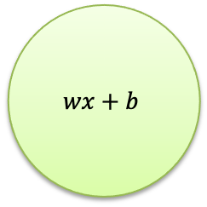

Linear Model
weight
bias
$$wx+b$$
input
$$x$$
$$w$$
$$\hat{y}$$
output
linear
transform

Slide 4
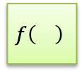
Generalized Linear Model
weight
bias
$$wx+b$$
input
$$x$$
$$w$$
$$f\left(\right)$$
$$\hat{y}$$
output
linear
transform
nonlinear
transform

Slide 5





Generalized Linear Model
weights
bias
$$x_{1}$$
$$w_{1}$$
input
$$f\left(\right)$$
$$\hat{y}$$
output
$$w_{2}$$
$$w_{1}x_{1}+w_{2}x_{2}+b$$
$$x_{2}$$
linear
transform
nonlinear
transform

Slide 6




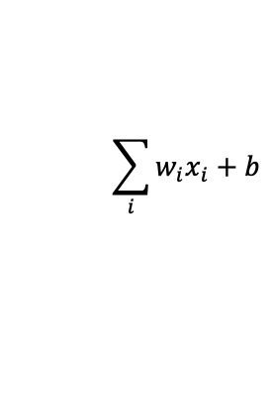


Generalized Linear Model
weights
bias
$$x_{1}$$
$$w_{1}$$
input
$$x_{2}$$
$$w_{2}$$
$$\sum_{i}{w_{i}x_{i}}+b$$
$$f\left(\right)$$
$$\hat{y}$$
output
$$w_{N}$$
$$x_{N}$$
linear
transform
nonlinear
transform

Slide 7
Artificial Neuron
weights
bias
$$x_{1}$$
$$w_{1}$$
input
$$x_{2}$$
$$w_{2}$$
$$\sum_{i}{w_{i}x_{i}}+b$$
$$f\left(\right)$$
$$\hat{y}$$
output
$$w_{N}$$
$$x_{N}$$
linear
transform
activation
function

Slide 8




Artificial Neuron
bias
activation
function
weights
$$x_{1}$$
$$w_{1}$$
input
$$x_{2}$$
$$w_{2}$$
$$b, f$$
$$\hat{y}$$
output
$$w_{N}$$
$$x_{N}$$

Slide 9








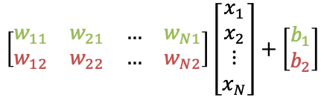



A neural network with two neurons
$$W=\left[N×2\right]$$
$$x_{1}$$
$$w_{11}$$
$$w_{12}$$
$$b_{1},f_{1}$$
$${\hat{y}}_{1}$$
$$w_{21}$$
input
$$x_{2}$$
output
$$w_{22}$$
$$b_{2},f_{2}$$
$${\hat{y}}_{2}$$
$$w_{N1}$$
$$w_{N2}$$
$$x_{N}$$
$$\left[\begin{matrix}w_{11} & w_{21} & … & w_{N1} \\ w_{12} & w_{22} & … & w_{N2}\end{matrix}\right]\left[\begin{matrix}x_{1} \\ x_{2} \\ ⋮ \\ x_{N}\end{matrix}\right]+\left[\begin{matrix}b_{1} \\ b_{2}\end{matrix}\right]$$

Slide 10




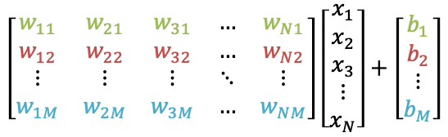







A neural network with $M$ neurons
$$W=\left[N×M\right]$$
$$x_{1}$$
$$b_{1},f_{1}$$
$${\hat{y}}_{1}$$
$$x_{2}$$
$$b_{2},f_{2}$$
$${\hat{y}}_{2}$$
input
output
$$x_{3}$$
$$b_{M},f_{M}$$
$${\hat{y}}_{M}$$
$$x_{N}$$
$$\left[\begin{matrix}w_{11} & w_{21} & w_{31} & … & w_{N1} \\ w_{12} & w_{22} & w_{32} & … & w_{N2} \\ ⋮ & ⋮ & ⋮ & ⋱ & ⋮ \\ w_{1M} & w_{2M} & w_{3M} & … & w_{NM}\end{matrix}\right]\left[\begin{matrix}x_{1} \\ x_{2} \\ x_{3} \\ ⋮ \\ x_{N}\end{matrix}\right]+\left[\begin{matrix}b_{1} \\ b_{2} \\ ⋮ \\ b_{M}\end{matrix}\right]$$

Slide 11









Multiple Layers → Deep Neural Network
$$W_{1 }=\left[N×M\right]$$
$$x_{1}$$
$$W_{2 }=\left[M×2\right]$$
$$b_{11},f_{11}$$
$$x_{2}$$
$$b_{21},f_{21}$$
$${\hat{y}}_{1}$$
$$b_{12},f_{12}$$
input
output
$$x_{3}$$
$$b_{22},f_{22}$$
$${\hat{y}}_{2}$$
$$b_{1M},f_{1M}$$
$$x_{N}$$

Slide 12

Function approximation for scalar target: $y=f\left(x_{1},x_{2},⋯x_{N}\right)$
Age
$$x_{1}$$
Sex
$$x_{2}$$
$$y$$
Diabetes Score
BMI
$$x_{3}$$
Glu
$$x_{N}$$

Slide 13

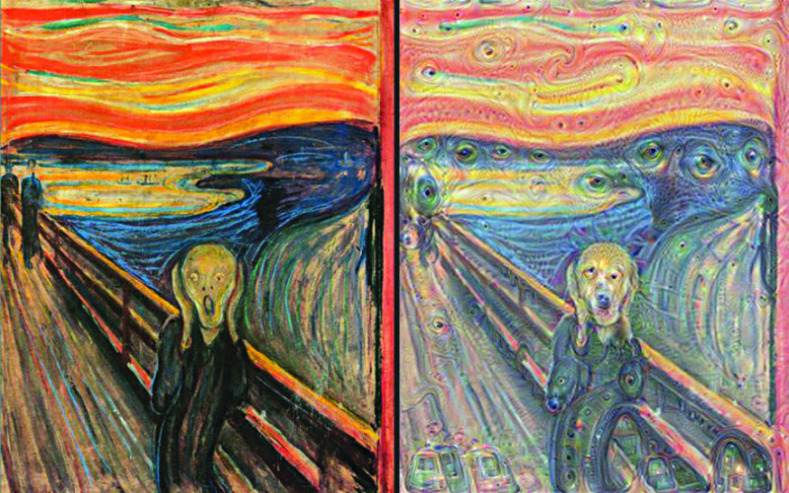




Function approximation for vector target: $\vec{y}=f\left(\vec{x}\right)$
$$x_{1}$$
$$y_{1}$$
$$x_{2}$$
$$y_{2}$$
input
image
pixels
output
image
pixels
$$x_{3}$$
$$y_{3}$$
$$x_{N}$$
$$y_{N}$$

Slide 14
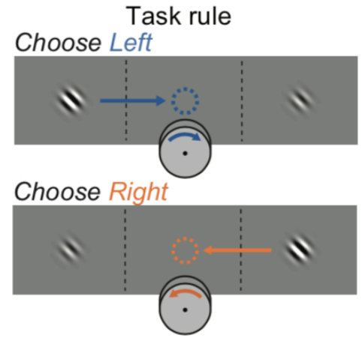
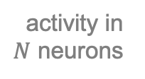
Binary Classifier
$$x_{1}$$
sigmoid
activation
function
$$x_{2}$$
activity in $N$ neurons
$$x_{3}$$
[0,1]
$$x_{N}$$

Slide 15
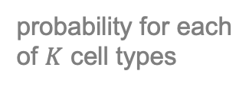

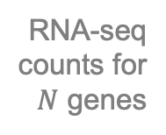
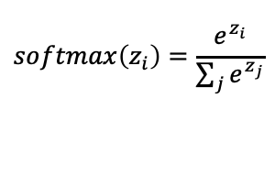


Multiple Classifier
softmax
activation
function
$$softmax\left(z_{i}\right)=\frac{e^{z_{i}}}{\sum_{j}{e^{z_{j}}}}$$
$$x_{1}$$
$$p_{1}$$
$$x_{2}$$
RNA-seq
counts for
$N$ genes
$$p_{2}$$
probability for each
of $K$ cell types
$$x_{3}$$
$$p_{K}$$
$$x_{N}$$

Slide 16




Output layer size and activation function are based on the desired functionality of your network.
softmax
$$x_{1}$$
$$p_{1}$$
$$x_{2}$$
RNA-seq
counts for
$N$ genes
$$p_{2}$$
probability for each
of $K$ cell types
$$x_{3}$$
$$p_{K}$$
$$x_{N}$$

Slide 17
Hidden layer sizes and activation functions?
activation
function?
softmax
$$x_{1}$$
?
$$p_{1}$$
$$x_{2}$$
RNA-seq
counts for
$N$ genes
?
$$p_{2}$$
probability for each
of $K$ cell types
$$x_{3}$$
?
$$p_{K}$$
$$x_{N}$$
number of
neurons?

Slide 18
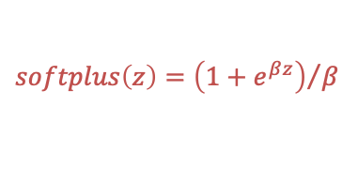


Rectified Linear Unit (ReLU)
$$softplus\left(z\right)={\left(1+e^{βz}\right)}/β$$
$$ReLU\left(z\right)=max\left(0,z\right)$$
$$z$$
$$x_{1}$$
$$w_{1}$$
input
$$x_{2}$$
$$w_{2}$$
$$\sum_{i}{w_{i}x_{i}}+b$$
$$ReLU$$
$$\hat{y}$$
output
$$w_{N}$$
$$x_{N}$$
linear
transform
activation
function
This is how a neural network can approximate a nonlinear function!

Slide 19
ReLU often used for hidden layers
ReLU
softmax
$$x_{1}$$
$$p_{1}$$
$$x_{2}$$
RNA-seq
counts for
$N$ genes
$$p_{2}$$
probability for each
of $K$ cell types
$$x_{3}$$
$$p_{K}$$
$$x_{N}$$
Many ReLUs together can approximate nonlinear functions like a sine wave.

Slide 20
Consider this network
What are the sort of things you might do with such a network?
$$x_{1}$$
$$b_{11},f_{11}$$
$$x_{2}$$
$$b_{21},f_{21}$$
$${\hat{y}}_{1}$$
$$b_{12},f_{12}$$
input
output
$$x_{3}$$
$$b_{22},f_{22}$$
$${\hat{y}}_{2}$$
$$b_{1M},f_{1M}$$
$$x_{N}$$

Slide 21













First you must initialize the weights & biases (typically random).
What are the odds that your network does anything besides spit out garbage?
$$W_{1 }=\left[N×M\right]$$
$$x_{1}$$
$$W_{2 }=\left[M×2\right]$$
$$b_{11},f_{11}$$
$$x_{2}$$
$$b_{21},f_{21}$$
$${\hat{y}}_{1}$$
$$b_{12},f_{12}$$
input
output
$$x_{3}$$
$$b_{22},f_{22}$$
$${\hat{y}}_{2}$$
$$b_{1M},f_{1M}$$
$$x_{N}$$

Slide 22
How do you find the weights & biases that provide useful output?
$$W_{1 }=\left[N×M\right]$$
$$x_{1}$$
$$W_{2 }=\left[M×2\right]$$
$$b_{11},f_{11}$$
$$x_{2}$$
$$b_{21},f_{21}$$
$${\hat{y}}_{1}$$
$$b_{12},f_{12}$$
input
output
$$x_{3}$$
$$b_{22},f_{22}$$
$${\hat{y}}_{2}$$
$$b_{1M},f_{1M}$$
$$x_{N}$$

Slide 23


Compare the network’s predictions to known outputs.
$$W_{1 }=\left[N×M\right]$$
$$x_{1}$$
$$W_{2 }=\left[M×2\right]$$
$$b_{11},f_{11}$$
$$x_{2}$$
$$b_{21},f_{21}$$
$${\hat{y}}_{1}$$
$$y_{1}$$
$$b_{12},f_{12}$$
input
$$x_{3}$$
$$b_{22},f_{22}$$
$${\hat{y}}_{2}$$
$$y_{2}$$
$$b_{1M},f_{1M}$$
known
output
(training data)
network
prediction
$$x_{N}$$

Slide 24


Choose a loss function $L$ to quantify the error between the network’s predictions and known outputs for training data.
$$W_{1 }=\left[N×M\right]$$
$$x_{1}$$
$$W_{2 }=\left[M×2\right]$$
$$b_{11},f_{11}$$
e.g., $L=MSE(y,\hat{y})$
$$x_{2}$$
$$b_{21},f_{21}$$
$${\hat{y}}_{1}$$
$$y_{1}$$
$$b_{12},f_{12}$$
input
$$x_{3}$$
$$b_{22},f_{22}$$
$${\hat{y}}_{2}$$
$$y_{2}$$
$$b_{1M},f_{1M}$$
known
output
(training data)
network
prediction
$$x_{N}$$

Slide 25

Use gradient descent and backpropagation to iteratively update the weights & biases to minimize the loss function.
$$W_{1 }=\left[N×M\right]$$
$$x_{1}$$
$$W_{2 }=\left[M×2\right]$$
$$b_{11},f_{11}$$
$$\frac{∂L}{∂w_{i}},\frac{∂L}{∂b_{i}}$$
$$x_{2}$$
$$b_{21},f_{21}$$
$${\hat{y}}_{1}$$
$$y_{1}$$
$$b_{12},f_{12}$$
input
$$x_{3}$$
$$b_{22},f_{22}$$
$${\hat{y}}_{2}$$
$$y_{2}$$
$$b_{1M},f_{1M}$$
known
output
(training data)
network
prediction
$$x_{N}$$

Slide 26
Training iteration
1. Network
prediction
2. Loss between prediction and known training data
3. Compute gradients of loss w.r.t. network weights
4. Update network weights to reduce loss
Your selected loss function
Backpropagation

