Slide 1
Fantasy Stock Market Project
Moises Vasquez
Marcel Socorro
Data Mining and Machine Learning CIS544_20sp1

Slide 2
Requirements
-All trading must be done from R and completely automated,
-Running a script in a Virtual Machine hosted in AWS.
- Number of calls are limited to 2 calls per minute, maximum 300 API calls per day.
-At least 250 successful trades (buy/sell) must be done per day.
-All trading is to be done between 10am-4pm. Failed transactions will result in penalties.
-The user linked to the key has a budget of 100000 Big Data Dollars.
-The total value is composed by Value Shares and Budget Available. Penalties are subtracted of the Total

Slide 3
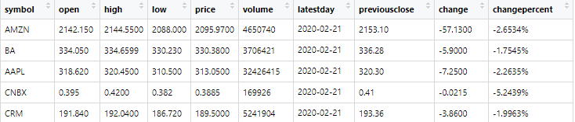
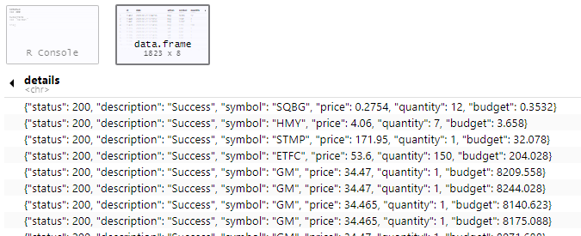
Variables of the model
Current price
Transaction price

Slide 4
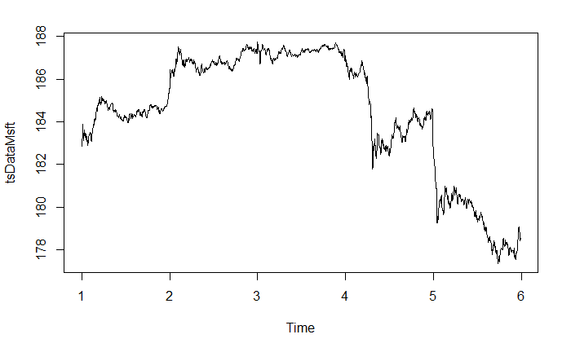
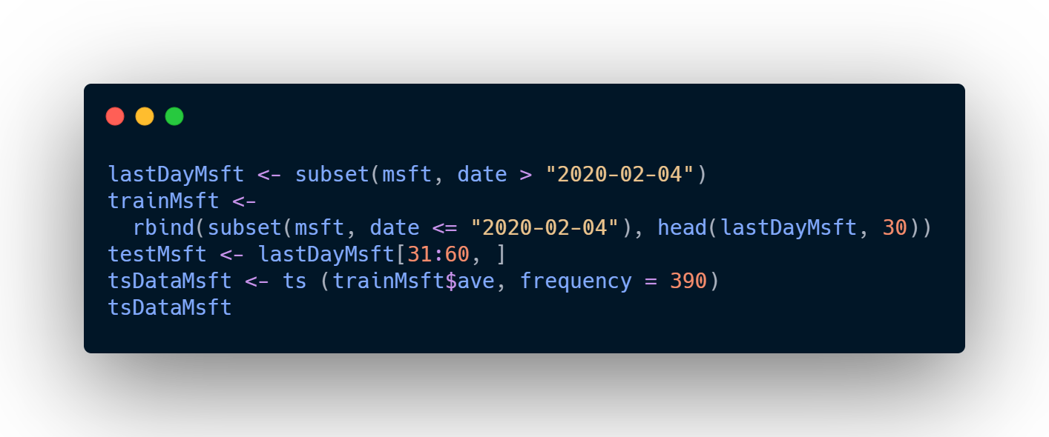
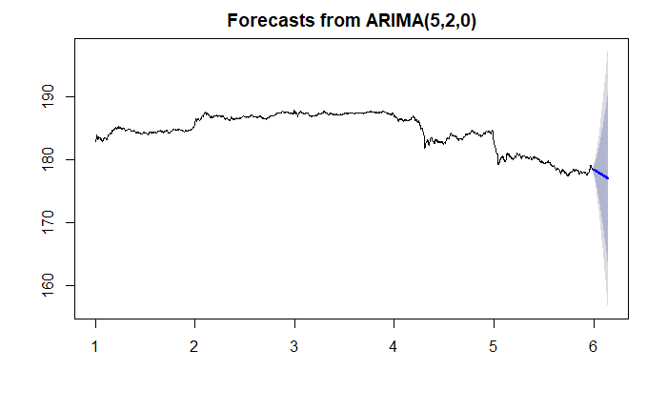
Variables of the model. Predicting price per minute
High error value
RMSE 2.62

Slide 5
Model Decision Making
Time Series Analysis 20 stocks
Choosing Max (Current pricing-Last transaction price) to SELL
Choosing Min (Current pricing-Last transaction price) to BUY
Comparing to Time Series Prediction
Comparing to Time Series Prediction
Market
Market
Market
Market
Don’t sell. Pass to 2nd Max
Sell all, leave 1 share
Spend 3K
Don’t buy. Pass to 2nd Min
Increasing Budget 0.02% 21 days

Slide 6
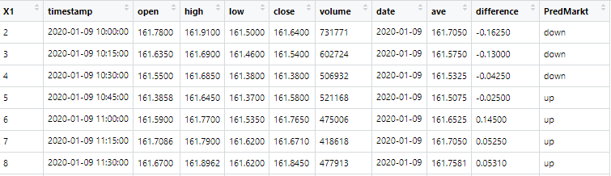
Recommendation 2nd Algorithm
Prediction next observation
Behavior in the past

Slide 7
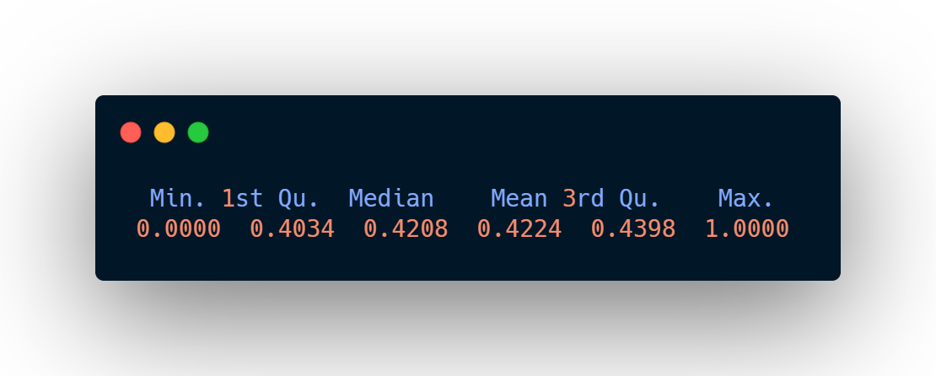
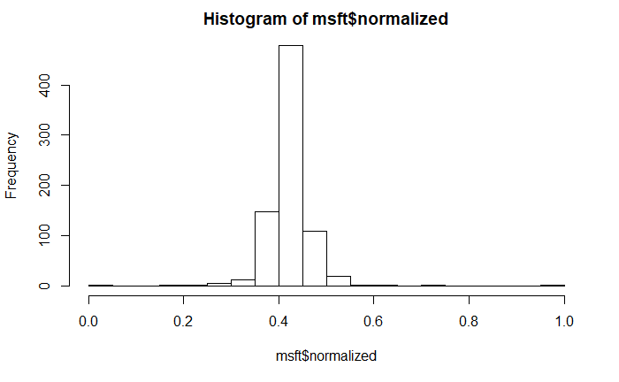
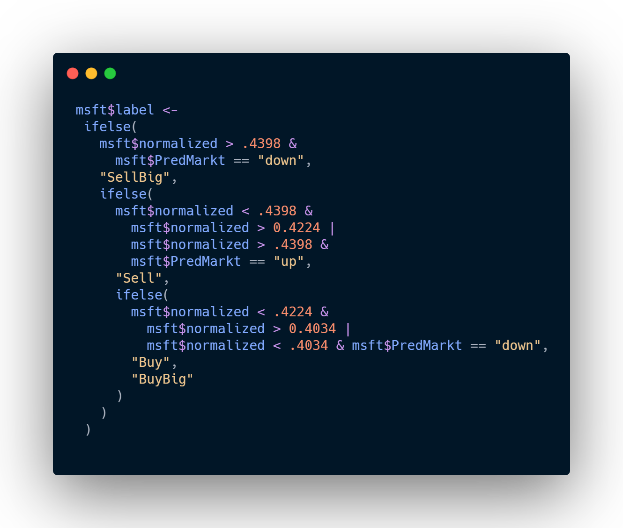
Setting thresholds

Slide 8
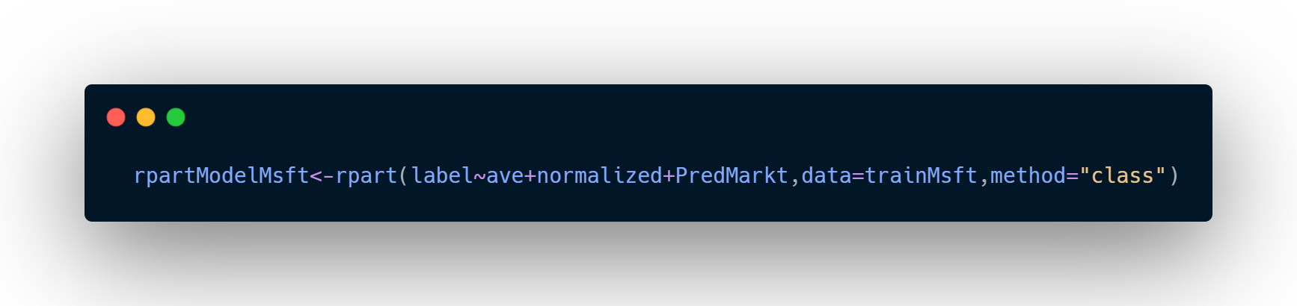
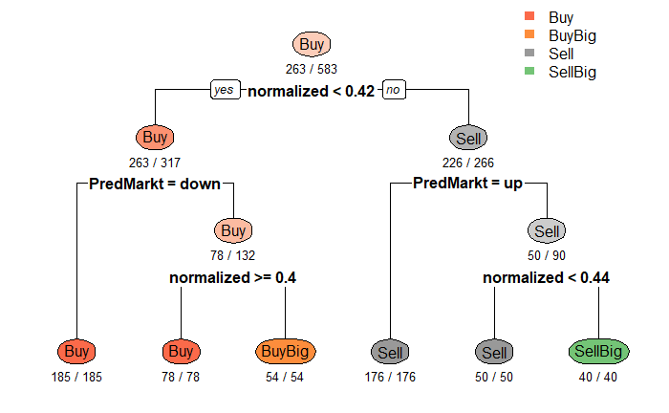
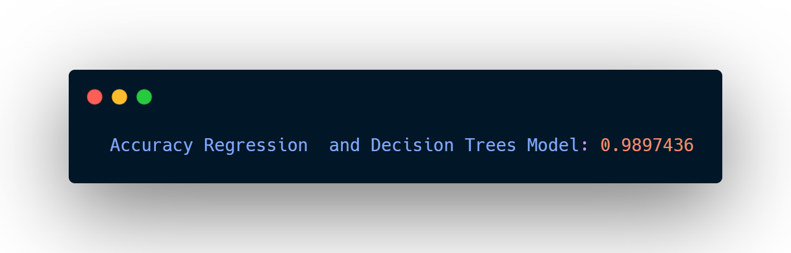
Building the model

Slide 9
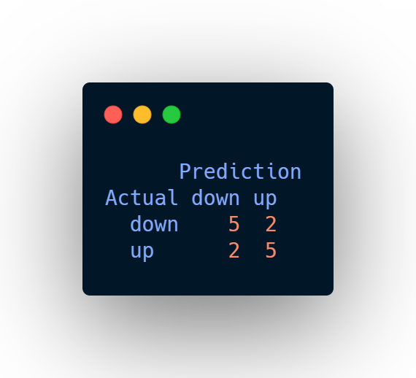
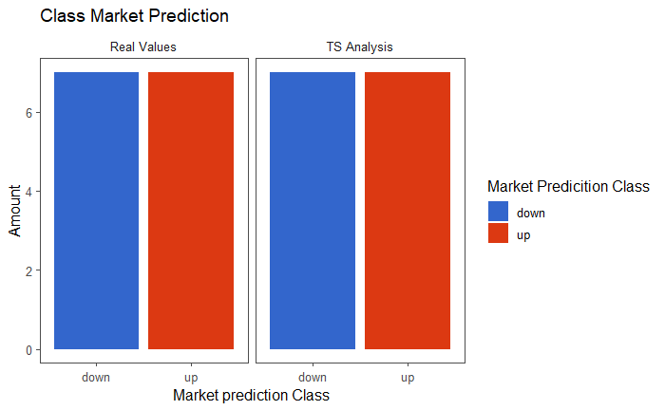
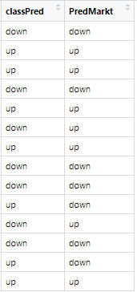
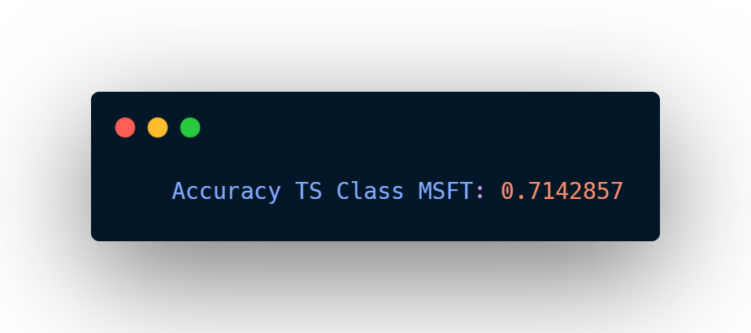
Testing TS Model to determine Class Market Prediction

Slide 10
THANK YOU

